Slide 1
sgRNA Synthesizability Prediction
Modeling sequence-derived risk signals for HPLC QC review prioritization
6 slides
Sequence
Review
modeling deliverable
input signal
decision support
one title page plus five concise content pages
decorated sgRNA chemistry parsed into features
rank designs for QC risk follow-up

Slide 2
Background, Problem, and Goals
Scientific context, operational need, and hackathon deliverables.
Scientific context
Operational context
Prediction task
Decorated sgRNAs combine RNA sequence, base chemistry, and backbone modifications that can affect synthesis purity.
HPLC QC failures create review, remake, and delivery-risk decisions after designs have already entered production.
Given a decorated sgRNA sequence, estimate risk of HPLC QC failure or low purity before QC is complete.
Hackathon goal: build a reproducible feature and modeling workflow that turns decorated sequence text into presentation-ready risk evidence.
Decision goal: support review prioritization and feature insight rather than automated release decisions.
Scientific goal: identify interpretable sequence-chemistry patterns associated with QC and purity outcomes.
2

Slide 3
Data, Feature Families, and Modeling Approach
Problem scale, feature families, and the best-performing model families.
2,646
86
161
9
5-fold
binary-labeled rows
source Fail rows
features
compact panel
CV
source Pass/Fail endpoint
3.25% baseline failure rate
sequence-derived numeric inputs
readable cross-endpoint signals
grouped by sequence
Feature families: sequence size, base composition, motif and run structure, modification burden, positional chemistry, and parser completeness.
Best-performing classifiers: correlation-pruned Histogram Gradient Boosting for source Pass/Fail and formula-derived Need_Review.
Best-performing purity model: ExtraTrees regression on full sequence-derived features; top-40 reduced features are close behind.
Parser note
+A, +C, +G, +U, and +T are interpreted as LNA nucleotides before feature extraction.
3

Slide 4
Key Performance
Classification-compatible metrics for the best current model or feature set by endpoint.
Endpoint | Best current model / feature set | PR-AUC | ROC AUC | F1 score
Source Pass/Fail | 71-feature correlation-pruned HGB | 0.1139 | 0.6529 | 0.0800
Full-feature Pass/Fail | 161-feature HGB | 0.1087 | 0.6304 | 0.1165
Formula Need_Review | 71-feature correlation-pruned HGB | 0.4082 | 0.7719 | 0.3467
MainPeak-derived Pass/Fail | Elastic-net MainPeak regressor + rule threshold | 0.1069 | 0.6217 | 0.1212
Compact 9-feature Pass/Fail | 9-feature L1 logistic panel | 0.1078 | 0.5483 | 0.0693
Compact 9-feature Need_Review | 9-feature HGB panel | 0.3749 | 0.7677 | 0.3529
Interpretation
Need_Review is the strongest classification endpoint; source Pass/Fail remains a rare-event ranking problem.
4

Slide 5
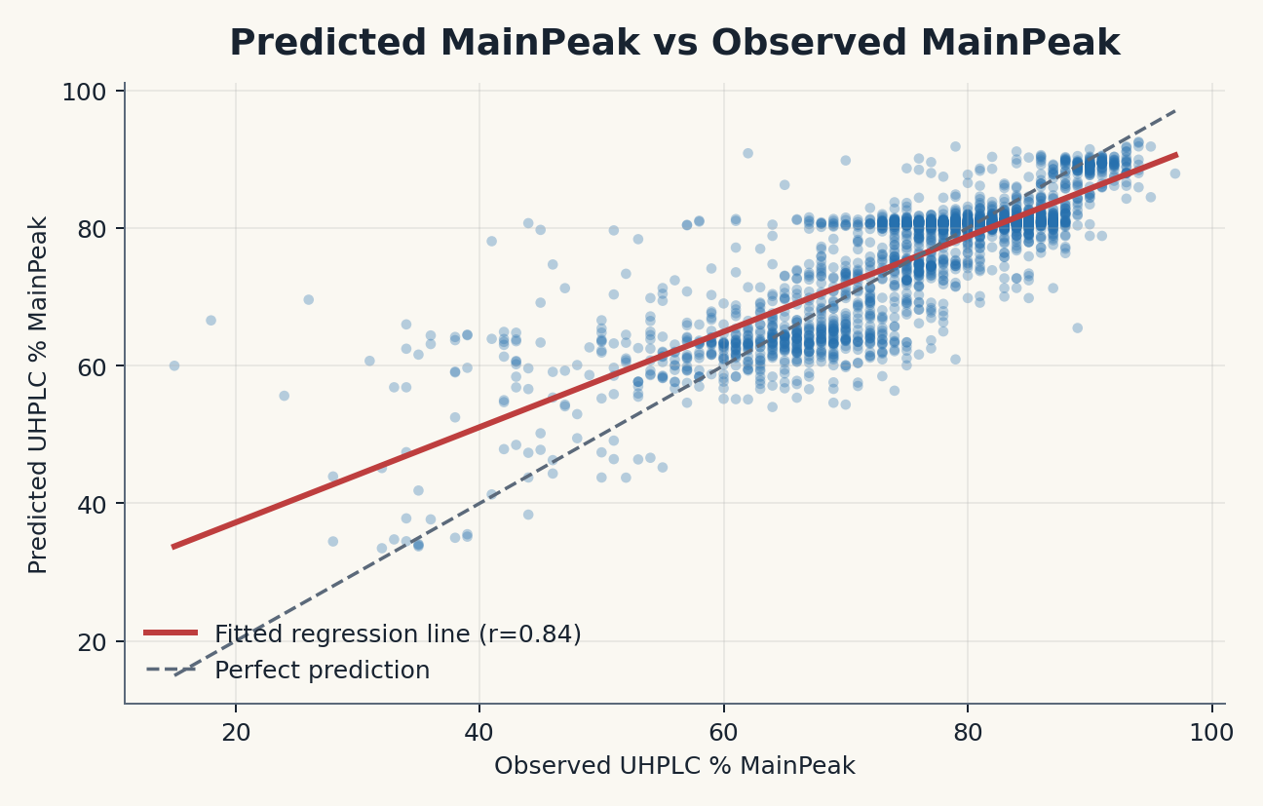
Feature Insights and Purity Signal
MainPeak prediction gives a quantitative view of sequence-derived purity signal.
The observed-vs-predicted plot uses full-feature ExtraTrees MainPeak predictions with a fitted regression line and a perfect-prediction reference.
MainPeak keeps quantitative purity information that binary Pass/Fail labels discard.
Top-40 ExtraTrees-selected features nearly match the full model: RMSE 6.0998 vs 6.0574.
RNA Count in Middle Region
Standard Deviation of Modified Token Positions
rC Token Count
LNA Span Fraction
U Base Count
3' Star Modification Count
lG Token Fraction
Longest rU Run
Longest lC Run
Compact interpretation
The 9-feature panel is the best lightweight cross-endpoint explanation set, while the 71-feature HGB remains the best Pass/Fail ranking option.
5

Slide 6
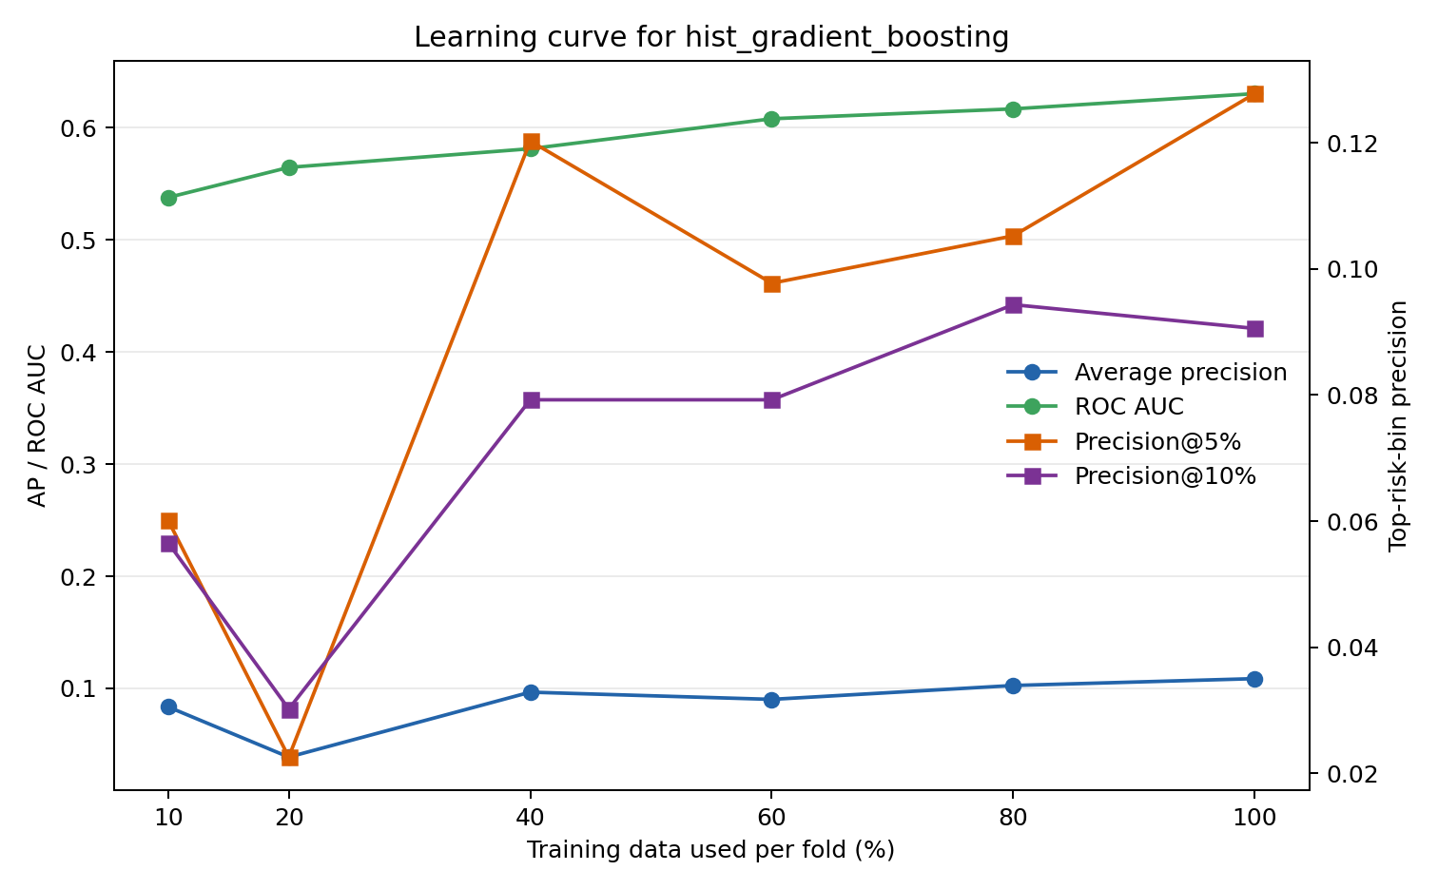
Lessons Learned and Next Steps
The main constraint is rare-fail evidence, not feature availability.
Lesson 1
Lesson 2
Lesson 3
Rare source Fail labels make ranking metrics more honest than accuracy or default-threshold F1.
MainPeak and Need_Review are more learnable because they preserve or derive from stronger purity signal.
Compact panels explain cross-endpoint behavior, but 71-feature HGB remains best for source Fail ranking.
Calibrate thresholds against a fixed review budget or target precision.
Validate on prospective or time-split batches when available.
Collect more true-Fail and low-MainPeak examples to improve rare-event performance.
6

