Slide 1
Your mission – if you choose to accept it!
When you leave the room you think …
LLMs are way bigger then prompts!
I don’t need a PhD, I can go to my desk and run this today!
When you’re in the room …
Read and understand the code
Speak up when something isn’t clear
It’s code, ask what happens when I chat it
If you’re not a programmer …
You think the start and end of the talk are really interesting
You don’t follow the code, but you get the concepts

Slide 2
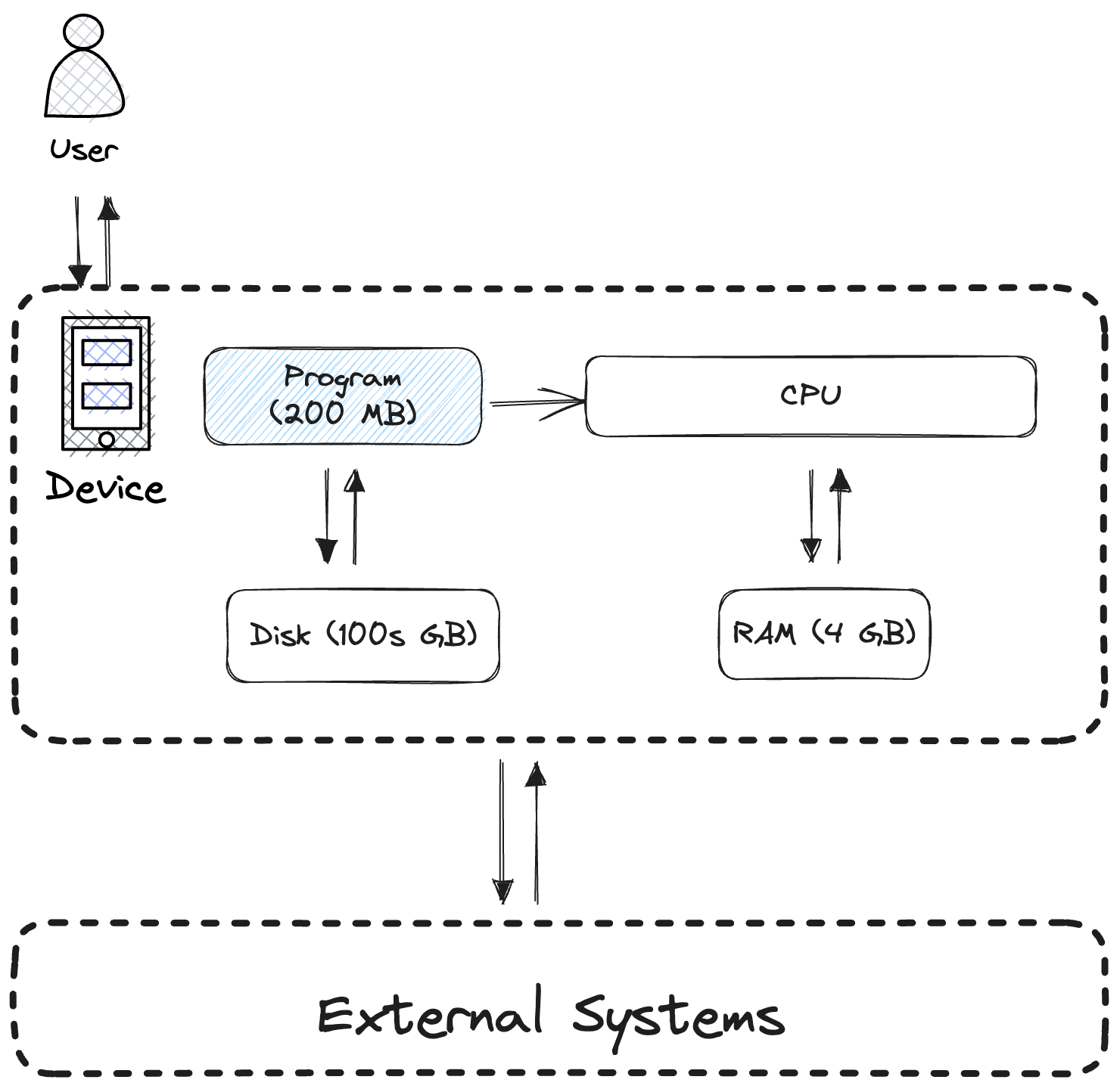
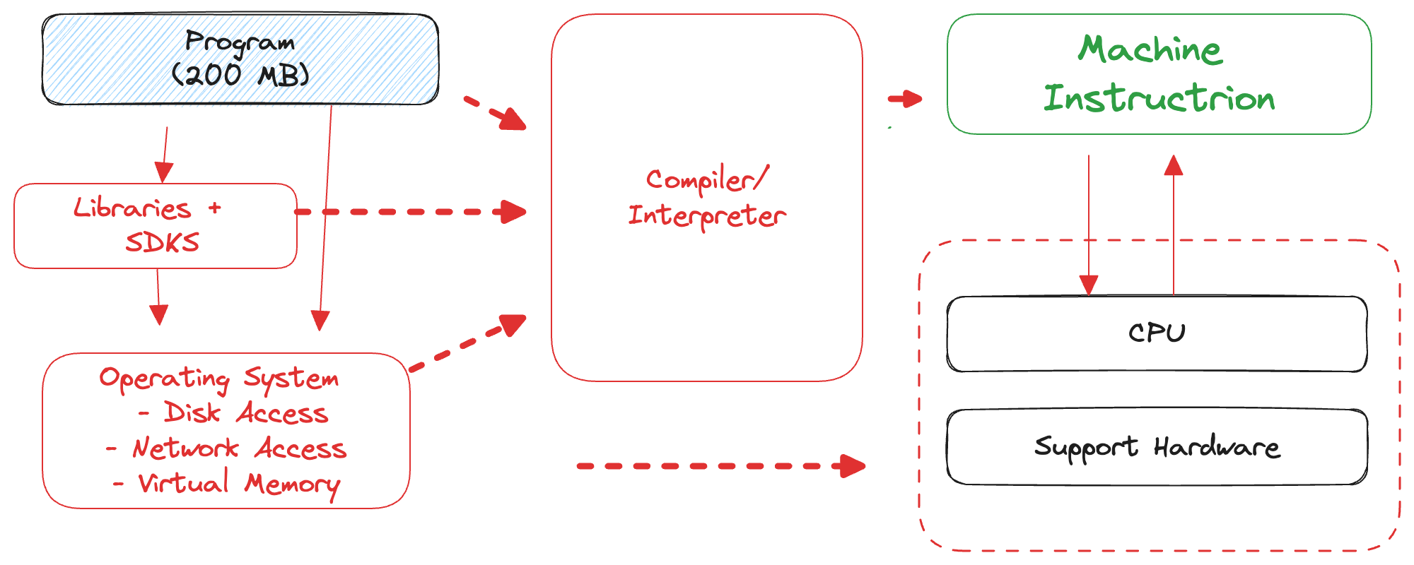
Conventional Programming today More Details
Notes:
“Program” has a lot of abstractions
Libraries
Gives your program access to interesting stuff
Compilier
Converts programming language to be runnable on the CPU
Converts byte code to runnable in a virtual machine
OS
Accesses Memory
Networking/IPC

Slide 3
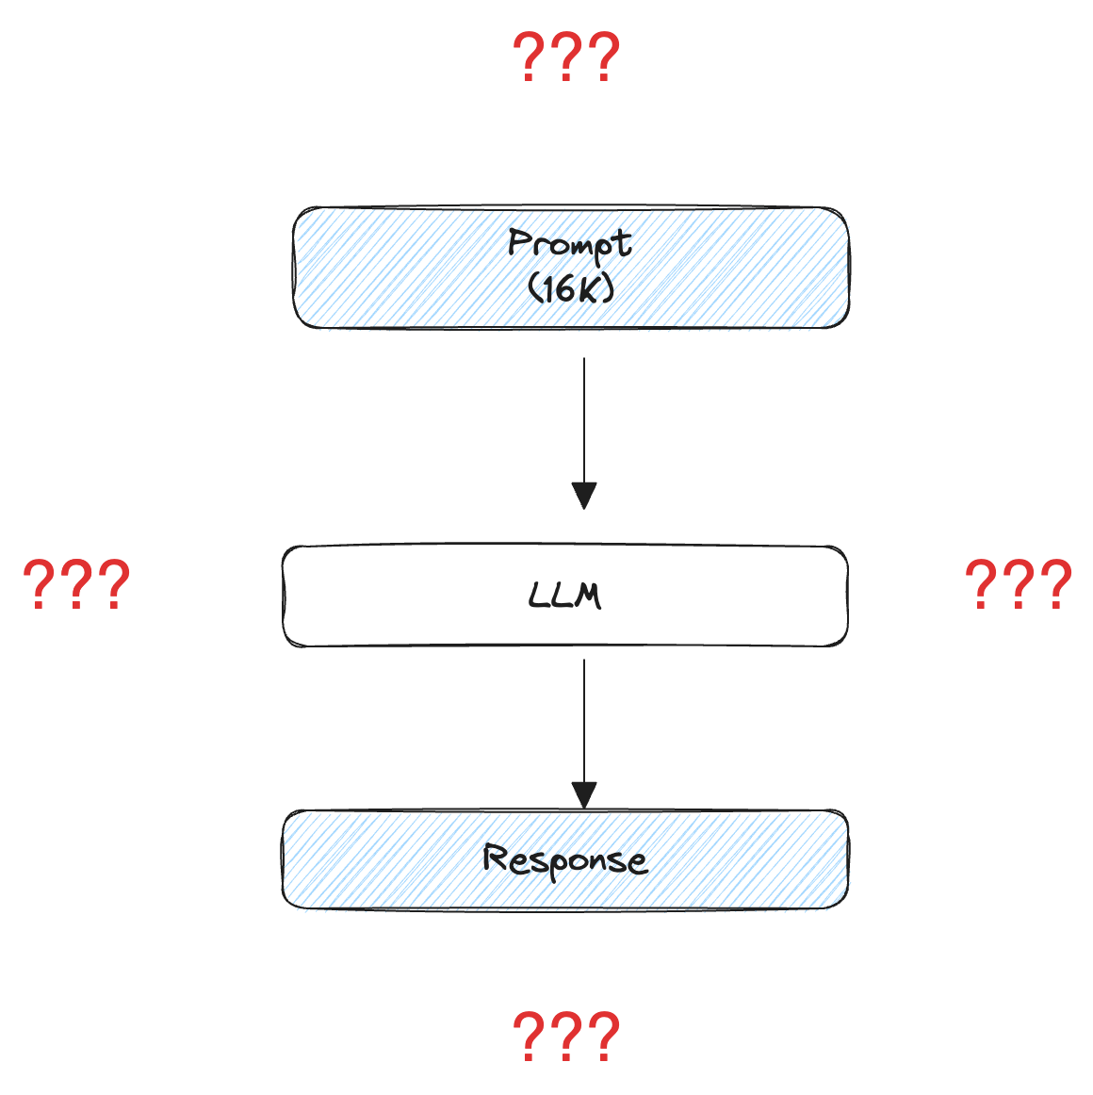
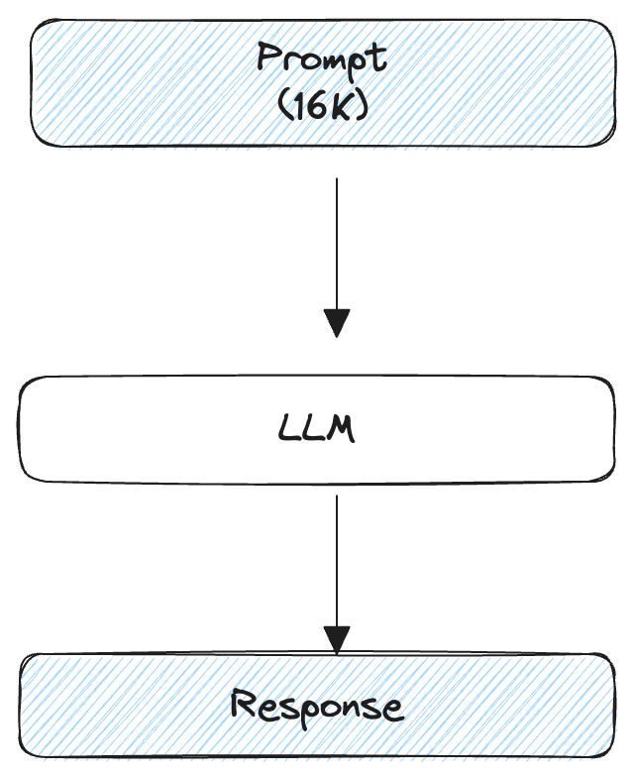
Layman’s LLM “programming” today

Slide 4
What support systems will we code?
Compilers – Convert high level to things that can run on hardware
Operating Systems – I/O Interface to other systems
Operating Systems – Memory Management
Distributed Systems – Big Data Process
Distributed Systems – Orchestration/Workflow Management

Slide 5
Let’s code!!!

Slide 6
Original; Imitate; Innovate (IRL->Mobile)
Technology | Food Ordering
Original - 1990 – Pre Internet | Find Phonebook Phone a restaurant Drive There
Imitate – 2002 – The Early Web | Look up restaurant in Yahoo Directory Go to restaurant website See Menu, Place Order using web form
Innovate – 2022 – Maximum Mobile | Grub Hub, Door Dash

