Slide 1
Docker Development Workflow
Diwaker Ghimire
@idwaker

Slide 2
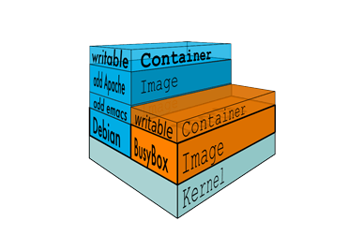
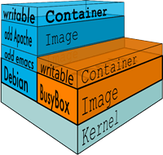
What is docker ?
Containerization
Process Isolation
Union filesystems

Slide 3
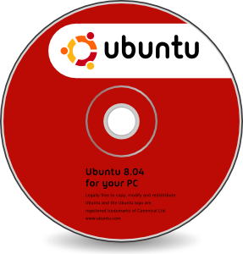
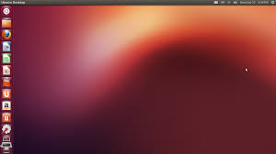

Image, Containers and Volumes
Image are readonly media
Containers are writable instance of image.
Volumes are persistent mountable location

Slide 4
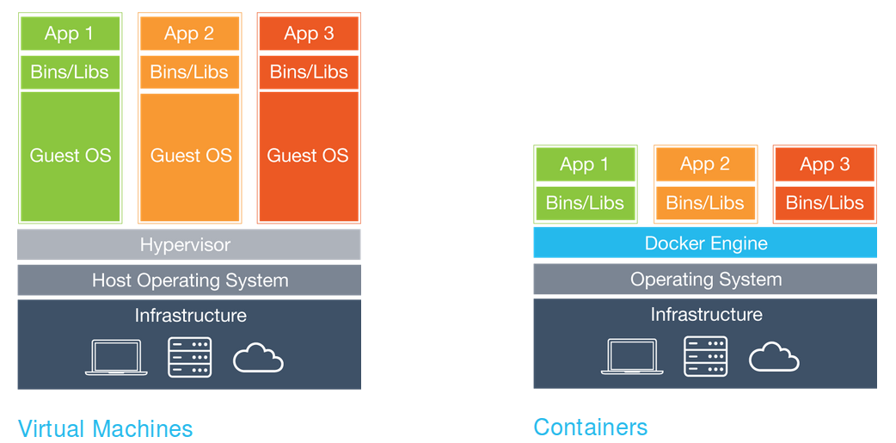
Docker and Vagrant
Screenshot from docker.com

Slide 5
...
https://github.com/idwaker/lfdocker

Slide 6
Installation
ArchLinux users:
https://docs.docker.com/installation/archlinux/
you need to add your user to group docker as well
$ gpasswd -a $USER docker
Ubuntu users:
https://docs.docker.com/installation/ubuntulinux/
MacOSX users:
https://docs.docker.com/installation/mac/
Windows users:
https://docs.docker.com/installation/windows/

Slide 7
Step 1
git clone git@github.com:idwaker/lfdocker.git
cd lfdocker
git tag
  step1
  step2
  step3
  step4
git checkout -b step1 step1
docker build -t lfdocker/php .
atom . [ OR sublime-text if you prefer ]
docker images
docker run -p 8080:80 lfdocker/php
composer install [ php composer.phar install ]
Goto localhost:8080

Slide 8
Step 2
git checkout master &&
    git checkout -b step2 step2
Install docker-compose
  sudo apt-get install docker-compose [ ubuntu ]
  brew install docker-compose [ OSX ]
  Use aur4.archlinux.org for Archlinux
  sudo pip install -U docker-compose
    [ Everybody if above install doesn't work ]
atom .
docker-compose up
composer install [ php composer.phar install ]
Open localhost:8000

Slide 9
Step 3
git checkout master &&
  git checkout -b step3 step3
docker-compose up
atom docker-compose.yml
atom Dockerfile
docker-compose stop [ Using same directory ]
docker-compose start
composer install [ php composer.phar install ]
Goto localhost:8000/dev/myadmin?username=root and import dump.sql
Goto https://docs.docker.com/compose/yml/ for complete reference

Slide 10
Tips
Login into running container shell
docker-compose run web /bin/bash
  web is service defined in docker-compose.yml
Check stdout log from container
docker-compose logs web
check running services
docker-compose ps
check all running containers
docker ps [ docker ps -a lists all containers ]
https://docs.docker.com/compose/cli/

Slide 11
Step 4 and Step 5 ( stage )
git checkout master &&
git checkout -b step4 step4
docker-compose up
atom docker-compose.yml
atom Dockerfile
atom Dockerfile-gearmand
atom tasks/Dockerfile
cd stage
atom docker-compose.yml
atom Dockerfile
atom supervisord.conf
  TODO: Fillup missing parts and run container

Slide 12
Finally
Images are extensible they build up layer by layer so use already available image or build your base layer and extend from that.
Each container should run single process atleast on production
Images can be hosted on private registry just like docker registry.
Docker containers can be easily managed by tools like supervisor just like processes.

