Slide 1
DS 410 - Miniproject
Kakao
Dongyeon Kang, Jay Patel, Jiho Lee,
Jongmin Chung, Junho Lee, Seongeun Kim,
Sunwoo Kim, Yong Jun Choi
Book recommendations
Notes:
‹#›

Slide 2
Data science question and dataset acquisition.
Introduce the question you wish to answer. How did you decide to choose this problem?
→ Our project tries to address the challenge of personalizing book recommendations. The question arose from our collective interest in literature and the potential to leverage data analytics to enhance readers' experiences. We aim to develop a system that can recommend books to users in a way that enhances their reading satisfaction.
Introduce your dataset. How did you find it, how did you prepare it for analyses, how big is it, what challenges did you face in preparing it.
→ The dataset for our study is the Amazon Books Reviews dataset, obtained from Kaggle. This dataset, which is approximately 2.86GB, includes a wide range of user reviews spanning from 1996 to 2014. Preparing this dataset for analysis involved big preprocessing to manage its size and complexity, including cleaning the data and extracting relevant features for our analysis.
Talk about what you ultimately wish to do with this data in terms of modeling, analyses.
→ Our ultimate objective with this dataset is to create a recommendation system using machine learning techniques. We aim to provide genre-specific book suggestions tailored to each user. This work involves not only just predicting user preferences but also identifying trends within genres.
Notes:
‹#›

Slide 3
Requirement for ICDS
Why was this problem intractable for your local mode? How would ICDS Roar-Collab assist you?
→ Our project involves analyzing a huge Amazon book review dataset (2.86GB), which is too large and complex for ordinary computers. Running sophisticated machine learning algorithms like Alternating Least Squares (ALS) requires a lot of computing power. ICDS Roar-Collab gives us access to high-performance computing, allowing us to handle big datasets more effectively and run complicated models quicker than we could with just a regular computer.
What steps did you take to make this run on ICDS. Mention any unique challenges that you faced and how you overcame them.
→
Handling large dataset
Notes:
‹#›

Slide 4
Exploring the Dataset for Enhanced Book Recommendation
1.Research Objective
Our team is focused on tailoring book recommendations to individual preferences, sparked by our passion for literature and data analytics. We are building a system to suggest books that not only fit user tastes but also elevate their reading experience
2.Data Overview
We are utilizing the Amazon Books Reviews dataset from Kaggle, featuring 2.86GB of user reviews from 1996 to 2014. Our preparation process involved significant preprocessing to streamline the dataset, including data cleaning and feature extraction, to ready it for in-depth analysis.
2.Analytical Goals
Our goal is to leverage machine learning to craft a recommendation engine. We strive to offer personalized genre-specific book recommendations, aiming to accurately predict user preferences and detect emerging trends across book genres.
Notes:
‹#›

Slide 5
Methods
Introduce your methods/modeling strategies and the rationale for using them
Method Used: ALS(Alternative Least Squares)
Rationale
scalability : ALS can handle large datasets comprising of book reviews
model: ALS performs as optimal method using matrix factorization to find out the pattern or relationship between items(book) and user feedback(review)
Notes:
‹#›

Slide 6
Introduction
Topic : Book recommendation system
How did we decided to choose this problem
Primary goal of utilizing the dataset
What are we going to talk about
Dataset acquisition
Data preprocessing
Requirement for ICDS
Methods
Results
Notes:
‹#›

Slide 7
Abstract / Motivation
This project aims to develop a genre-specific book recommendation system using the Amazon book review dataset.
Leveraging machine learning, particularly Alternating Least Squares (ALS), our system delivers personalized book recommendations tailored to user preferences.
Our team is deeply passionate about reading and literature. Inspired by our coursework in data analytics and machine learning, we are excited to take on the challenge of creating a book recommendation system customized to the diverse range of literary genres available.
Notes:
‹#›

Slide 8
Dataset Acquisition
About our dataset
Amazon Books Reviews dataset - Kaggle
2.86GB, includes a wide range of user reviews
Challenge
Due to its volume, processing the dataset on local machine was inefficient and time-consuming
Data Preprocessing
Sample Dataset Creation
Data Merging
Data Storage
Notes:
‹#›

Slide 9
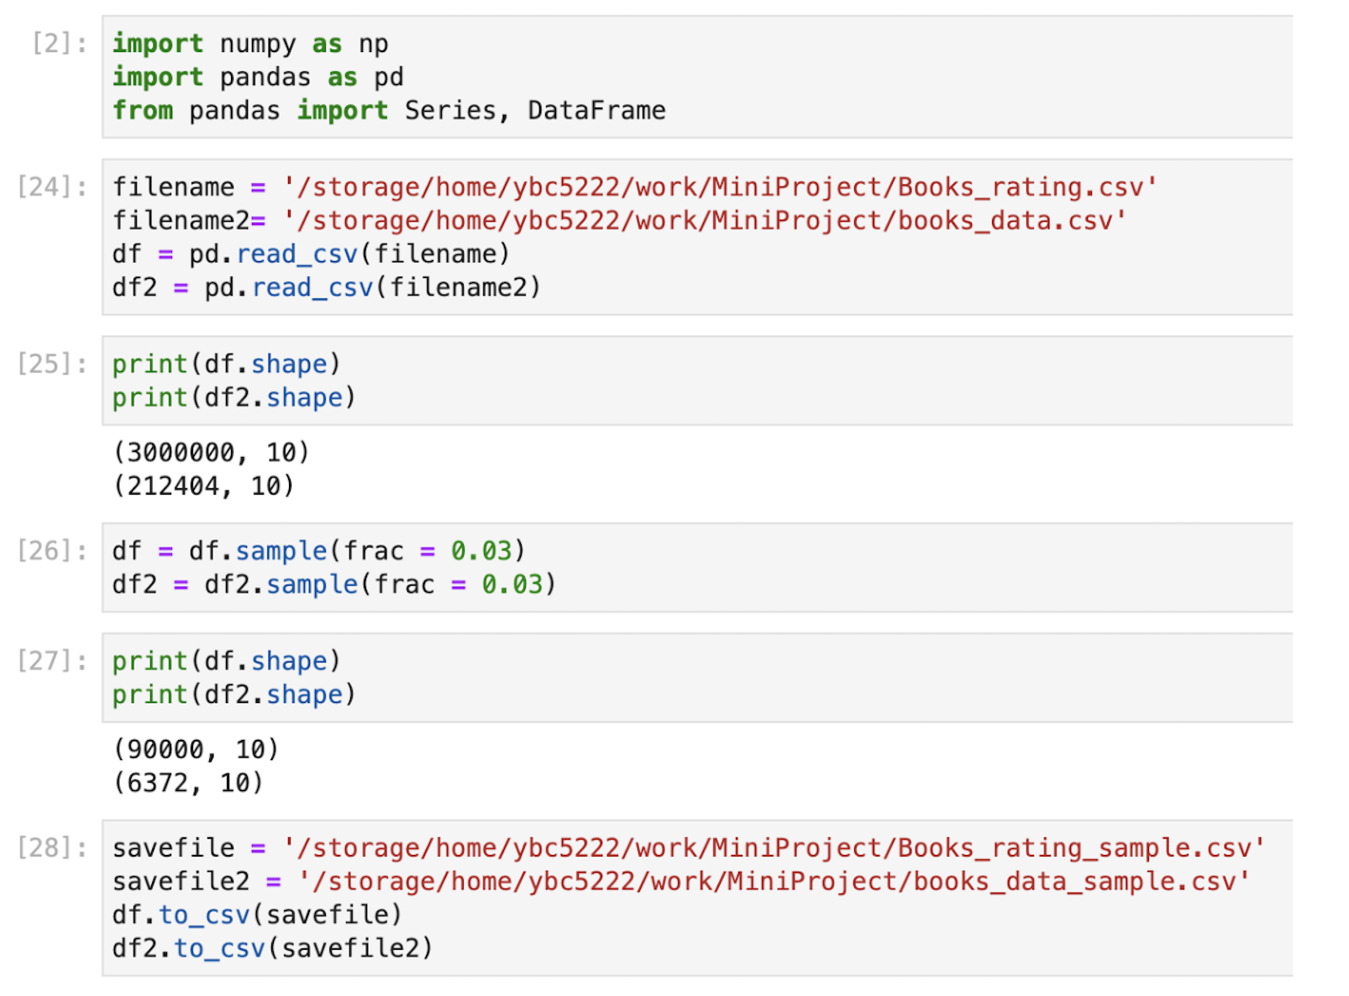
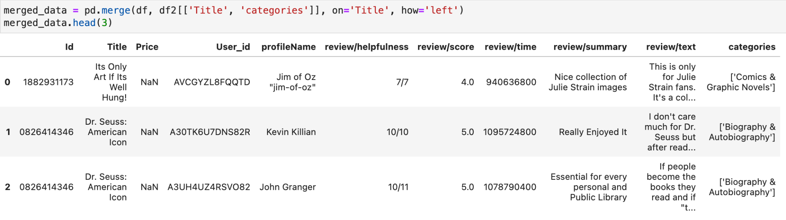
Data Pre-processing
1. Sample Dataset Creation
Generated a 3% sample from the
original dataset to streamline our
development and test processing
2. Data Merging
Merged two dataset by matching book
titles to combine ratings with book data
3. Data Storage
Saved out new dataset into CSV file
for further analysis and model training
Notes:
‹#›

Slide 10
Data Pre-processing (Cont’)
Data merging & sample data
: Merged the two datasets using a common key to enrich the raw rating data with additional contextual information.
Sample data
: Utilized sample dataset by creating a 10 percent random value from the full dataset to enhance efficiency and explore the data structure distribution and relationship for prototyping models
Data cleaning
: Removed null values in essential columns like Review/score, Title, and User_id to enhance the data quality
String Indexing
: User_id and Title are indexed to numeric values to be utilized for ALS
Notes:
‹#›

Slide 11
Methods
Method Used: ALS(Alternative Least Squares)
Rationale
scalability : ALS can handle large datasets comprising of book reviews
model: ALS performs as optimal method using matrix factorization to find out the pattern or relationship between items(book) and user feedback(review)
Notes:
‹#›

Slide 12
Methods
Model Training : The ALS algorithm from the lecture is applied to train data
Model Evaluation :
- trained model is used to predict ratings for a validation dataset
then, the predictions are compared to actual ratings to compute
RMSE(Root Mean Square Error) to provide model accuracy
Hyperparameter Tuning:
- utilized various combinations of hyperparameters
(rank, regularization, iterations)
Notes:
‹#›

Slide 13
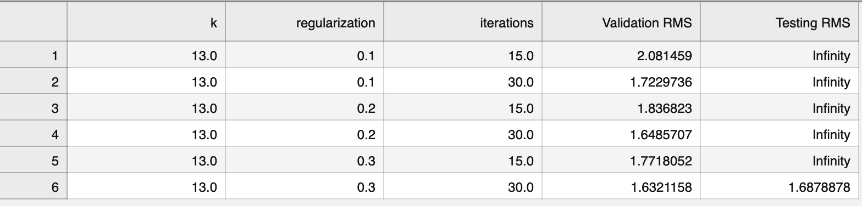
Results
Fiction
History
Science
Business and economy
Computers
Juvenile Fiction
Juvenile NonFiction
Social science
Biography &
Autobiography
Notes:
‹#›

Slide 14
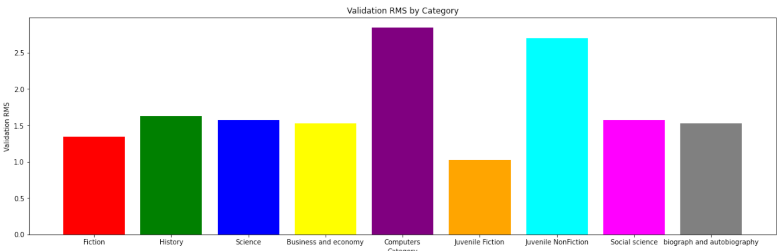
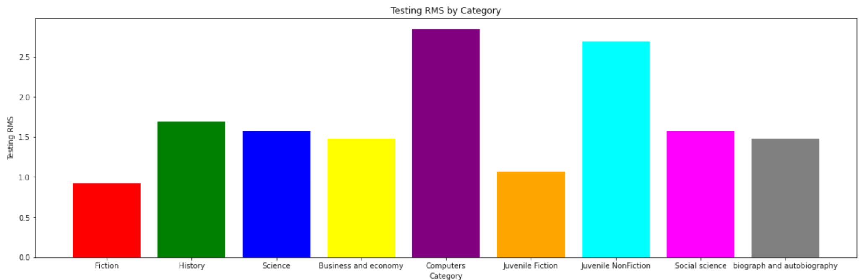
Results
Notes:
‹#›

Slide 15
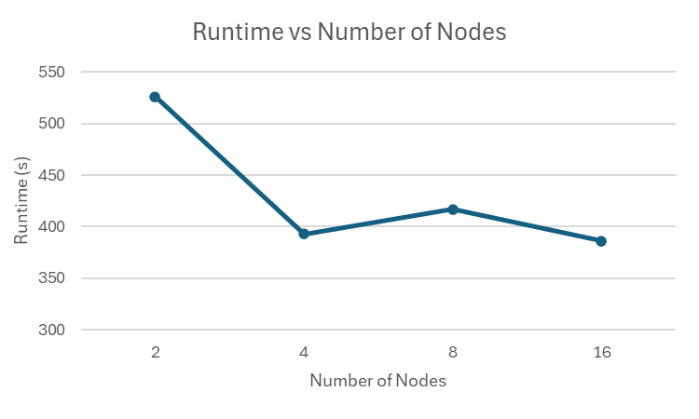
Results
Notes:
‹#›

Slide 16
Requirement for ICDS
Why ICDS?
Local mode has memory limitation and time-consuming for handling this large dataset
Offered enhanced processing power and improved data management
Encountered Errors:
java.lang.OutOfMemoryError: Java heap space" indicates that the Java Virtual Machine (JVM) has run out of memory while executing the ALS algorithm.
ALS algorithm matrix exception error
Reason : The dataset was too large when running locally or in cluster mode.
Notes:
‹#›

Slide 17
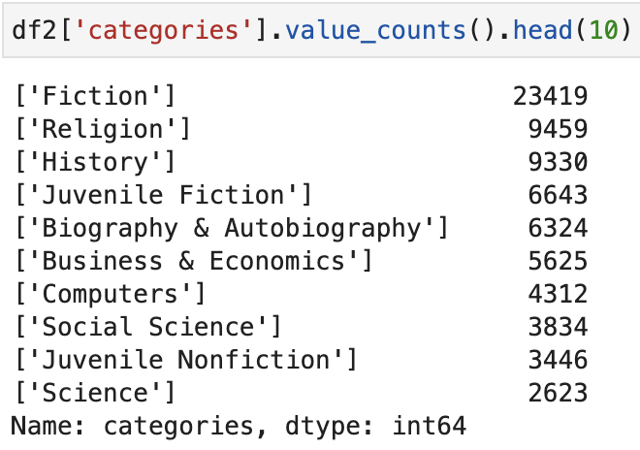
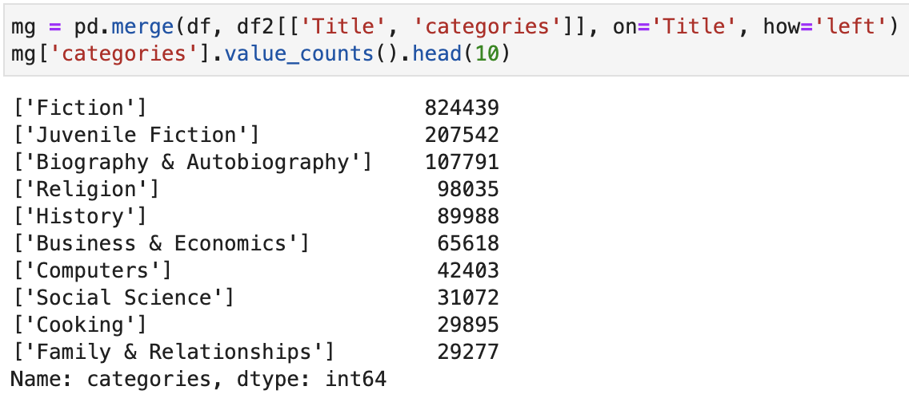
Requirement for ICDS
Notes:
‹#›

Slide 18
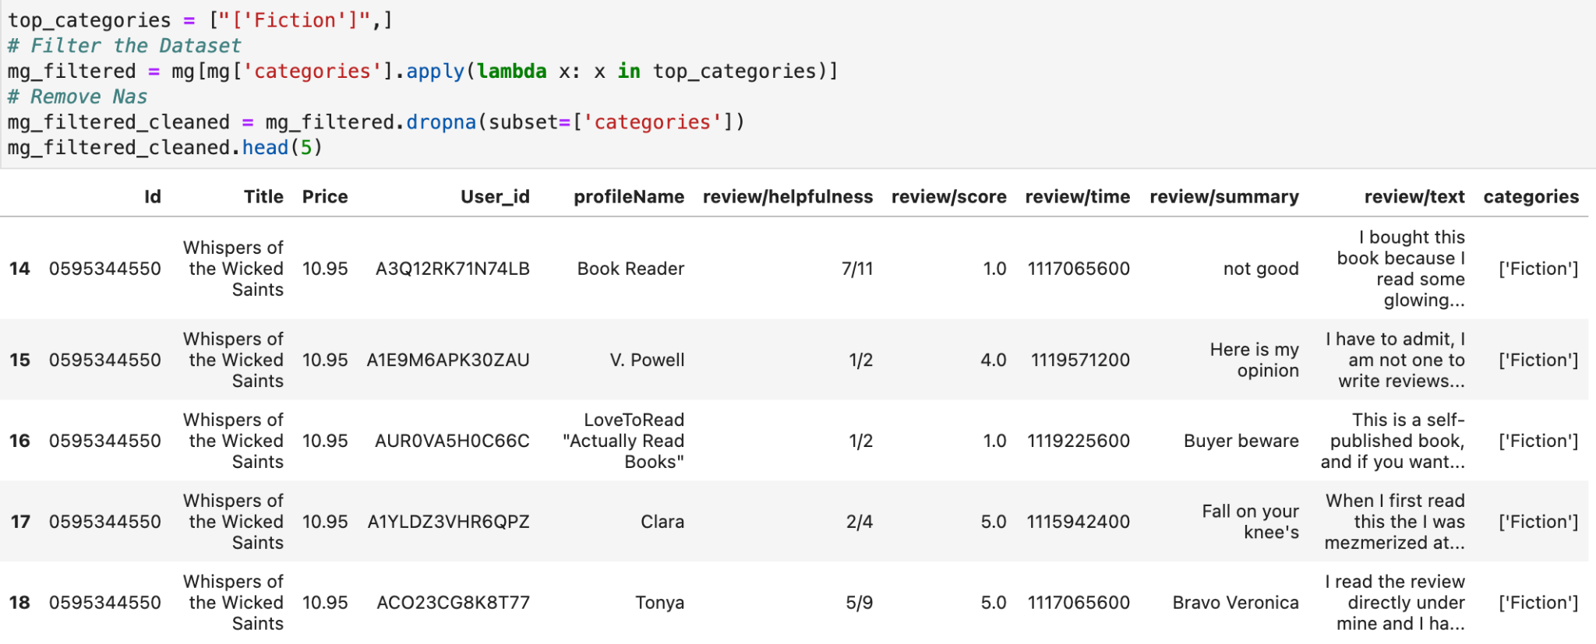
Requirement for ICDS
Notes:
‹#›

Slide 19
Requirement for ICDS
Adaptation to ICDS:
ICDS clusters with high-memory nodes reduce processing time for computational intensive tasks
partitioned the large dataset into clusters based on genres
examined by focusing on the top 10 genres with the highest number of ratings
Result:
we were able to manage the dataset more efficiently and delve into the data without encountering issues while running in cluster mode
Notes:
‹#›

Slide 20
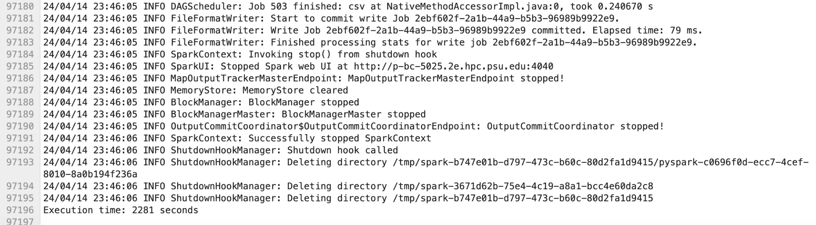
Requirement for ICDS
Notes:
‹#›

Slide 21
ICDS utilization
Combined Usage overall : 30 + times
Duration of Each Session : ~4 hours
Number of Cores Used : ~ 30 CPU cores
Memory Per Core : ~8 GB
Notes:
‹#›

