Slide 1

Duel Reality
Software Engineering
Spring 2010
Josh Kilgore
Obi Atueyi
Tom Calloway
Ye Tian

Slide 2
Summary
Overview
Modules
Graphics (Tom Calloway)
User Interface (Obi Atueyi)
Game Mechanics and AI (Josh Kilgore)
Database (Ye Tian)
Conclusion
Questions

Slide 3
The Overview
Game Description
Details
Game flow, battle flow
Tools
Module Breakdown

Slide 4

Duel Reality: the Game
Total Game play experience
2D
Turn based
Strategy battle simulation
1 Player w/ Ai opponent
(maybe 2)
Upgradable units
7 - level Campaign and Free Battle Modes
Save / Load functionality
Amazing Graphics and Sound
Dynamic Action Points Game play
X
O
X
X
O
O

Slide 5
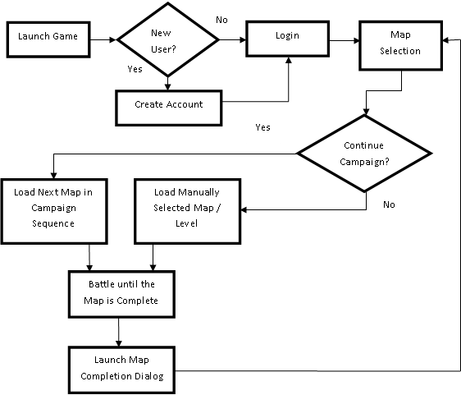
Main Game

Slide 6
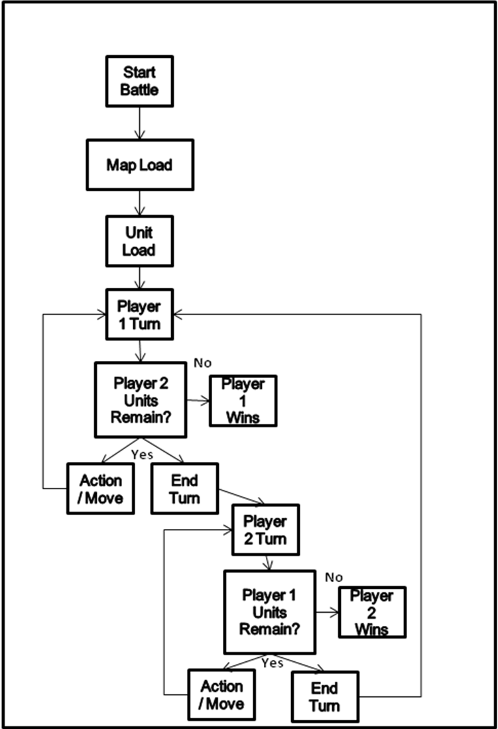

Battles
Basically:
KILL EM ALL

Slide 7



Tools
Development Platform
Graphics
Database
C++

Slide 8
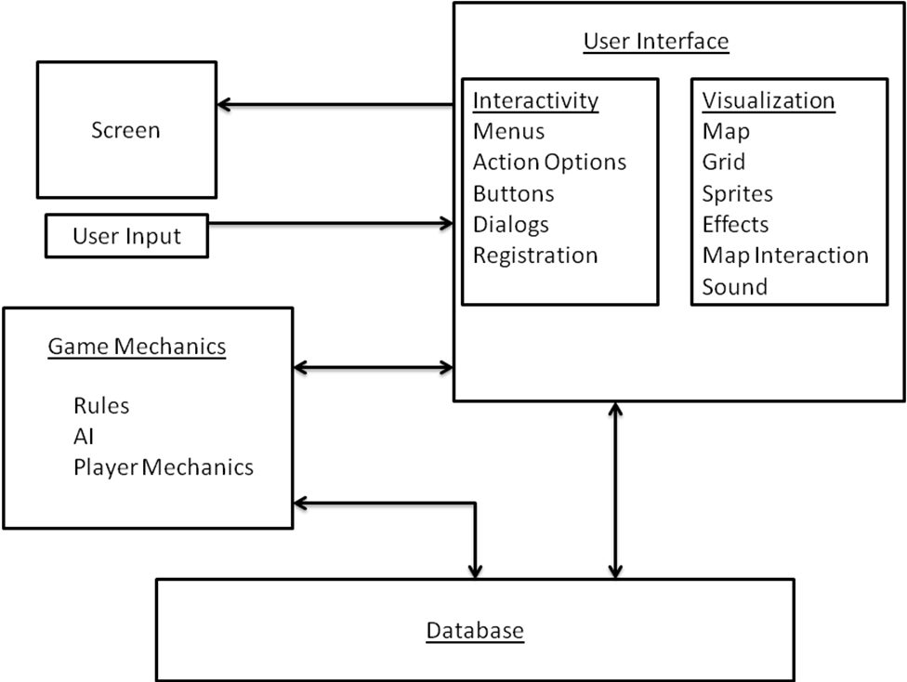
Modules

Slide 9
Overview Summary
Game Description
Details
Game flow, battle flow
Tools
Module Breakdown
Graphics
UI
Game Mechanics
Database
X
O
X
X
O
O

Slide 10

Game Graphics Module Presenter: Tom Calloway
What it is.
Purpose and overview.
What it does.
Key functionality.
How it is implemented.
Tools & Architecture.
Challenges.
Unit Test & Verification.

Slide 11
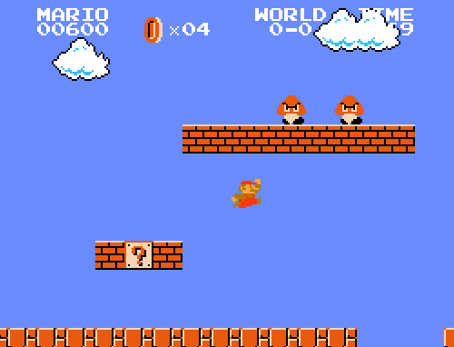
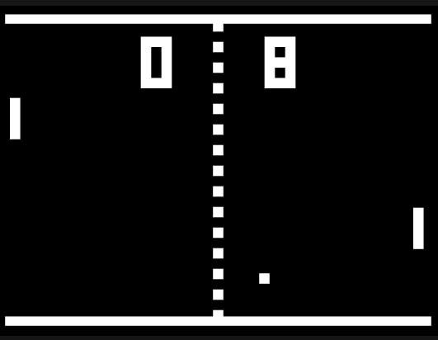
Game Graphics Module Purpose & Overview (What it is)
The 2D Graphics & Sound Effects!
Super Mario Bros. - 1985
Pong - 1972

Slide 12
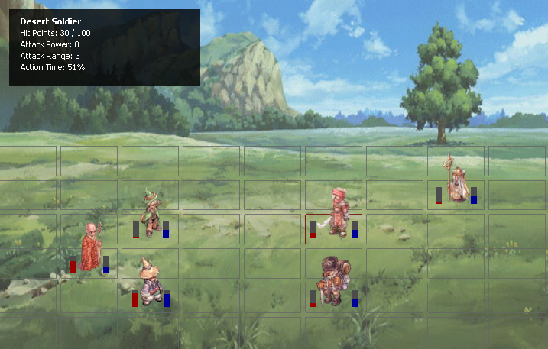
Game Graphics Module Functionality (What it does)

Slide 13

Game Graphics Module Implementation (Tools)
Some Possibilities
Direct image manipulation
Microsoft DirectX Technology
OpenGL (Open Graphics Libraries)
OpenGL Selected
Cross-platform
Simple Qt Integration
Free ($$)

Slide 14
Game Graphics Module Implementation (Architecture)
How it works.
Receives data from other modules.
Content is loaded from hard drive.
Allows events triggered by external code modules and users (e.g., move, select, attack, remove, add) .
Data Classes
- Unit Class (array)
- Map Class
OpenGL Graphics Widget
- Redrawn at 10 fps (10 Hz)
User Input
- Cell Selection
- Resize Window

Slide 15



Game Graphics Module Implementation (Challenges)
Transparency
Bit masking of multiple images.
Mouse Interactions
Coordinate calculations.
OpenGL Familiarity
Know what is available.
Know how functions work.
Understand quirks.
Many Others…

Slide 16
Game Graphics Module Unit Test & Verification
Create “Dummy” Data Classes
Tweak data and observe the results.
Create “Wrapper” Class
Calls and exercises functions.
Wrapper Class
Dummy Data Classes
Graphics Module
User Input

Slide 17
Game Graphics Module Summary
Graphics vs. Mechanics
2D Mechanics = 2D Overhead Graphics.
Tools / Architecture Choices Important
Avoid future frustration.
Create a solid game.

Slide 18
User Interface Module Presenter: Obi Atueyi
Function
Architecture
Module Interactions
Mainwindow
Application Interaction Items
Implementation
Tools
Class Diagrams
Qt Classes
QWizard & QWizardPage Classes
Unit Test & Verification
Challenges
Summary

Slide 19
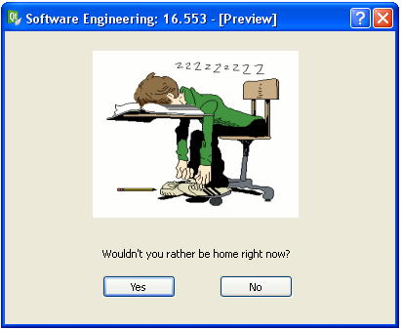
User Interface Module Function
Provide the framework for user interaction with the application

Slide 20
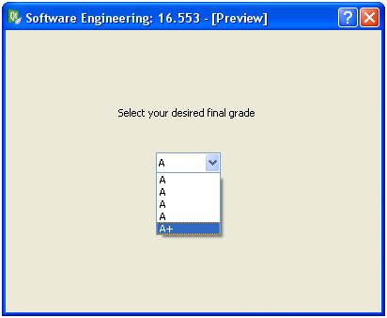
User Interface Module Function
Provide the ability for user to choose desired settings

Slide 21
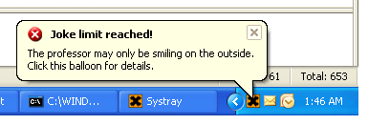
User Interface Module Function
Provide status or error messages

Slide 22
User Interface Module Architecture: Module Interactions
User Interface module
Menu bar
-
x
Tool bar
Game Mechanics module
Game Graphics module
Database module
Status bar
AI module

Slide 23
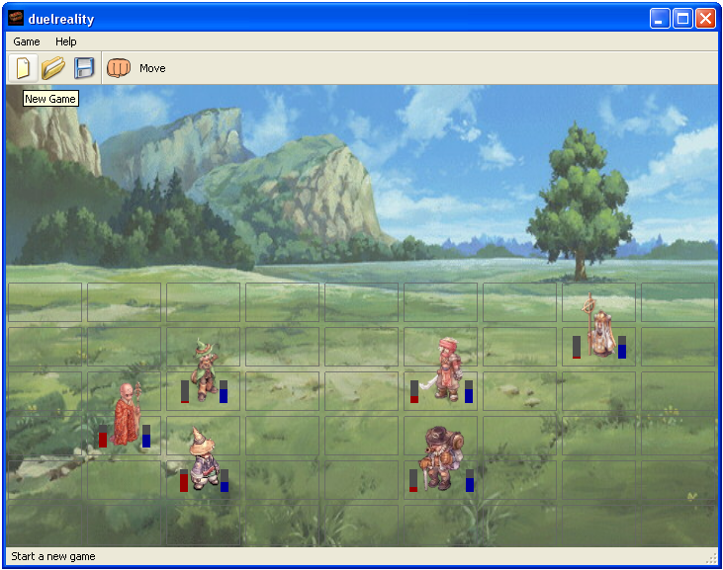
User Interface Module Architecture: Mainwindow
Menu bar
Tool bar
Game graphics
Status bar

Slide 24
User Interface Module Architecture: Application Interaction Items
Menu Items
New Game
Load Game
Save Game
Restart Game
Quit Game
Toolbar Items
Attack
Move
End Turn
Status Bar Items
Tool tips

Slide 25



User Interface Module Implementation: Tools
Considered Tools
Qt
wxWidgets
MFC
Qt Selected
Cross-platform
Non-GUI features (SQL database)
Meta-object compiler (object macros)

Slide 26
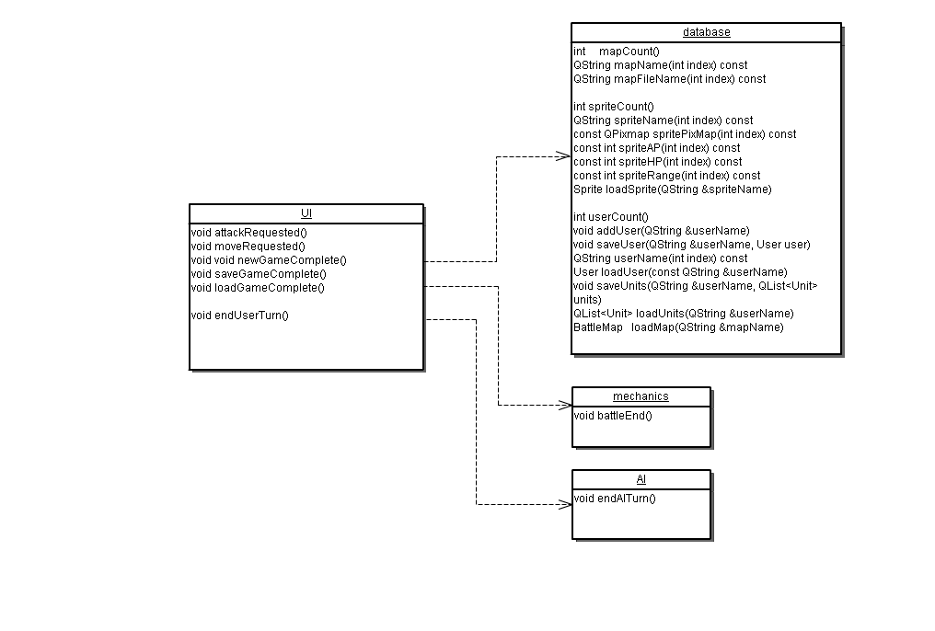
User Interface Module Implementation: Class Diagram

Slide 27
User Interface Module Implementation: Qt Classes
QMainWindow
QPushButton
QCheckBox
QDialog
QWizard
QWizardPage

Slide 28
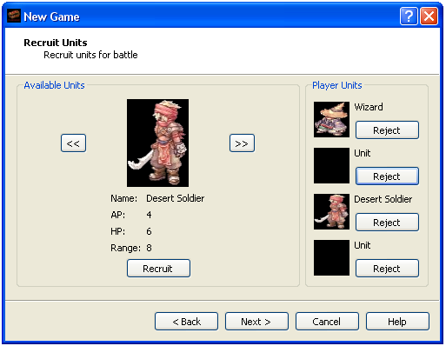
User Interface Module QWizard and QWizardPage
QWizard
QWizardPage

Slide 29
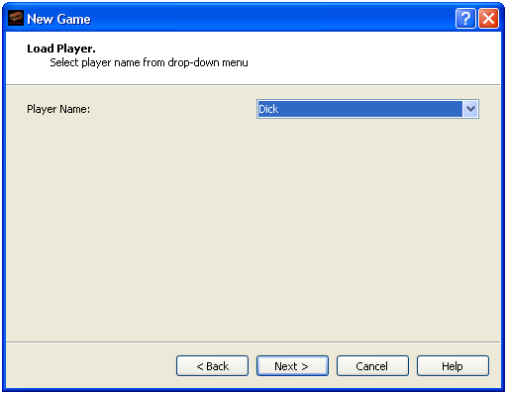
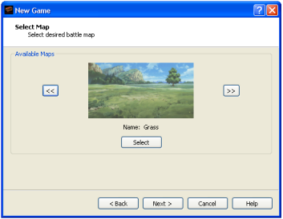
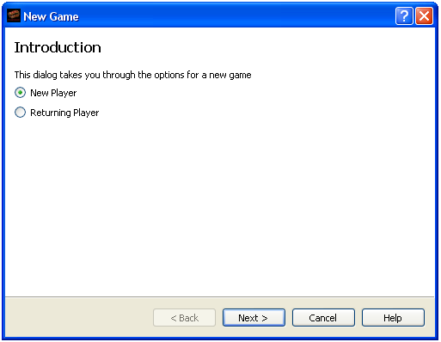
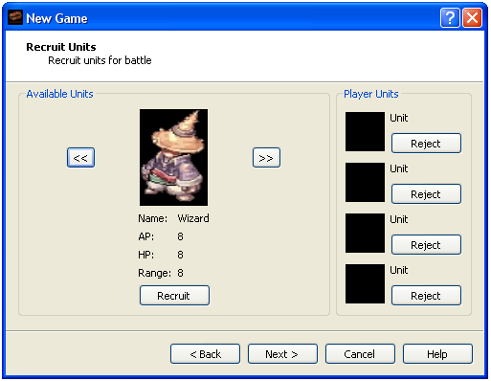
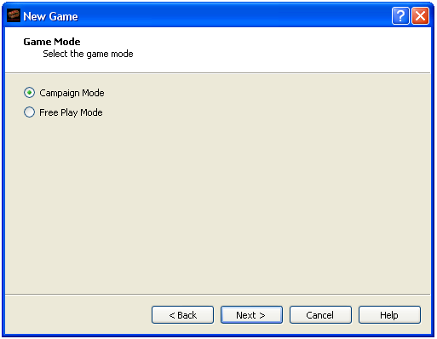
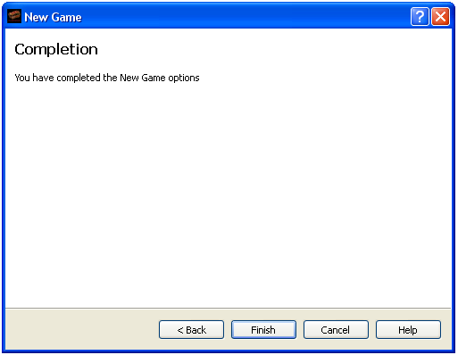
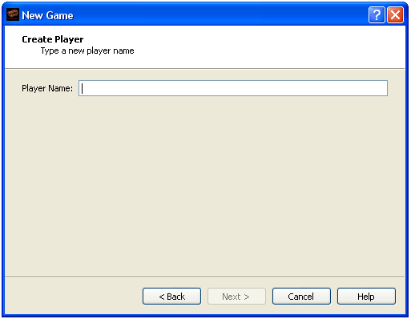
User Interface Module QWizard & QWizardPage: New Game Dialog Traversal Paths

Slide 30
User Interface Module Unit Testing & Verification
Database
Generate sprites, maps & test users
Perform data reads & writes during new game dialogs
AI
Generate end turn signal
Mechanics
Generate battle over signal

Slide 31
User Interface Module Challenges
Object-oriented design knowledge
Qt knowledge
Modularity in game development
Time constraint

Slide 32
User Interface Module Summary
Absolutely a fun project
Relative knowledge of final product
Code complexity vs. user-friendliness

Slide 33
Game Mechanics and AI Presenter: Josh Kilgore
Unit
Player
Mechanics
Move
Attack
Etc.
Artificial Intelligence
What
How

Slide 34



Unit Class
More than just a pretty face
Health
Attack Power
Attack Range
Action Points
Movement Rate
XP
Upgradable Attributes
Teamwork is Key

Slide 35

Player Class
Keep Login ID
Keep Upgraded Units
Continue Campaign from save point
XP Ranking

Slide 36
Game Mechanics
Movement ( X moves, cost Action Points)
X
O
X
O
X
X
X
O
X
O
O
O
O
X
O
X
O
X
X
X
O
X
O
O

Slide 37
Game Mechanics
Attack (X attacks O, range = 1)
X
X
X
O
-2 Health
X
O
X
O
X
O
O
O
O
X
X
X
O
X
O
X
O
X
O
O

Slide 38
Game Mechanics
switchPlayers()
isGameOver();
moveComplete();
isValidMove();
isValidAttack();
isOccupied();

Slide 39
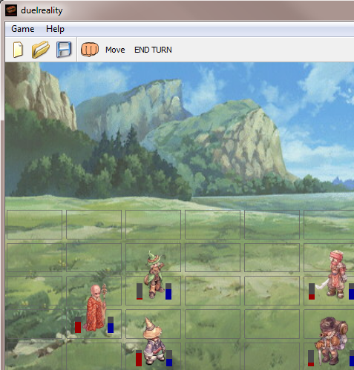
Player Interaction
Player sees icons
Signals & slots

Slide 40
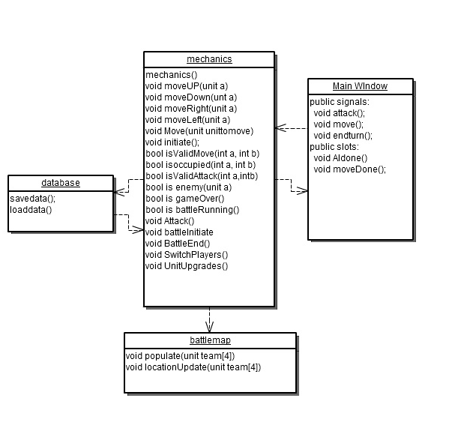
Game Mechanics Class Diagram
Rely on Database to store unit data
Internal Manipulation of data

Slide 41
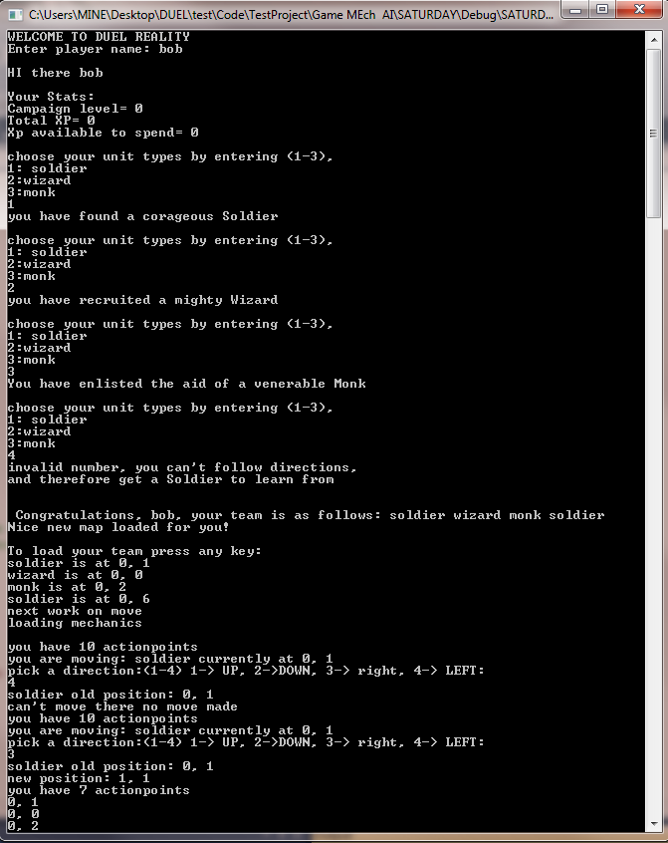
Game Mechanics Verification
Initial Unit Testing -
Console Version
Module Testing
System Testing

Slide 42
AI
Provide Player with playable opponent
Decision Tree
Board Evaluation
Decide on Best Action
Same constraints as Player actions

Slide 43
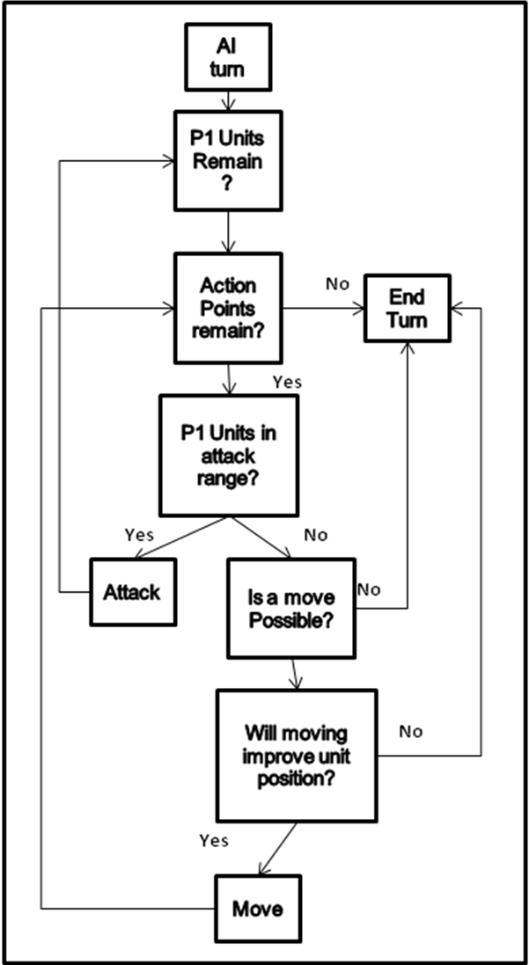
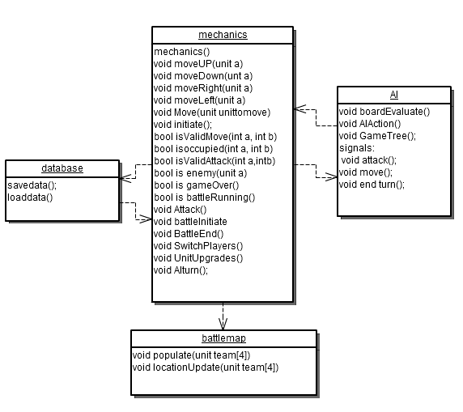
AI - Decision Tree

Slide 44

AI
X
O
X
X
X
O
X
O
X
O
O
O
O
Board Value = 200
Board Value = 300
X
O
X
O
X
X
X
O
X
O
O
O
Board Value = 250
Board Value = 175

Slide 45
Game Mechanics & AI Conclusion
Game Mechanics
Classes
Functions
AI
Opponent generation

Slide 46
Database Presenter: Ye Tian
Database in the game
Software-based containers
Storage and retrieval
Database Design
SQLite
Qt classes
Database Classes
Database
Test window
Summary

Slide 47
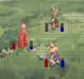
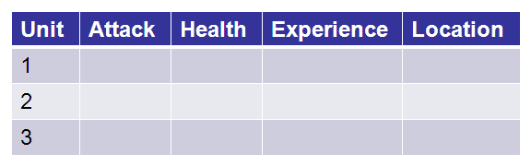
Database in the game
Software-based containers
Game
front
Game
background

Slide 48
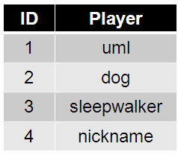
Database in the game
Storage and retrieval
Storage
Retrieval

Slide 49
Database Design
SQLite
Self-contained
Serverless
Zero-configuration
Transactional
Public domain

Slide 50
Database Design
Qt classes
QSqlDriver
QSqlDatabase
QSqlQuery
QSqlTableModel
QSqlRelationalTableModel
QSqlRecord
QSqlIndex
QSqlField
QSqlError

Slide 51
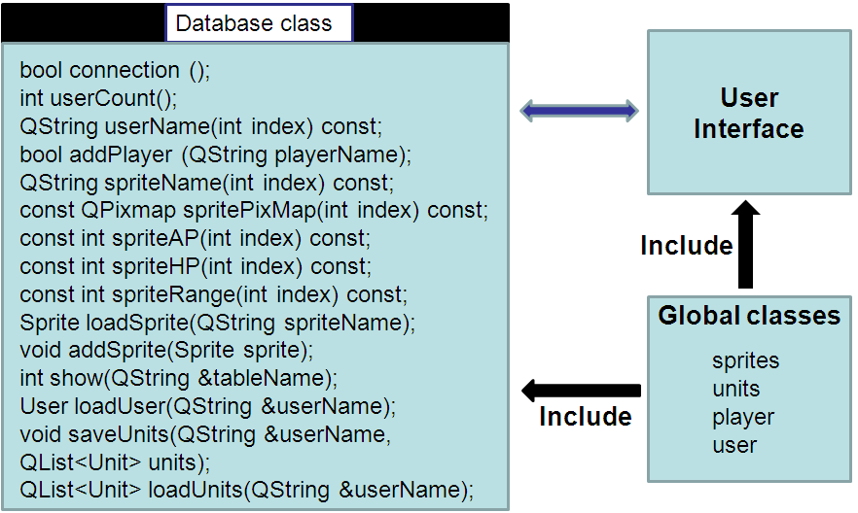
Database Classes
Database

Slide 52
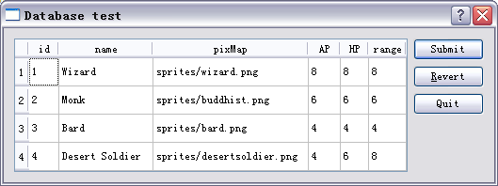
Database Classes
Test window
int main(int argc, char *argv[])
{
QApplication app(argc, argv);
Database gamedata;
gamedata.connection();
gamedata.addPlayer(“sprites”);
gamedata.show("sprites");
}

Slide 53
Database Classes
After unit test
Database module will be added into the entire project through following three steps:
1. Header file and source file
database.h; database.cpp
2. SQLITE database file
gamedata.db3
3. Project file
QT += sql;

Slide 54
Summary
Good organization for the game data.
Useful for Storage and for game.
Interesting but challengeable.

Slide 55
Duel Reality: Conclusion
Told you about our awesome game
Details
Modules – Graphics, UI, Game Mechanics &AI, Database
Pre-orders available
Thanks for your attention

Slide 56
Questions?

