Slide 1

Data Binding Magic Ivan Djikovski
SW B2C ERL, Ivan Djikovski

Slide 2
Agenda
Topic:
Magic or Illusion? (How it works? INotifyPropertyChanged, Binding Class)
Topic:
Binding Context property and hierarchy, Template Binding
Topic:
Relative Bindings

Slide 3
Goals
Demystify Data Binding (Magic or Illusion?)
Ease day-to-day tasks related to Data Binding
Have fun ☺☺☺

Slide 4
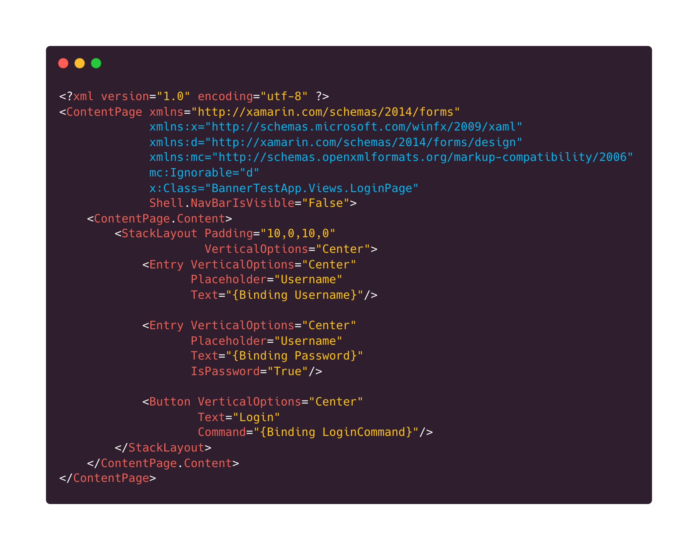
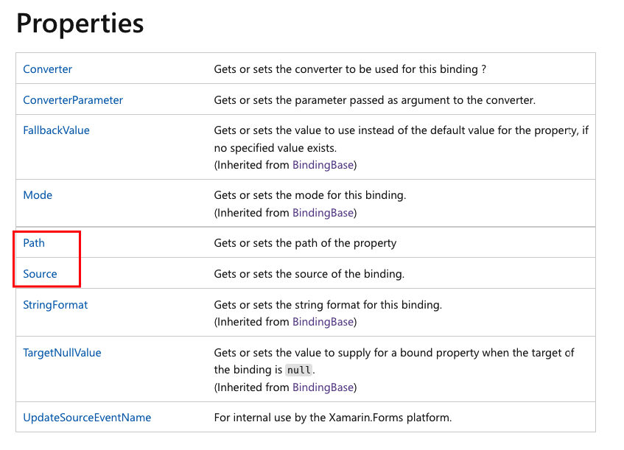
Binding Class & Binding Extension

Slide 5
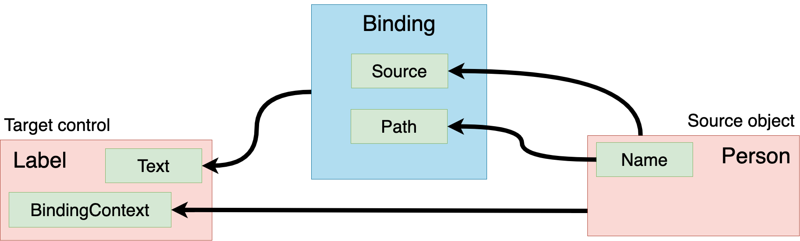
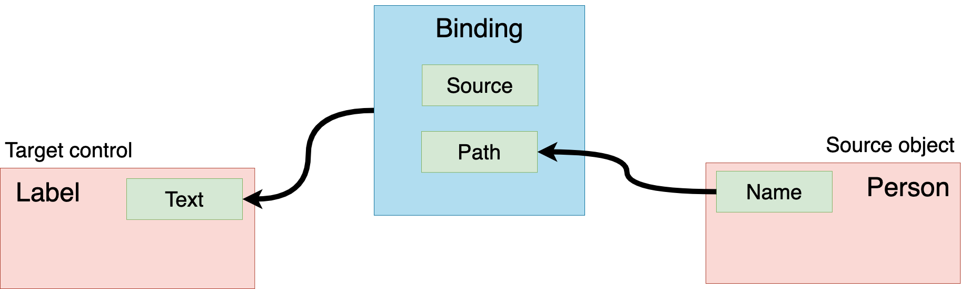
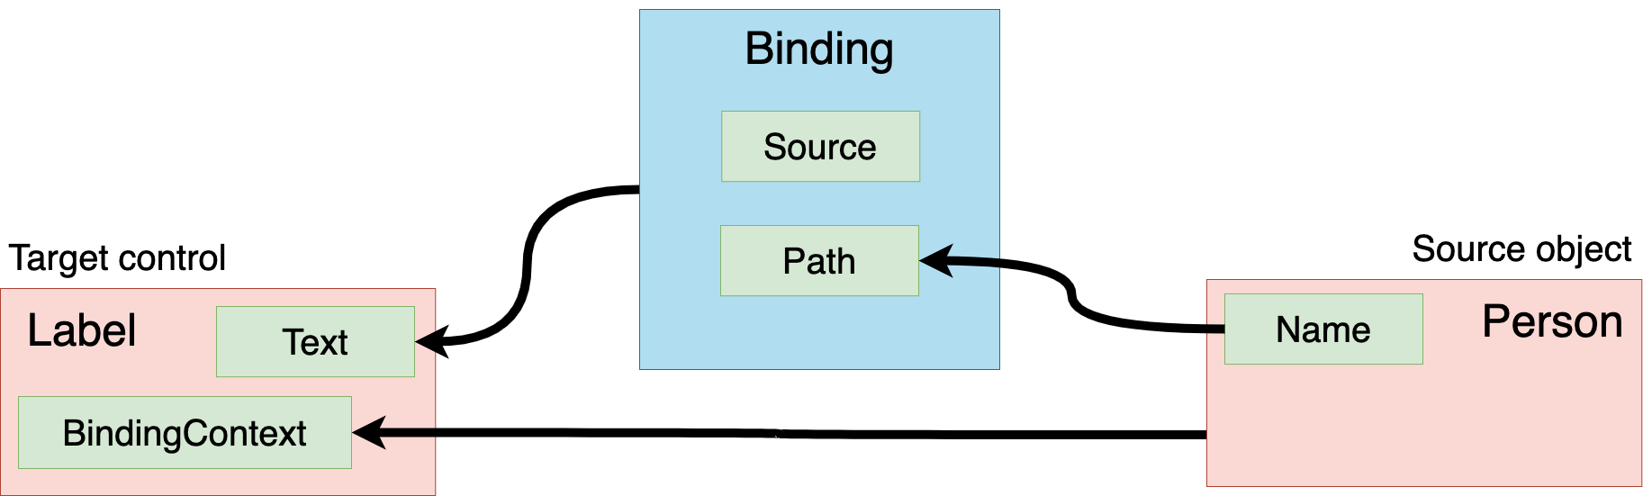
Data Binding

Slide 6
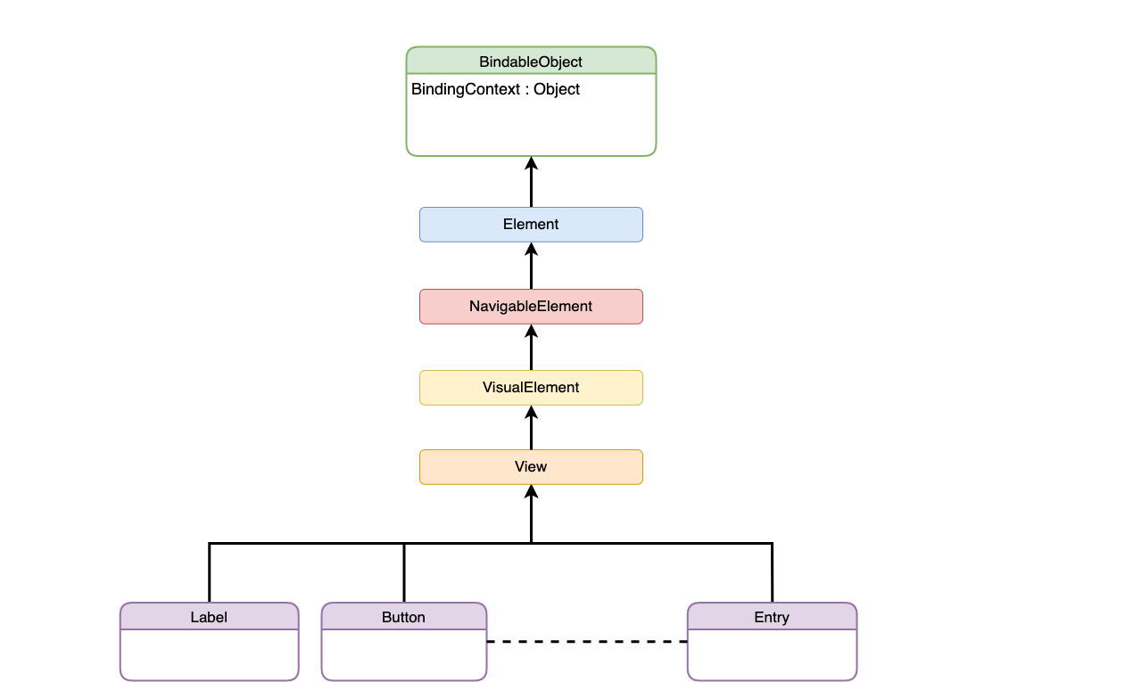
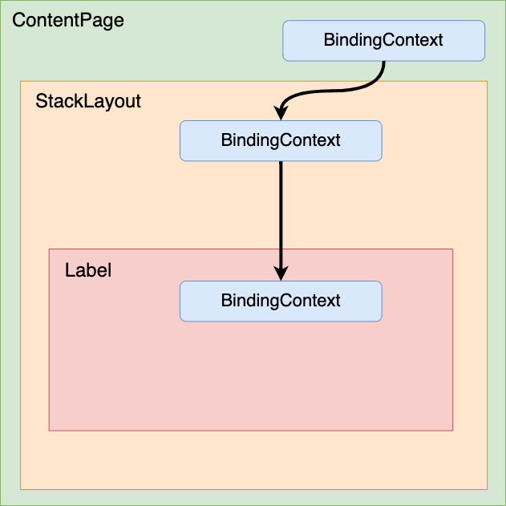
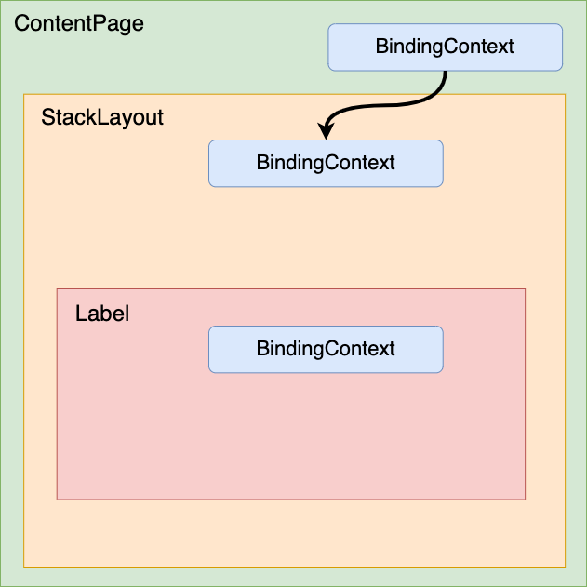
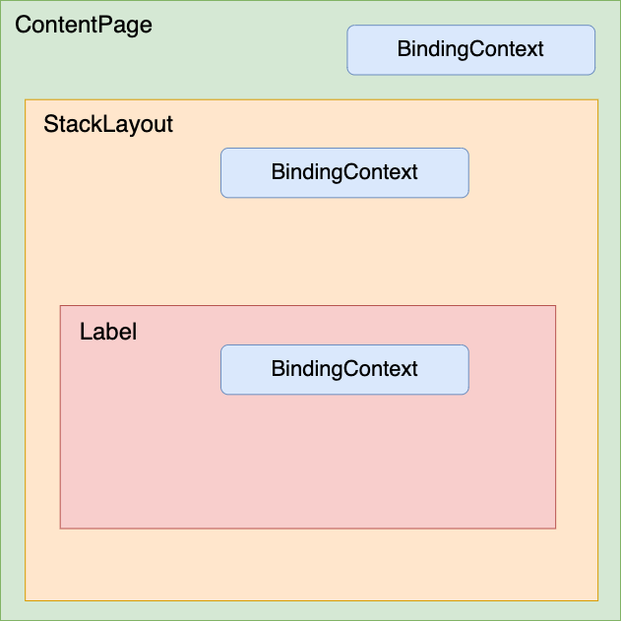
Binding Context & Propagation

