Slide 1
Phase2-8
Algorithm:
DFS(depth-first-search)
Details:
First, each node has two data(pre, low).
Vector<int> pre(n,0) // store the pre-order value
Vector<int> low(n,0) // store minimum pre-order value of accessible node
Procedure
Selecting one node
If the next node hasn’t visited, set the pre and low of that node
If the next node has already visited, comparing the low value of current node and next node, then set the minimum one as current one
Each time finishing the dfs, updating the parent node

Slide 2
Phase2-8
Int def(){
low[current] = pre[current] = cnt++; //set the low and pre
for(i=0;i<node[current].to.size();i++){
to=node[current].to[i];
if(!pre[to]){ //check the whether node has already visited or not
low[current] = min(low[current], dfs()) //set the minimum value
if(pre[to] == low[to]){ // get the bridge
bridge.push_back(make_pair(crr,to));
}
else if (from != to){ //update the parent node’s low value
low[current] = min(low[current], low[to];
}
}
return low[crr];
}

Slide 3
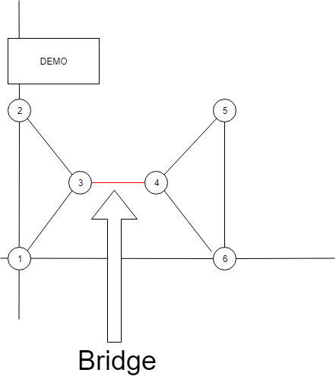
Phase2-8
DEMO:
Input data
6 7 0 0
0 0
0 10
1 5
2 5
3 10
3 0
1 2
2 3
1 3
3 4
4 5
5 6
4 6
Output data
3 - 4

Slide 4
Phase1-3,4
ここは前回もやったところなので簡単に

Slide 5
Phase1-3
Create the following data structure
Struct node{
double mincost;
int from;
bool done;
vector<double> cost;
vector<int> to; }

Slide 6
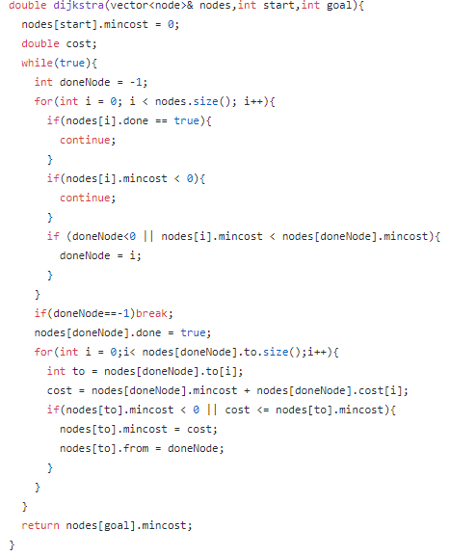
Phase1-3
Use the Dijkstra algorithm

Slide 7
Phase1-4
Follow the “from” data in the node structure for output the shortest path
for(int i = goal; i != start; i=node[i].from){
path.push_back(i); //push the data from goal to start
} path.push_back(start);
for(int i = path.size()-1; i >= 0; i--){
cout << path[i] << endl; //output
}

