Slide 1
Final Presentation

Slide 2
Team: SKYS
Members
Sora Koshikawa(s1250133)
Kaito Kimura(s1250131)

Slide 3
Development Environment
Language: Python3
Editor, IDE: All members used Atom IDE for developing
Management: Github, Git
Libraries: matplotlib(for visualizing), venv(for using virtual environment)
Why we chose Python?
There are few restrictions ➜ Focus on implement algorithms

Slide 4
Project abstract
The system constructs “roots network” and searches root any point to any point or adds some points to network efficiently.
Main algorithm is recursive function.
Improvement of the final phase is introduced in each algorithms part.

Slide 5
Progress
Ex1-9(Normal, Special and Minimun Case) ➜ Done
Ex3-9(Max case) ➜ Calculation doesn’t finish
Ex10-11(Max case) ➜ Calculation doesn’t finish

Slide 6
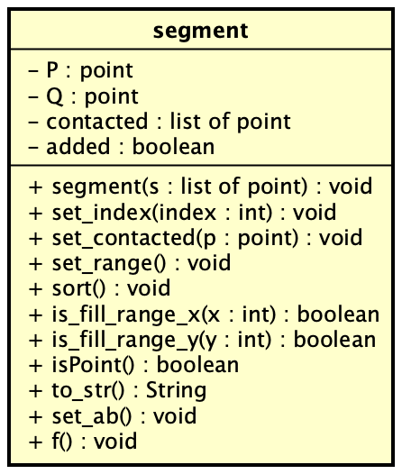
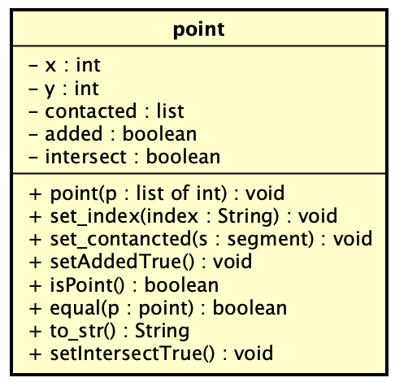
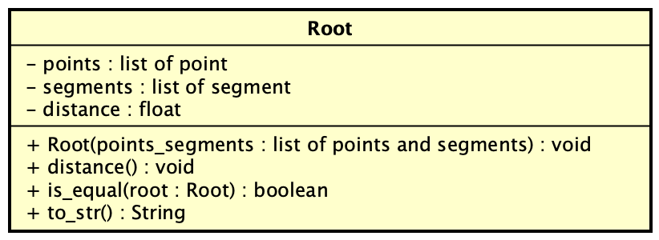
Class Diagrams 1(abstract of source code)

Slide 7
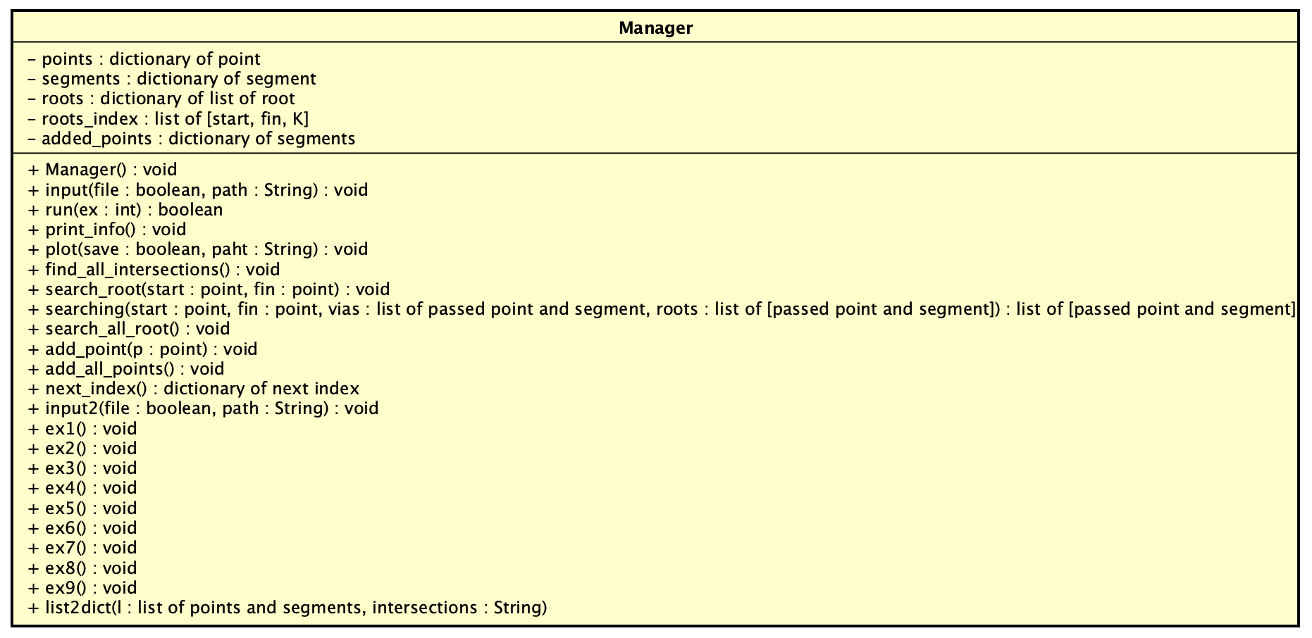
Class Diagram 2(abstract of source code)

Slide 8
Algorithms: Searching all intersections
for seg1, seg2 in segments:
Find the intersection of seg1 and seg2
Remove intersection if the point is end point
Append intersection to intersections list
Sort intersections list
Improve efficiency
Using binary search for sort intersections list
Change to Quicksort

Slide 9

Algorithms: Searching roots
Using Recursive Function: searching(start, fin, vias, roots)
All contacted segments ➜ searching(contacted_seg, fin)
Forward and backward points ➜ searching(contacted_point, fin)
if start is fin ➜ Go 4 elif start in vias ➜ Fin else ➜ Back 1
Append roots and stop recursive
終点
接線
接点
始点
接線
接点

Slide 10
Improvement efficiency
Recursive function has distance information(start ➜ now position), so if the distance + direct distance(now position ➜ fin) is bigger than roots[K-1].distance, stop the recursive. ➜ Waste recursive has been minimized.
High priority segment and point are going ahead.
If goal point have no contacted segments, Do not run recursive func.

Slide 11
Algorithms: Adding new point to network
for segment in segments:
Find the straight line which cross segment with 90 degree
Find the intersection of the straight line and segment
if the intersection is not on segment, update intersection to closer point between start point and end point of segment
append the intersection to intersections list
Find the point which has the minimum distance in intersections list
Add the intersection and segment to the network

Slide 12
Algorithms: Detection of highways
For point in points
Get the all segments value
Decide start point and end point, run SEARCH_ROOT
Unconnected point is appended to list.
Recursive self function(argument is that list and main road list)
It is continued when that list is void
Return main road list

Slide 13
Exercise 9
P = 0 and Q = 0 ➜ Intersections, Main Loads ( = Ex2, 8 )
P != 0 ➜ Added Point ( = Ex7 )
Q != 0 ➜ K-Roots and Distance( = Ex6 )
P != 0 and Q != 0 ➜ Both( = Ex6, 7 )

Slide 14
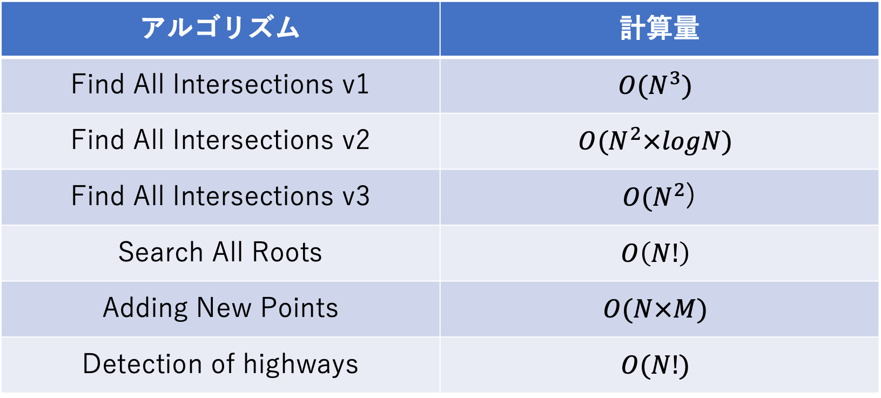
Order of each algorithm
アルゴリズム | 計算量
Find All Intersections v1 | $${O(N}^{3})$$
Find All Intersections v2 | $${O(N}^{2}×logN)$$
Find All Intersections v3 | ${O(N}^{2}$)
Search All Roots | $$O\left(N!\right)$$
Adding New Points | $$O(N×M)$$
Detection of highways | $$O(N!)$$

Slide 15
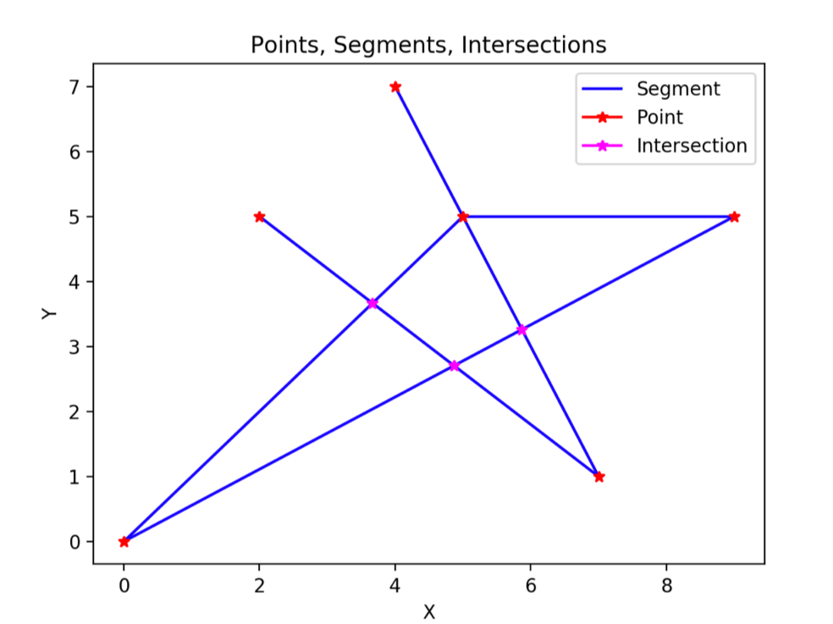
Visualization
Used Matplotlib for visualizing!
Plot:
Segments(Blue lines)
Points(Red points)
Intersections(Pink points)

Slide 16
Testdata generator
We made test data Generator for max input and minimum input.
We created other test datas(for normal and special cases) by hand.

Slide 17
Demonstration

Slide 18
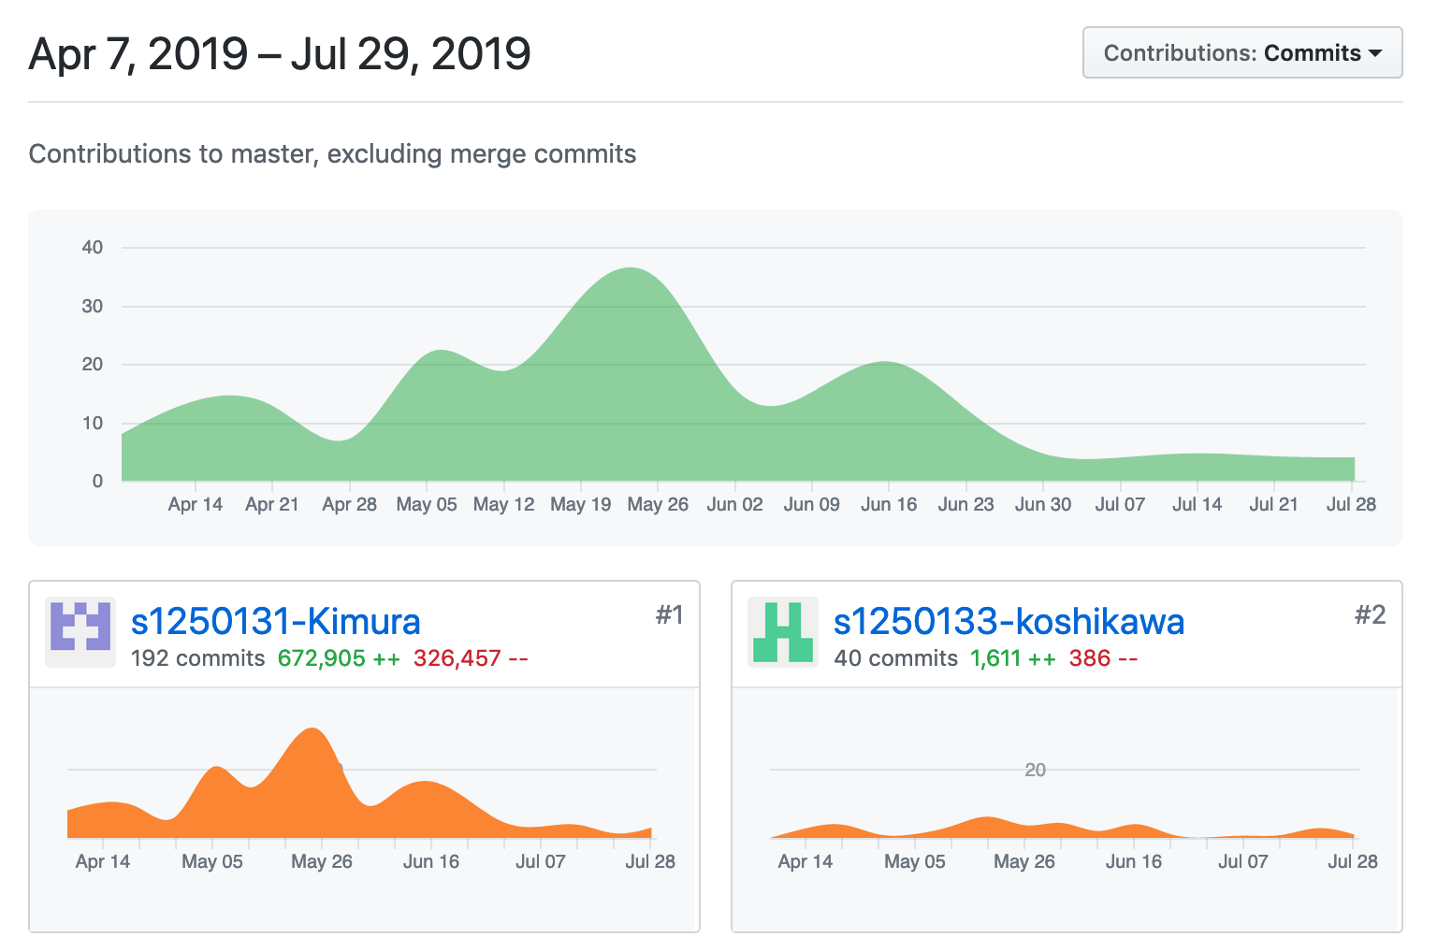
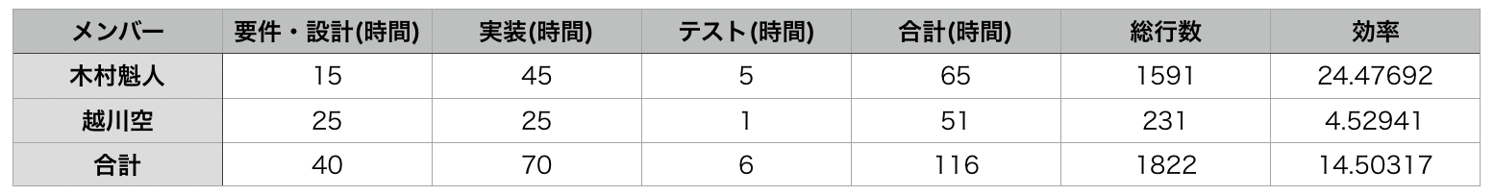
Contribution
Sora Koshikawa
231 lines per 51hours
LOC is 4.5
Kaito Kimura
1591 lines per 65 hours
LOC is 24.5

Slide 19
Summary
We thought and implemented algorithm(Recursive) by self.
Difficult, but it would be a good experience
We could design the system well ➜ Implement system efficiently
Algorithm efficiency was so bad that the system could not treat the big size input(not only ex10 and ex11 but also ex3-9)
We should have think deeply about what algorithm we use
It was a good opportunity to improve a programming skill.

Slide 20
Thank you for listening!

