Slide 1
こしかわへ
まとめのとこなにか足しといてけろ
テストデータ周りつけたしたかったらつけたしといて
あと, Keynoteで開いてもいいけどpptxで保存し直してね

Slide 2
Final Presentation

Slide 3
Team: SKYS
Members
Sora Koshikawa(s1250133)
Kaito Kimura(s1250131)

Slide 4
Development Environment
Language: Python3
Editor, IDE: All members used Atom IDE for developing
Management: Github, Git
Librarys: matplotlib(for visualizing), venv(for using virtual environment)
Why we chose Python?
There are few restrictioins ➜Focus on imprelemt algorithms

Slide 5
Project abstract
The system constructs “roots network” and searchs root any point to any point or adds some points to network efficiently.
Main algorithm is recursive function.
Improvement of the final phase is introduced in each algorithms part.

Slide 6
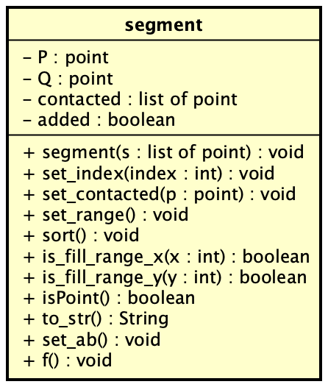
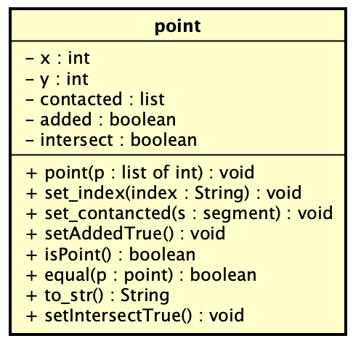
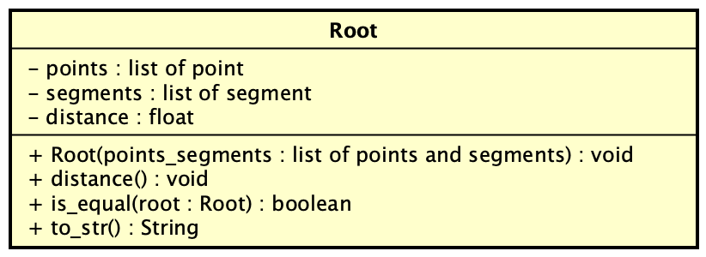
Class Diagrams 1(abstract of source code)

Slide 7
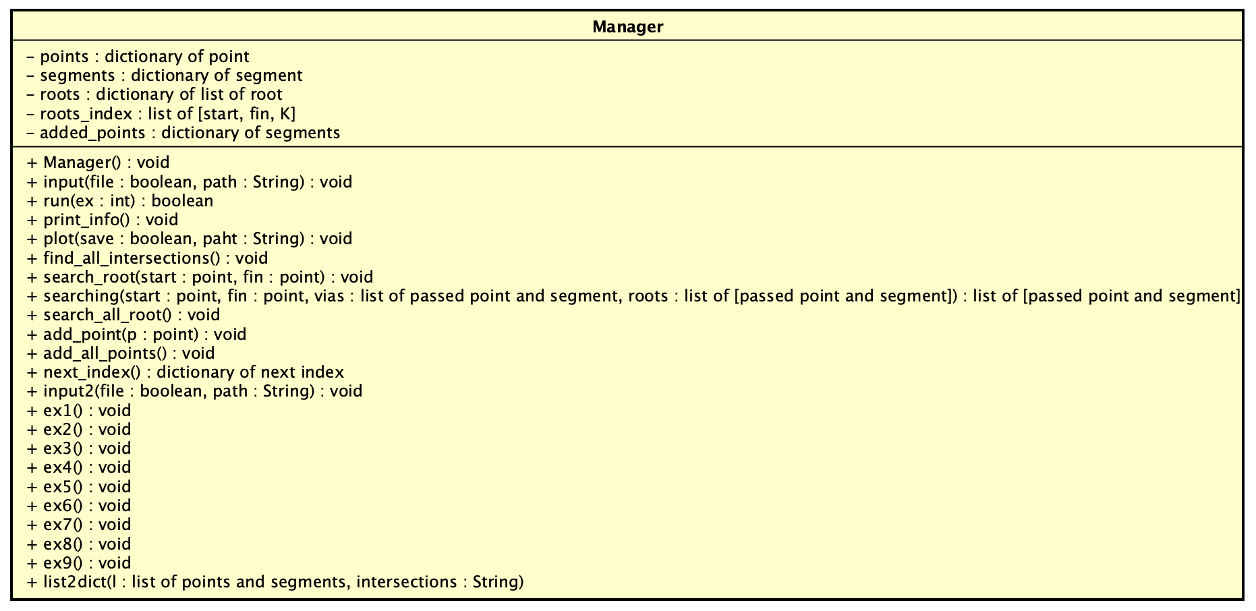
Class Diagram2(abstract of source code)

Slide 8
Demonstration
映像貼る
どこで挟むかは考えておく

Slide 9
Algorithms: Searching all intersections
Find the intersection of 2 segments
Remove intersection if the point is end point
Append intersection to intersections list(sorted) and sort
Improve efficiency
Using binary search for sort intersections list
Change to Quicksort

Slide 10

Algorithms: Searching roots
Using Recursive Function: searching(start, fin, vias, roots)
All contacted segments ➜ searching(contacted_seg, fin)
Forward and backward points ➜ searching(contacted_point, fin)
if start is fin ➜ Go 4 elif start in vias ➜ Fin else ➜ Back 1
Append roots(sorted) and stop recursive
終点
接線
接点
始点
接線
接点

Slide 11
Improvement efficiency
Recursive function has distance information(start ➜ now position), so if the distance is bigger than roots[K].distance, stop the recursive. ➜ Waste recursive has been minimized.
High priority segments and points is going ahead.
If goal points have no contacted segments, Do not run recursive func.

Slide 12
Algorithms: Adding new point to network
for segment in segments:
Find the straight line which cross segment with 90 degree
Find the intersection of the straight line and segment
if the intersection is not on segment, update intersetion to closer point between start point and end point of segment
append the intersection to intersrctions list
Find the point which has the minimum distance in intersections list
Add the intersection and segment to the network

Slide 13
Algorithms: Detection of highways

Slide 14
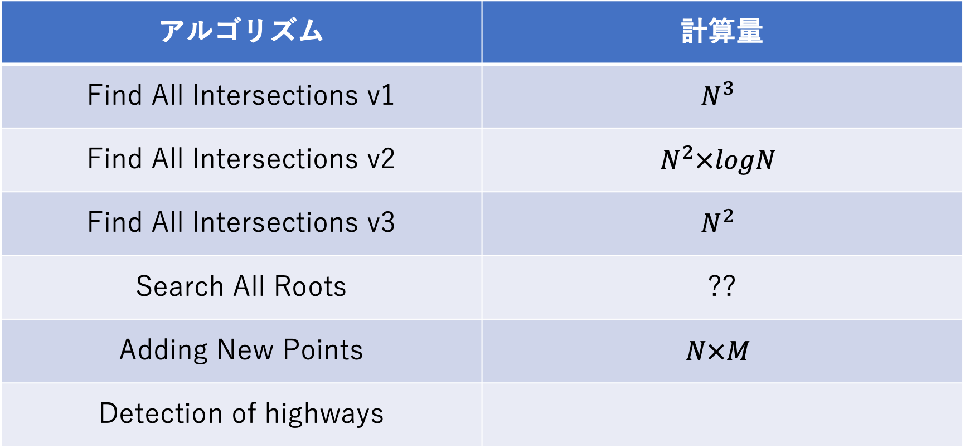
Order of each algorithm
アルゴリズム | 計算量
Find All Intersections v1 | $$N^{3}$$
Find All Intersections v2 | $$N^{2}×logN$$
Find All Intersections v3 | $$N^{2}$$
Search All Roots | ??
Adding New Points | $$N×M$$
Detection of highways

Slide 15
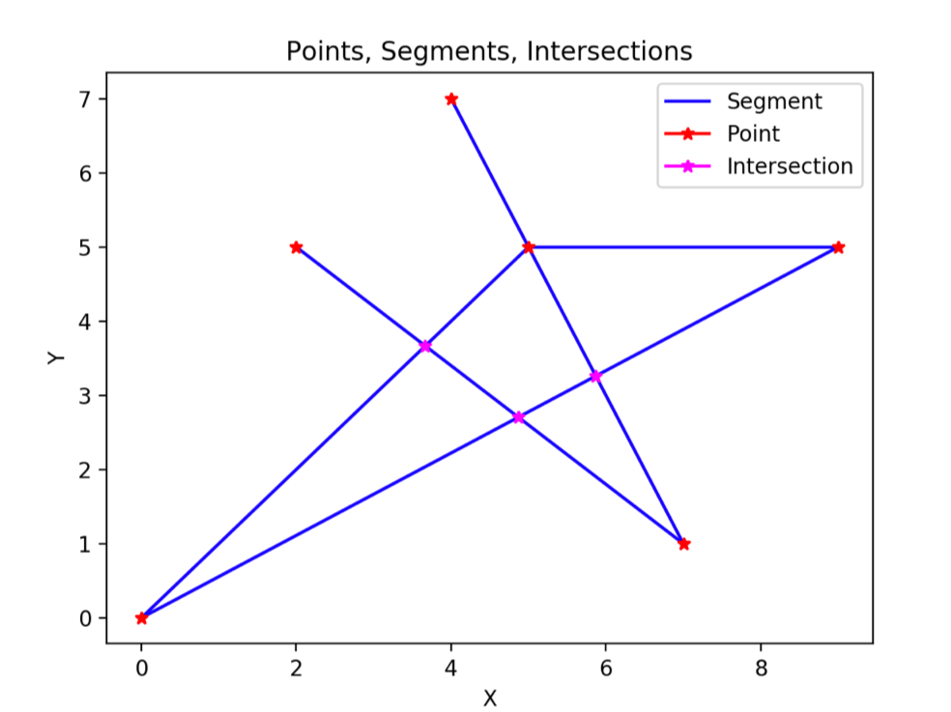
Visualization
Used Matplotlib for visualizing!
Plot:
Segments(Blue lines)
Points(Red points)
Intersetcions(Pink points)

Slide 16
Testdata generator
We made testdata Generator for max input and minimun input.
We created other testdatas(for normal and special cases) by hand.

Slide 17
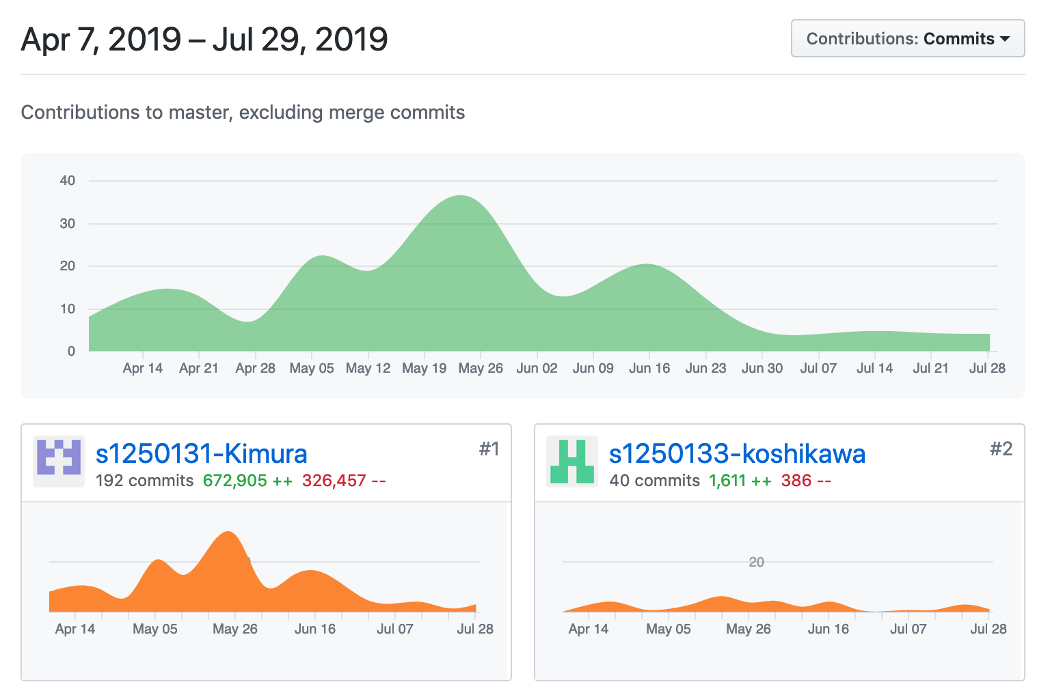
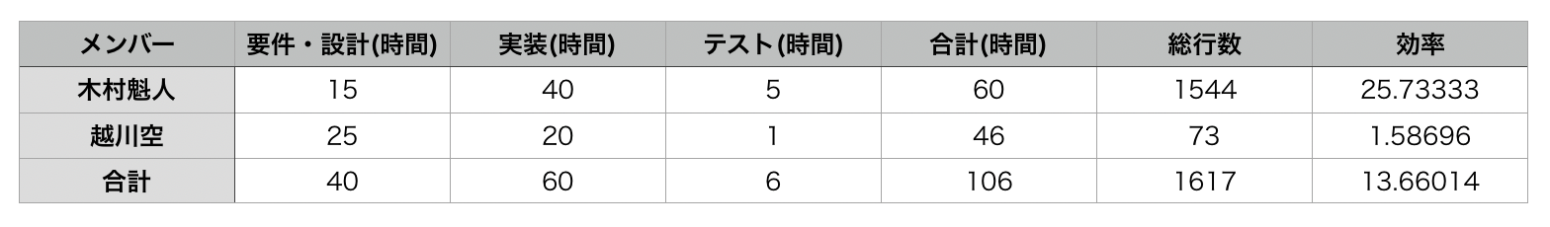
Contribution
Sora Koshikawa
73 lines per 46hours
LOC is 1.58
Kaito Kimura
1544 lines per 60 hours
LOC is 25.73

Slide 18
Summary
We thohght and impremented algorithm(Recursive) by self.
Difficult, but it would be a good experience
We could design the system well ➜ Imprement system efficiently
Algorithm efficiency was so bad that the system could not treat the big size input(ex10, ex11)
We should have think deeply about what algorithm we use
こしかわ流総括も書いといて

Slide 19
Thank you for listening!

