Slide 1
Final Presentation

Slide 2
Team: SKYS
Members
Sora Koshikawa(s1250133)
Kaito Kimura(s1250131)

Slide 3
Development Environment
Language: Python3
Editor, IDE: All members used Atom IDE for developing
Management: Github, Git
Librarys: matplotlib(for visualizing), venv(for using virtual environment)
Why we chose Python?

Slide 4
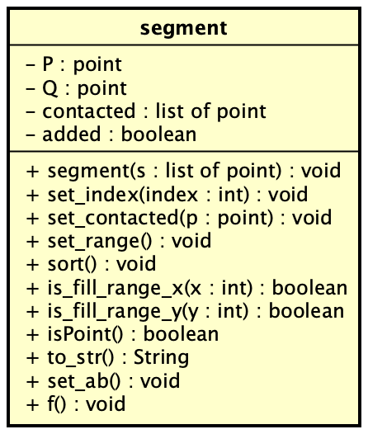
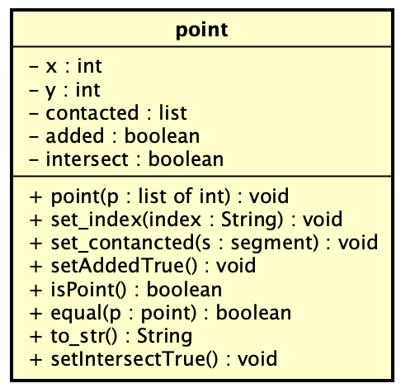
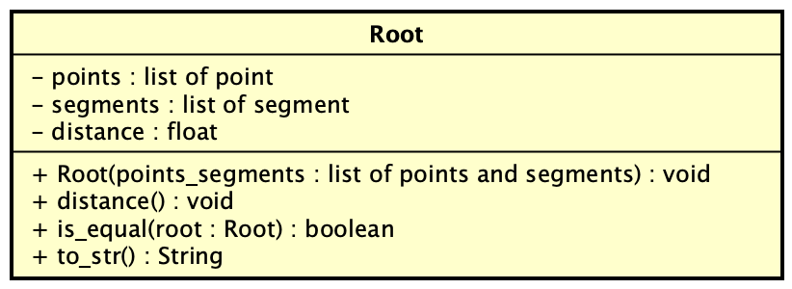
Class Diagrams1(abstract of source code)

Slide 5
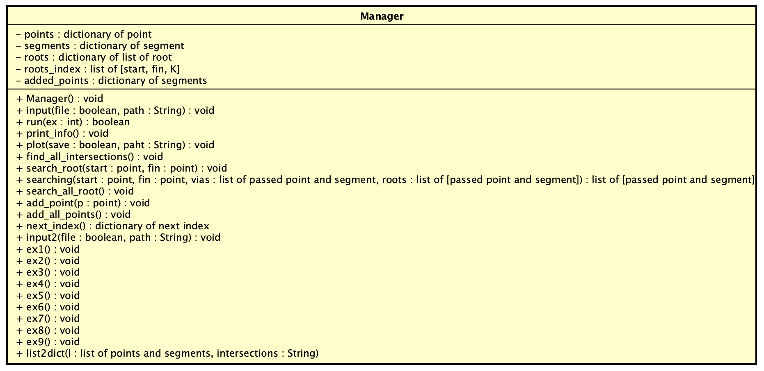
Class Diagram2(abstract of source code)

Slide 6
Demonstration
映像貼る

Slide 7
Algorithms: Searching all intersections
Find the intersection of 2 segments
Remove intersection if the point is end point
Append intersection to intersections list(sorted)
Improve efficiency
Using binary search for sort intersections list

Slide 8

Algorithms: Searching roots
Using Recursive Function: searching(start, fin, vias, roots)
All contacted segments ➜ searching(contacted_seg, fin)
All contacted points ➜ searching(contacted_point, fin)
if (start is fin) or (start in vias) ➜Go 4, else Back 1
Append roots(sorted) and stop recursive
終点
接線
接点
始点
接線
接点

Slide 9
Improvement efficiency
Recursive function has distance information(start -> now position), so if the distance is bigger than roots[K].distance, stop the recursive. -> Waste recursive has been minimized.
High priority segments and points is going ahead.
If goal points have no contacted segments, Do not run recursive func.

Slide 10
Algorithms: Adding new point to network
for segment in segments:
Find the straight line which cross segment with 90 degree
Find the intersection of the straight line and segment
if the intersection is not on segment, update intersetion to closer point between start point and end point of segment
append the intersection to intersrctions list
Find the point which has the minimum distance in intersections list
Add the intersection and segment to the network

Slide 11
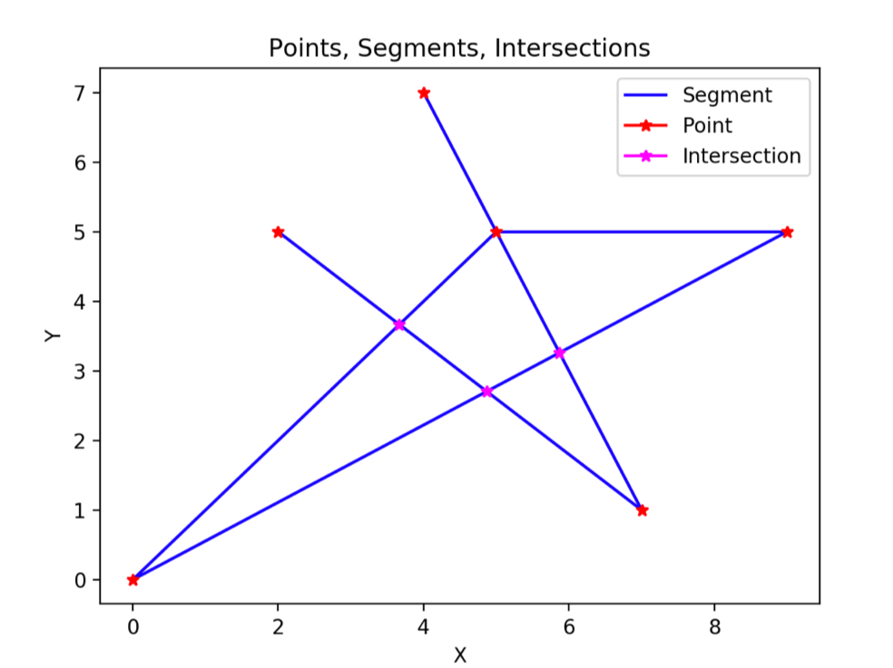
Visualization
Used Matplotlib for visualizing!
Plot:
Segments(Blue lines)
Points(Red points)
Intersetcions(Pink points)

Slide 12
Testdata generator
We made testdata Generator for max input and minimun input.
We created other testdatas(for normal and special cases) by hand.

Slide 13
Contribution(Git Contributors)

Slide 14
Contribution(LOC)
メンバー | 設計(時間) | 実装(時間) | テスト(時間) | 合計(時間) | 行数 | 効率
越川空 |  |  |  |  | 76
木村魁人 |  |  |  |  | 1544
合計

Slide 15
Summary

