Slide 1
Final presentation
Team (仮)

Slide 2
table of contents
Project Outline
Development environment
Deliverable
Degree of contribution
Project-wide consideration

Slide 3
Project Outline
Develop a system to support road construction plans.
Advance development by dividing those functions into three stages.

Slide 4
Project Outline
Phase 1
1.Detection of crossing points
2.Enumeration of crossing points
3.Shortest path distance
4.Shortest path
We use Dijkstra's algorithm for making program of Phase1.

Slide 5
Project Outline
Phase 2
1.K shortest path
2.Proposal of multiple routes
3.Construction proposal of the best road
4.Main road detection

Slide 6
Project Outline
Phase 3
1.Road network construction plan support system
2.Special large scale data
3.General large scale data
Menber
S1250111 Shun Kinemuchi
S1250081 Yuuki Mizuguchi
S1250178 Saki Tanaka

Slide 7
Development environment
Basically using c language and the Linux environment of the practice room.
The reason is that processing is quick.
When debugging, sometimes use a Mac with a large amount of information.
When debugging, we use a debugging tool such as lldb.
The reason is that there are many functions specialized for debugging.

Slide 8
Deliverable
Program of Phase 1
Due to problems such as time to gather, I spent a great deal of time only with Phase 1 debugging.

Slide 9
Phase 1 program
We use Dijkstra's algorithm.
Disadvantages of algorithms
If there is no way, a way that does not exist will be output depending on the input.
Hard point
Exception handling when there is a point where three or more sides intersect.

Slide 10
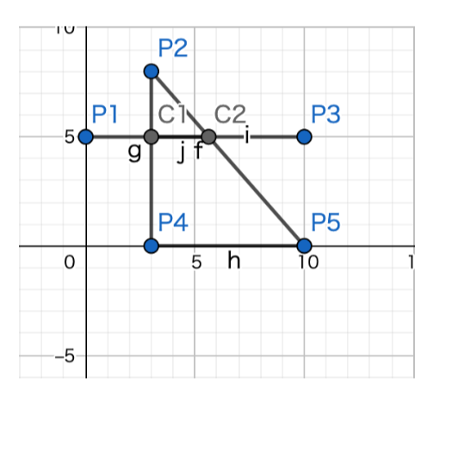
Test Data(1)
Normal pattern 5 4 0 1
0 5
3 8
10 5
3 0
10 0
1 3
2 4
2 5
4 5
1 4 1
It can run without delay.

Slide 11
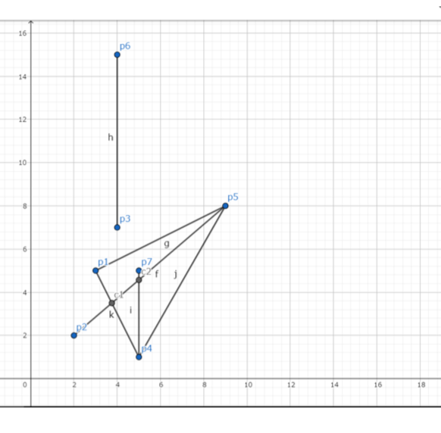
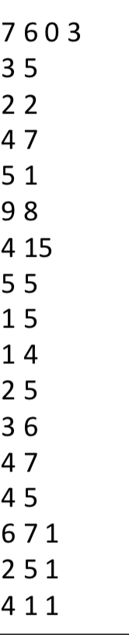
Test Data(2)
Output
最短経路:10.90615
経路:6-> C5-> C6-> 7
2 5 1
最短経路:9.21954
経路:2-> C1-> C4-> 5
4 1 1
最短経路:4.47214
経路:4-> C3-> C1-> 1
The road which should not exist originally is output.

Slide 12
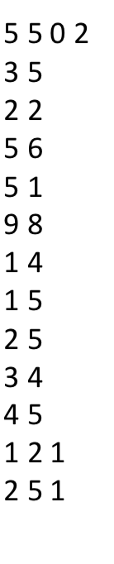
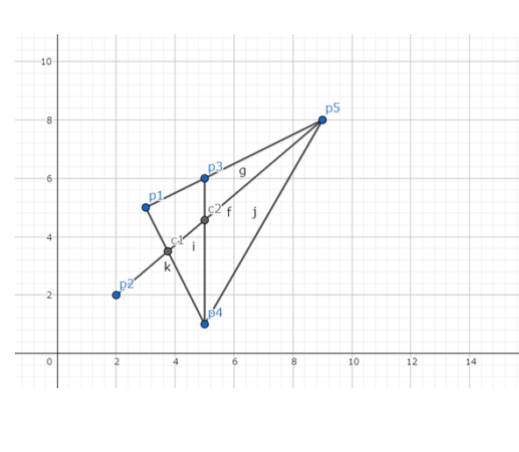
Test Data(3)
Output
最短経路:3.98194
経路:1-> C1-> 2
2 5 1
最短経路:9.21954
経路:2-> C1-> C2-> 5
Now I got the right result.

Slide 13
Degree of contribution
Shun Kinemuchi
Responsible for programming support. Also in charge of handling of debugging tools.
Yuuki Mizuguchi
Create a main program. Most contributing in the team
Saki Tanaka
Create test data. Suggested a useful idea.

Slide 14
Project-wide consideration
In programming, our team took the most trouble to implement exception handling.
Well done point of this system.
example 1-> C1-> C2-> 2 Express the route along the way with arrows.
We learned that it is important to share ideas across the team.
From the other team, I would like to share the algorithm used in this class and the experience of team development.

