Slide 1

Mastering Web Automation with Selenium WebDriver
Name: Mriganka Patra
Emp ID: 2415820
Email: Mriganka.patra@cognizant.com

Slide 2
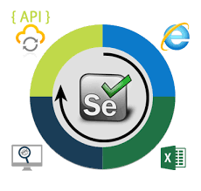
Agenda
What is Selenium?
The Selenium Suite of Tools
Deep Dive: Selenium WebDriver
How WebDriver Works: The Architecture
Finding Elements: The Power of Locators
Interacting with Elements: Essential Commands
Coding examples
Structuring Your Tests: The Page Object Model (POM)
Advantages & Limitations of Selenium

Slide 3
What is Selenium?
Selenium is a free, open-source, and powerful suite of tools for automating web browsers.
It's primarily used for automating web applications for testing purposes but is certainly not limited to just that.
Key Features:
Supports multiple programming languages (Java, Python, C#, JavaScript, etc.).
Runs on multiple operating systems (Windows, macOS, Linux)
Compatible with all major browsers (Chrome, Firefox, Safari, Edge)

Slide 4
The Selenium Suite of Tools
Selenium WebDriver: The core of the suite. Provides an API to create and run browser automation scripts.
Selenium IDE A browser extension for Chrome and Firefox that allows you to record and playback user interactions. Great for beginners.
Selenium Grid: Allows you to run tests in parallel on multiple machines with different browsers and operating systems, speeding up test execution.

Slide 5
Deep Dive: Selenium WebDriver
WebDriver is an object-oriented API that drives a browser natively, as a real user would.
It communicates directly with the browser's own engine.
Why WebDriver?
More stable and faster than older methods (like Selenium RC).
Provides a modern and elegant programming interface.
Overcomes the limitations of the single-host origin policy.

Slide 6
How WebDriver Works: The Architecture
Selenium Script (Your Code): You write commands in your preferred language (e.g., driver.findElement()).
Browser Driver: Each browser has a specific driver (e.g., ChromeDriver, GeckoDriver-firefox). This driver acts as a bridge.
Browser: The driver receives the command and executes it on the actual browser.
Response: The browser sends a response back to the driver, which then sends it back to your script.

Slide 7
Finding Elements: The Power of Locators
How WebDriver Identifies Elements on a Page
Locators are the strategy used to identify one or more elements on a web page.
Common Locators:
ID: Most reliable and fastest.
Name: Good for form elements.
ClassName: For elements sharing a CSS class.
TagName: To find elements by their HTML tag (e.g., <a>, <div>).
LinkText & PartialLinkText: For hyperlink elements.
CSS Selector: Powerful and fast, uses CSS syntax to find elements.
XPath: Most flexible, can traverse the entire HTML DOM, but can be slower.

Slide 8
Interacting with Elements: Essential Commands
Once we locate an element, we can interact with it.
Common Commands:
.click(): Clicks on an element (button, link, etc.).
.sendKeys("text"): Types text into an input field.
.getText(): Retrieves the visible text of an element.
.getAttribute("value"): Gets the value of an attribute (e.g., href from a link).
.clear(): Clears the text from an input field.
.isDisplayed(), .isEnabled(), .isSelected(): Checks the state of an element.

Slide 9
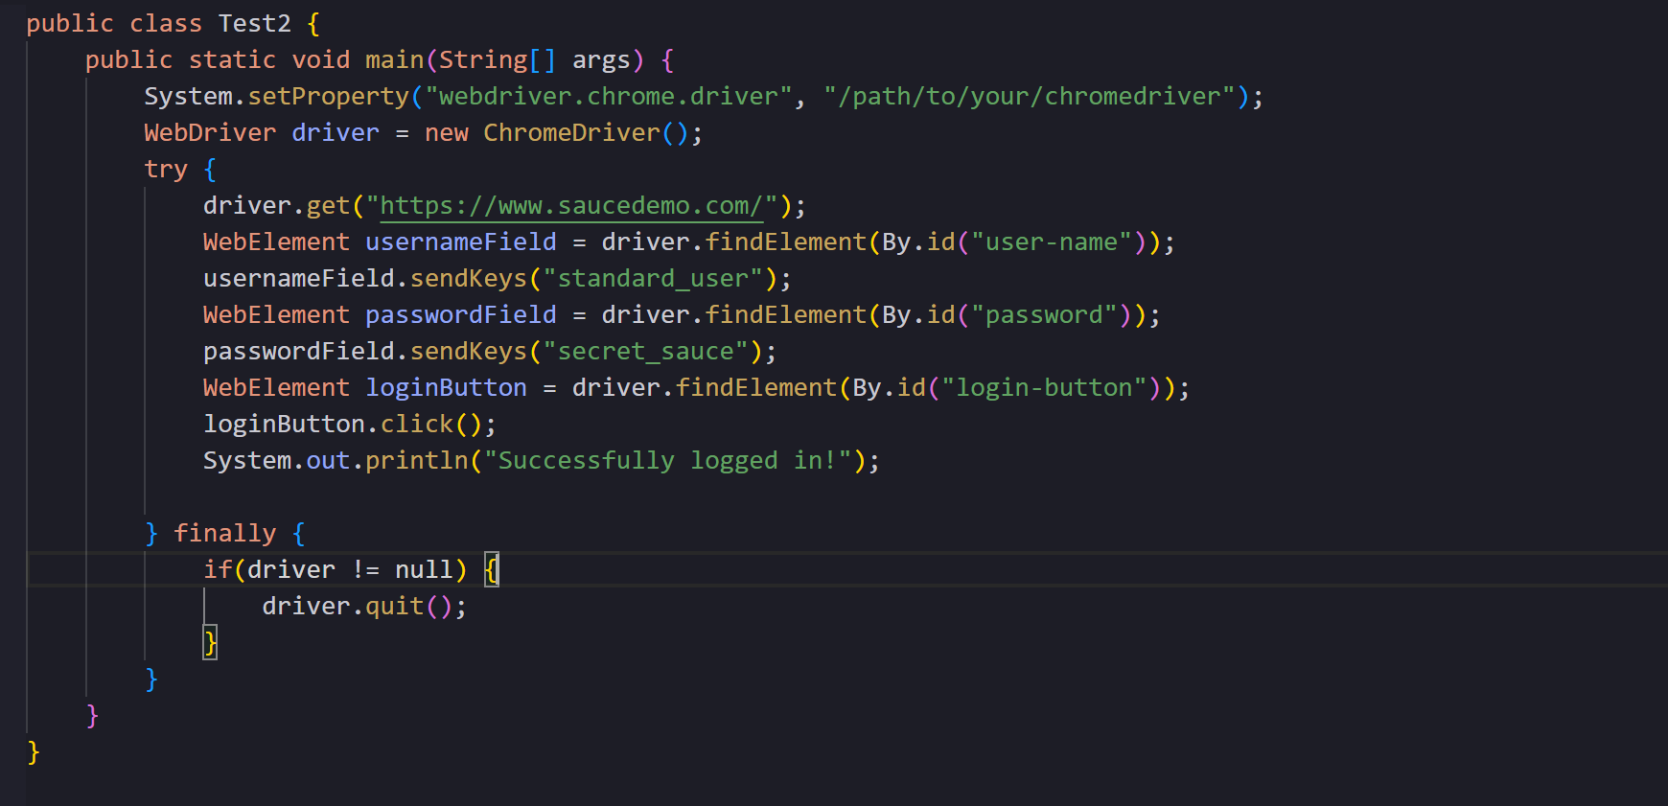
Code Examples

Slide 10
Structuring Tests: Page Object Model (POM)
A Design Pattern for Maintainable Tests
Concept: Create a separate class for each page of your web application.
What goes in a Page Class?
Locators: All element locators for that page.
Methods: All user interactions that can be performed on that page (e.g., login(), search()).
Benefits:
Reduces Code Duplication: Reuse methods instead of rewriting code.
Easy Maintenance: If the UI changes, you only need to update the locator in one place.
Improves Readability: Test scripts become cleaner and easier to understand.

Slide 11
Advantages & Limitations
Advantages:
Open-source and free.
Large community support.
Multi-language and multi-browser support.
Highly extensible and integrates well with other tools (e.g., TestNG, JUnit, Jenkins).
Limitations:
Only automates web applications. Cannot automate desktop applications.
No built-in reporting facility.
Can be complex to set up and maintain.
Can be slow for performance testing.

Slide 12

Thank You

