Slide 1
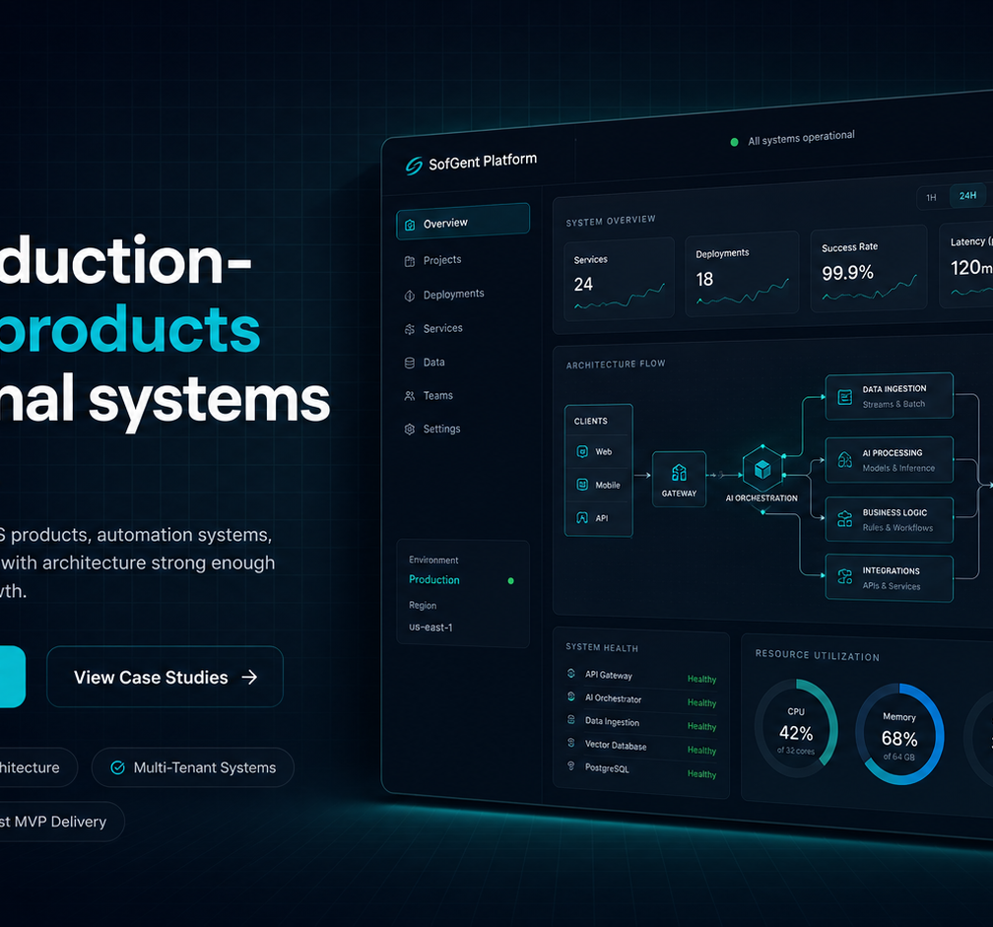
SOFGENT AI PRODUCT STUDIO
Build AI systems, SaaS MVPs, and delivery capacity fast.
SofGent helps startups and SMEs ship AI-powered services, production-ready MVPs, and embedded engineering support without long vendor cycles or fragile builds.
AI Services
SaaS MVP Delivery
Augmented Teams
2-6 weeks
Weekly
Arch-first
AI services, product workflows, and delivery operations in one execution model.
typical first delivery window
working demos and sprint feedback
scope, data, and deployment planned early
Free consultation
support@sofgent.com | calendly.com/sofgent
AI workflow audit, MVP scoping, and delivery recommendation.

Slide 2
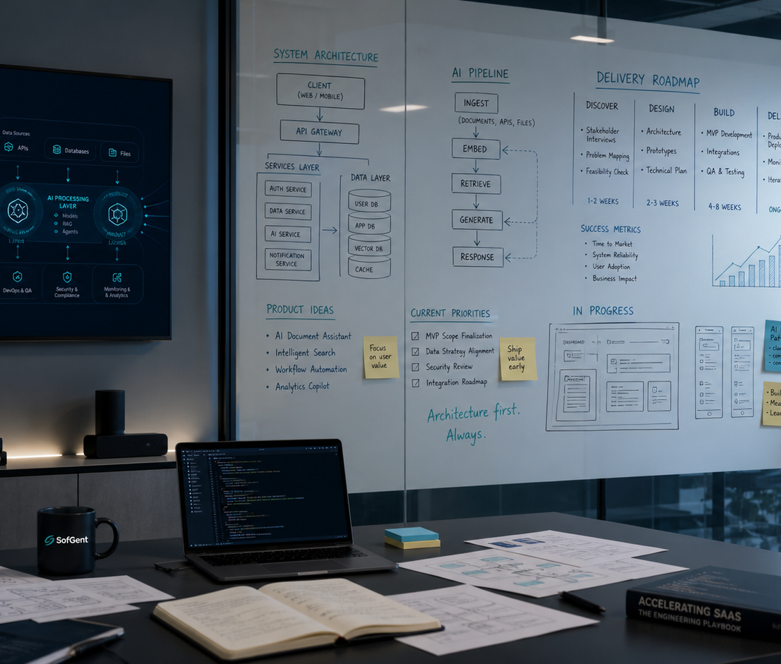
AI SERVICES + MVP DELIVERY
AI service delivery built around operations, with MVP execution that can survive growth.
We focus on the systems that remove operating friction, ship product value fast, and give founders a production path instead of a rewrite path.
AI service scope
30-day MVP launch model
AI implementation inside the systems your team already runs
01
Discovery
Define the smallest valuable wedge and the operating constraint it solves.
Document intelligence: OCR, extraction, validation, and review flows
02
Architecture
Set tenancy, auth, data model, integrations, and deployment path up front.
Workflow automation across CRM, ERP, payments, and internal tools
03
Build
Ship the customer-facing surface, admin workflow, and core API in focused sprints.
AI integrations, knowledge systems, and internal business software
04
Launch
Deploy with monitoring, QA, and a handover path your team can own.
4 weeks
78%
Multi-tenant
first production AI workflow
less manual document handling in sanitized delivery work
MVP architecture designed from day one
Best fit
View case studies | sofgent.com/case-studies
Startups, SMEs, and ops-heavy teams that need real software outcomes fast.

Slide 3
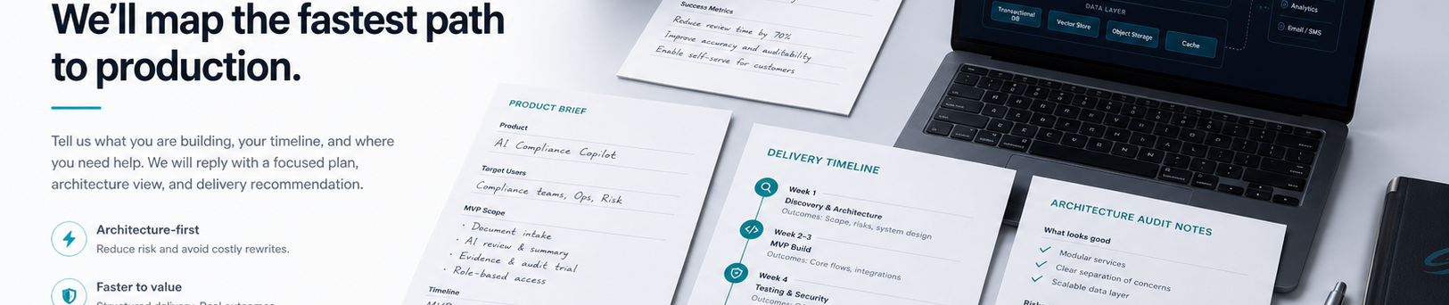
AUGMENTED TEAMS
Augmented teams for delivery spikes, modernization work, and AI execution capacity.
When your internal team needs senior execution without the overhead of full-time hiring, SofGent can operate as an embedded build pod focused on speed, architecture quality, and dependable handoff.
When to use us
Typical delivery pod
Unblock architecture, integrations, or AI implementation without hiring a full internal squad first.
Tech lead / architect
Full-stack engineer
System boundaries, solution design, delivery direction
App surface, APIs, auth, billing, and product workflows
Embed with founders, CTOs, or product teams for 30-90 day delivery pushes.
AI / integration engineer
QA / DevOps support
Own sprint execution, weekly demos, and handoff so internal teams do not inherit chaos.
Automation, OCR, RAG, partner APIs, and orchestration
Release checks, environments, observability, and stabilization
Embedded delivery works best when architecture, build, and operating constraints are reviewed together.
2-5 contributors
30-90 day sprints
Typical embedded pod size depending on architecture, AI, frontend, and integration scope.
Weekly demos, direct Slack coordination, and a handoff plan when the sprint ends.
Next step
support@sofgent.com | sofgent.com/contact
Start with a free architecture review, AI workflow audit, or MVP scoping call.

