Slide 1
Graph based Data Mining and their applications in Database and Health Informatics
Islam (Akef) Ebeid
iaebeid@ualr.edu
Notes:
Thank you so much for arranging this meeting Dr. Yu. I am truly honored to meet with you. My name is Akef, and I am in my last semester as a PhD candidate at the University of Arkansas at Little Rock. My PhD is in Computer and Information Science. I am expecting to graduate this coming may and currently I am working on my dissertation. And I am here today to introduce myself and my research for a potential postdoc position with your group.

Slide 2
Content
Introduction
Research
  NLP & Entity Resolution for Data Integration, Database
  Biomedical Knowledge Discovery, Information Retrieval & Data Mining
  HCI, UX, Visualization & Eye Tracking
Methods
  Graph-based Clustering for Unsupervised Entity Resolution
  Biomedical Information Retrieval using Knowledge Graphs
Closing Remarks
Notes:
So today I will be going over a quick introduction. I will go over my current and previous work. I will also spend some time describing methods I used in current research. And finally will describe some future directions. After that I will be happy to take any questions.

Slide 3
1. Introduction
PhD Computer and Information Science → UA Little Rock → Arkansas, USA (2014-2022)
Spent time at the PhD Information Studies → UT Austin→ Texas, USA (2017-2020)
M.Sc. Information Science → UA Little Rock → Arkansas, USA (2021)
M.Sc. Information Technology → Arkansas Tech → Arkansas, USA (2013)
B.Sc. Electrical and Computer Engineering → Ain Shams University → Cairo, Egypt (2008)
Postdoctoral Fellow @ UNT → Fall 2022
Research Intern @ AbbVie → Summer 2020
Research Assistant @ Texas Advanced Computing Center → Summer 2018
Software Engineering Intern @ Intel → Summer 2016-2017
Software Developer @ Arkansas.gov → 2013-2014
Notes:
So, since I started my PhD, I was always trying to apply my research to benefit the biomedical field. I truly enjoy interdisciplinary, collaborative and applied research. I also enjoy the idea of automated knowledge discovery and mining from text especially bibliographical text and unstructured data such as graphs and networks. So as far as education. I also earned 2 masters degrees in computer and information science and a bachelors degree in ECE. In addition I spent some time and finished coursework at the UT Austin at the School of Information as a PhD student.
As far as professional experience I interned in several places like Abbvie, Intel, and The Texas Advanced Computing Center in addition to being a software developer at Arkansas.gov.

Slide 4
2. Research
  Graph based Entity Resolution and NLP for Data Integration in Databases
  Biomedical Knowledge Discovery, Information Retrieval & Data Mining
  HCI, UX, Visualization & Eye Tracking
Notes:
first I will start by my current research and my dissertation work which is mainly in using graph and network algorithms in data integration especially in entity recognition and resolution in datasets that are not naturally a graph using nlp methods. The second line of research is biomedical information retrieval and data mining especially using knowledge graph and network embedding models. Third is a line of research in using human computer interaction and user studies in addition to eye tracking and visualization also to understand or enhance search experiences.

Slide 5
2A. Data Integration & Entity Resolution
Graph-based unsupervised entity resolution for identifying entity profiles in ambiguous data
Graph-based hierarchical record clustering for unsupervised entity resolution
ModER: Graph-based unsupervised entity resolution using composite modularity optimization and locality sensitive hashing
Computational social science for nonprofit studies: Developing a toolbox and knowledge base for the field
Ebeid, I. A. (2022). Graph-Based Unsupervised Entity Resolution for Identifying Entity Profiles in Ambiguous Data (Doctoral dissertation, University of Arkansas at Little Rock).
Ebeid, I. A., Talburt, J. R., & Siddique, M. A. S. (2022). Graph-based hierarchical record clustering for unsupervised entity resolution. In ITNG 2022 19th International Conference on Information Technology-New Generations (pp. 107-118). Springer, Cham.
Islam Akef Ebeid, John R. Talburt, Nicholas Kofi Akortia Hagan and Md Abdus Salam Siddique, “ModER: Graph-based Unsupervised Entity Resolution using Composite Modularity Optimization and Locality Sensitive Hashing” International Journal of Advanced Computer Science and Applications(IJACSA), 13(9), 2022. http://dx.doi.org/10.14569/IJACSA.2022.0130901
Ma, J., Ebeid, I. A., de Wit, A., Xu, M., Yang, Y., Bekkers, R., & Wiepking, P. (2021). Computational social science for nonprofit studies: Developing a toolbox and knowledge base for the field. VOLUNTAS: International Journal of Voluntary and Nonprofit Organizations, 1–12. https://link.springer.com/article/10.1007/s11266-021-00414-x
Notes:
One project related to the third paper that led me to this line of research is when I was part of a team where we integrated multiple heterogenous bibliographical databases used in nonprofit studies by finding tunning BERT for text classification on the metadata of the articles in the database. That work was part of a project that aimed at introducing machine learning and nlp to researchers in the computational social science field. That led me to work on entity resolution especially unsupervised and automated entity resolution. In the work related to the second paper which just got accepted at the ITNG conference I focus on the problem of record clustering using a graph algorithm to optimize a heuristic known as modularity after pairwise fuzzy matching of records in a merged datafile of structured data. Graph clustering algorithms are very useful to that problem because of the transitivity property. And in an upcoming work in progress article which is the first paper I am expanding the framework that I introduced in the first paper. I will discuss more details on the methods used in the 1st and 2nd papers work also later in the talk.

Slide 6
2B. Biomedical Information Retrieval and Mining
MedGraph: A semantic biomedical information retrieval framework using knowledge graph embedding for PubMed
Building a PubMed knowledge graph
Ebeid IA. MedGraph: A semantic biomedical information retrieval framework using knowledge graph embedding for PubMed. Front Big Data. 2022 Oct 19;5:965619. doi: 10.3389/fdata.2022.965619. PMID: 36338335; PMCID: PMC9627348.
Xu, J., Kim, S., Song, M., Jeong, M., Kim, D., Kang, J., Rousseau, J., Li, X., Xu, W., Torvik, V., Bu, Y., Chen, C., Ebeid, I. A. et al. (2020) Building a PubMed knowledge graph. Sci Data.
Notes:
The second line of research that I am working on in parallel with my dissertation is biomedical information retrieval and mining. I got really interested in biomedical information retrieval and mining when with my previous advisor I started contributing to a project where we used BioBERT, to extract and resolve mentions of biological entities such as names of species, drugs, diseases, genes, proteins and mutations for the entire corpus of PubMed’s metadata. Not just that also names of authors were disambiguated in addition to related NIH grant projects for each article and their PIs. The goal was to build a complete knowledge graph from the entities extracted from PubMed but of course biomedical relation extraction is not as reliable as needed to be. I always thought that that dataset was incredibly useful especially if it was somehow utilized in a search algorithm. So that was the paper titled Building a PubMed knowledge graph. In another unpublished report titled knowledge profiling using biomedical word embedding and knowledge graph I tried to use the extracted entites from each article and replace each mention of them in the abstract and the title with a unique identifier for each entity and run word2vec. And that could be applied to provide a search capability to find related bioentites for each author when queried. In the latest paper MedGraph I wanted to somehow marry the ideas of extracting a knowledge graph from all the articles of PubMed with graph representation learning and knowledge graph embedding models and also graph neural networks. Those models are very useful and provide robust embeddings that are capable of encoding not just the graph structure but also relationships and heterogenous entity types. I provided a proof ofconcept on a subset of the articles with a simple search engine to rank the documents after converting them to a knowledge graph and embedding the graph using cosine similiarty. I will talk later about that.

Slide 7
2B. Biomedical Information Retrieval and Mining
Analyzing knowledge entities about COVID-19 using entity metrics
Coronavirus Knowledge Graph: A Case Study
Yu Q, Wang Q, Zhang Y, Chen C, Ryu H, Park N, Baek JE, Li K, Wu Y, Li D, Xu J, Liu M, Yang JJ, Zhang C, Lu C, Zhang P, Li X, Chen B, Ebeid IA, Fensel J, Min C, Zhai Y, Song M, Ding Y, Bu Y. Analyzing knowledge entities about COVID-19 using entitymetrics. Scientometrics. 2021;126(5):4491-4509. doi: 10.1007/s11192-021-03933-y. Epub 2021 Mar 12. PMID: 33746309; PMCID: PMC7953944.
Chen, C., Ebeid, I. A., Bu, Y., & Ding, Y. (2020). Coronavirus Knowledge Graph: A Case Study. arXiv preprint arXiv:2007.10287. https://arxiv.org/pdf/2007.10287.pdf
Notes:
During that time when the pandemic started I contributed to a couple of projects in the first titled Coronairus knowledge graph a case study it was a KDD workshop paper. We extracted a cooccurance network of drugs, genes, disease names related to Covid from the CORD-19 dataset. We used BioBert fine tuning again to extract the names of bioentities from the CORD19 dataset which was available on Kaggle. For each drug we extract and ego centric graph and apply frequency metrics to find the most similar entities to it. Also we used a similar approach in the paper titled Analyzing knowledge entities about COVID 19 using entity metrics.

Slide 8
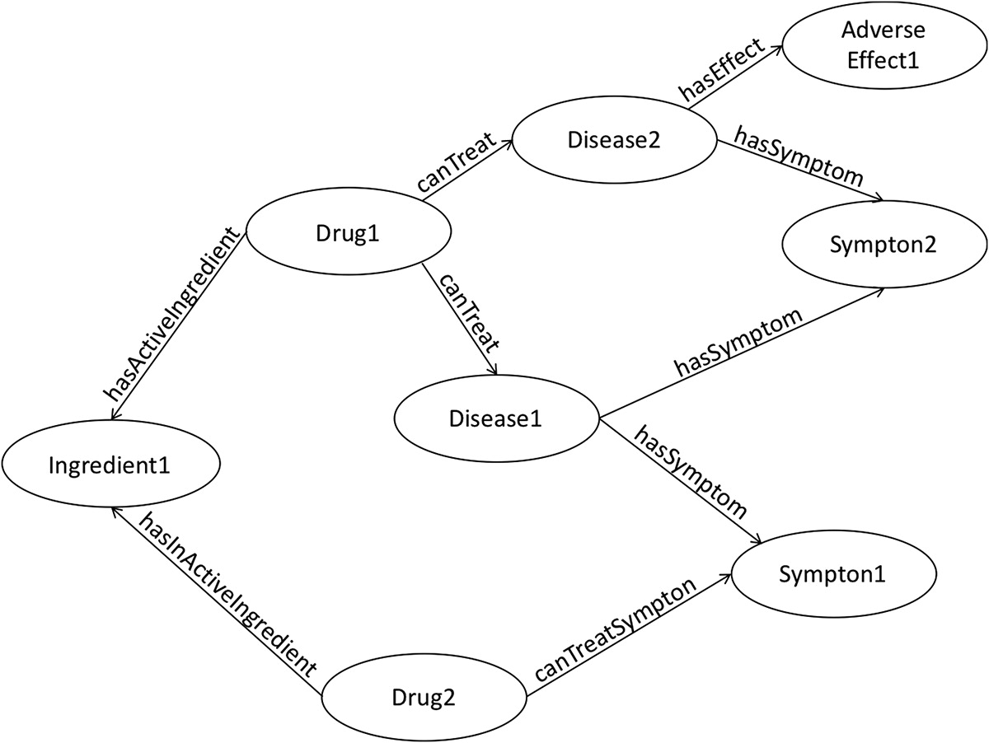
2B. Biomedical Information Retrieval and Mining (Current)
Biomedical Knowledge Graph Refinement and Completion Using Graph Representation Learning and Top-K Similarity Measure
Ebeid I.A., Hassan M., Wanyan T., Roper J., Seal A., Ding Y. (2020) Biomedical Knowledge Graph Refinement and Completion Using Graph Representation Learning and Top-K Similarity Measure. iConference.
Chen, B., Dong, X., Jiao, D., Wang, H., Zhu, Q., Ding, Y., & Wild, D. J. (2010). Chem2Bio2RDF: a semantic framework for linking and data mining chemogenomic and systems chemical biology data. BMC bioinformatics, 11(1), 1-13.
Notes:
Finally in this line of research I collaborated with AbbVie Inc. the drug company. There is this dataset called Chem2Bio2RDF. It’s a knowledge graph that links multiple data sources of bioentities such as PDB and PubChem and all the entities are resolved and semantically link. However it is incomplete. So we tested a link prediction method using multiple knowledge graph embedding and vector operations on the extracted emebddings to estimate the missing links in the knowledge graph.

Slide 9
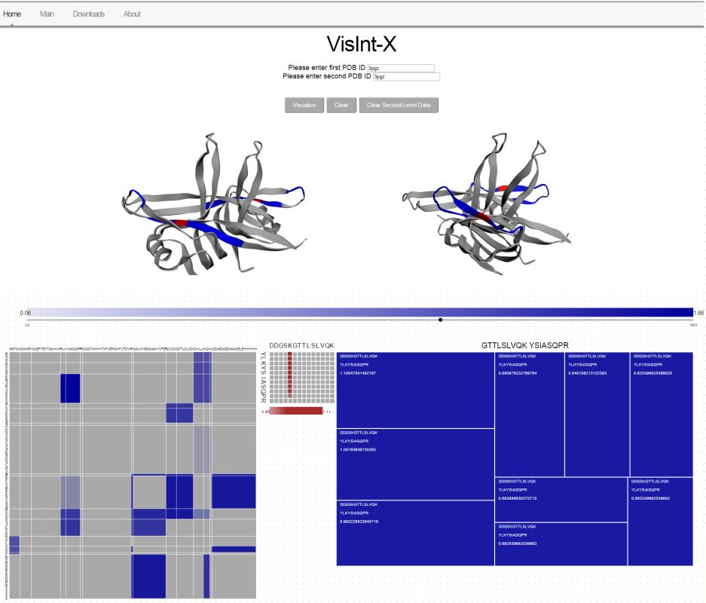
2C. HCI, UX, Visualization and Eye tracking (Previous)
Protein Chemical Cross-linking/Mass Spectrometry: From raw data to fully immersive visualizations
Ebeid, Islam Akef and Cruz-Neira, Carolina and Jaiswal, Mihir and Zybaylov, Boris. (2016) Protein Chemical Cross-linking/Mass Spectrometry: From raw data to fully immersive visualizations. Electronic Imaging.
Notes:
My third theme or topic that I worked in is HCI, UX, Visualization and Eyetracking. It started back in 2015/16 I worked on a collaboration with the department of bioinformatics. The bioinformatics folks had an algorithm that produces sequences of letters describing the interactions of molecules when two proteins interact I provided a visualization tool that was able to visualize those interactions hieracrhcualy on different levels in a 2D and 3D approaches. It was helpful to them and it is being used. Later when

Slide 10
2C. HCI, UX, Visualization and Eye tracking (Previous)
Promoting the evaluation of the credibility and the quality of online health information through online web applications
Analyzing Gaze Transition Behavior using Bayesian Mixed Effects Markov Models
Real-time Gaze Transition Entropy
Ebeid, I. A., Bhattacharya, N., Gwizdka, J., & Sarkar, A. (2019). Analyzing Gaze Transition Behavior using Bayesian Mixed Effects Markov Models. Proceedings of the 11th ACM Symposium on Eye Tracking Research & Applications
Ebeid, I. A., & Gwizdka, J. (2018). Real-time Gaze Transition Entropy. Proceedings of the 2018 ACM Symposium on Eye Tracking Research & Applications
Notes:
Later when I first moved to Texas I worked in eye tracking and how to extract useful measures from the movements of eyes in order to correlate it to other self reported measures used in User Experience Studies especially in health information seeking. So that lead to the 2 published papers and an unpublished reports where I actually used eyetracking to evaluate the design of a search engine aimed to help in health information seeking.

Slide 11
3. Methods
ModER: Graph-based entity profiling for unsupervised entity resolution
MedGraph: An experimental semantic information retrieval method using knowledge graph embedding for PubMed
Notes:
So first I will talk about graph based unsupervised entity resolution which is my dissertation work.

Slide 12
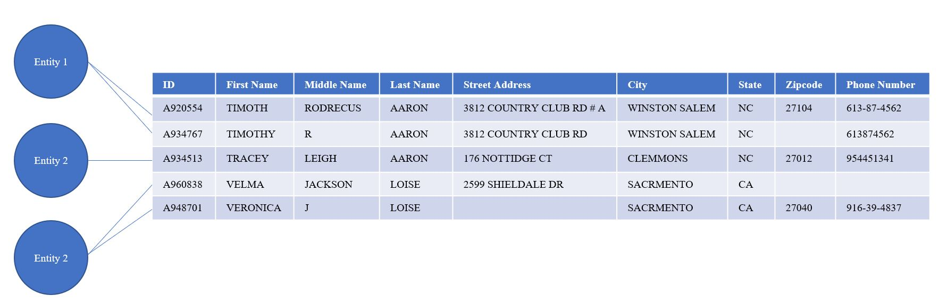
3A. Graph-based Unsupervised Entity Resolution
Notes:
But first, let me start from the top and explain entity resolution and then narrow it down to the problem at hand. Entity resolution is a data quality problem that appears in data curation processes. It refers to finding records in a database or a data file that refer to the same real-world entity. Other term variants can be entity matching, record linkage, deduplication, or the merge/purge problem. As you can see in the figure, this is an excerpt of a merged data file. And I am saying merged because usually data like that come in multiple files. Hence, we typically merge all those files in one. Sometimes using a single layout and sometimes just merging without knowing the specific layout of the metadata. There is one layout in this figure, meaning that all the data rows are organized in the same fields. However, some of those rows might be identical to each other, and some might be a little similar yet ambiguous. Ambiguous in the sense that some of the fields might be identical and some might not be. This brings up the question of which rows in this data file might refer to the same person. Of course, just by looking, we can say that the first and the second rows most probably refer to the same person, and the fourth and the fifth rows also might refer to another same person. But of course, to scale this on large datasets, we need an automated way of clustering those records together just as we did with our human eyes. So that is in a nutshell what the task of entity resolution.

Slide 13
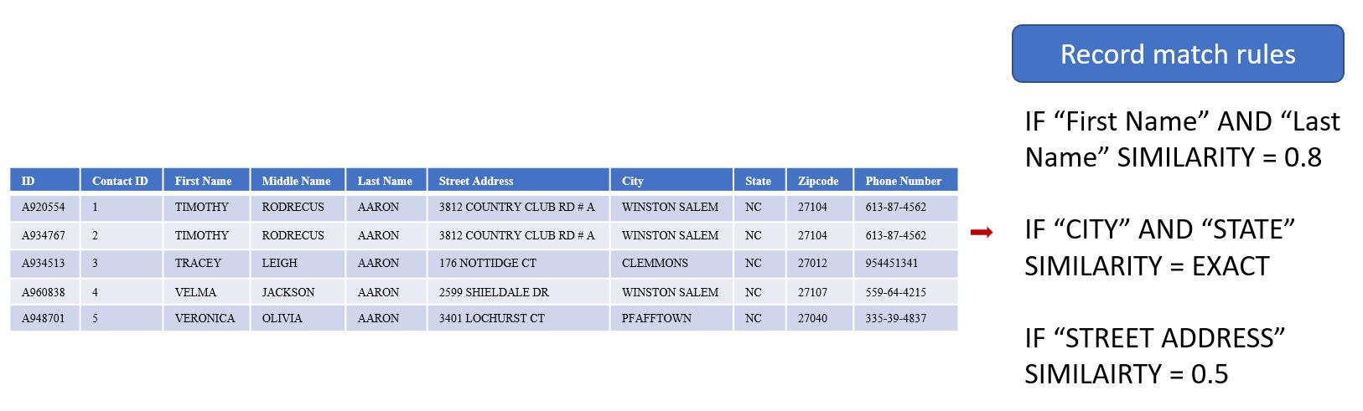
3A. Graph-based Unsupervised Entity Resolution
Notes:
The core of entity resolution is text similarity and fuzzy matching. The idea is that if we can compare each record in a file, we will get a score for each pairwise comparison. Based on those scores, probabilities can be derived, indicating whether each pair of rows match. Text similarity approaches could be applied in many ways. Traditional rule-based methods rely on handcrafting rules based on the semantics, the context, and the schema of the dataset. Matching probabilities are then computed based on the handcrafted rules in combination with syntactic similarity or string similarity. Previously mentioned approaches could be referred to as supervised methods in entity resolution because they rely on human input to function correctly. Supervised techniques are characterized by producing robust results.

Slide 14
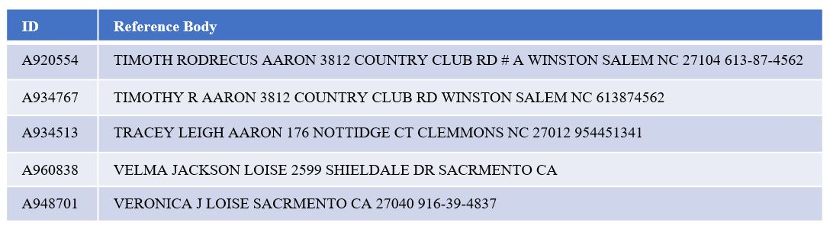
3A. Graph-based Unsupervised Entity Resolution
Notes:
On the other hand, as organizations' data assets increase in volume and size, the need for automating data curation and supporting processes such as entity resolution becomes more crucial. Automating entity resolution to become fully unsupervised requires relying only on syntactic string and text similarity measures and ignoring prior knowledge and hand-crafted rules about the dataset's schema. The task, however, is muddled with challenges and scalability issues. Since the unsupervised entity resolution relies on syntactic string similarity, a naive approach of pairwise comparison will have quadratic complexity. Notice here that I removed the columns and field names and combined all the tokens in one body ignoring any schema or metadata. Now you can imagine just comparing every record in the dataset to the other and how that approach would be problematic for large-scale data.

Slide 15
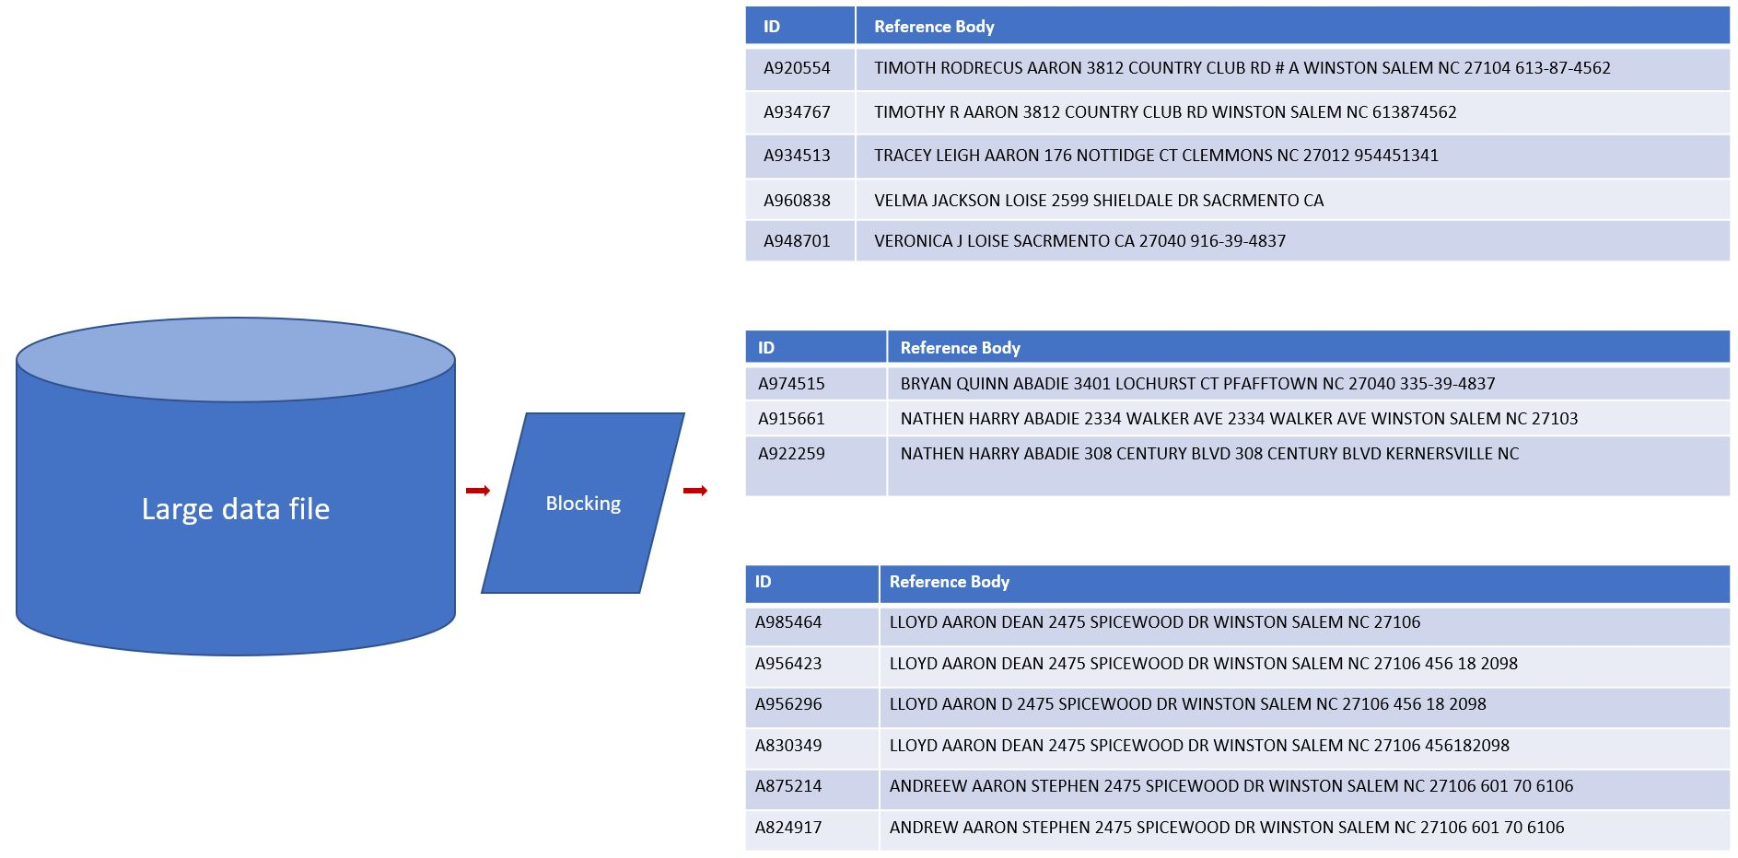
3A. Graph-based Unsupervised Entity Resolution
Notes:
The solution to that in unsupervised entity resolution is called blocking. Blocking refers to quick and dirty techniques that first avoid using computationally expensive string comparisons and second would reduce the number of pairwise comparisons in the data file by dividing the data file into blocks.
As you can see in the figure a large data file is broken down into references that have the potential of referring to the same entity. Block sizes don’t have to be equal.
Now each block can be processed separately where pairwise string similarity can be applied with less computational cost and possibly in parallel. Blocking is typically based on the assumption that two records that might refer to the same entity will share at least one token. Other blocking techniques include locality sensitive hashing and random sampling.

Slide 16
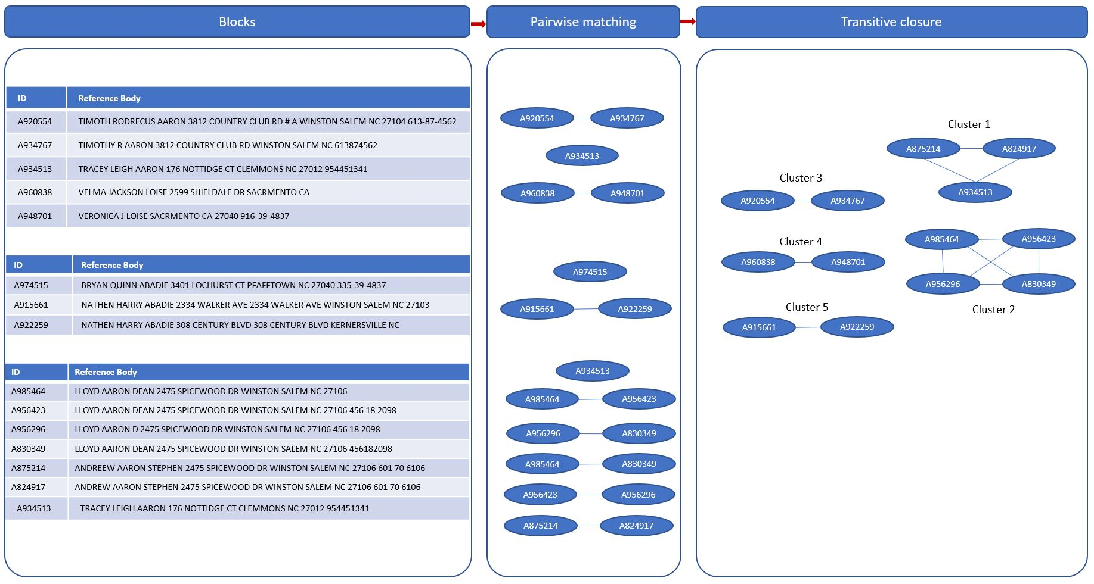
3A. Graph-based Unsupervised Entity Resolution
Notes:
The matched pairs from each processed block are then combined and clustered. The clustering process aims at resolving any conflicts in pairwise matching and find records that indirectly match. The final clusters then represent the matched and resolved entity records with the highest matching probabilities.
As you can see in the figure the blocks from the previous slide are passed to a pairwise matching process on each block separately. Each ellipse in the image represents one unique record. The paired records are passed to a clustering process where pairs are identified where common records appear in multiple pairs. In addition, records that match each other indirectly are identified to form the entity clusters.

Slide 17
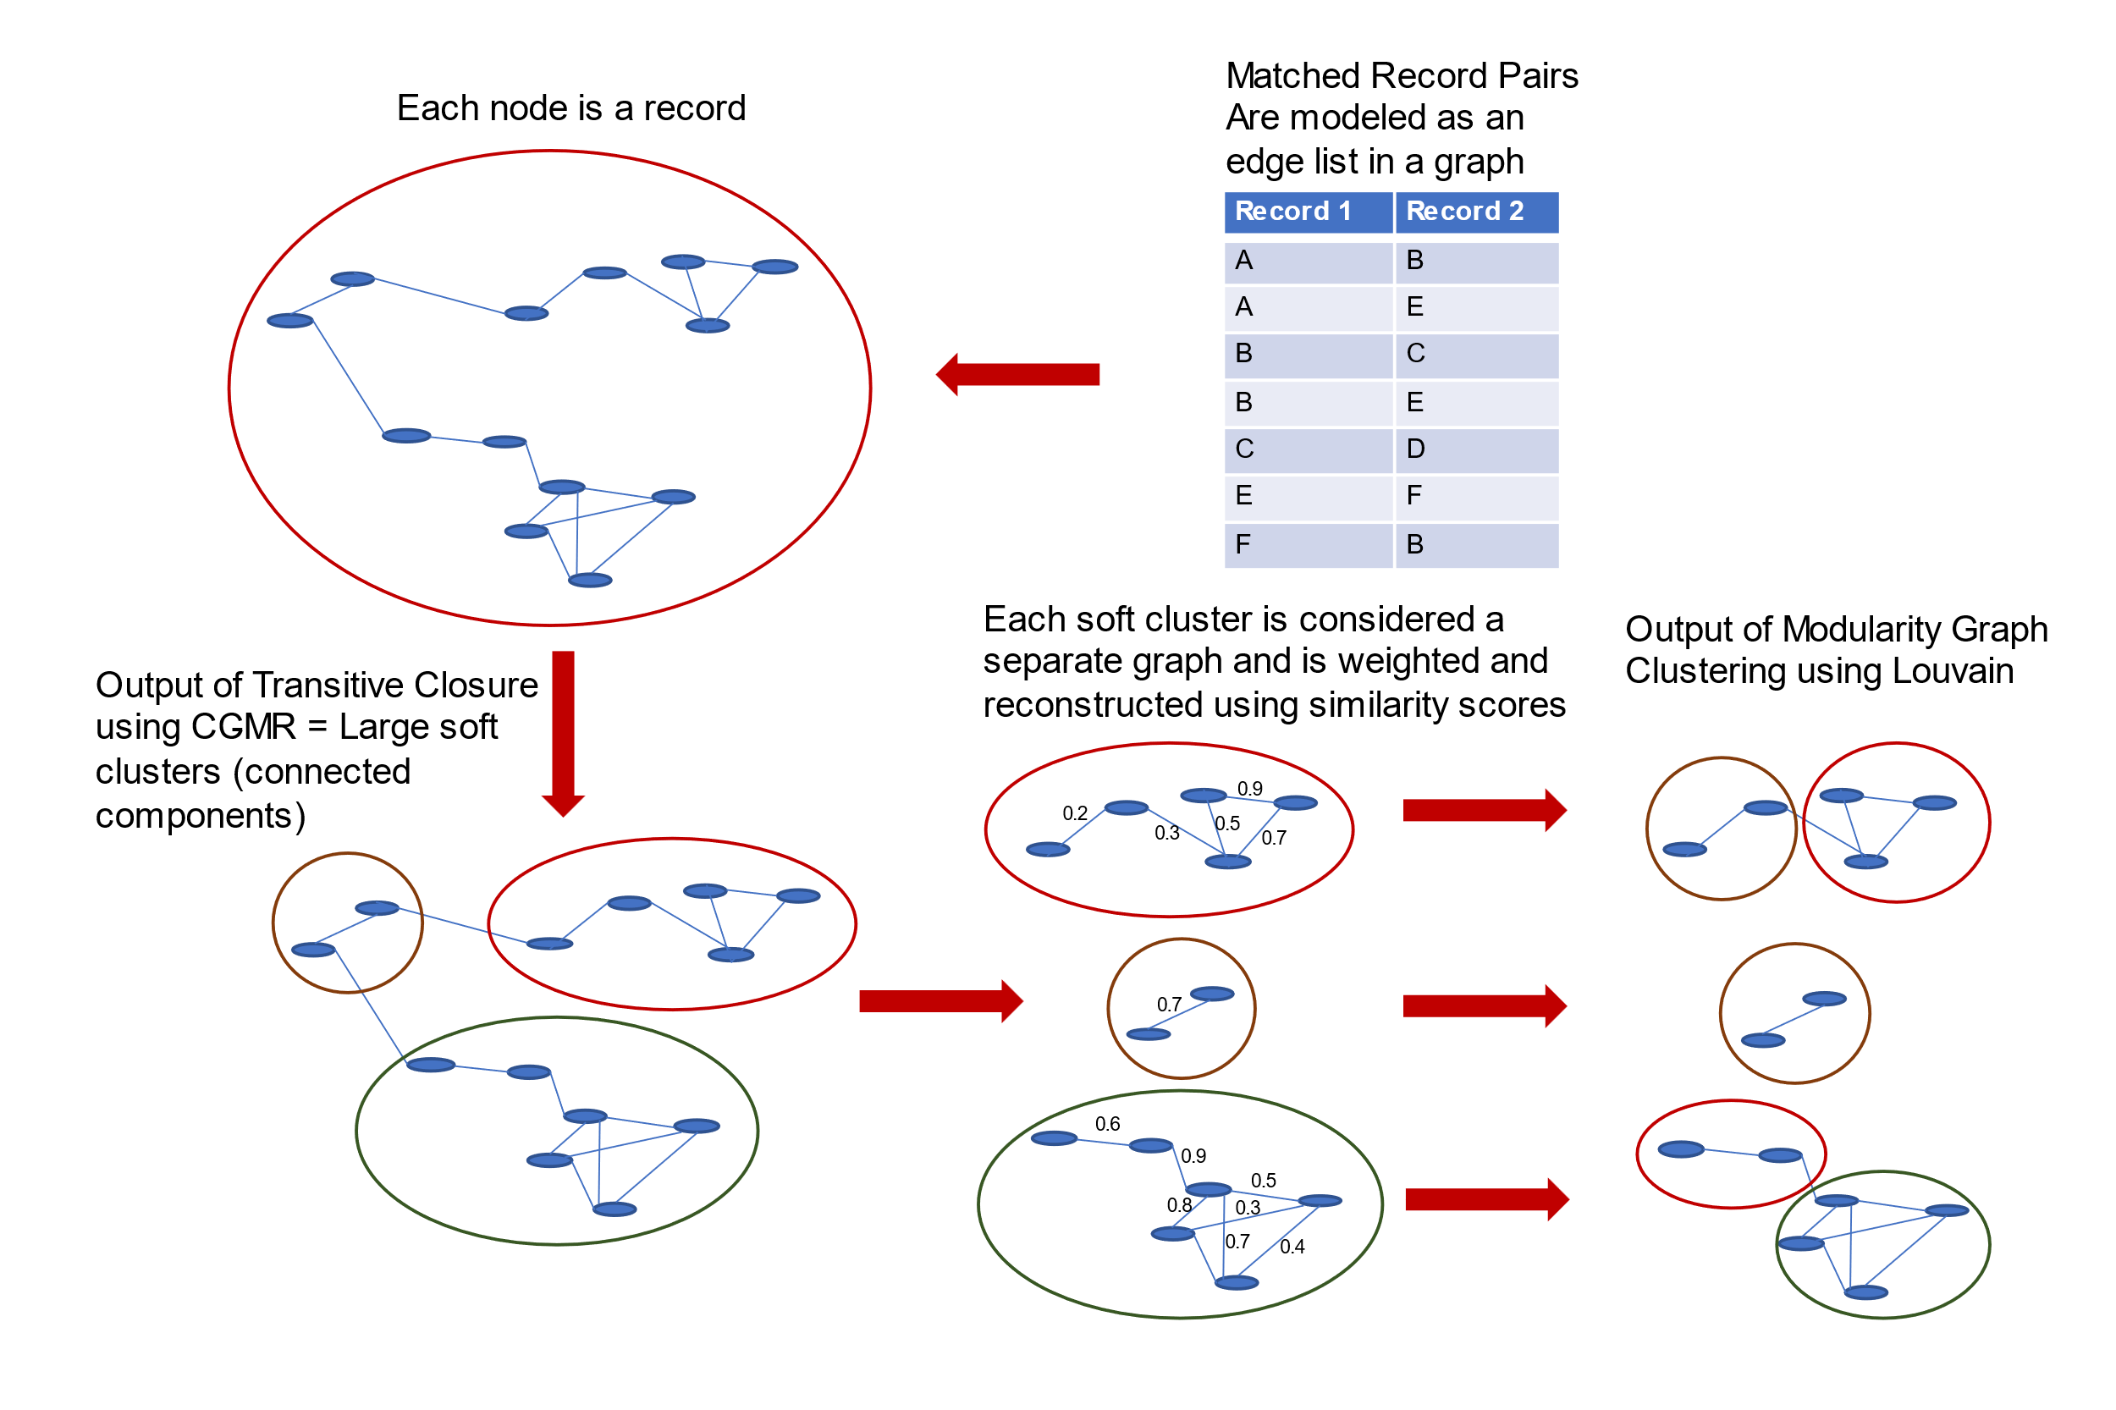
3A. Graph-based Unsupervised Entity Resolution
Notes:
So basically the matched pair records can be seen as an edge list in a graph. The properties of that blocking process help us see it that way because one record might appear in different blocks so that naturally creates a graph. So that was the main observation in the paper. Now if we experiment with different graph clustering methods and adapt them. After many trials I found that a 2-step algorithm where first I apply a graph method used for what they call in database transitive closure that algorithm helps discover large clusters. Then each large cluster I break down using an adapted Louvain community detection algorithm after I apply weights to the graph.

Slide 18
3A. Graph-based Unsupervised Entity Resolution
A920554 | 1 | TIMOTHY | RODRECUS | AARON | 3812 COUNTRY CLUB RD # A | WINSTON SALEM | NC | 27104 | 613-87-4562
A934767 | 2 | TIMOTHY | RODRECUS | AARON | 3812 COUNTRY CLUB RD # A | WINSTON SALEM | NC | 27104 | 613-87-4562
A934513 | 3 | TRACEY | LEIGH | AARON | 176 NOTTIDGE CT | CLEMMONS | NC | 27012 | 954451341
A960838 | 4 | VELMA | JACKSON | AARON | 2599 SHIELDALE DR | WINSTON SALEM | NC | 27107 | 559-64-4215
A948701 | 5 | VERONICA | OLIVIA | AARON | 3401 LOCHURST CT | PFAFFTOWN | NC | 27040 | 335-39-4837
A948701
TIMOTHY
RODRECUS
A920554
CLEMMONS
AARON
A934513
TRACEY
A960838
LEIGH
WINSTON
A934767
SALEM
Notes:
So in the latest work I introduced a combined 2 step hierarchical graph based method by adapting two algorithms to cluster the records coming out of pairwise matching.

Slide 19
3A. Graph-based Unsupervised Entity Resolution
A830349
0.78
A875214
0.78
0.9
A824917
Cluster ID | Reference ID | Reference Body
A824917 | A985464 | LLOYD AARON DEAN 2475 SPICEWOOD DR WINSTON SALEM NC 27106
A824917 | A956423 | LLOYD AARON DEAN 2475 SPICEWOOD DR WINSTON SALEM NC 27106 456 18 2098
A824917 | A956296 | LLOYD AARON D 2475 SPICEWOOD DR WINSTON SALEM NC 27106 456 18 2098
A824917 | A830349 | LLOYD AARON DEAN 2475 SPICEWOOD DR WINSTON SALEM NC 27106 456182098
A824917 | A875214 | ANDREEW AARON STEPHEN 2475 SPICEWOOD DR WINSTON SALEM NC 27106 601 70 6106
A824917 | A824917 | ANDREW AARON STEPHEN 2475 SPICEWOOD DR WINSTON SALEM NC 27106 601 70 6106
0.9
0.8
0.8
0.6
1.0
0.6
0.6
0.8
A956296
0.6
A985464
0.9
0.9
A956423
1.0
Notes:
So in the latest work I introduced a combined 2 step hierarchical graph based method by adapting two algorithms to cluster the records coming out of pairwise matching.

Slide 20

3A. Graph-based Unsupervised Entity Resolution
A830349
A830349
m → is the sum of all edge weights in the graph
A → weight between node i and node j
k → sum of weights of node i neighborhood
0.78
0.78
A875214
A875214
0.78
0.78
0.9
0.9
A824917
A824917
0.8
0.9
0.8
0.9
0.8
0.8
0.6
0.6
1.0
0.6
1.0
A956296
0.6
A956296
0.8
0.6
0.8
0.6
A985464
0.9
A985464
0.9
0.9
0.9
A956423
A956423
1.0
1.0
Notes:
For the evaluation we have a database of synthetic individual data that was created with the intention of being used in entity resolution tasks. That database has multiple rows rereferring to the same person but corrupted on purpose using a statistical error generator.

Slide 21
3A. Evaluation
Results averaged across 18 samples with equivalent parameters
Method | Precision | Recall | F1-Score | Balanced Accuracy
DWM | 72.43 | 57.82 | 62.97 | 76.89
GDWM | 84.78 | 68.62 | 71.47 | 84.31
ModER | 80.308 | 44.24 | 51.691 | 72.113
F1-scores on the Abt-Buy benchmark dataset
Model | F1-Score
Magellan | 43.6
ModER | 58.82
Notes:
For the evaluation we have a database of synthetic individual data that was created with the intention of being used in entity resolution tasks. That database has multiple rows rereferring to the same person but corrupted on purpose using a statistical error generator.

Slide 22
3A. Future Work
Real life use cases: PubMed affiliations, Integrating bibliographic databases
Scalability issues to files more than 100K rows
Notes:
The future work here focuses on scalability to large datasets and applying the method to tasks such as author disambiguation or affiliation disambiguation. For example in the PubMed dataset that I talked about before the affilations are not disambiguated so this can provide a used method to do that.

Slide 23
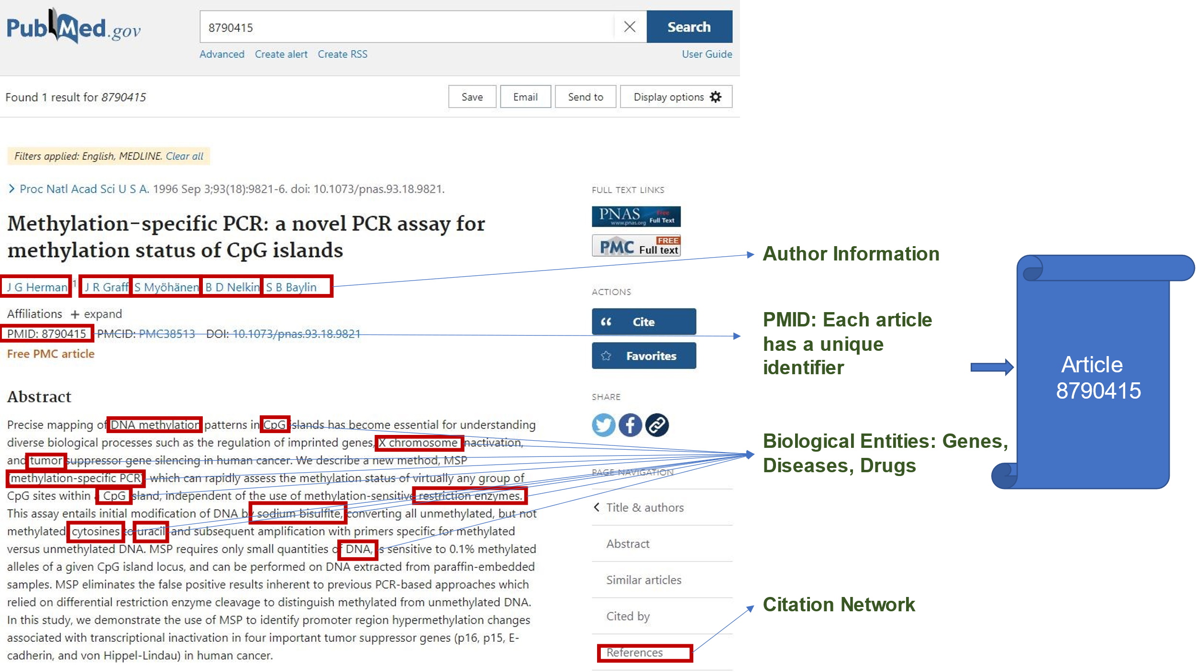
3B. MedGraph
Notes:
As also I mentioned before from each article I extract the extracted bioentites from the PubMed dataset that I described before.

Slide 24
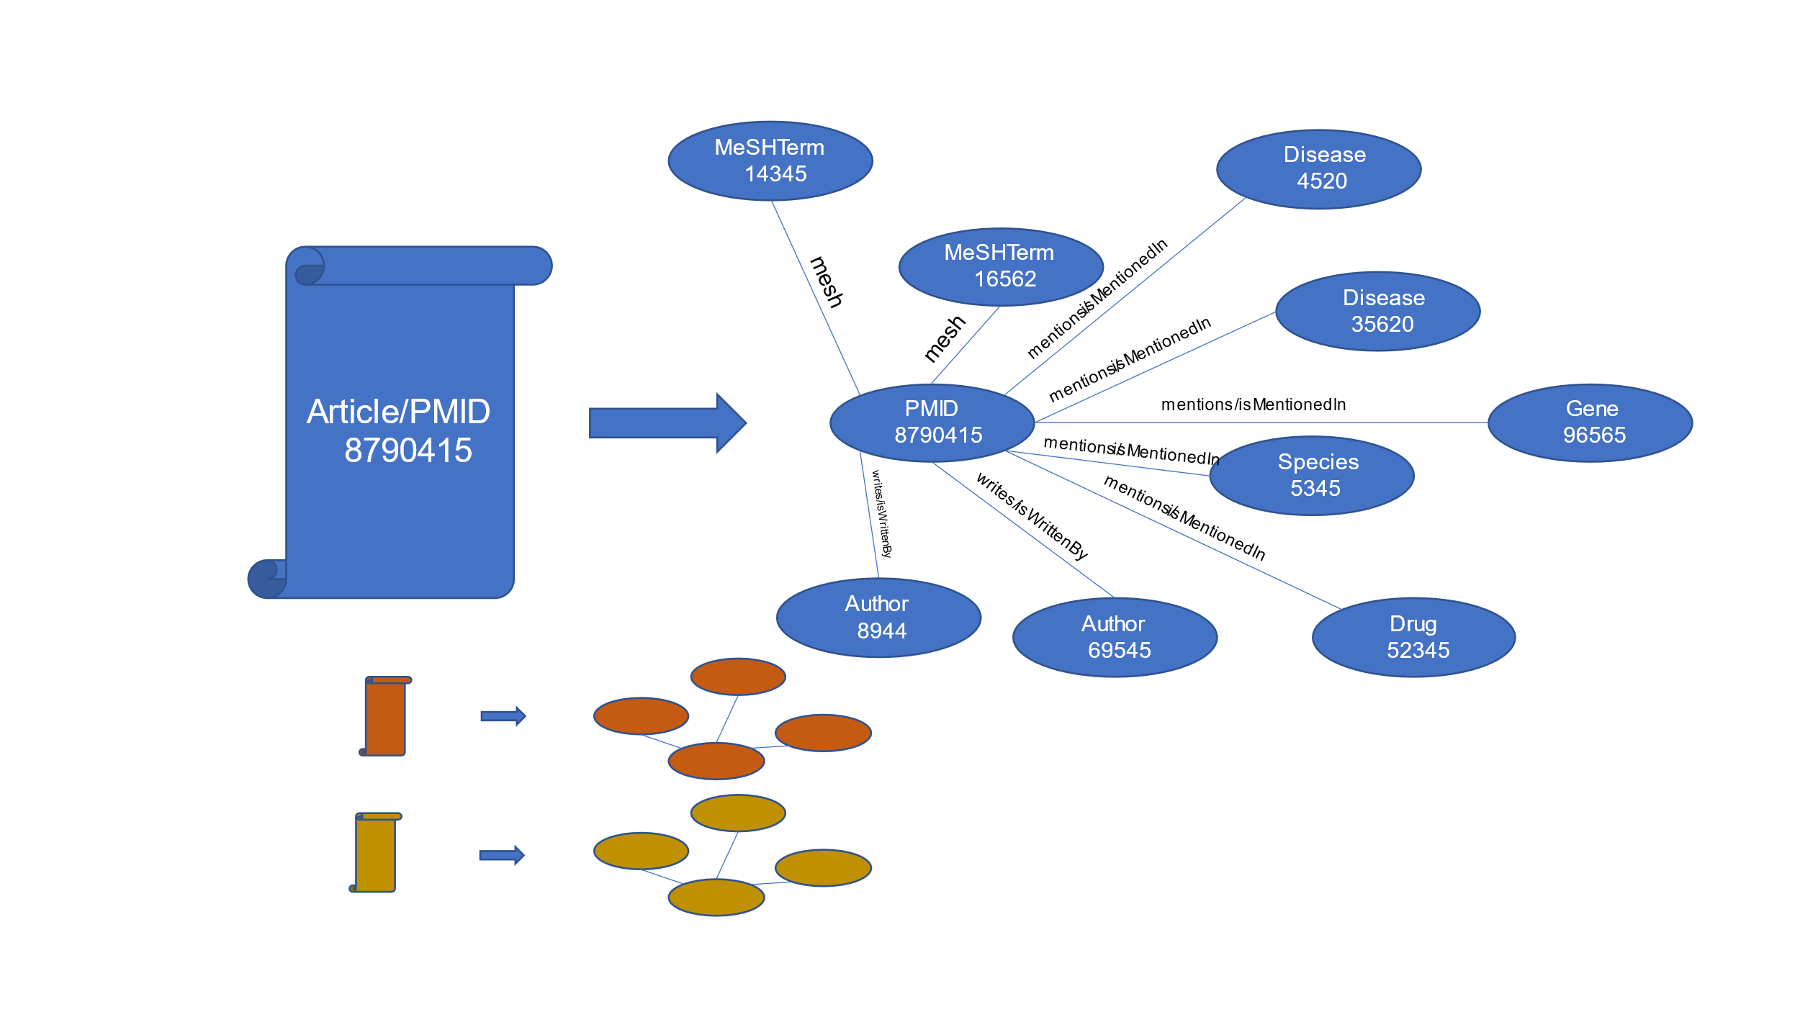
3B. MedGraph
Notes:
And the for each article I model the extracted information as a mini knowledge graph with relationships

Slide 25
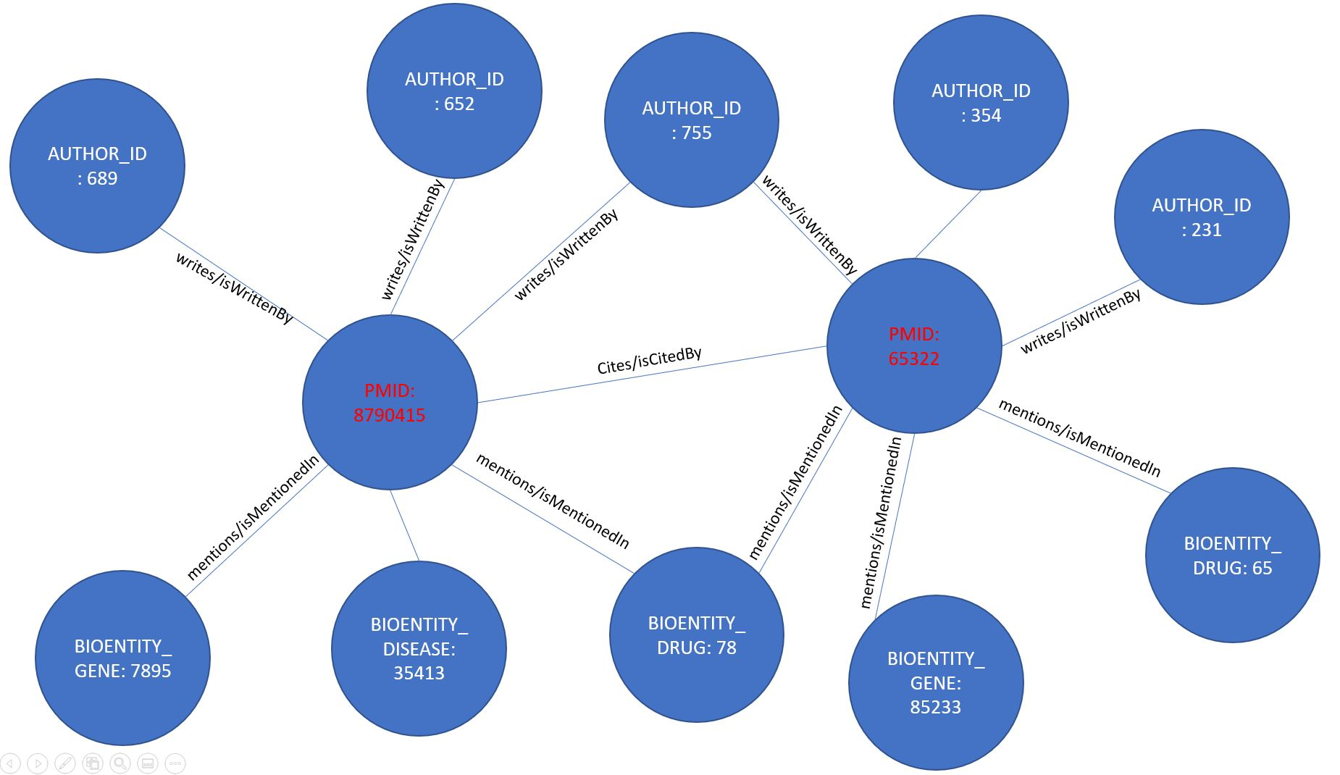
3B. MedGraph
Notes:
Then I integrate those mini knowledge graphs semantically so that its not just co occurrence.

Slide 26
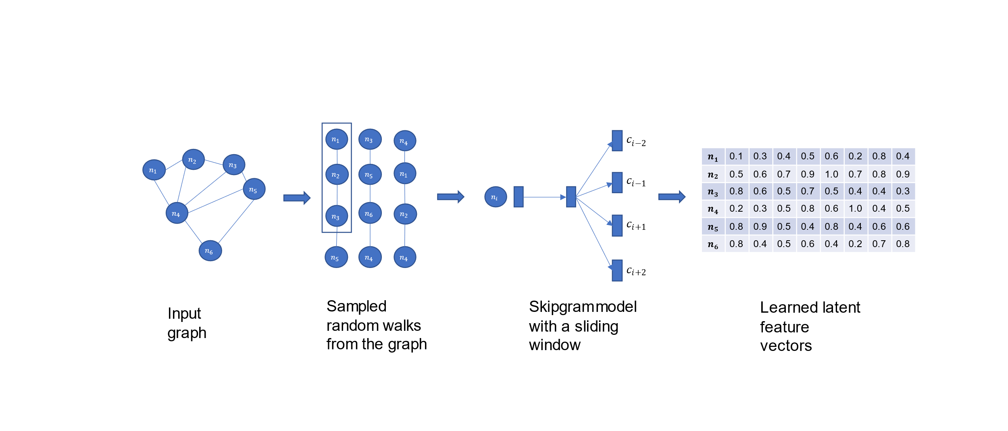
3B. MedGraph
Notes:
Then I apply a graph embedding method Node2Vec to embed the nodes in the knowledge graph. Note the the vectors will encode the structure of the graph.

Slide 27
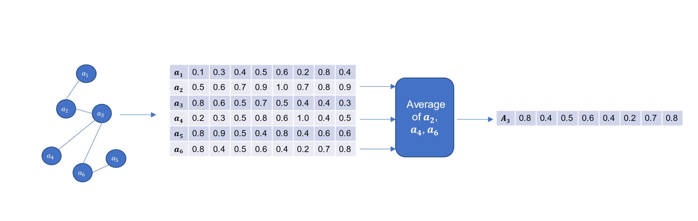
3B. MedGraph
Notes:
Then for each article node I pool the neighborhood embeddings and create one vector for each article.

Slide 28
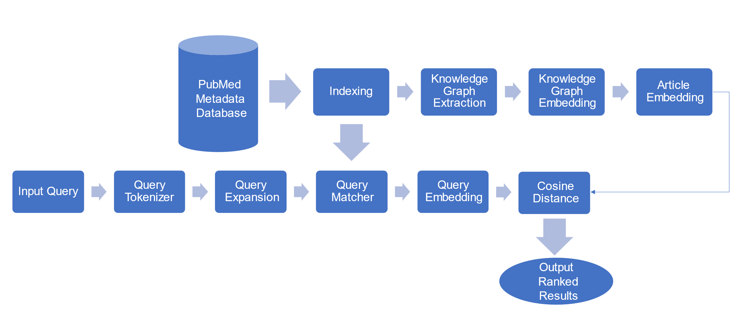
3B. MedGraph
Notes:
For the query I use the extracted bio entities as an index and match the query terms using fuzzy matching to the extracted bio entities and then I find the corresponding nodes in the graph. Pool the corresponding nodes and that gives me one vector for the query. Now I can easly apply a cosince distance metric to find for example the top 10 articles for that query.

Slide 29
3B. Evaluation
Metric | Method | K=1 | K=2 | K=5 | K=10 | K=25 | K=50 | K=75 | K=100 | K=150 | K=250 | K=500 | K=1000
Recall | TFIDF | 0.053 | 0.062 | 0.078 | 0.113 | 0.177 | 0.197 | 0.202 | 0.207 | 0.217 | 0.22 | 0.22 | 0.22
 | MedGraph | 0.227 | 0.245 | 0.297 | 0.392 | 0.545 | 0.646 | 0.693 | 0.726 | 0.749 | 0.846 | 0.931 | 0.976
Precision | TFIDF | 0.467 | 0.4 | 0.307 | 0.293 | 0.248 | 0.171 | 0.136 | 0.117 | 0.1 | 0.064 | 0.032 | 0.016
 | MedGraph | 0.867 | 0.667 | 0.507 | 0.453 | 0.336 | 0.248 | 0.202 | 0.172 | 0.134 | 0.103 | 0.064 | 0.034
F1-Score | TFIDF | 0.081 | 0.083 | 0.09 | 0.122 | 0.161 | 0.138 | 0.118 | 0.107 | 0.097 | 0.074 | 0.046 | 0.026
 | MedGraph | 0.279 | 0.245 | 0.235 | 0.276 | 0.282 | 0.253 | 0.221 | 0.197 | 0.161 | 0.134 | 0.095 | 0.056
MAP | TFIDF | 0.467 | 0.383 | 0.272 | 0.221 | 0.184 | 0.177 | 0.175 | 0.174 | 0.174 | 0.173 | 0.173 | 0.173
 | MedGraph | 0.867 | 0.55 | 0.284 | 0.168 | 0.077 | 0.041 | 0.028 | 0.021 | 0.014 | 0.009 | 0.004 | 0.002
Notes:
Ofcourse I cannot do that on a dataset of 31 million articles I simply don’t have the resources so I figured I can do that on a proof of concept dataset. So first I found dates of published articles that are in English and in MEDLINE to give me around 2000 articles. I then use the 2000 articles to extracted a citation network. Which yielded 100K articles. I then Create the knowledge graph from those 100K articles which yielded 500K nodes and 2M articles. I then applied the framework I described before and compared with a traditional TFIDF ranking method using metrics like precision, recall, F1, MAP.

Slide 30
3B. Future Work
A/B testing
Run on the full PubMed dataset
Notes:
I did not do A/B testing so that is in the future work. Also I would like to run this on the full PubMed dataset but again I don’t have the resources.

Slide 31
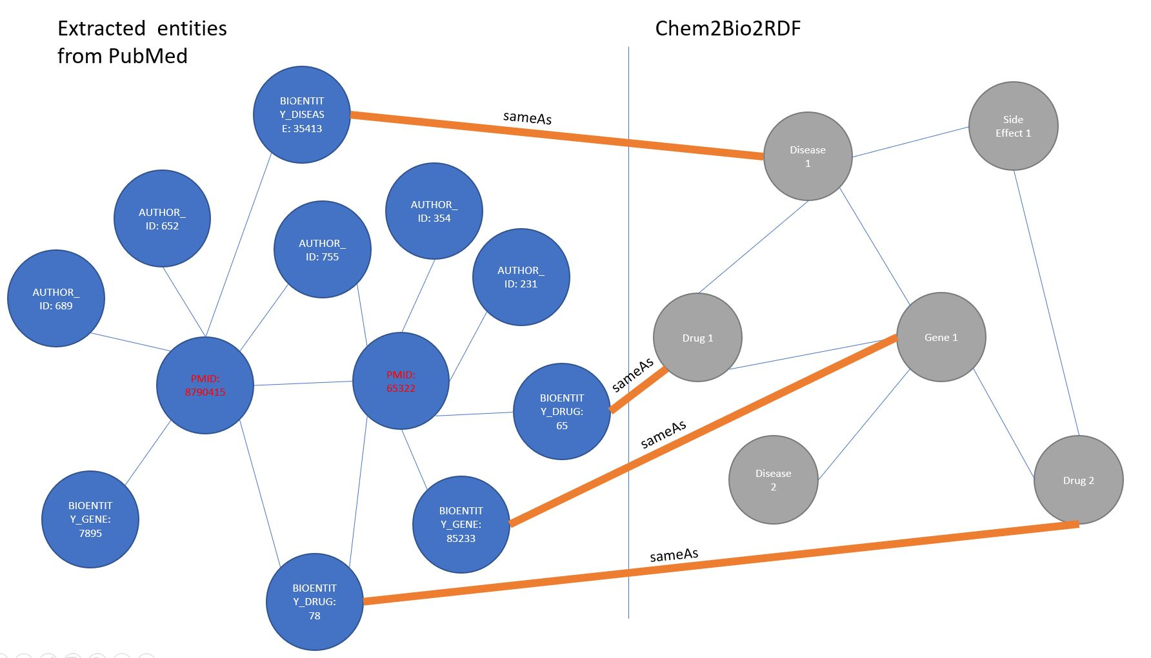
3B. Future Work
Notes:
One more idea is that that dataset could be enriched using a semantic dataset like Chem2Bio2RDF. However it is quiet a task. I tried before. Matching the entities is very difficult without a dictionary or a lookup. My guess is if that dataset somehow worked it will be superefficient for searching the literature.

Slide 32
4. Closing Remarks
A future vision might be of having systems where you can feed multiple articles and the out is some insights or hypotheses extracted from the articles automatically
Relation extraction, entity resolution and recognition are crucial in knowledge discovery especially in the biomedical field
Graph and network methods in combination with natural language processing are incredibly useful in knowledge discovery and data integration tasks especially in biomedicine
Notes:
Finally, I am very interested in this postdoc position and even though I don’t know everything in biomedical text mining and knowledge discovery I promise that I am passionate about this field and have the intention to produce good research in it.

Slide 33
Thank you
Questions
iaebeid@ualr.edu

