Slide 1
Methods in Biomedical Knowledge Discovery, Information Integration & Data Mining using Graph Theory and Natural Language Processing
Islam (Akef) Ebeid
PhD Candidate @ University of Arkansas at Little Rock – Expected May 2022
iaebeid@ualr.edu
Notes:
Thank you so much for arranging this meeting Dr. Bozdag. I am truly honored to meet with you. My name is Akef, and I am in my last semester as a PhD candidate at the University of Arkansas at Little Rock. My PhD is in Computer and Information Science. I am expecting to graduate this coming may and currently I am working on my dissertation. And I am here today to introduce myself and my research for a potential postdoc position with your respected and highly productive research group.

Slide 2
Content
Introduction
Research
  Data Integration, Information Curation & Entity Resolution
  Biomedical Knowledge Discovery, Information Retrieval & Data Mining
  HCI, UX, Visualization & Eye Tracking
Methods
  Graph-based Clustering for Unsupervised Entity Resolution
  MedGraph: Biomedical Information Retrieval using Knowledge Graphs
Closing Remarks
Notes:
So today I will be going over a quick introduction. I will go over my current and previous work. I will also spend some time describing methods I came up with in current research. And finally will describe some closing remarks. After that I will be happy to take any questions.

Slide 3
1. Introduction
I finished coursework PhD Information Studies → UT Austin→ Texas, USA (2017-2020)
M.Sc. Information Science → UA Little Rock → Arkansas, USA (2021)
M.Sc. Information Technology → Arkansas Tech → Arkansas, USA (2013)
B.Sc. Electrical and Computer Engineering → ASU → Cairo, Egypt (2008)
AbbVie → Summer 2020
Texas Advanced Computing Center → Summer 2018
Intel → Summer 2016,2017
Arkansas.gov → 2013,2014
Notes:
So, since I started my PhD, I was always trying to apply my research to benefit the biomedical field. Also it was a main focus at the lab that I was part of at the time. I truly enjoy interdisciplinary, collaborative and applied research. I also enjoy the idea of automated knowledge discovery and mining from text especially bibliographical text and unstructured data such as graphs and networks. So as far as education. I also earned 2 masters degrees in computer and information science and a bachelors degree in ECE. In addition I spent some time and finished coursework at the UT Austin at the School of Information as a PhD student.
As far as professional experience I interned in several places like Abbvie, Intel, and The Texas Advanced Computing Center in addition to being a software developer at Arkansas.gov.

Slide 4
2. Research
  Data Integration, Information Curation & Entity Resolution
  Biomedical Knowledge Discovery, Information Retrieval & Data Mining
  HCI, UX, Visualization & Eye Tracking
Notes:
first I will start by my current research and my dissertation work which is mainly in using graph and network algorithms in data integration especially in entity recognition and resolution in datasets that are not naturally a graph using nlp methods. The second line of research is biomedical information retrieval and data mining especially using knowledge graph and network embedding models. Third is a line of research in using human computer interaction and user studies in addition to eye tracking and visualization also to understand or enhance search experiences.

Slide 5
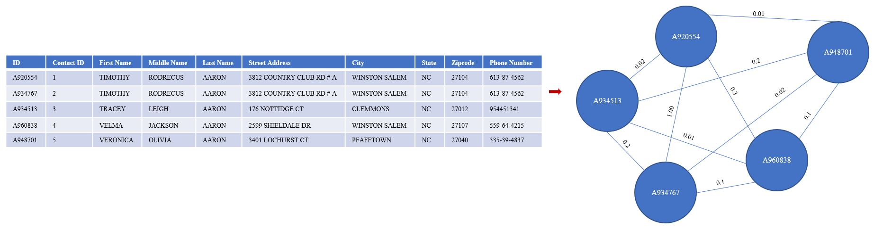
2A. Data Integration & Entity Resolution (Current)
[Journal Article - In progress] Ebeid I.A., Talburt J., Siddique Md. (2022) Unsupervised automated schema-agnostic entity resolution and data curation using a graph-based hierarchical record clustering approach. Frontiers in Big Data
[Full Paper] Ebeid I.A., Talburt J., Siddique Md. (2021) Graph-based hierarchical record clustering for unsupervised entity resolution. Accepted at the 19th International Conference on Information Technology: New Generations ITNG
[Journal Article] Ma, J., Ebeid, I. A., de Wit, A., Xu, M., Yang, Y., Bekkers, R., & Wiepking, P. (2020). Computational social science for nonprofit studies: Developing a toolbox and knowledge base for the field. VOLUNTAS: International Journal of Voluntary and Nonprofit Organizations
Notes:
One project related to the third paper that led me to this line of research is when I was part of a team where we integrated multiple heterogenous bibliographical databases used in nonprofit studies by finding tunning BERT for text classification on the metadata of the articles in the database. That work was part of a project that aimed at introducing machine learning and nlp to researchers in the computational social science field. That led me to work on entity resolution especially unsupervised and automated entity resolution. In the work related to the second paper which just got accepted at the ITNG conference I focus on the problem of record clustering using a graph algorithm to optimize a heuristic known as modularity after pairwise fuzzy matching of records in a merged datafile of structured data. Graph clustering algorithms are very useful to that problem because of the transitivity property. And in an upcoming work in progress article which is the first paper I am expanding the framework that I introduced in the first paper. I will discuss more details on the methods used in the 1st and 2nd papers work also later in the talk.

Slide 6
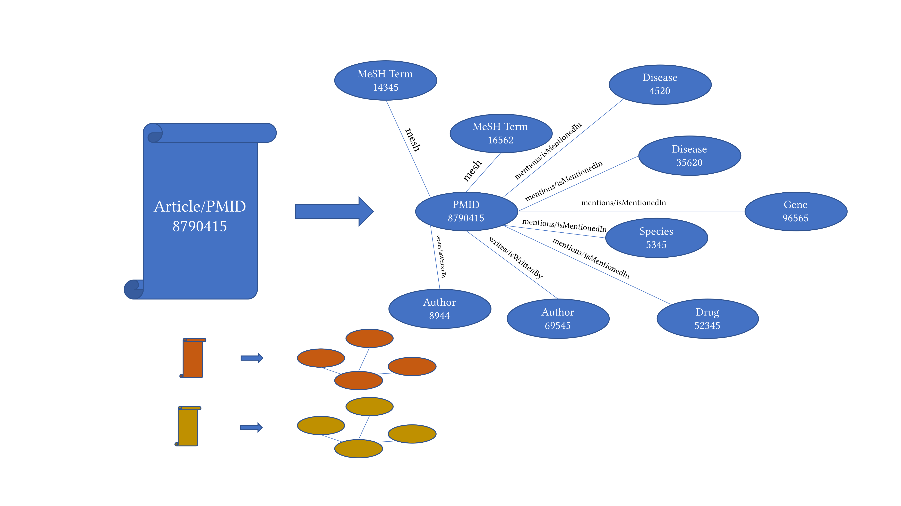
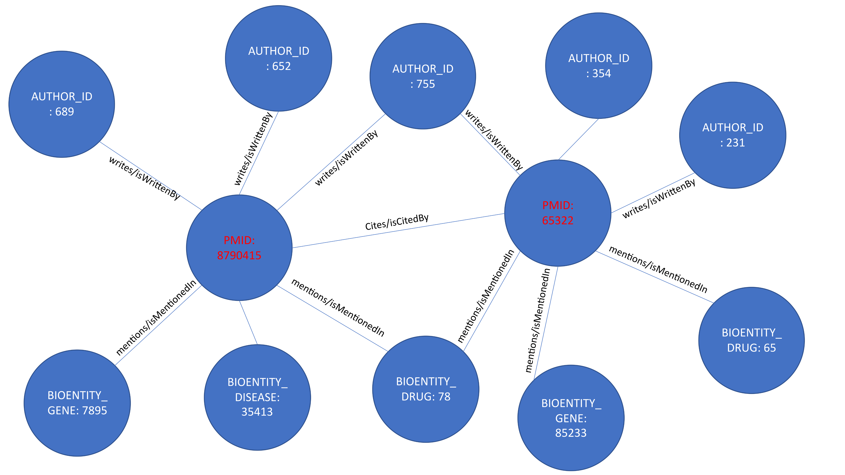
2B. Biomedical Information Retrieval and Mining (Current)
[Regular Paper] Ebeid I.A., Pierce E. (2022) MedGraph: An experimental semantic information retrieval method using knowledge graph embedding for the biomedical citations indexed in PubMed. Accepted at the 19th International Conference on Information Technology: New Generations ITNG
[Unpublished report] Ebeid I.A. (2020) Knowledge Profiling Using Biomedical Word Embedding and Knowledge Graph
[Journal Article] Xu, J., Kim, S., Song, M., Jeong, M., Kim, D., Kang, J., Rousseau, J., Li, X., Xu, W., Torvik, V., Bu, Y., Chen, C., Ebeid, I. A. et al. (2020) Building a PubMed knowledge graph. Sci Data.
Notes:
The second line of research that I am working on in parallel with my dissertation is biomedical information retrieval and mining. I got really interested in biomedical information retrieval and mining when with my previous advisor I started contributing to a project where we used BioBERT, to extract and resolve mentions of biological entities such as names of species, drugs, diseases, genes, proteins and mutations for the entire corpus of PubMed’s metadata. Not just that also names of authors were disambiguated in addition to related NIH grant projects for each article and their PIs. The goal was to build a complete knowledge graph from the entities extracted from PubMed but of course biomedical relation extraction is not as reliable as needed to be. I always thought that that dataset was incredibly useful especially if it was somehow utilized in a search algorithm. So that was the paper titled Building a PubMed knowledge graph. In another unpublished report titled knowledge profiling using biomedical word embedding and knowledge graph I tried to use the extracted entites from each article and replace each mention of them in the abstract and the title with a unique identifier for each entity and run word2vec. And that could be applied to provide a search capability to find related bioentites for each author when queried. In the latest paper MedGraph I wanted to somehow marry the ideas of extracting a knowledge graph from all the articles of PubMed with graph representation learning and knowledge graph embedding models and also graph neural networks. Those models are very useful and provide robust embeddings that are capable of encoding not just the graph structure but also relationships and heterogenous entity types. I provided a proof ofconcept on a subset of the articles with a simple search engine to rank the documents after converting them to a knowledge graph and embedding the graph using cosine similiarty. I will talk later about that.

Slide 7
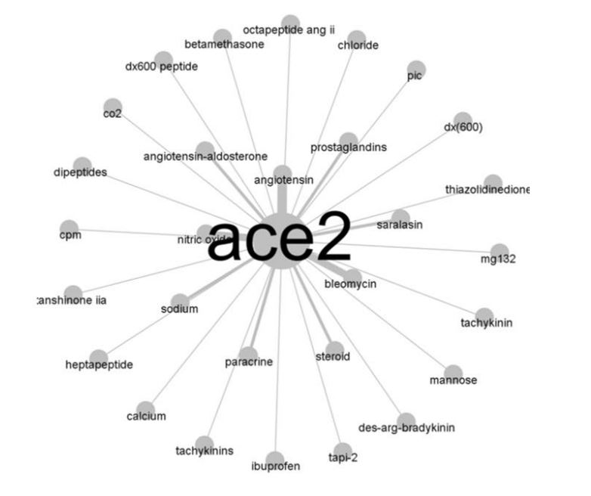
2B. Biomedical Information Retrieval and Mining (Current)
[Journal Article] Yu, Q., Wang, Q., Zhang, Y., ..., Ebeid, I. A. et al. (2021) Analyzing knowledge entities about COVID-19 using entity metrics. Scientometrics
[ACM KDD Workshop Paper] Chen, C., Ebeid, I. A., Bu, Y., & Ding, Y. (2020) Coronavirus Knowledge Graph: A Case Study. arXiv preprint.
Notes:
During that time when the pandemic started I contributed to a couple of projects in the first titled Coronairus knowledge graph a case study it was a KDD workshop paper. We extracted a cooccurance network of drugs, genes, disease names related to Covid from the CORD-19 dataset. We used BioBert fine tuning again to extract the names of bioentities from the CORD19 dataset which was available on Kaggle. For each drug we extract and ego centric graph and apply frequency metrics to find the most similar entities to it. Also we used a similar approach in the paper titled Analyzing knowledge entities about COVID 19 using entity metrics.

Slide 8
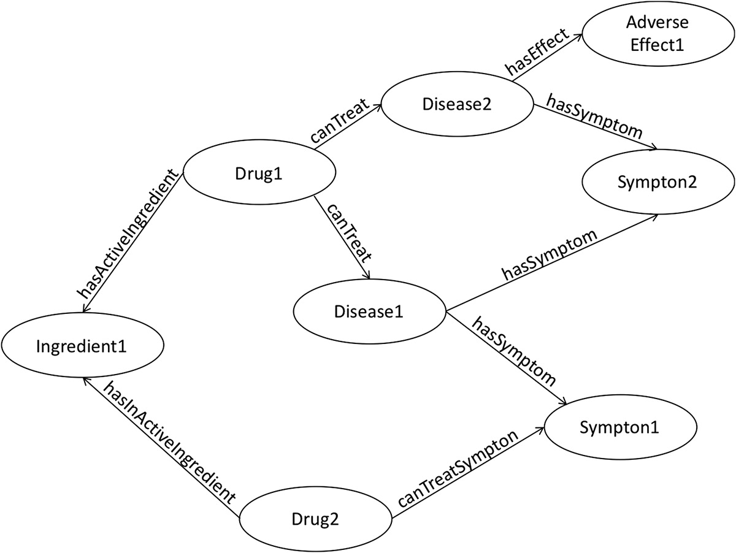
2B. Biomedical Information Retrieval and Mining (Current)
[Short Paper] Ebeid I.A., Hassan M., Wanyan T., Roper J., Seal A., Ding Y. (2020) Biomedical Knowledge Graph Refinement and Completion Using Graph Representation Learning and Top-K Similarity Measure. iConference.
Chen, B., Dong, X., Jiao, D., Wang, H., Zhu, Q., Ding, Y., & Wild, D. J. (2010). Chem2Bio2RDF: a semantic framework for linking and data mining chemogenomic and systems chemical biology data. BMC bioinformatics, 11(1), 1-13.
Notes:
Finally in this line of research I collaborated with AbbVie Inc. the drug company. There is this dataset called Chem2Bio2RDF. It’s a knowledge graph that links multiple data sources of bioentities such as PDB and PubChem and all the entities are resolved and semantically link. However it is incomplete. So we tested a link prediction method using multiple knowledge graph embedding and vector operations on the extracted emebddings to estimate the missing links in the knowledge graph.

Slide 9
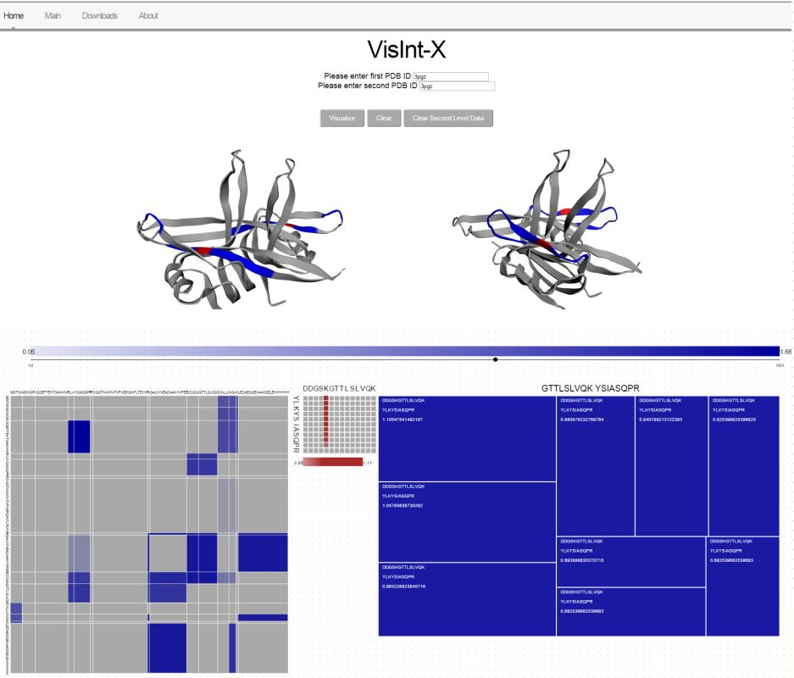
2C. HCI, UX, Visualization and Eye tracking (Previous)
[Short Paper] Ebeid, Islam Akef and Cruz-Neira, Carolina and Jaiswal, Mihir and Zybaylov, Boris. (2016) Protein Chemical Cross-linking/Mass Spectrometry: From raw data to fully immersive visualizations. Electronic Imaging.
Notes:
My third theme or topic that I worked in is HCI, UX, Visualization and Eyetracking. It started back in 2015/16 I worked on a collaboration with the department of bioinformatics. The bioinformatics folks had an algorithm that produces sequences of letters describing the interactions of molecules when two proteins interact I provided a visualization tool that was able to visualize those interactions hieracrhcualy on different levels in a 2D and 3D approaches. It was helpful to them and it is being used. Later when

Slide 10
2C. HCI, UX, Visualization and Eye tracking (Previous)
[Unpublished Report] Ebeid, I. A., (2019) Promoting the evaluation of the credibility and the quality of online health information through online web applications
[Best Short Paper Award] Ebeid, I. A., Bhattacharya, N., Gwizdka, J., & Sarkar, A. (2019). Analyzing Gaze Transition Behavior using Bayesian Mixed Effects Markov Models. Proceedings of the 11th ACM Symposium on Eye Tracking Research & Applications
[Poster Note] Ebeid, I. A., & Gwizdka, J. (2018). Real-time Gaze Transition Entropy. Proceedings of the 2018 ACM Symposium on Eye Tracking Research & Applications
Notes:
Later when I first moved to Texas I worked in eye tracking and how to extract useful measures from the movements of eyes in order to correlate it to other self reported measures used in User Experience Studies especially in health information seeking. So that lead to the 2 published papers and an unpublished reports where I actually used eyetracking to evaluate the design of a search engine aimed to help in health information seeking.

Slide 11
3. Methods
Graph-based entity profiling for unsupervised entity resolution
MedGraph: An experimental semantic information retrieval method using knowledge graph embedding for the biomedical citations indexed in PubMed
Notes:
So first I will talk about graph based unsupervised entity resolution which is my dissertation work.

Slide 12
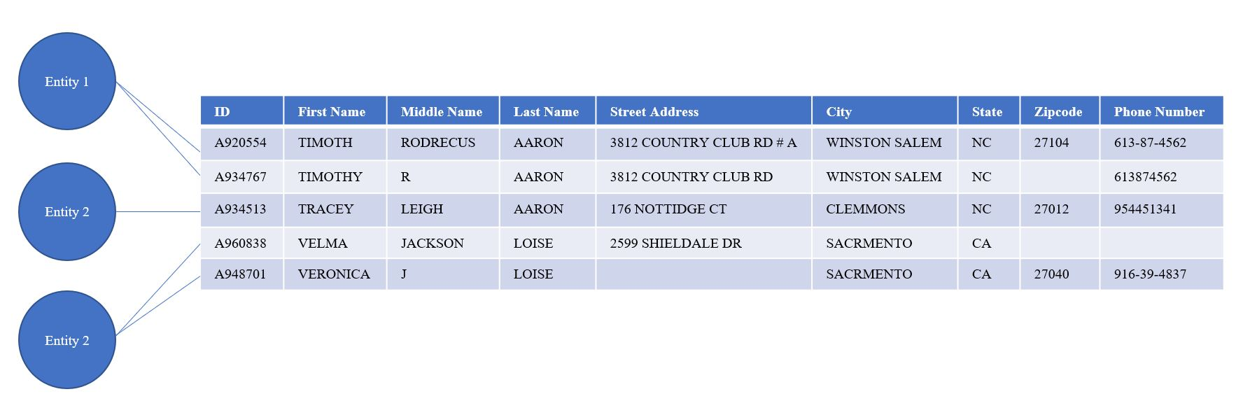
3A. Graph-based Unsupervised Entity Resolution
Notes:
But first, let me start from the top and explain entity resolution and then narrow it down to the problem at hand. Entity resolution is a data quality problem that appears in data curation processes. It refers to finding records in a database or a data file that refer to the same real-world entity. Other term variants can be entity matching, record linkage, deduplication, or the merge/purge problem. As you can see in the figure, this is an excerpt of a merged data file. And I am saying merged because usually data like that come in multiple files. Hence, we typically merge all those files in one. Sometimes using a single layout and sometimes just merging without knowing the specific layout of the metadata. There is one layout in this figure, meaning that all the data rows are organized in the same fields. However, some of those rows might be identical to each other, and some might be a little similar yet ambiguous. Ambiguous in the sense that some of the fields might be identical and some might not be. This brings up the question of which rows in this data file might refer to the same person. Of course, just by looking, we can say that the first and the second rows most probably refer to the same person, and the fourth and the fifth rows also might refer to another same person. But of course, to scale this on large datasets, we need an automated way of clustering those records together just as we did with our human eyes. So that is in a nutshell what the task of entity resolution.

Slide 13
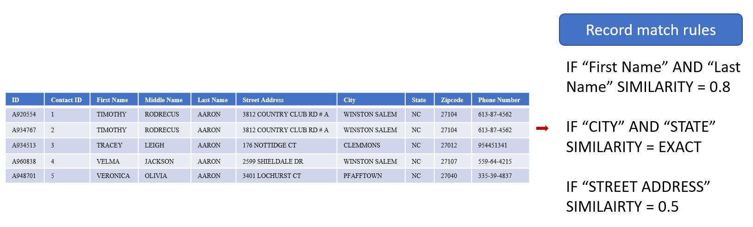
3A. Graph-based Unsupervised Entity Resolution
Notes:
The core of entity resolution is text similarity and fuzzy matching. The idea is that if we can compare each record in a file, we will get a score for each pairwise comparison. Based on those scores, probabilities can be derived, indicating whether each pair of rows match. Text similarity approaches could be applied in many ways. Traditional rule-based methods rely on handcrafting rules based on the semantics, the context, and the schema of the dataset. Matching probabilities are then computed based on the handcrafted rules in combination with syntactic similarity or string similarity. Previously mentioned approaches could be referred to as supervised methods in entity resolution because they rely on human input to function correctly. Supervised techniques are characterized by producing robust results.

Slide 14
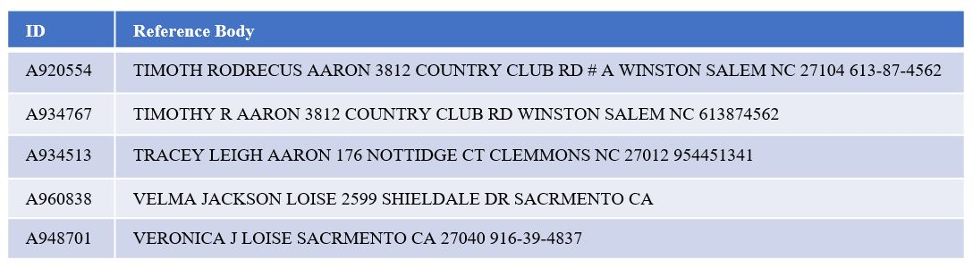
3A. Graph-based Unsupervised Entity Resolution
Notes:
On the other hand, as organizations' data assets increase in volume and size, the need for automating data curation and supporting processes such as entity resolution becomes more crucial. Automating entity resolution to become fully unsupervised requires relying only on syntactic string and text similarity measures and ignoring prior knowledge and hand-crafted rules about the dataset's schema. The task, however, is muddled with challenges and scalability issues. Since the unsupervised entity resolution relies on syntactic string similarity, a naive approach of pairwise comparison will have quadratic complexity. Notice here that I removed the columns and field names and combined all the tokens in one body ignoring any schema or metadata. Now you can imagine just comparing every record in the dataset to the other and how that approach would be problematic for large-scale data.

Slide 15
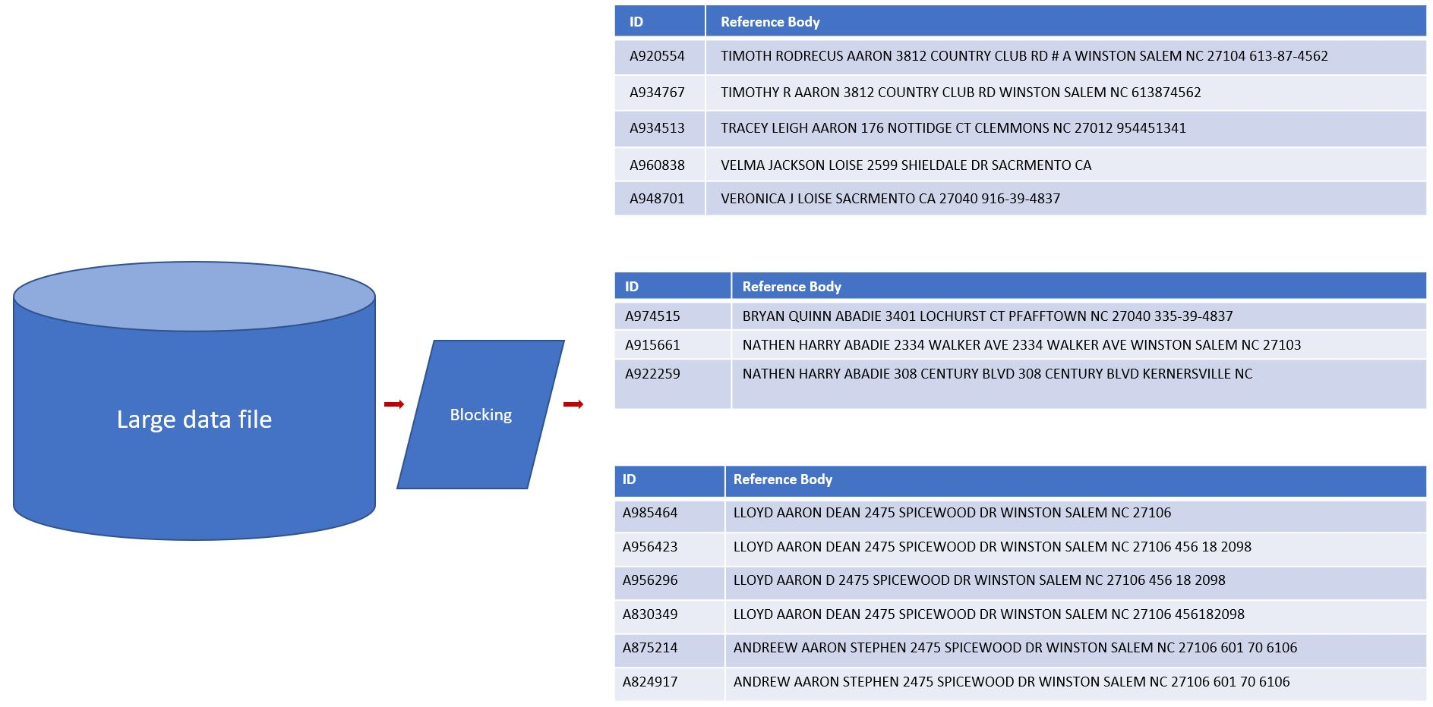
3A. Graph-based Unsupervised Entity Resolution
Notes:
The solution to that in unsupervised entity resolution is called blocking. Blocking refers to quick and dirty techniques that first avoid using computationally expensive string comparisons and second would reduce the number of pairwise comparisons in the data file by dividing the data file into blocks.
As you can see in the figure a large data file is broken down into references that have the potential of referring to the same entity. Block sizes don’t have to be equal.
Now each block can be processed separately where pairwise string similarity can be applied with less computational cost and possibly in parallel. Blocking is typically based on the assumption that two records that might refer to the same entity will share at least one token. Other blocking techniques include locality sensitive hashing and random sampling.

Slide 16
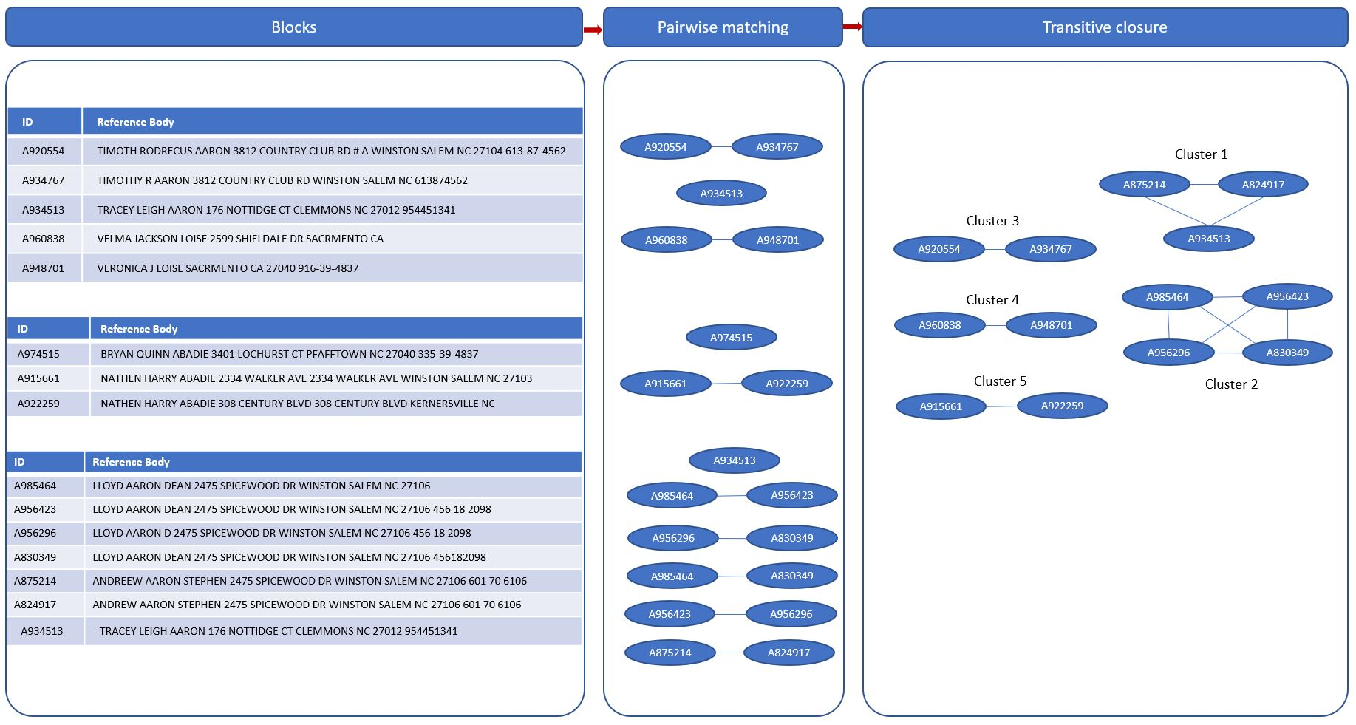
3A. Graph-based Unsupervised Entity Resolution
Notes:
The matched pairs from each processed block are then combined and clustered. The clustering process aims at resolving any conflicts in pairwise matching and find records that indirectly match. The final clusters then represent the matched and resolved entity records with the highest matching probabilities.
As you can see in the figure the blocks from the previous slide are passed to a pairwise matching process on each block separately. Each ellipse in the image represents one unique record. The paired records are passed to a clustering process where pairs are identified where common records appear in multiple pairs. In addition records that match each other indirectly are identified to form the entity clusters.

Slide 17
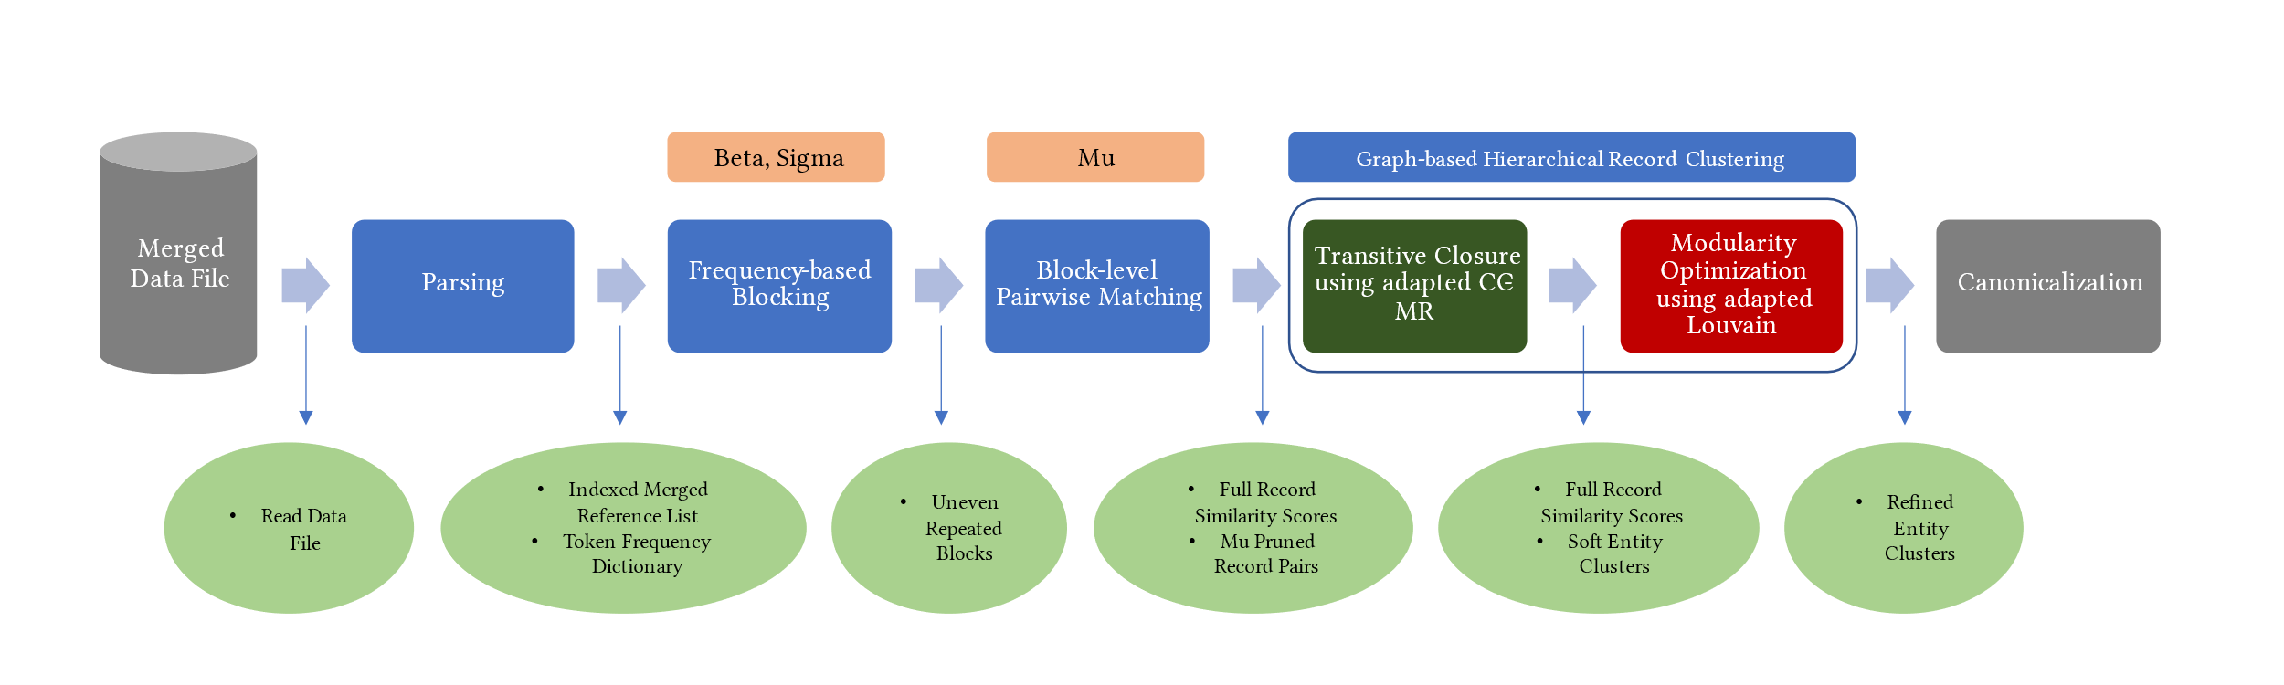
3A. Graph-based Unsupervised Entity Resolution
Notes:
So in the latest work I introduced a combined 2 step hierarchical graph based method by adapting two algorithms to cluster the records coming out of pairwise matching.

Slide 18
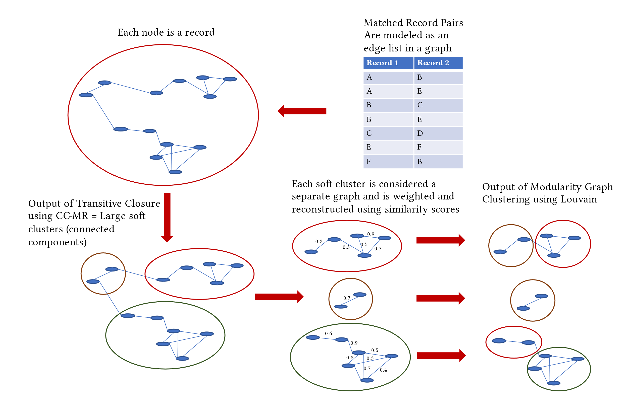
3A. Graph-based Unsupervised Entity Resolution
Notes:
So basically the matched pair records can be seen as an edge list in a graph. The properties of that blocking process help us see it that way because one record might appear in different blocks so that naturally creates a graph. So that was the main observation in the paper. Now if we experiment with different graph clustering methods and adapt them. After many trials I found that a 2 step algorithm where first I apply a graph method used for what they call in database transitive closure that algorithm helps discover large clusters. Then each large cluster I break down using an adapted Louvain community detection algorithm after I apply weights to the graph.

Slide 19
3A. Evaluation
Synthetic data set with errors and known ground truth clusters
Measure: precision, recall, F1, balanced accuracy
Notes:
For the evaluation we have a database of synthetic individual data that was created with the intention of being used in entity resolution tasks. That database has multiple rows rereferring to the same person but corrupted on purpose using a statistical error generator.

Slide 20
3A. Future Work
Real life datasets: PubMed affiliations, Integrating bibliographic databases
New algorithm for similarity scoring and spectral graph clustering instead of modularity
Scalability issues to files more than 100K rows
Notes:
The future work here focuses on scalability to large datasets and applying the method to tasks such as author disambiguation or affiliation disambiguation. For example in the PubMed dataset that I talked about before the affilations are not disambiguated so this can provide a used method to do that.

Slide 21
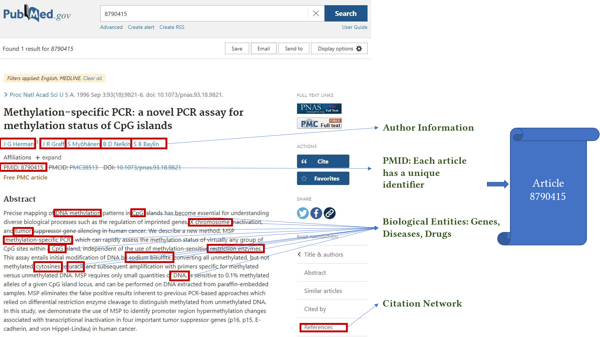
3B. MedGraph
Notes:
As also I mentioned before from each article I extract the extracted bioentites from the PubMed dataset that I described before.

Slide 22
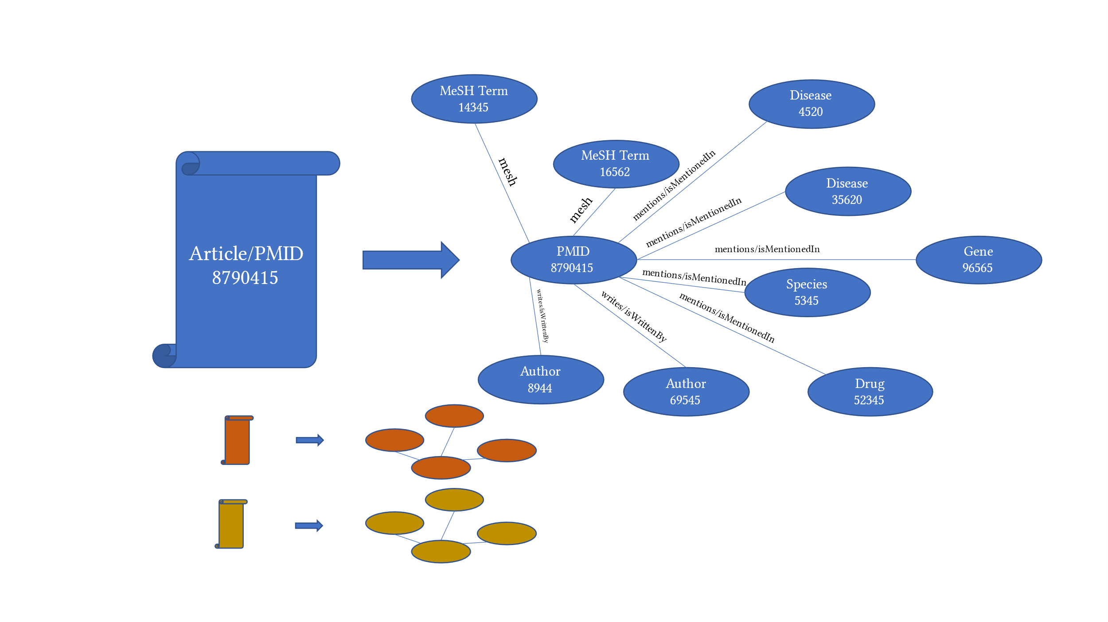
3B. MedGraph
Notes:
And the for each article I model the extracted information as a mini knowledge graph with relationships

Slide 23
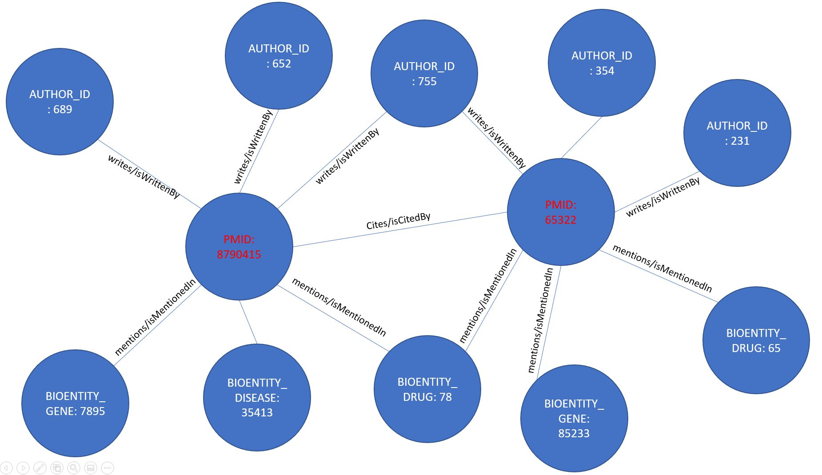
3B. MedGraph
Notes:
Then I integrate those mini knowledge graphs semantically so that its not just co occurrence.

Slide 24
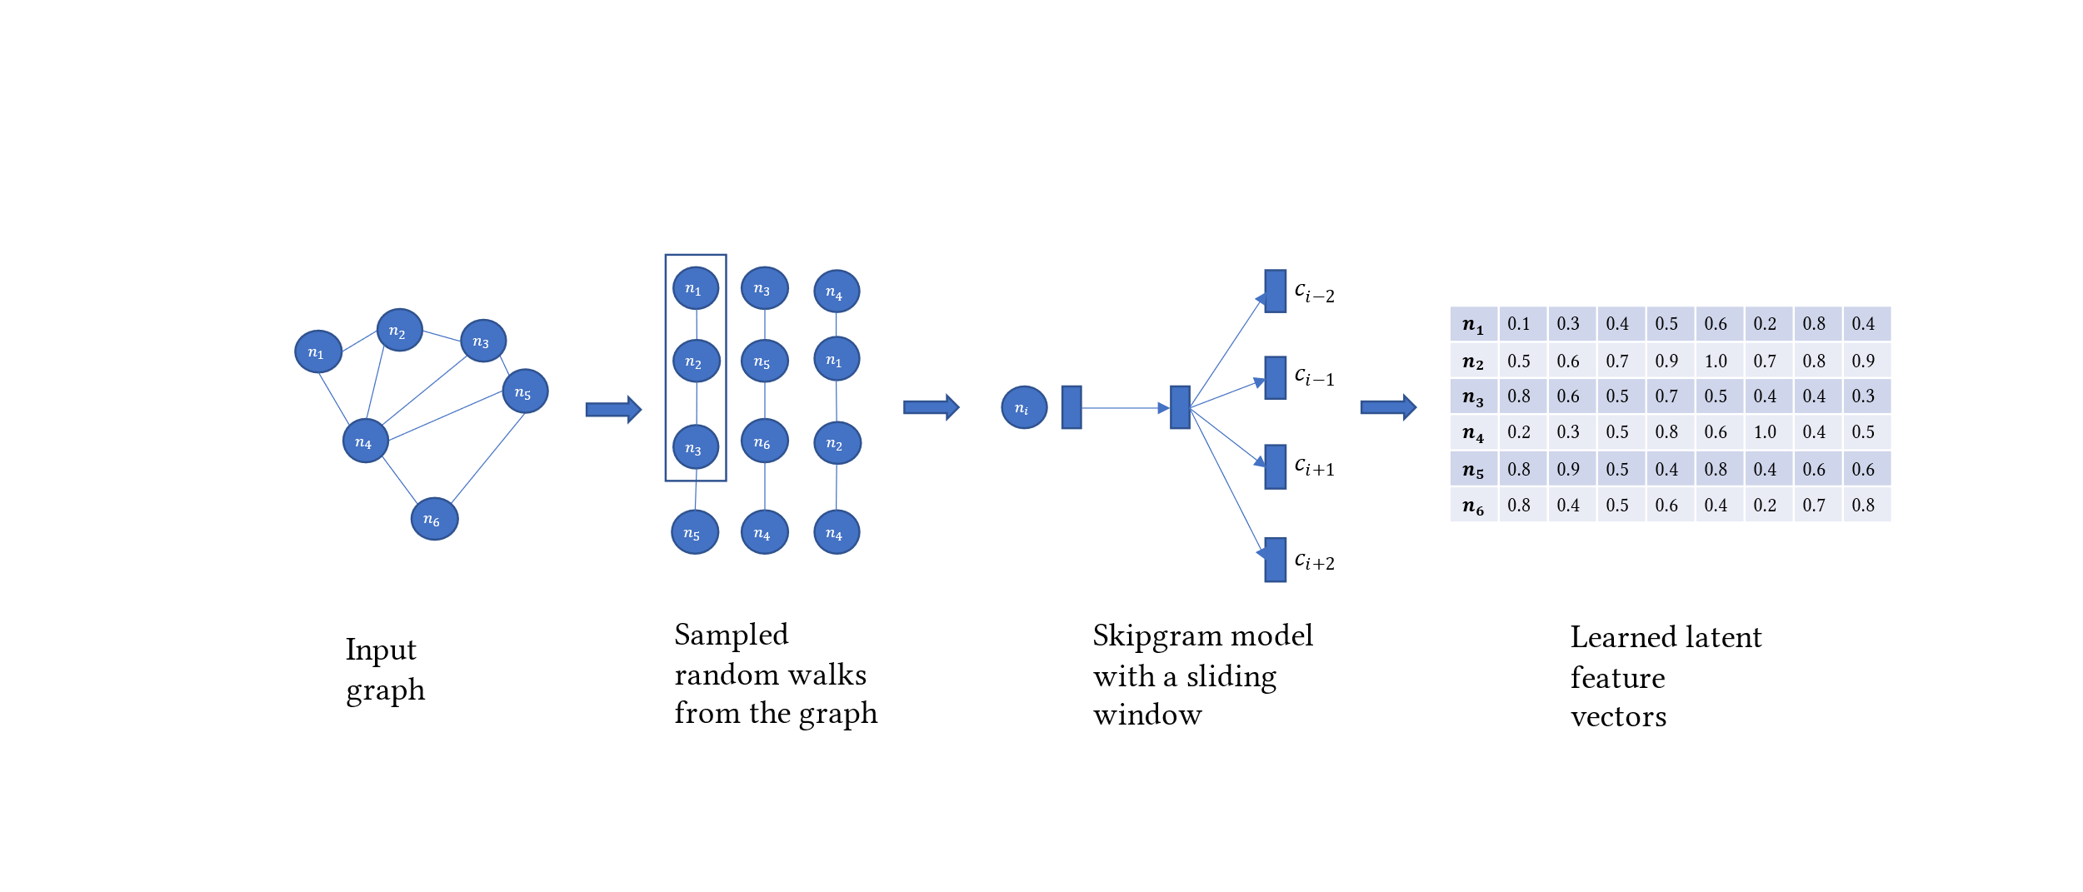
3B. MedGraph
Notes:
Then I apply a graph embedding method Node2Vec to embed the nodes in the knowledge graph. Note the the vectors will encode the structure of the graph.

Slide 25
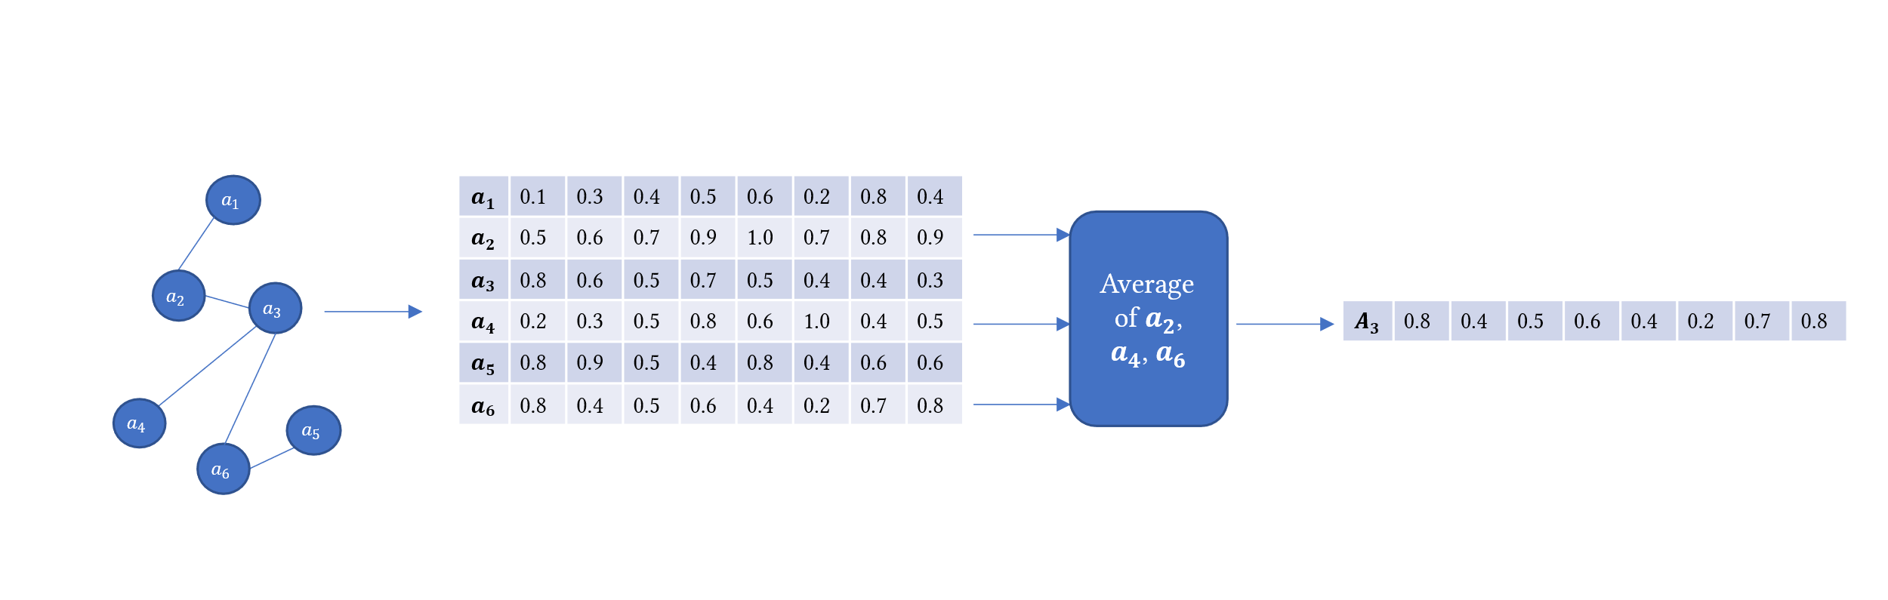
3B. MedGraph
Notes:
Then for each article node I pool the neighborhood embeddings and create one vector for each article.

Slide 26
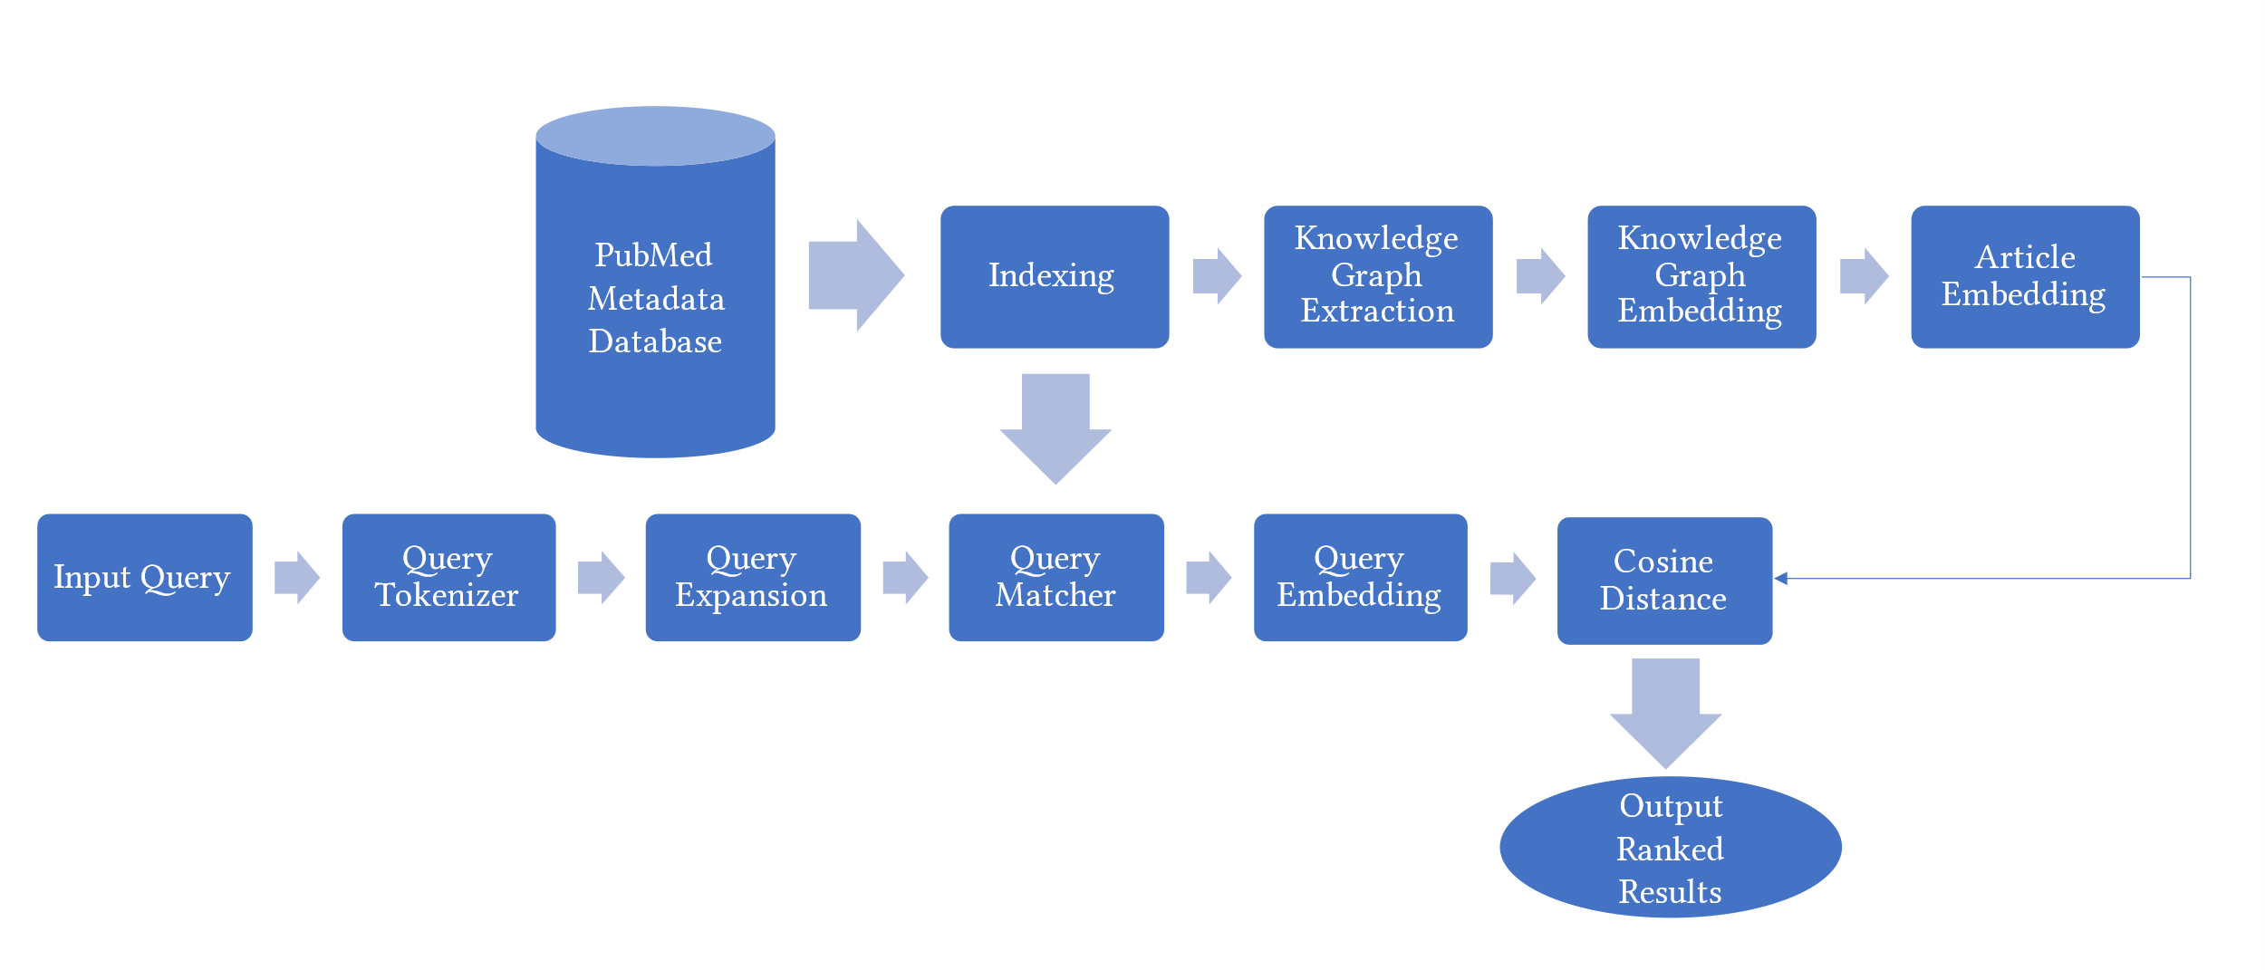
3B. MedGraph
Notes:
For the query I use the extracted bio entities as an index and match the query terms using fuzzy matching to the extracted bio entities and then I find the corresponding nodes in the graph. Pool the corresponding nodes and that gives me one vector for the query. Now I can easly apply a cosince distance metric to find for example the top 10 articles for that query.

Slide 27
3B. Evaluation
Pulled a ground truth dataset from PubMed ranked using BestMatch for different queries
100K articles. 500K nodes. 2M edges.
Compared with TFIDF
MAP
Notes:
Ofcourse I cannot do that on a dataset of 31 million articles I simply don’t have the resources so I figured I can do that on a proof of concept dataset. So first I found dates of published articles that are in English and in MEDLINE to give me around 2000 articles. I then use the 2000 articles to extracted a citation network. Which yielded 100K articles. I then Create the knowledge graph from those 100K articles which yielded 500K nodes and 2M articles. I then applied the framework I described before and compared with a traditional TFIDF ranking method using metrics like precision, recall, F1, MAP.

Slide 28
3B. Future Work
A/B testing
Run on the full PubMed dataset
Notes:
I did not do A/B testing so that is in the future work. Also I would like to run this on the full PubMed dataset but again I don’t have the resources.

Slide 29
4. Closing Remarks
A future vision might be of having systems where you can feed multiple datasets and the out is some insights or hypotheses extracted from the articles automatically
Relation extraction, entity resolution and recognition are crucial in knowledge discovery especially in the biomedical text mining
Graph and network methods in combination with natural language processing are incredibly useful in knowledge discovery and data integration tasks especially in biomedicine
Graph representation learning, network embedding methods and graph theory algorithms are all projections of the data that we have. The data should be understood before applying algorithms to it.
Notes:
Finally, I am very interested in this postdoc position and even though I don’t know everything in biomedical text mining and knowledge discovery I promise that I am passionate about this field and have the intention to produce good research in it.

Slide 30
Thank you
Questions
iaebeid@ualr.edu

