Slide 1


Knowledge Graph Mining using Graph Embeddings
Abhik Seal,
Majdi Hassan,
Islam Akef Ebeid,
Tingyi Wanyan,
Brian Martin,
Ying Ding

Slide 2
Outline
Knowledge Graphs
Why do we need to do knowledge mining algorithms
Graph Mining Algorithms
Data & Results
Summary and Discussion

Slide 3
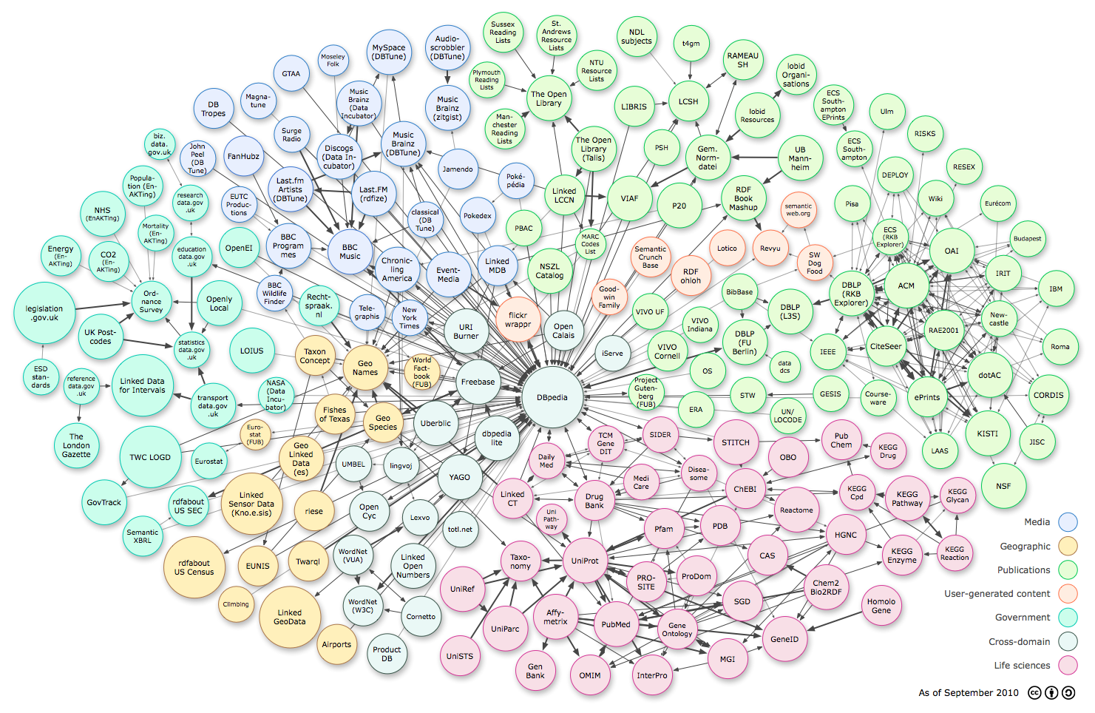
Knowledge Graphs Defined
“Knowledge is Power” , If a program is to perform a complex task well, it must know a great deal about the world in which it operates.
To behave intelligently in unexpected situations, an agent must be capable of falling back on increasingly general knowledge.
The knowledge graph is a virtual data layer on top of the existing databases or data sets to connect all data—whether structured or unstructured—at scale.
Knowledge graphs are paving the way from silo-controlled business intelligence based on traditional data warehouses to a holistic approach to augmented intelligence

Slide 4
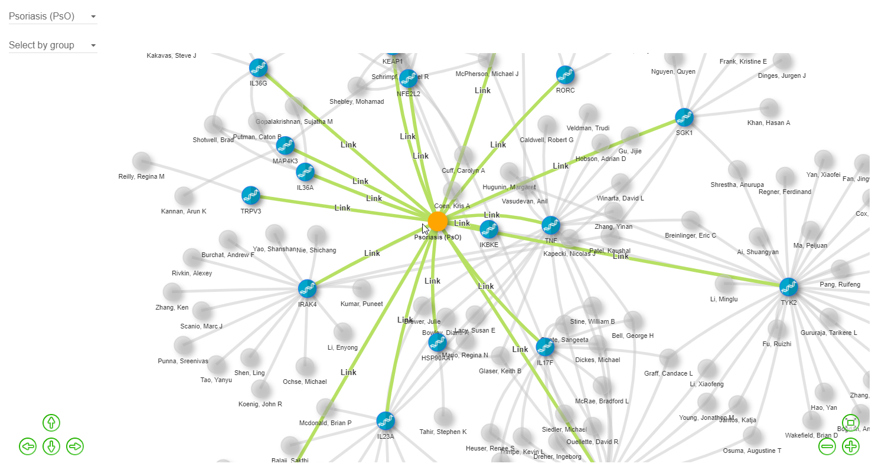
When do you need Knowledge Graphs
You often face the problem of having rephrase your questions ,
across domains, as your departments have different views on things,
there are so many Business systems, but they do not talk to each other,
have different data models and you need help to translate between them
you need experts to help wrangle the answers out of your systems,
you have completed a project or work; you have often found that something
similar already existed.
You always use Google instead of internal tools to find things.
Enterprise Knowledge Graphs : AbbVie Unite
https://rconnect-aws.abbvienet.com/unite/

Slide 5
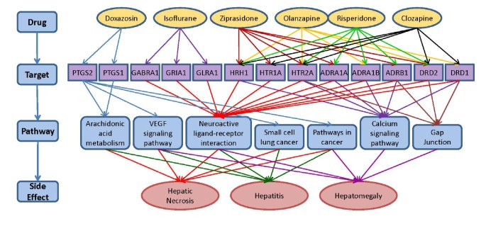
Why do we need to do knowledge mining algorithms
A number of practical languages have been proposed for querying graphs.
a) SPARQL query language for RDF graphs b) Cypher (Neo4j), c) Gremlin (Apache TinkerPop) d) G-CORE for querying property graphs.
Learn new software , query language, query operators & path patterns in knowledge graphs. We need experts ..
Example
Find the top 5 pathways in the KEGG pathway contain at least two of the efficient target that associated with a given side effect (i.e. hepatomegaly)
SELECT ?pathway_id (count(?pathway_id) as ?count)
WHERE { ?sider2compound sider:side_effect ?side_effect .
FILTER regex(?side_effect,"hepatomegaly","i") .
?sider2compound sider:cid ?compound .
?drug drugbank_drug:CID ?compound .
?drug2target drugbank_interaction:DBID ?drug .
?drug2target drugbank_interaction:SwissProt_ID
?uniprot .
?kegg_pathway kegg_pathway_protein:Uniprot
?uniprot .
?kegg_pathway kegg_pathway_protein:PathwayID
?pathway_id . } GROUP BY ?pathway_id ORDER BY ?count
Chen, B., Dong. X., Jiao, D., Wang, H., Zhu, Q., Ding, Y., Wild, D.J. Chem2Bio2RDF: a semantic framework for linking and data mining chemogenomic and systems chemical biology data. BMC Bioinformatics 2010, 11, 255

Slide 6
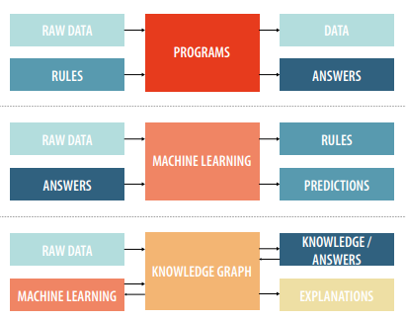
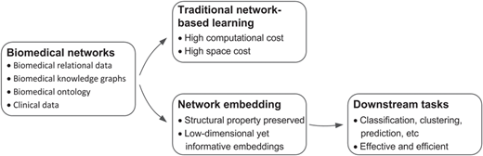
Why do we need to do knowledge mining algorithms
Programmatical Approach
Machine
Learning
Knowledge Graph
Network embedding technologies provide new effective paradigms to solve the network analysis problem.
Network embedding aims at converting the network into a low-dimensional space while structural information of the network is preserved

Slide 7
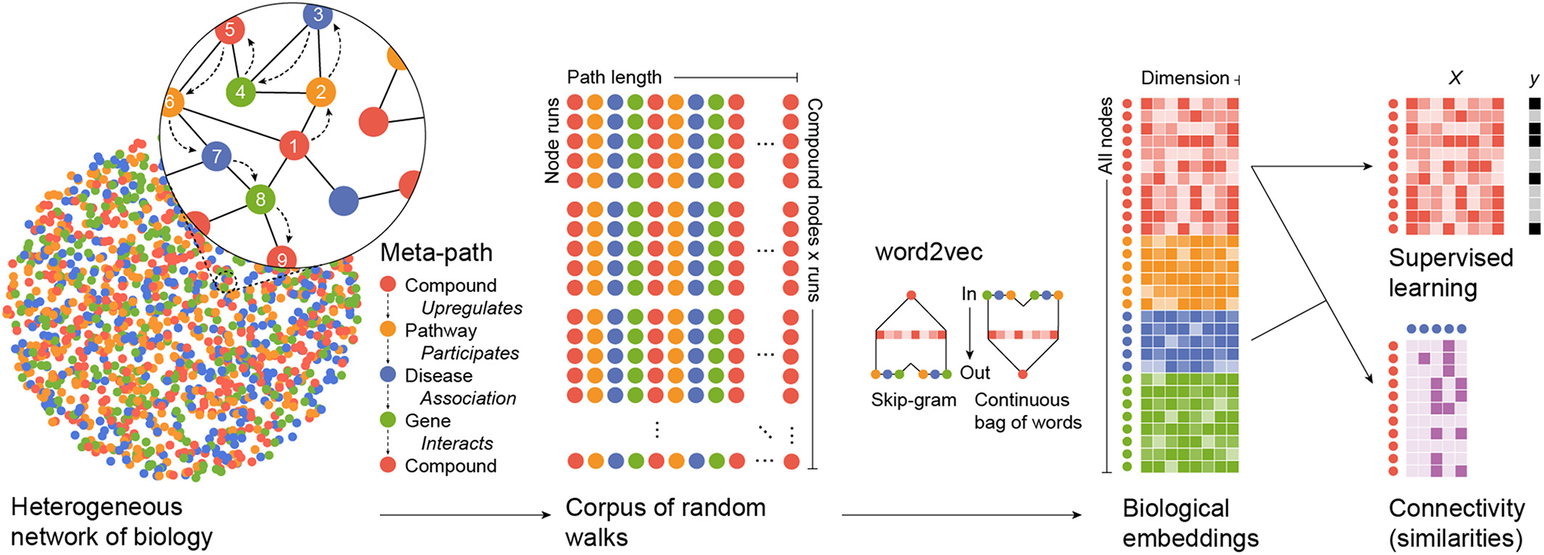
Why do we need to do knowledge mining algorithms
Edge2Vec
Metapath2Vec
node2vec
Large complex biological networks can be converted to a vector format .
Random walks with bias and without bias can be used to generated the node sequences which can be used to embed the graph using skip gram model.
The vectorized pharmceutical data can be used to perform a supervised learning to predict new associations between drugs,targets , disease , pathways and side-effects.
In this work we present how we can use Graph Embeddings to predict Compound pharmaceutical targets.
Aloy Etal. Formatting biological big data for modern machine learning in drug discovery. https://doi.org/10.1002/wcms.1408

Slide 8
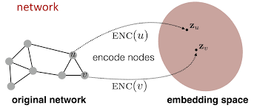
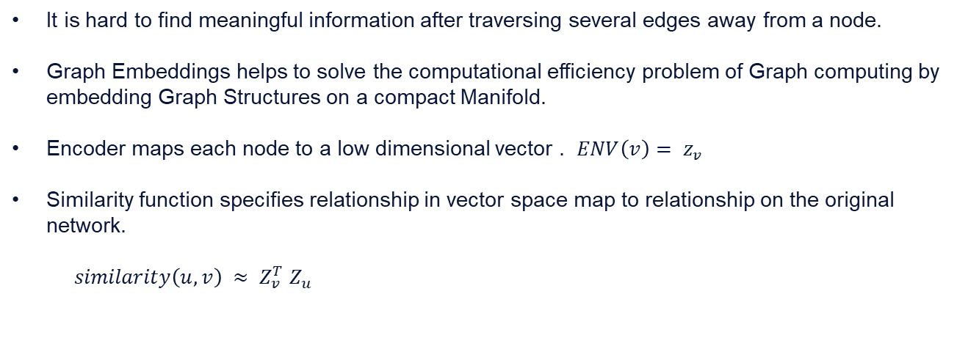
Why do we need to do knowledge mining algorithms
It is hard to find meaningful information after traversing several edges away from a node.
Graph Embeddings helps to solve the computational efficiency problem of Graph computing by embedding Graph Structures on a compact Manifold.
Encoder maps each node to a low dimensional vector . $ENV\left(v\right)= z_{v}$
Similarity function specifies relationship in vector space map to relationship on the original network.
$similarity\left(u,v\right) ≈ Z_{v}^{T}$ $Z_{u}$
Similarity of u and v in the original network
Dot product between node embeddings

Slide 9
Graph Mining Algorithms
Node2Vec: Adds a parameter to bias walks to go away or towards nodes they’ve already visited
Edge2Vec: Biases walks to walk on edge transition types which are rarer/more important
Metapath2Vec: Only allow certain types of walks with metapaths
  Compound->Gene->Compound
GraphSAGE : Modified version of GCN (Graph Convolutional Networks)
Fundamental concept of Graph Embedding
preprocessing to compute transition probabilities for guiding random walks
Generate node sequences (input corpus) using second order random walk with BFS and DFS strategy.
Iterate random walks from same source node multiple times for convergence
Supply the node sequences as input to skip-gram model.
Maximize the probability of neighborhoods for the given nodes.

Slide 10
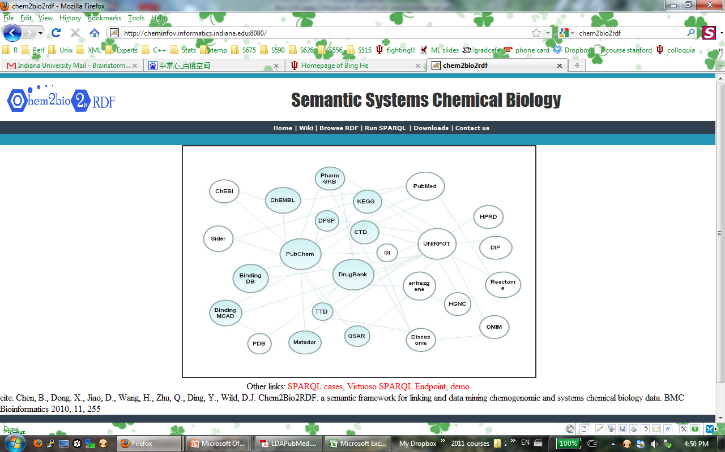
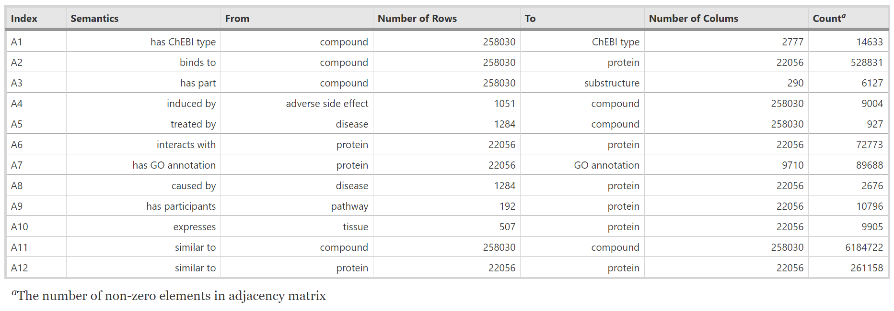
Data and Results section
Edge Type | Count
hasSubStructure | 6169
chemicalOntology | 15986
causesSideEffect | 9004
causesDisease | 2929
drugHasPathway | 943
proteinHasPathway | 11258
expressInTissue | 10178
protProtInteraction | 40393
hasGeneFamily | 7181
Express | 16167
binds | 522545
hasGoID | 95422
Node Type | Count
Gene Ontology | 9710
Compound/Drug | 258030
Side effect | 1051
Target | 22056
Tissue | 507
Pathway | 192
Disease | 1284
Substructure​ | 290​
Chemical ontology​ | 2777​
Chem2Bio2RDF: ~296,000 nodes with ~728,000 relations
12 relation types & 9 node types:

Slide 11
Data and Results section
Experimental Setup : Drug Target Prediction
Compound-Protein Pair Prediction
Test/Train embeddings on 30,000 compound-gene pairs , Positive pair = 3317 ; Negative pair = 26,683
Drugbank Test Data:
+ves : All approved small molecule drug bank associations (5836)
-ves: experimental data of drugs having more than 5uM activity found in ChEMBL data.(2368)
Evaluation
Top N evaluation – Cosine Similarities
  Ranking of cosine similarities between the vectors for compounds and genes
  If link exists between a compound and gene, and the similarity score is found in the top N similarities, then True Positive
• F1, Precision, and Recall metrics for Top N similarities and classifiers

Slide 12
Data & Results
Internal Test data
DrugBank data
Link Pred. | F1 | Precision | Recall
Node2Vec | 0.963 | 0.984 | 0.943
Edge2Vec | 0.964 | 0.987 | 0.941
Metapath2Vec | 0.970 | 0.989 | 0.952
GraphSAGE | 0.937 | 0.974 | 0.902
Link Pred. | F1 | Precision | Recall
Node2Vec | 0.734 | 0.651 | 0.840
Edge2Vec | 0.748 | 0.666 | 0.852
Metapath2Vec | 0.725 | 0.652 | 0.814
GraphSAGE | 0.706 | 0.650 | 0.772
Top 100 Link Pred. | F1 | Precision | Recall
Node2Vec | 0.732 | 0.772 | 0.695
Edge2Vec | 0.797 | 0.740 | 0.863
Metapath2Vec | 0.788 | 0.713 | 0.881
GraphSAGE | 0.085 | 0.254 | 0.051
Top 100 Link Pred. | F1 | Precision | Recall
Node2Vec | 0.254 | 0.452 | 0.177
Edge2Vec | 0.231 | 0.407 | 0.161
Metapath2Vec | 0.556 | 0.591 | 0.524
GraphSAGE | 0.056 | 0.681 | 0.029
Node Class. | F1 | Precision | Recall
Node2Vec | 0.415 | 0.720 | 0.394
Edge2Vec | 0.413 | 0.698 | 0.395
Metapath2Vec | 0.464 | 0.930 | 0.379
GraphSAGE | 0.138 | 0.883 | 0.129

Slide 13
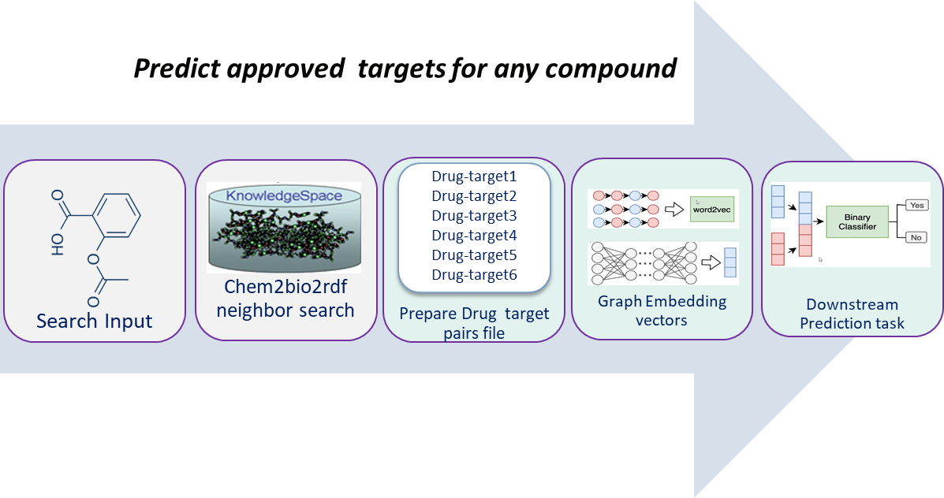

Summary and Discussion
We provide an overview of different types of graph embedding methods and discuss how they can be used in drug target link prediction.
We compile datasets for all the above prediction tasks and use them to systematically evaluate 4 representative graph embedding methods selected from different categories.
We develop an easy-to-use Python package with detailed instructions, including all source code and datasets.
We created a target prediction pipeline which predicts targets with any given chemical structure as input using A-number and smiles.
Developing better inductive graph embedding algorithms. This will help on performing predictions on other graphs with similar context
Ranking Algorithm (Future Work)
  Identifying an efficient and effective ranking algorithm based on the embedding measures
  Developing the ranking algorithm based on the ensembled approaches of integrating different embedding algorithms
  Evaluate ranking algorithms with end users, domain experts, and using clinical trial data
  Diversifying ranking algorithms according to different kinds of tasks and applications
https://pig.abbvienet.com/sealax/KnowledgeGraphAlgos

Slide 14
Acknowledgements
Akef Ebeid Islam (Metapath2Vec, Metapath2vec++)
Tingyi Wanyan (GraphSage)
Thanks to Jack Roper ( Node2Vec , edge2vec ) initial implementations.
Prof Ying Ding ( UT Austin)
Brian Martin
Jennifer Van Camp
Phil Hajduk

Slide 15
Backup slides

Slide 16
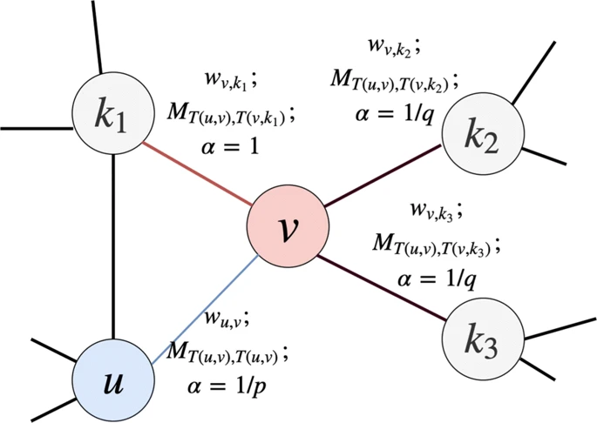
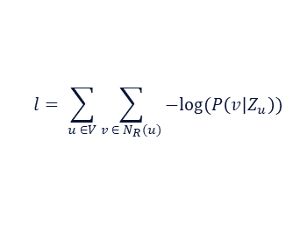

Algorithm 1. Node2Vec
preprocessing to compute transition probabilities for guiding random walks
Generate node sequences (input corpus) using second order random walk with BFS and DFS strategy.
Iterate random walks from same source node multiple times for convergence
Supply the node sequences as input to skip-gram model.
Optimize the embeddings and Maximize the probability of neighborhoods for the given nodes.
$$l= \sum_{u ∈V}{\sum_{v ∈ N_{R}(u)}{−log⁡(P\left(v|Z_{u}\right))}}$$
Parameterize $P\left(v|Z_{u}\right)$ using softmax

Slide 17
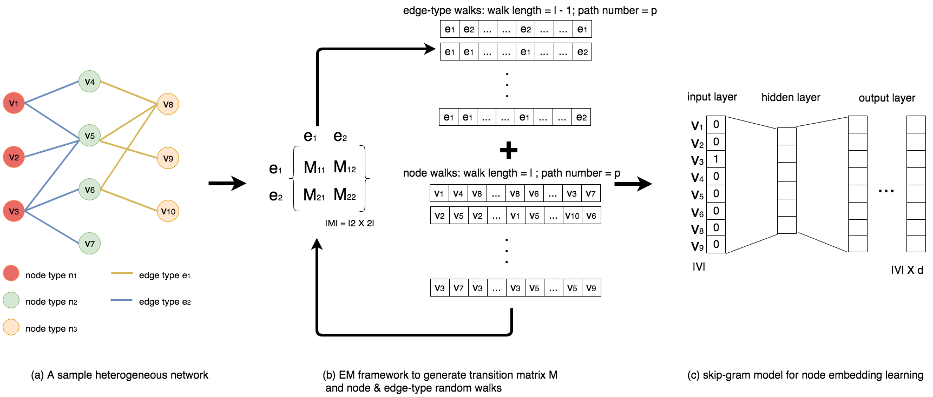
Algorithm 2. Edge2vec
Build a transition matrix from edge-type to edge-type by walking along the graph
  Edge-edge transition probability is measured as Pearson correlation between edge-types occurring next to each other in walks.
After building transition matrix, bias walks with transition probability stored in matrix

Slide 18
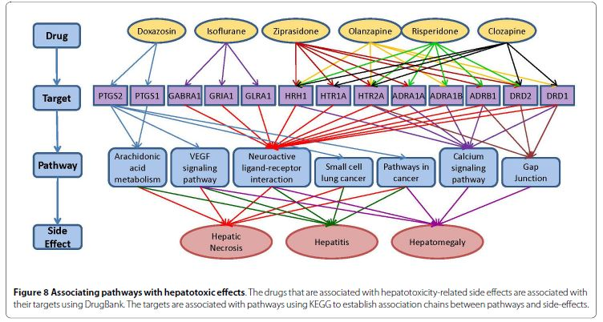
Algorithm3: Metapath2vec (Akef)
Drug
Binds
Gene
Associates
Disease
Drug → Target → Pathway → Side Effect
1. Metapath based Random walk
Select meaningful metapaths of interest
Run random walks that capture structural correlations between different node types
2. Random walk optimization and learning process
Given the random walks, optimize node embeddings. The sampled graph are then passed on a Skip gram algorithm for Embedding.
The result is a feature vector that is learnt per node

Slide 19
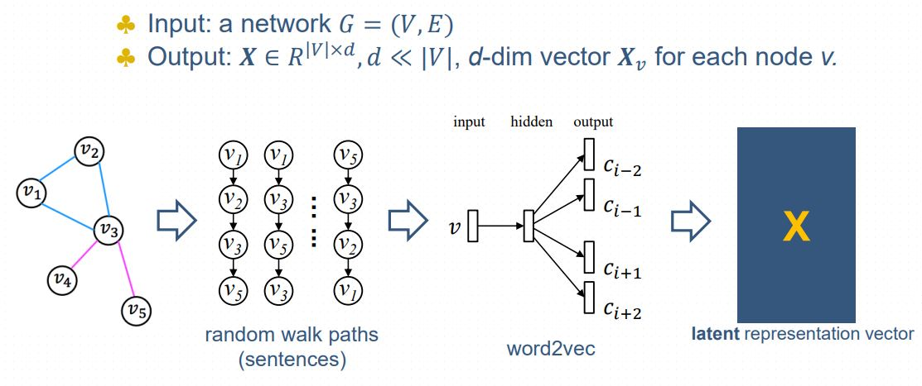
Algorithm3: Metapath2vec
The random walker is used to generate “corpus”. We loop on the defined metapaths.
For each metapath we start at a random node and check whether this node type is similar to the first node type in the metapath
We then find the first hop neighborhood of the node., then choose the next node uniformly if its type is similar to the next node in the metapath
The parameters that control this are number of walks and walk length.
Metapaths information:
Fu, G., Ding, Y., Seal, A., Chen, B., Sun, Y., & Bolton, E. (2016). Predicting drug target interactions using meta-path-based semantic network analysis. BMC bioinformatics, 17(1), 160.

Slide 20
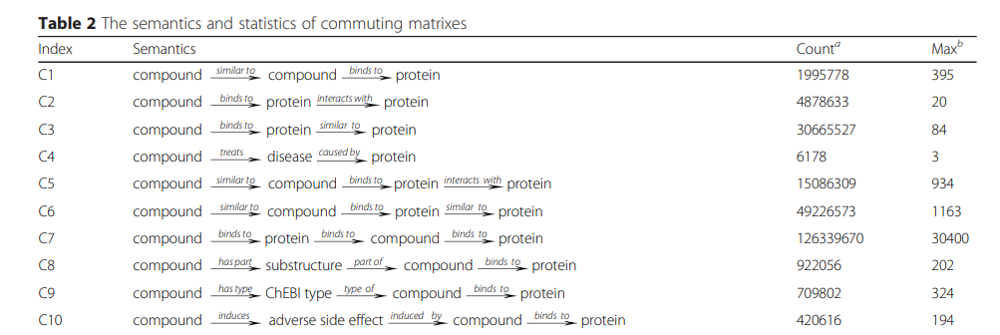
Algorithm3: Metapath2vec
We chose a set of 49 metapaths collected from an early studied presented in Fu et al., 2016
The study investigated several machine learning models for drug target prediction
The training dataset comprised of constructing adjacency matrices for each type of relationship then extracting commuting matrics based on the metapaths defined
We use the same set of metpaths to sample the dataset based on random walks
Each random walk has a predefined length and number of node iterations
The sampled random walks are then passed to 2 versions of the skip gram model described in Mikolov et al., 2013 and Dong et al., 2017

Slide 21
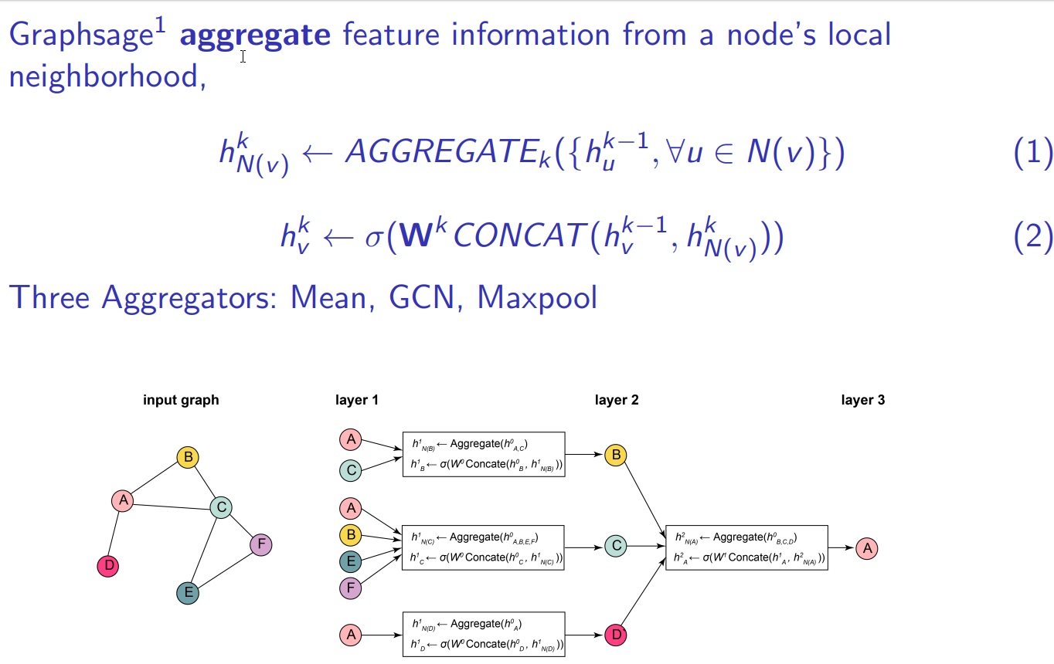
Algorithm 4: GraphSage

Slide 22
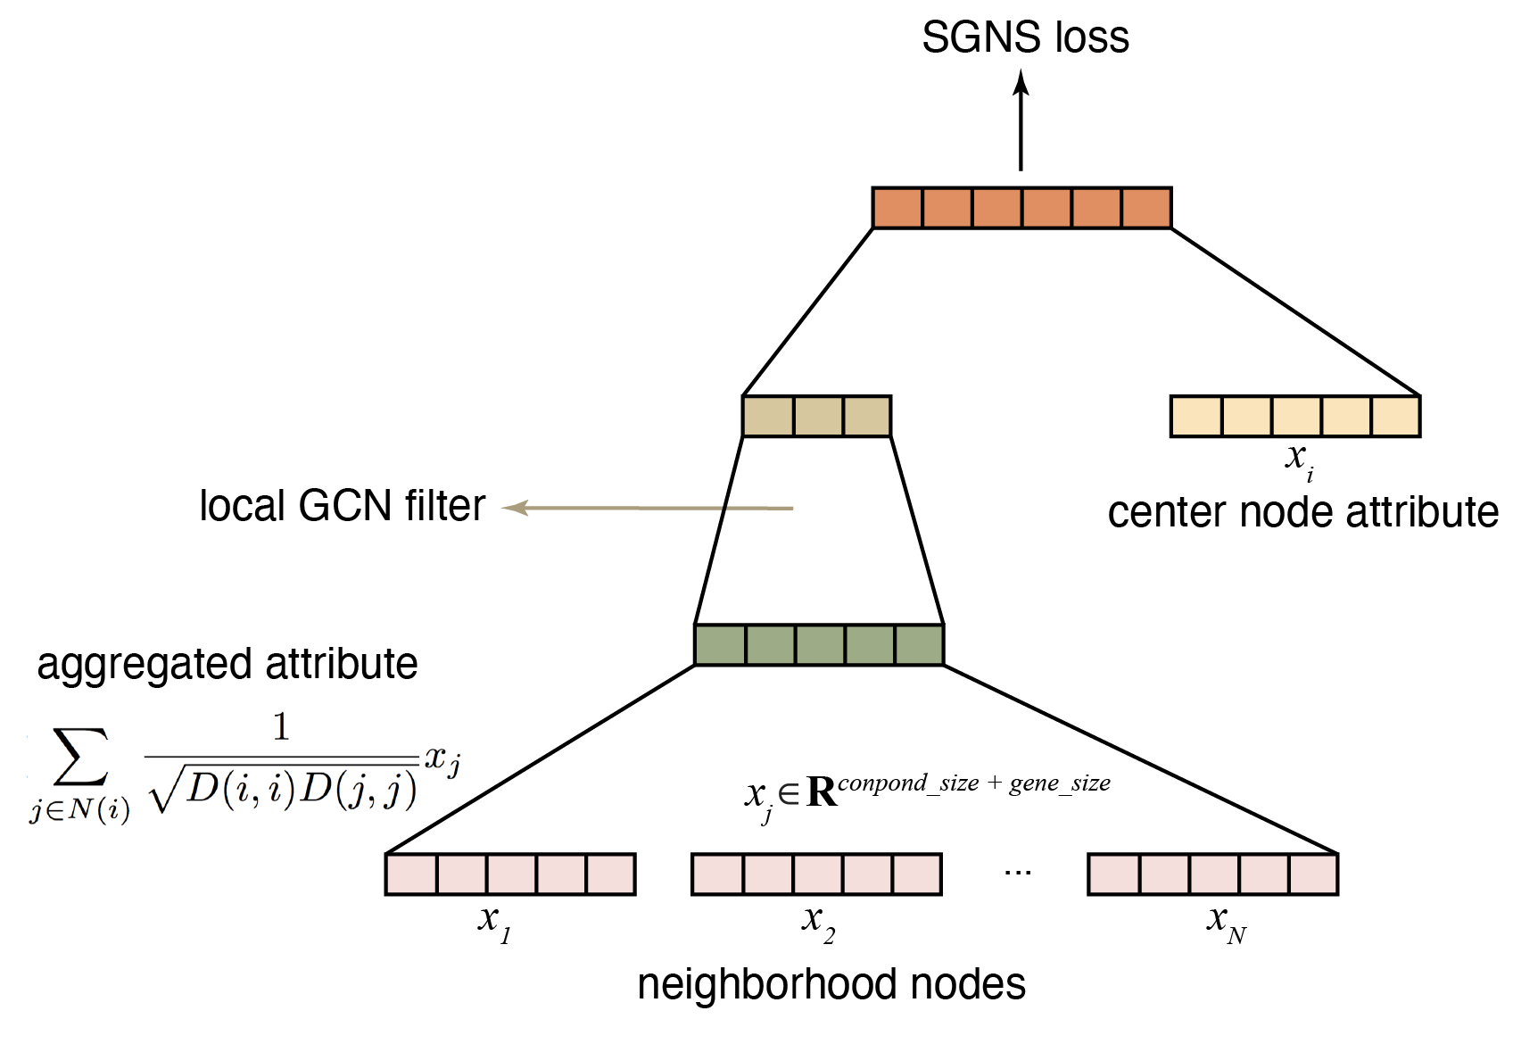
Algorithm 4: GraphSage
1.Perform random walk traverse the
graph to find neighborhood nodes of
the center node, here we set random
walk length = 5
2.Perform negative sampling to get
nodes that doesn’t connect to the
center node, neither connect to
the nodes in the generated walk.
3.Input to the graphsage model, and
perform Skip-Gram learning

Slide 23
P and Q Evaluation
Walks like Node2Vec and Edge2Vec have parameters p and q
p is the return parameter meaning the likelihood of the random walk to revisit a node. If p > (max(q,1), the walk would unlikely revisit nodes.
Q parameter controls whether the walk would explore nodes further away or closer to the node
q > 1 like BFS while q < 1 like DFS
Varied both p and q for values 0.25, 0.5, 0.75, 1, 1.25, 1.5, 1.75, 2, 5, 10
The variation in parameters resulted in average accuracy score difference of + or - 0.00789

