Slide 1
MedGraph: An experimental semantic information retrieval method using knowledge graph embedding for the biomedical citations indexed in PubMed
Islam Akef Ebeid
Final project presentation in partial fulfillment of the degree of Master of Science in Information Science MSIS – Fall 2021
Elizabeth Pierce
Ningning Wu
Mary Wang
Notes:
I would like to thank you all for attending the meeting. I have been working under the guidance of Dr. Pierce on this project for the past year now. As the title points in this project, I am focused on information retrieval and knowledge graphs especially in the biomedical field. You know digital libraries like PubMed contain a lot of knowledge. Recently there has been a movement to convert the text present in those libraries into machine readable formats. The aim is to provide ways to automatically discover new knowledge from the corpus of articles through semantic web technologies like knowledge graphs. On the other hand, search and information retrieval is one form of knowledge discovery and data mining that requires better representation of information to provide more relevant results for users especially researchers in the biomedical field.

Slide 2
Outline
Introduction
Method
Background
Evaluation
Discussion
Conclusion
Bibliography
Notes:
So today I will go over what I did in this project. First, I will go over the introduction, then the background. Then, I will go over the proposed method and framework, following I will describe how I evaluated the system and the results of the evaluation then I will discuss the results and finally I will conclude and provide a full bibliography.

Slide 3
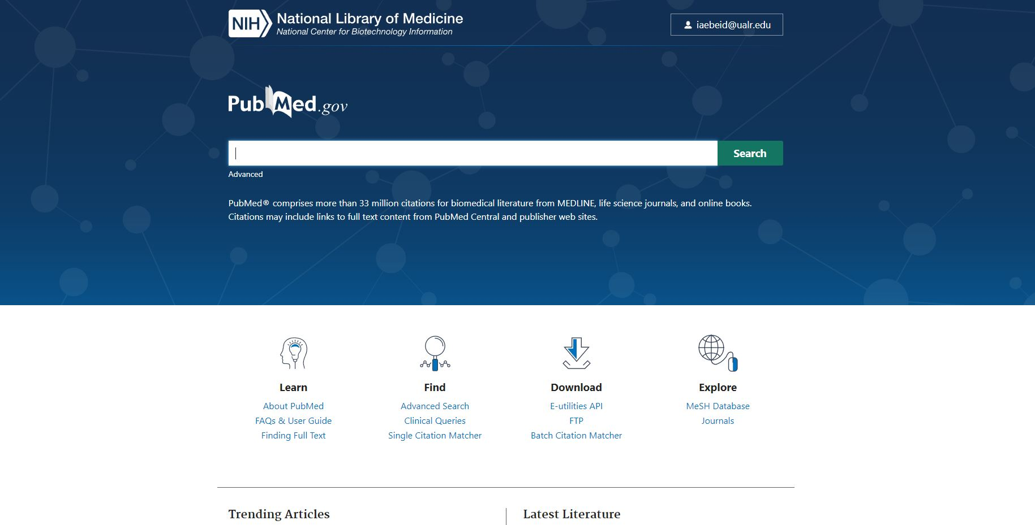
1. Introduction: What is PubMed?
https://pubmed.ncbi.nlm.nih.gov/
Notes:
But first I would like to describe what is PubMed because it is the central focus here in this project. PubMed is the National Library of Medicine’s free authoritative database of citations and search engine of more than 30 million articles in biology, medicine, pharmacy, and life sciences and across multiple curated databases such as MEDLINE. MEDLINE is a bibliographic database of life sciences and biomedical information. It includes bibliographic information for articles from academic journals covering medicine, nursing, pharmacy, dentistry, veterinary medicine, and health care. It is the largest curated corpus by the national library of medicine. PubMed could be thought of as the search engine and the online portal on top of MEDLINE in addition to other repositories as well. However, from here on I will refer to PubMed as an entity that encompasses MEDLINE.
PubMed is used by more than 2.5 million users each day, serving clinicians, physicians, researchers, and students. It is worth mentioning that PubMed is a database of citations, not a database of full-text articles. That is because about two-thirds of the articles indexed in PubMed do not provide access to full texts. Instead, when a free full text is available by the publisher or published as open access or is supported by an NIH grant, the full article gets indexed in PubMed Central, that’s another database under PubMed and is the National Library of Medicine accessible repository of full-text articles. Accordingly, the PubMed search engine relies on metadata and citations instead of parsing full-text articles when providing a search experience. Articles’ metadata are indexed and parsed in fields to be utilized in the search process. Metadata fields include titles, abstracts, authors, journal names, publication dates, submission dates, related MeSH terms, citation and references information, funding grants, projects, and many more.

Slide 4
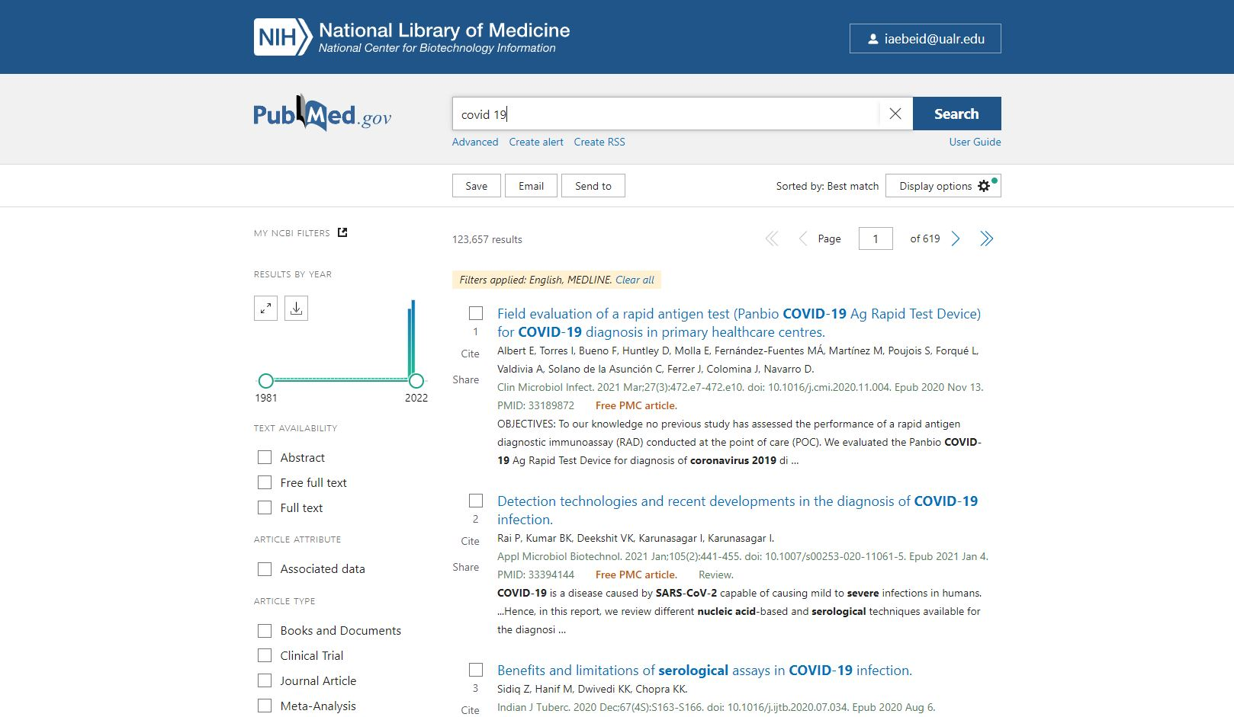
1. Introduction: How to search PubMed?
Notes:
So, on the website when the user enters a query in the search box. Let’s say the term “covid-19”. The result page appears with the relevant articles ranked based on the display option. The current default method in PubMed is called Best Match the other method is TFIDF and the retrieved results are ranked based on date or author names. Best Match is the latest algorithm used by PubMed to retrieve and rank returned articles.
More filters can be used from the left panel to filter out the results. For example, in this case we only want articles that are in English. Also, only from the MEDLINE database and not any other repository under PubMed.

Slide 5
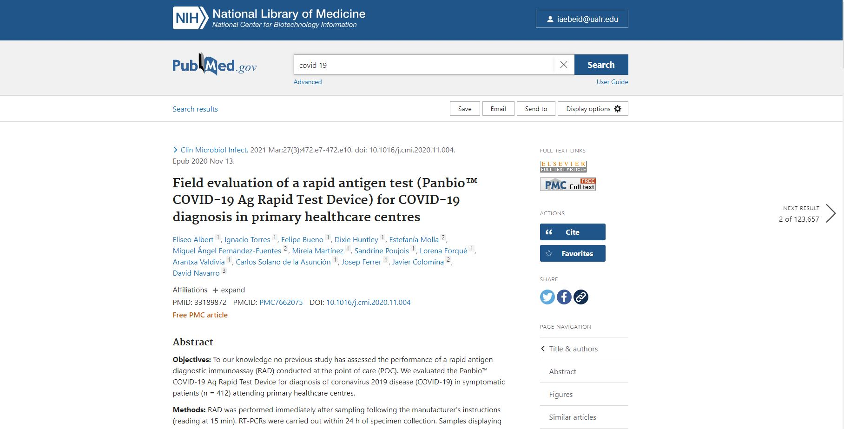
1. Introduction: How to search PubMed?
Notes:
Then when the user clicks on any of the articles retrieved. The article will appear with a title, abstract, list of authors, and their affilations, PMID, DOI, references, related keywords and MeSH terms. In addition to a link to the full text if available as shown in this picture. A PMID is the unique identifier provided by PubMed to each article.

Slide 6
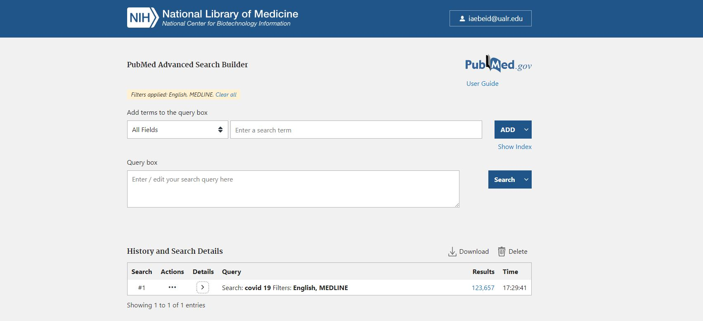
1. Introduction: How to search PubMed?
Notes:
But lets backup a little bit before the resultant ranked documents are presented to the user the query gets expanded using the Automatic Term Mapping system (ATM). The ATM system expands the input query and finds which fields the query entered intended. The expanded query is then matched with the most relevant documents using MeSH terms, keywords, and other metadata. The most relevant articles are then retrieved using TF-IDF and ranked based on date or alphabetically using either the title or the author name.

Slide 7
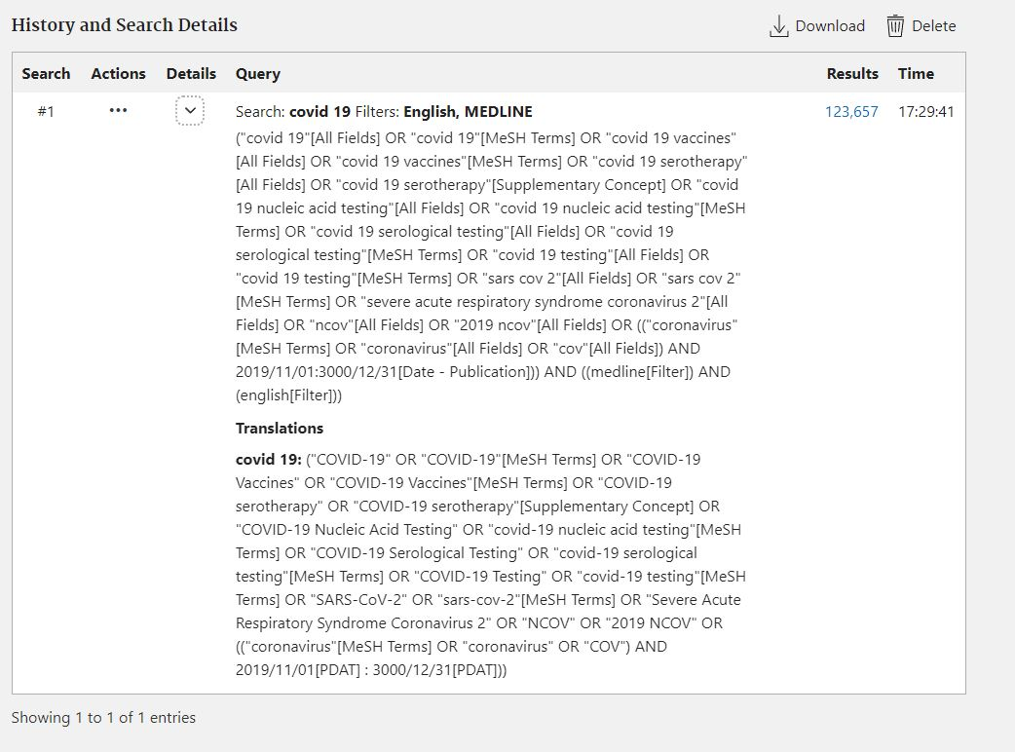
1. Introduction: How to search PubMed?
Notes:
So for our example query “covid-19” the Automatic Term Mapping system (ATM) will expand the query as shown in the image. So instead of just finding articles that mention covid-19 also articles that include coronavirus, sars cov 2 in addition to other related concepts to covid-19 will be searched in all fields.

Slide 8
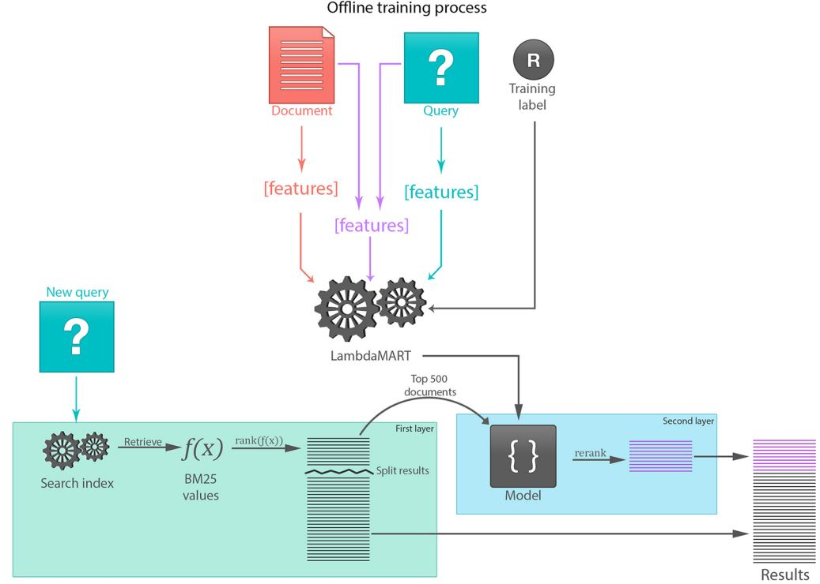
1. Introduction: How Best Match works?
Notes:
So I mentioned before Best Match as the latest method so how does Best Match work. The Best Match algorithm consists of two stages: first retrieval by BM25 which is the default method in PubMed and a classic TF-IDF algorithm; Second the top 500 results are re-ranked by LambdaMART. LamdaMART is a machine learning technique that aims at converting the task of document ranking into a classification task. It achieves that by extracting a set of features for documents in the PubMed database not just from the metadata but also from the historical query logs in addition to including the TFIDF scores. The model is learned offline then combined with the TFIDF retrieved documents to rerank the documents and present the final ranked documents to the user.

Slide 9
1. Introduction: So, what's the problem with all of that?
Not semantic
Does not sort out ambiguous queries
Requires retraining and redeployment
Takes context and semantics into account to provide better ranking
Does not need retraining
Notes:
Currently both methods in PubMed whether the legacy TFIDF or BestMatch are used widely. Yet those models are not context based. At the end of the day, they just search certain fields to find keywords. In addition, the new method BestMatch relies on training features extracted from query logs. Those query logs contain search logs of queries that are ambiguous. It also requires retraining and redeployment. Accordingly, the learned models can be ambiguous themselves. Even though those two algorithms might return highly relevant results just because the word covid -19 appeared in the metadata of the retrieved documents they might not rank them in a way that is objectively relevant. Those disadvantages highlight the need for a retrieval and ranking model that takes context and semantics into account in addition to the ability or the potential to infer the relevance of new documents without the need for retraining.

Slide 10
2. Background: what is a graph?
A
C
 | A | B | C | D | E | F
A | 0 | 1 | 0 | 0 | 1 | 0
B | 1 | 0 | 1 | 0 | 1 | 1
C | 0 | 1 | 0 | 1 | 0 | 0
D | 0 | 0 | 1 | 0 | 0 | 0
E | 1 | 1 | 0 | 0 | 0 | 1
F | 0 | 1 | 0 | 0 | 1 | 0
B
Source Node | Target Node
A | B
A | E
B | C
B | E
C | D
E | F
F | B
E
D
F
 | A | B | C | D | E | F
A | 2 | 0 | 0 | 0 | 0 | 0
B | 0 | 4 | 0 | 0 | 0 | 0
C | 0 | 0 | 2 | 0 | 0 | 0
D | 0 | 0 | 0 | 1 | 0 | 0
E | 0 | 0 | 0 | 0 | 3 | 0
F | 0 | 0 | 0 | 0 | 0 | 2
Notes:
Before I get into the next step which is the proposed model. I would like just to give a brief introduction to graphs and networks. So a graph as shown in the figure is made up of nodes or vertices and edges or links between those nodes and vertices. Those edges sometimes have weights and sometimes have labels. The graph like the one shown here can be represented using an edge list of tuples where each tuple pair is a source node label and a target node label. Graphs can also be represented using an adjacency matrix or a degree matrix. The use of those representations depends on the algorithm used and the application.

Slide 11
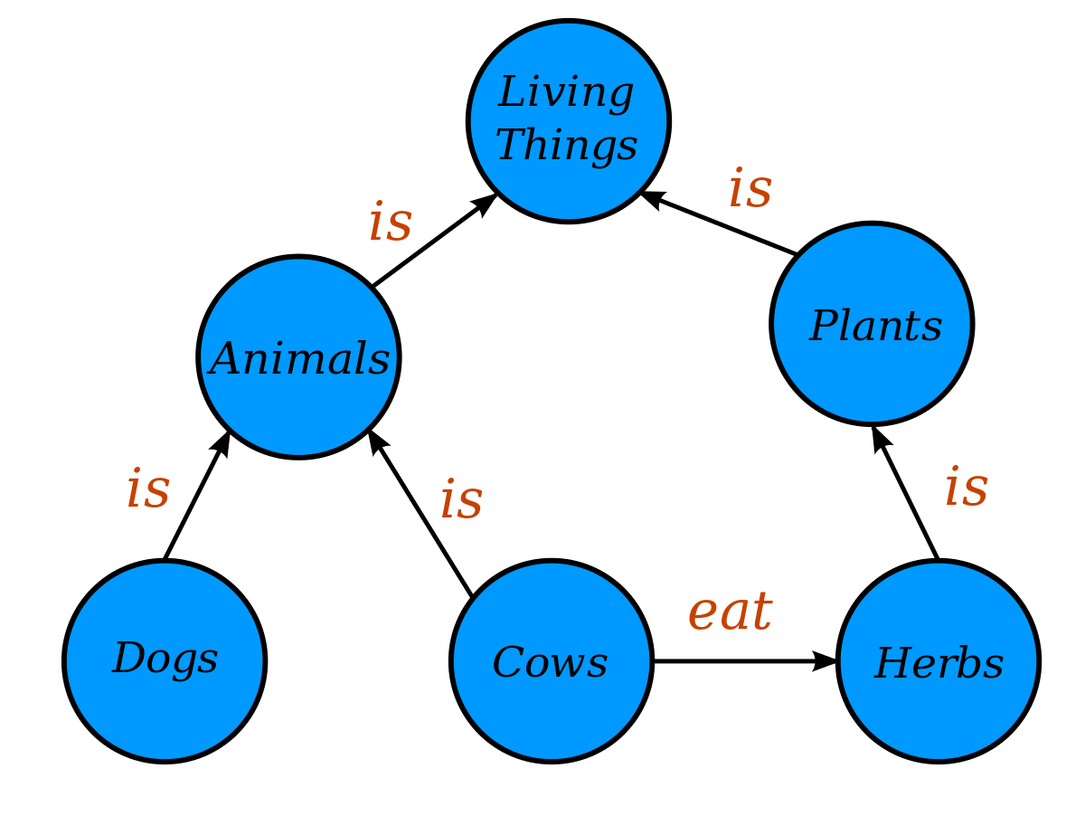
2. Background: What is a knowledge graph?
<“Animals”, “is”, “Living Thing”>
<“Plants”, “is”, “Living Thing”>
<“Dogs”, “is”, “Animals”>
<“Cows”, “is”, “Animals”>
<“Cows”, “eat”, “Herbs”>
<“Herbs”, “is”, “Plants”>
<“Plants”, “is”, “Living Thing”>
Notes:
The term “Knowledge Graph” has emerged to describe a new Google search technology in 2012. The term has expanded to describe any form of a knowledge base represented using a graph structure. Knowledge graphs are data models used to represent structured and unstructured knowledge in the form of triples <Mount Fuji, isLocatedIn, Japan>. The triples represent a semantic relationship between two objects following language semantics written in first-order logic such as <subject, verb, object>. So, a knowledge graph represents interrelated and semantically connected descriptions of real-world entities and relationships. The definitions of a knowledge graph vary widely.
They describe real-world phenomena in the form of entities and relationships.
The entities and relationships are represented in a graph structure using vertices and edges.
The graph structure containing the knowledge graph can be described mathematically and represented computationally using graph theory norms.
The entities’ metadata and relationships do not necessarily adhere to a schema or an ontology.
Entities of different types could be linked with multiple edges.
It could cover multiple domains of knowledge.
So as you can see here …
Knowledge graph construction can vary from manual to automatic curation by extracting entities and relations from unstructured text. Knowledge graphs can be represented using the property graph model. Knowledge graphs can also be represented using the Resources Descriptors Framework, defined by the WWW consortium. A relationship is defined between two connected entities or nodes, such as our previous example in this example.
Knowledge graphs can be constructed and curated under two assumptions: the open-world assumption or the closed world assumption (Cai et al., 2018). In the open-world assumption, information outside the knowledge graph is assumed to be unknown, and the knowledge graph itself is considered incomplete, such as DBpedia (Bizer et al., 2009). In a closed world assumption, information outside the knowledge graph is false. The data model in the closed-world assumption can be defined in a schema or ontology described using the RDFS language or the Resource Descriptor Framework Schema (Lassila et al., 1998). A schema is a concept map or ontology describing entities in the knowledge graph and their relationships.
Like relational databases, knowledge graphs are graph databases queried using query languages (Hogan et al., 2020). SPARQL (Harris, n.d.) and Cypher (Cypher Query Language, n.d.) are two popular graph query languages like the Structured Query Language (SQL). SPARQL was developed as part of the semantic web technology stack to query RDF triple stores and KGs, while Cypher is a property graph query language (Hogan et al., 2020). However, due to the unconventional structure of the graph model and the fact that knowledge graphs can be multigraphs with attributes and edges that could be weighted or labeled, graph query languages are difficult and impractical for the complex analysis of knowledge graphs. Those limitations have led to the emergence of knowledge graph mining methods and algorithms especially embedding models borrowing from graph theory, complex networks, machine learning, and deep learning to adapt approaches developed in those fields to mine knowledge graphs more flexibly and extract deeper insights (S. Wang et al., 2017).

Slide 12
2. Background: Knowledge graph embedding and similarity
A
C
B
A | 0.1 | 0.3 | 0.4 | 0.5 | 0.6 | 0.2 | 0.8 | 0.4 | 0.5 | 0.6 | 0.8
B | 0.5 | 0.6 | 0.7 | 0.9 | 1.0 | 0.7 | 0.8 | 0.9 | 0.5 | 0.3 | 0.9
C | 0.8 | 0.6 | 0.5 | 0.7 | 0.5 | 0.4 | 0.4 | 0.3 | 0.7 | 0.8 | 0.5
D | 0.2 | 0.3 | 0.5 | 0.8 | 0.6 | 1.0 | 0.4 | 0.5 | 0.6 | 0.7 | 0.7
E | 0.8 | 0.9 | 0.5 | 0.4 | 0.8 | 0.4 | 0.6 | 0.6 | 0.5 | 0.3 | 0.4
F | 0.8 | 0.4 | 0.5 | 0.6 | 0.4 | 0.2 | 0.7 | 0.8 | 0.8 | 0.9 | 0.7
E
D
F
Notes:
Another concept is knowledge graph embedding which they are machine learning models that aim at automatically extracting latent feature vectors from graph data without relying on stochastic and heuristic metrics and measures. All representation learning algorithms on graphs ultimately produce node embedding vectors in low-dimensional Euclidean space. The minimal constraint on the learned representations is that they preserve the graph’s structure in the Euclidean vector space. That is they are not random, they encode the structure of the graph. The node embedding vectors learned can be passed to downstream machine learning models for classification, regression, or clustering. For example, cosine distance could be applied to the learned vectors to rank the nodes compared to a query node.
One class of graph embedding algorithms is called the Skip-gram model described as an unsupervised language model aiming at learning discrete vectors of unique words given a corpus of text. The Skip-gram model has been adapted to learn vectors for individual nodes on a corpus of sampled nodes from the graph in unsupervised network and graph embedding algorithms.

Slide 13
2. Background: Knowledge graphs in search engines, recommender systems, and biomedical digital libraries
Xiong et al., 2017
Q. Wang et al., 2017
J. Z. Wang et al., 2014
Xu et al., 2020
Notes:
Knowledge graphs have been adapted to aid search engines and recommender systems. They are highly efficient in those applications due to their flexibility in modeling the data. For example (Xiong et al., 2017), the authors introduced explicit semantic ranking harnessing the power of knowledge graph embedding. The algorithm uses graph representation learning on the metadata of articles in the online search engine named Semantic Scholar (Fricke, 2018). They use a knowledge graph embedding model to represent queries and documents as vectors in the same vector space. This work is the closest to the work we present here. The authors provided strong evidence that using knowledge graph embedding in searching academic literature improves the relevance of the returned documents drastically due to the reliance on semantics and entity matching in the process. While in (Q. Wang et al., 2017), the authors demonstrated the usefulness of knowledge graphs and semantic modeling in search engines when retrieving web pages. They used a relation extraction algorithm to construct a knowledge graph. Though they have not used graph embedding, they devised a semantic matching approach based on support vector machines.
While in (J. Z. Wang et al., 2014), the authors used an efficient graph-based search engine on par with PubMed. Their approach tackled the problem of returning relevant documents from three angles. They first built a parallel document indexer. Second, they modeled each article’s metadata, such as MeSH terms and keywords, as a graph and applied a personalized PageRank (Lofgren et al., 2016) to rank the concepts in the built graph, followed by TF-IDF (Pita et al., 2018) to rank the documents relative to a query. Third, they included the user’s search behavior as a factor in relevance similar to BestMatch (Fiorini et al., 2018). Despite its efficiency compared to PubMed, the algorithm requires user input and is not fully unsupervised.
In Xi et al., 2020 the authors introduced a metho to extract a knowledge graph from PubMed metadata automatically using a language model named BioBERT.

Slide 14
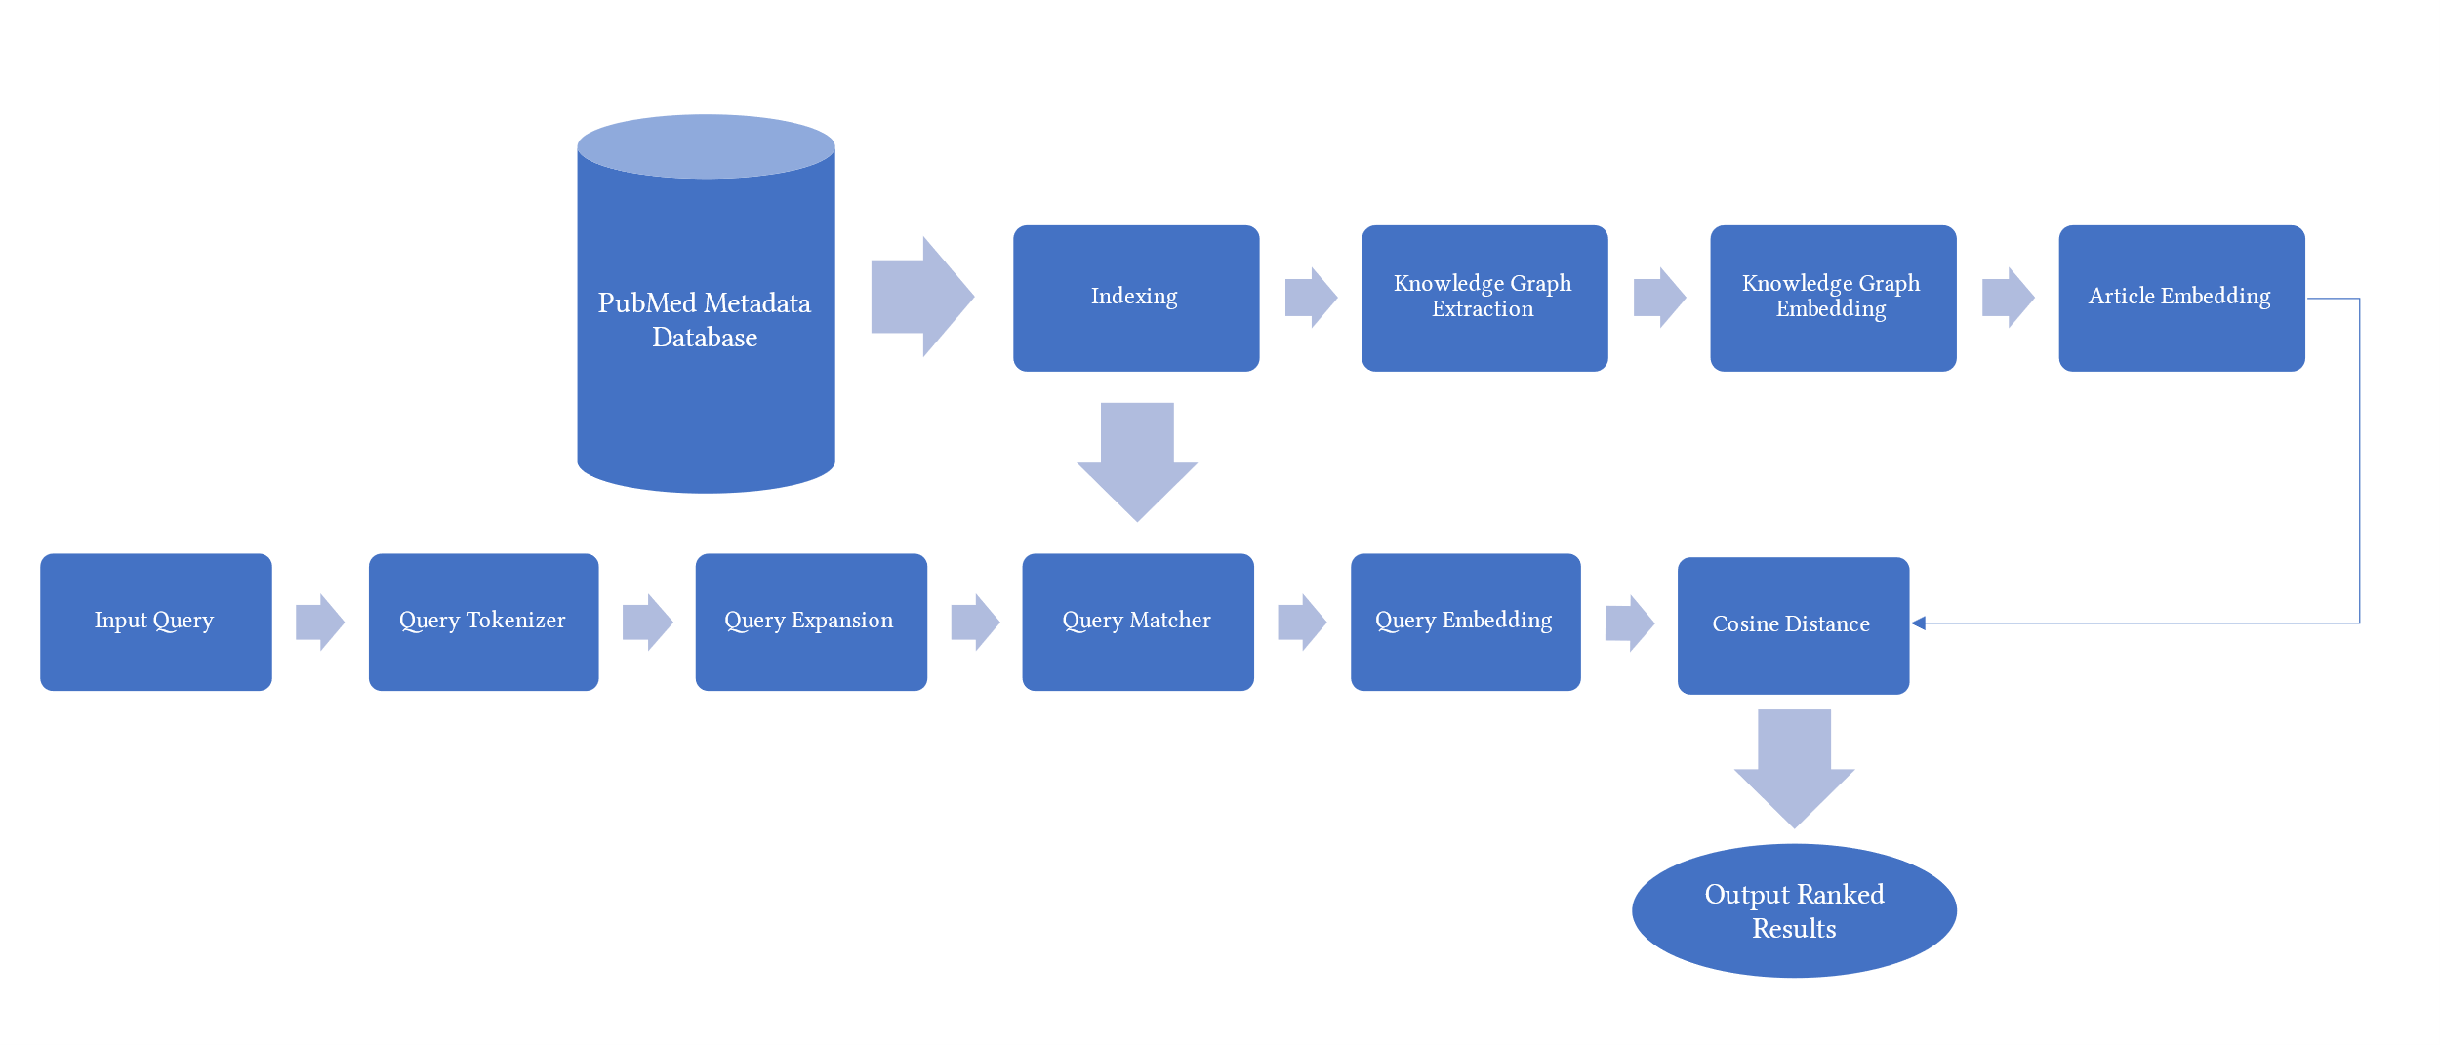
3. Method: knowledge graphs, graph embedding
Notes:
To overcome those challenges mentioned before here I modeled the PubMed citations as a knowledge graph. The modeling relies on the metadata that has been extracted in the paper (Xu et al., 2020). Then training a knowledge graph embedding model on the remodeled PubMed data. Following I use the index built from the extracted biological entities in (Xu et al., 2020) to create query embeddings. The generated query embedding along with the article embeddings are then compared using a simple cosine distance metric and ranked accordingly. I also provide results and evidence that using Knowledge Graphs and graph representation learning is useful and important in the future in information retrieval and bibliographic search engines.

Slide 15
3. Method: the PubMed dataset (Xu et al., 2020)
Table | # Of rows | # Of distinct entities | Description
A01_Articles | 31,928,777 | 31,926,861 | A table containing PubMed articles’ bibliographic information.
A02_AuthorList | 131,446,038 | 18,519,492 | A table containing PubMed authors and their unique identifier.
B10_BERN_Main | 295,921,671 | 20,136,150 | A table containing all types of extracted bio-entities by BioBERT are used in both building the Knowledge Graph and as an index.
C03_Affiliation_Merge | 62,015,712 | 9,502,394 | Table containing affiliations and them extracted fine-grained items.
C05_NIH_PubMed | 22,946,601 | 116,530 | A table containing projects from NIH ExPORTER and mapping relation between PI_ID, PMID, and AND_ID.
C04_ReferenceList | 633,401,975 | 23,856,949 | A table containing reference relations between PMID and reference PMID. It was extracted from the Web of Sciences.
Notes:
The Table provides statistics and a description of the PubMed relational database for essential tables. The original dataset that they have extracted contains 27 tables linked by PMID. Here we extract metadata from 7 tables. In addition, we do not use 31 million articles for our evaluation. Instead, we choose a subset of articles that have been submitted to journals between the dates of 2/1/2019 and 2/3/2019. This subset of the articles yielded 2696 articles when queried on PubMed. We then use the 2696 articles to extract a first-order citation network from the table C04_ReferenceList. The citation network yielded 100456 articles. Finally, for the 100456 articles, we extracted the rest of the metadata from the tables listed above, which will be described later.

Slide 16
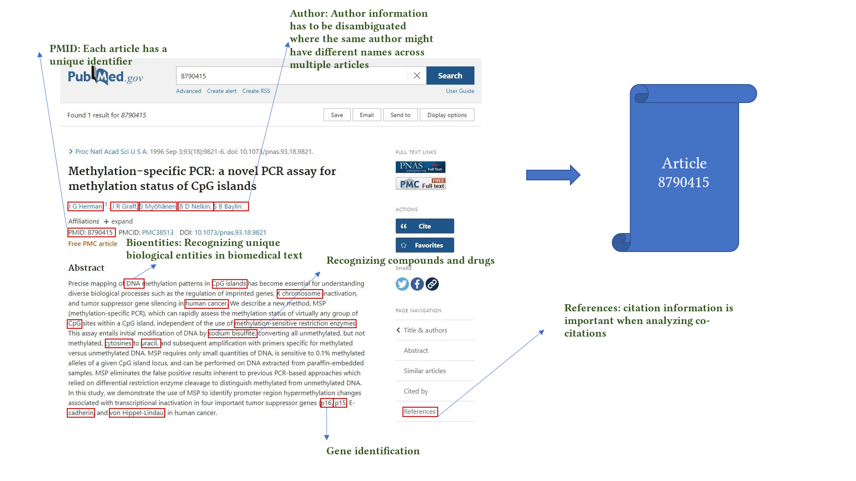
3. Method: indexing
Notes:
Next comes indexing. In the dataset described in the previous slide the authors extracted the mentions of the biological entities including names of drugs, diseases, genes, proteins and species from each title and abstract of each article in PubMed by applying a named entity recognition algorithm using the deep learning model BioBERT. The result is an index of each mention and its exact location in each article along with its recognized entity id. Meaning that if for example Aspirin was mentioned in an article and if an alternative name for Aspirin such as NSAID or acylitic acid was mentioned in another article both of those mentions will belong to the same recognized entity. In addition, in that dataset the authors extracted and disambiguated author names since the same author might appear with different names in different articles. Authors are also identified by a unique identifier in the table A02_AuthorList along with their name mentions and their articles that they have contributed to. Also, citation information from the table C04_ReferenceList where the first order citations are extracted for each article combining various sources such as PubMed and web of science. Also, for each article the funding information is extracted where each article belongs to an NIH project also the information for these projects are included such as PIs and whether those PIs are authors.

Slide 17
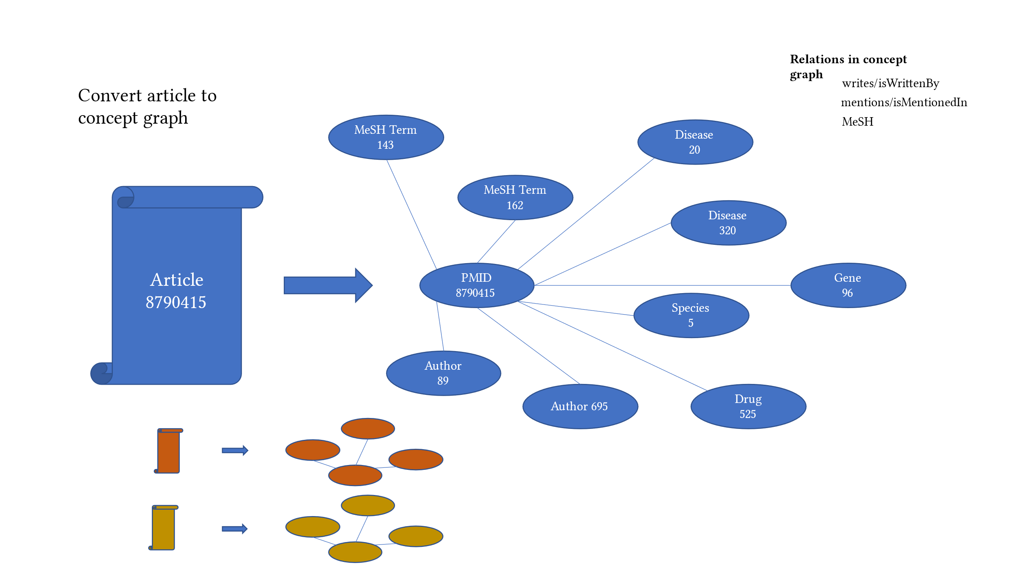
3. Method: knowledge graph extraction
<“bioentity/drug/1256”, “isMentionedIn/mentions,” “article/pmid/78456”>
Notes:
For each article, we first extract all author names, names of drugs, genes, proteins, diseases, and species in addition to related MeSH terms and Chemical Substances terms from the tables described above. Then, the unique identifiers representing each entity create the knowledge graph. As described before, knowledge graphs are represented as a list of triples. For example, in our case, when we extract an author name for an article from the metadata database, we represent that information as <“article/pmid/86509”, “isWrittenBy/wrote,” “author/aid/6754”>. Similarly, when we extract a drug name from an article, that information is represented as <“bioentity/drug/1256”, “isMentionedIn/mentions,” “article/pmid/78456”>. In addition, if an NIH grant or project funded an article, that information will be represented as <“ article/pmid/5678”, “isFundedBy/funds,” “nih_project/project_id/4123”>.

Slide 18
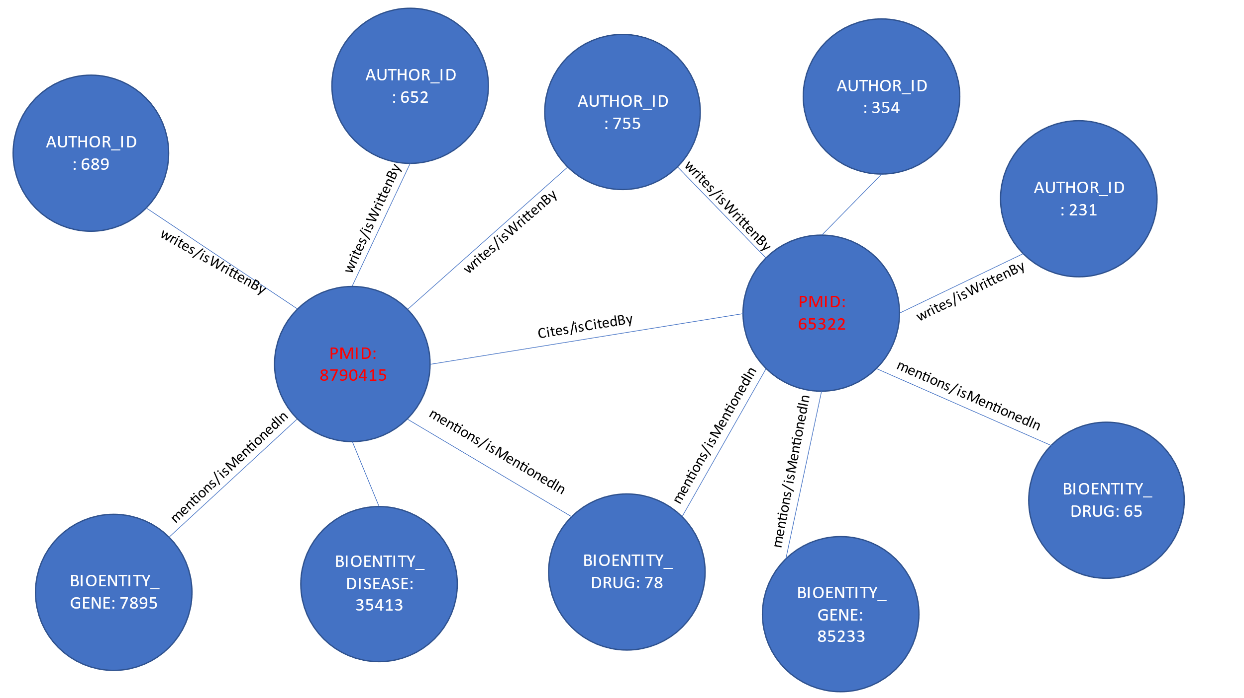
3. Method: knowledge graph extraction
<“article/pmid/652148”, “isCitedBy/cites,” “article/pmid/415923”>
Notes:
Accordingly, each article and associated metadata will be represented as a mini knowledge graph or a concept graph. Those mini knowledge graphs or concept graphs could be seen as subgraphs of a larger encompassing knowledge graph. In our case, we link all the subgraphs in two ways. First, we use the citation network provided in table C04_ReferenceList, representing extracted citation information from PubMed and Web of Science. The citation network provides the set of edges necessary to link most of the articles using the relationship “isCitedBy/cites.” For example, two articles will be linked and represented in the knowledge graph as a triple <“article/pmid/652148”, “isCitedBy/cites,” “article/pmid/415923”>. Second, since the authors and the names of drugs, diseases, genes, and proteins are disambiguated and unique, if an author appears with multiple names across several articles, all the names they appeared with will have the same author identifier number. Similarly, they will have the same unique identifier if they appear with different names such as Aspirin and NSAID for drugs, proteins, genes, and species. Second, since for each article, we create the mini knowledge graph using a unique identifier. The linked knowledge graph will also be semantically linked because an author will appear in multiple articles, a drug name in multiple articles, and the citation network links all articles together. The final knowledge graph will be a semantically linked network representing articles, authors, NIH grants, drugs, diseases, genes. Extracting a knowledge graph dataset as described above for the whole corpus of articles in PubMed is a daunting task, so to have a proof of concept, we extract only a small subset of articles with their citation information. Knowledge graph extraction can be formalized by seeing each subject and object in the extracted triples

Slide 19
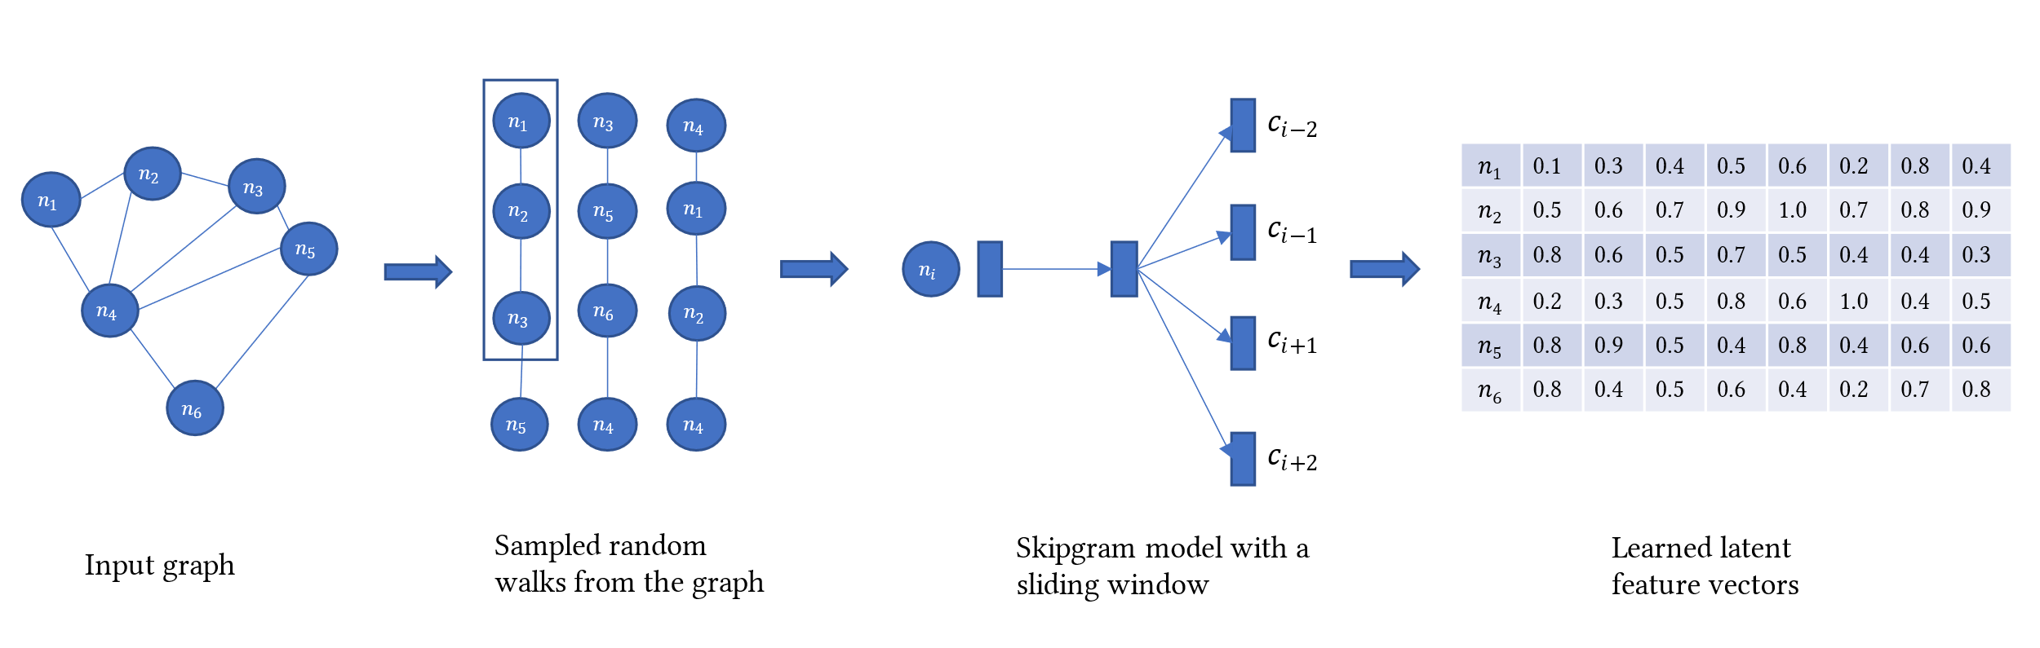
3. Method: KG embedding: Node2vec
Notes:
As mentioned before Knowledge graph embedding aims to learn a set of feature vectors for each node or entity in the knowledge graph. The feature vector needs to encode the structure of the graph. Node2vec performs a modified version of the random walk strategy (Perozzi et al., 2014), including parameters p and q to control the sampling strategy.
The p parameter controls the likelihood of the walk revisiting a node. The q parameter controls whether the search is constrained locally or globally. Given q > 1 and a random walk on an initial node, the random walk samples nodes closer to the initial node as in Breadth-First Search. Whereas q < 1, random walk samples nodes further from the initial node like a Depth First Search. This customizability in search behavior allows the random walker to capture diverse structural and topological properties within the graph. The sampling strategy builds a corpus of walks starting from each node.
Then a Skip-gram model trains on this corpus to generate a unique embedding vector for each node in the knowledge graph. Once the model finishes training, we get an embedding vector of size d for each node regardless of its type, whether an article, author, drug, disease, gene, NIH project, or MeSH term.

Slide 20
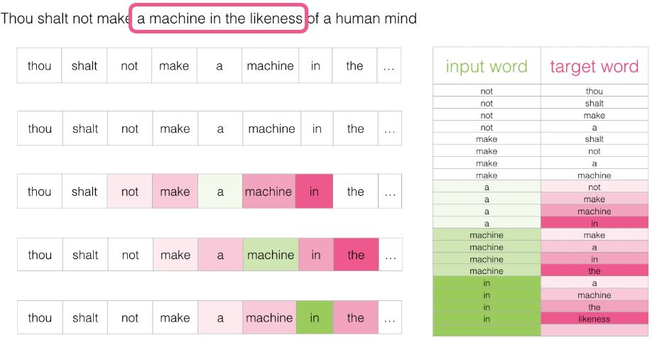
3. Method: KG embedding: Node2vec: Skipgram

Slide 21
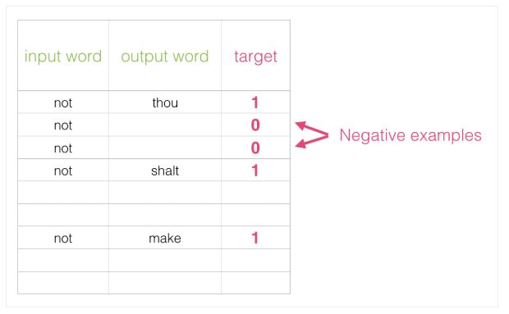
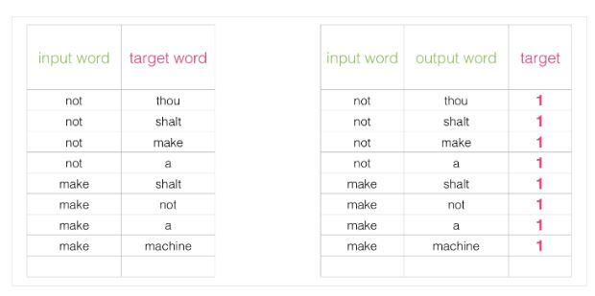
3. Method: KG embedding: Node2vec: Skipgram

Slide 22
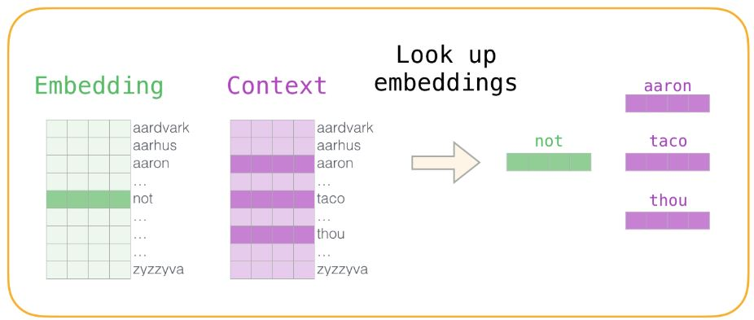
3. Method: KG embedding: Node2vec: Skipgram

Slide 23
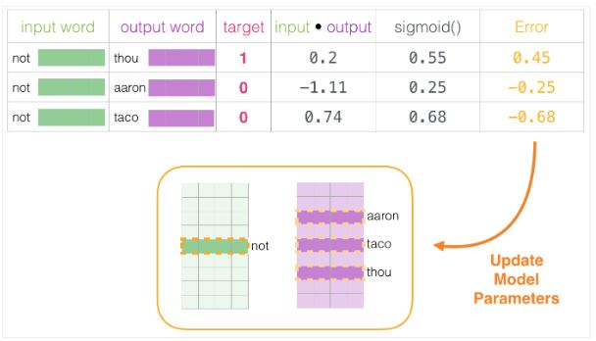
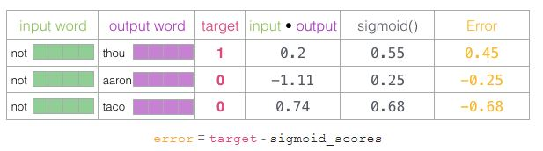
3. Method: KG embedding: Node2vec: Skipgram

Slide 24
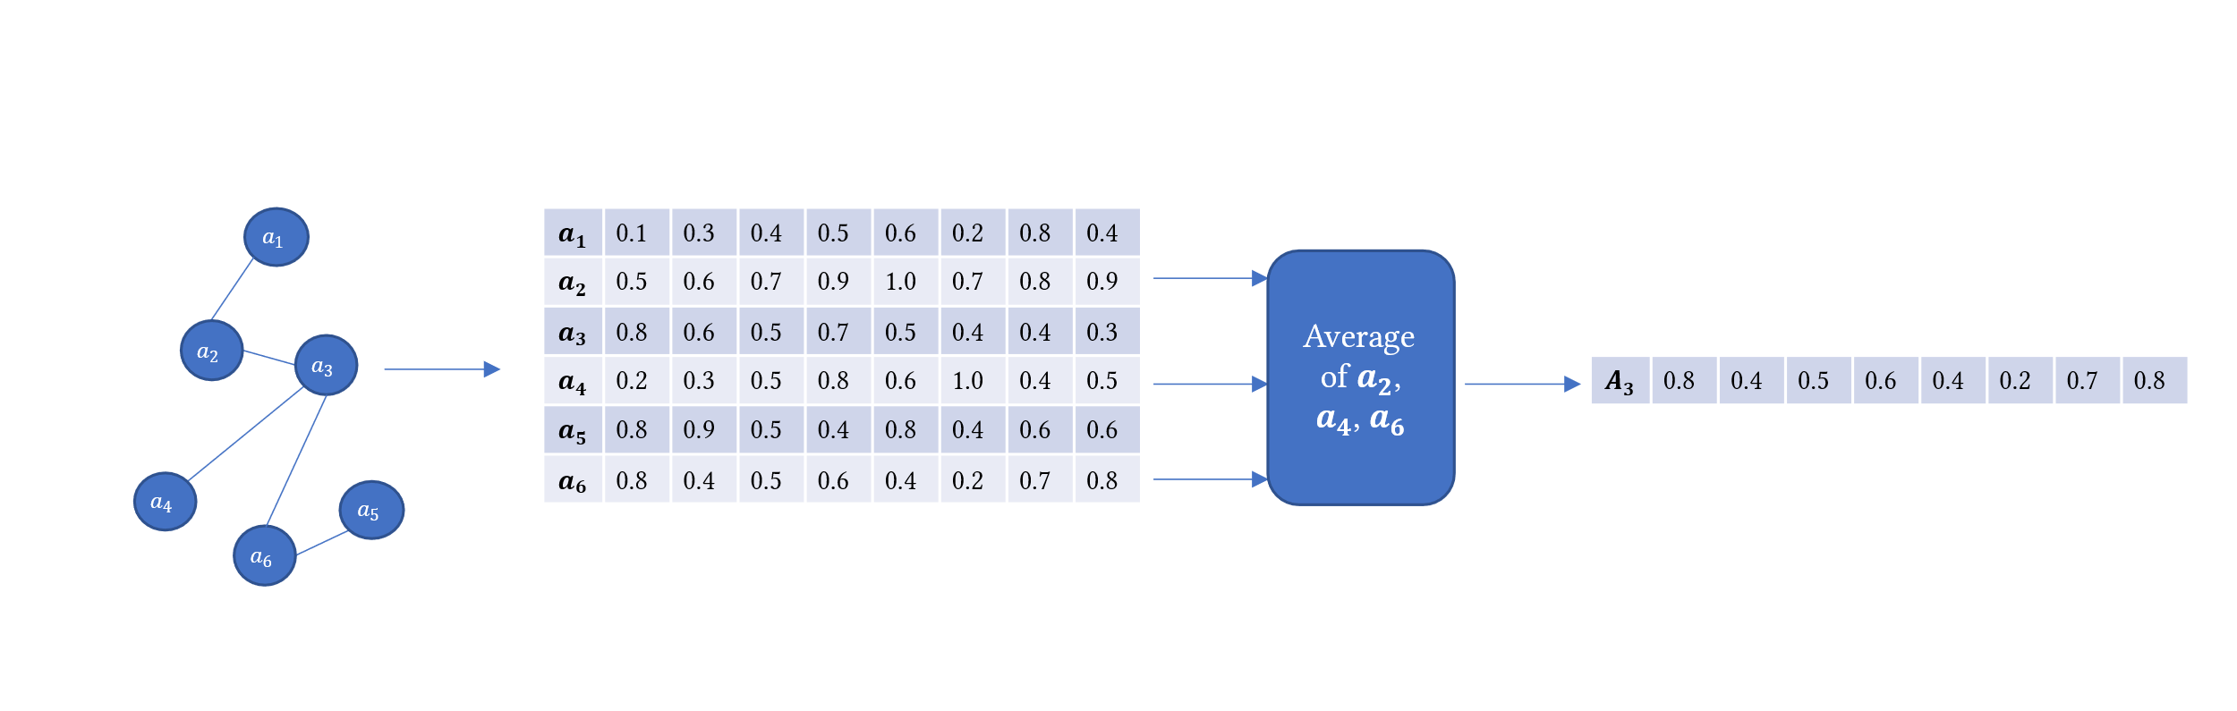
3. Method: Generate article embeding
Notes:
As mentioned before, our goal is to build a backend knowledge graph-based embedding model used by a front-end search engine to rank articles relevant to specific user queries.
Now that we have learned those node embeddings. Remember that each node in the graph can be an article, author, drug, gene, protein, NIH_project and so on. But what we want is one embedding vector per article. So this step uses a pooling operation averaging all the node embedding vectors of all types of nodes connected to each article node in its first-order neighborhood. We created the article embedding model in 2 stages. First, we performed the pooling operation of averaging all the nodes of the articles as described before mentioned in the citation network, which gives us 100456 articles. Next, we did a second pooling operation where we averaged the first-order neighbors of articles for the 2696 articles we intend to search.

Slide 25
3. Method: Search Interface: Query tokenizer
“show me articles on depression and type 2 diabetes”
[“articles,” “depression,” “type,” “2”, “diabetes”]
Notes:
This module acts as an interface with the user. It takes user queries and parses them. The input queries are assumed to be in English and are tokenized by splitting over white spaces after removing punctuation, stop words and verbs. For example, a query like “show me articles on depression and type 2 diabetes” after tokenization it will be reduced to [“articles,” “depression,” “type,” “2”, “diabetes”]. The output keywords will be passed to the query expansion module. Note that the assumption here is that the query should include keywords in the index.

Slide 26
3. Method: Search Interface: Query Matcher
[“articles,” “depression,” “type,” “2”, “diabetes”]
[“articles,” “depression,” “type,” “2”, “diabetes,” “articles depression,” “depression type,” “type 2”, “2 diabetes”, “articles depression type,” “depression type 2”, “type 2 diabetes”]
Notes:
The list of extracted keywords is then expanded using a sliding window of sizes 2, 3, and 4. The sliding window’s function captures multiple tokens from the initial keyword list. It slides over the list of keywords and expands it. For example, our list of keywords [“articles,” “depression,” “type,” “2”, “diabetes”] will be expanded to [“articles,” “depression,” “type,” “2”, “diabetes,” “articles depression,” “depression type,” “type 2”, “2 diabetes”, “articles depression type,” “depression type 2”, “type 2 diabetes”]. The expanded list of keywords is then matched using a Levenshtein string distance comparator to the index. The index contains all the extracted biological entities from the articles and their unique identifiers and locations. For the matched mentions in each article in the index, each biological entity’s unique identifier will be extracted and passed to the next step. The system exits if the keywords are not found in the index.

Slide 27
3. Method: Query Embedding
[“articles,” “depression,” “type,” “2”, “diabetes,” “articles depression,” “depression type,” “type 2”, “2 diabetes”, “articles depression type,” “depression type 2”, “type 2 diabetes”]
Search Index
Extracted biological entities: [“256321”, “96587”, “74125”, “203”, “98765”, “85210”, “74152”]
Average node embedding vectors to get query vector
Notes:
This step aims to find all the nodes in the knowledge graph with the same identifiers as the identifiers returned by the query matcher. After identifying the nodes, their corresponding learned embedding vectors from the knowledge graph embedding step is extracted. All the vectors are averaged to a single vector in a pooling operation like described before. The single vector becomes our query embedding vector.

Slide 28
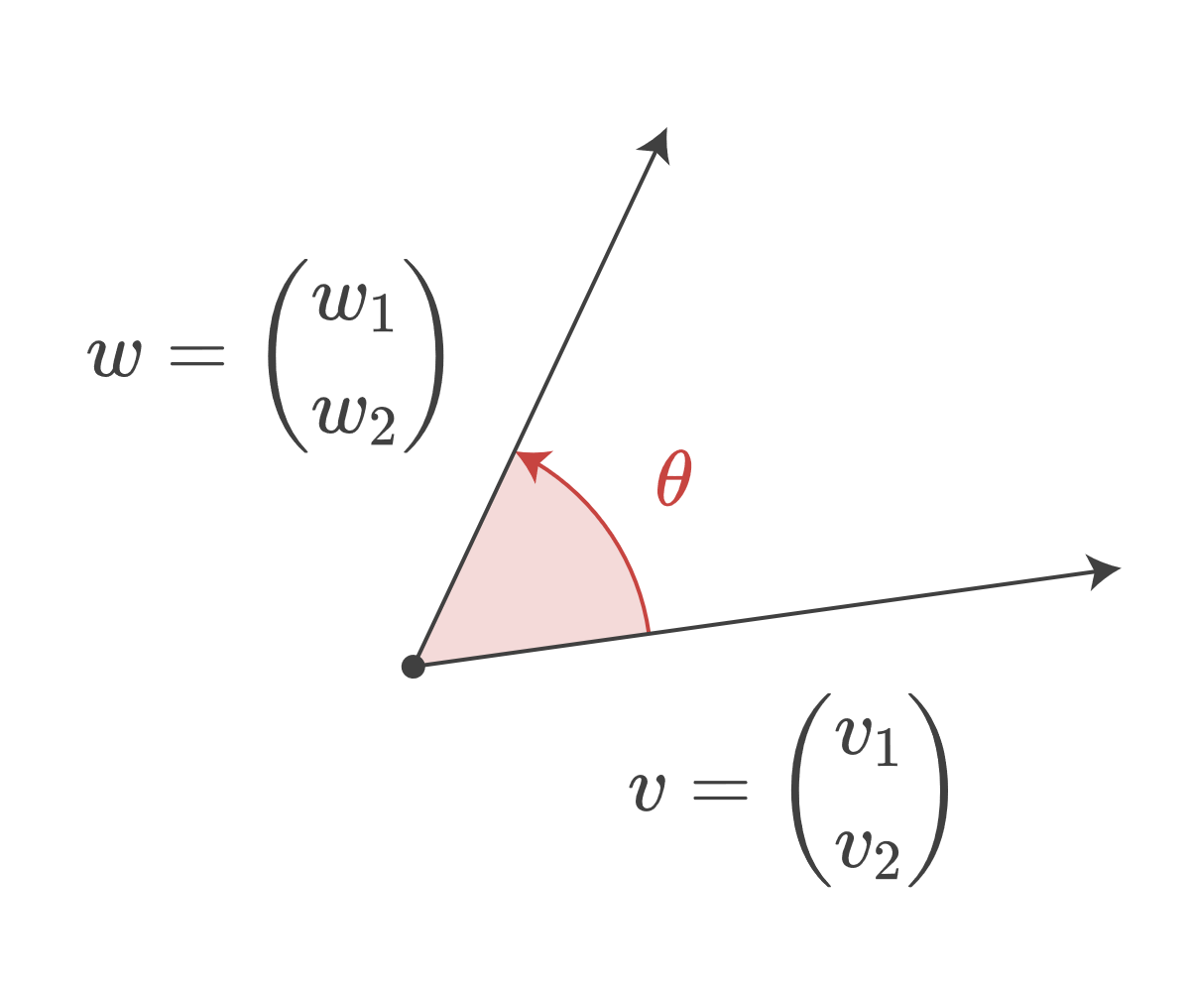

3. Method: Cosine distance ranking
$$similarity =\cos\left(θ\right)=\frac{AB}{\left|\left|A\right|\right|\left|\left|B\right|\right|}$$
Notes:
In a Euclidean space, the cosine of angle theta between two vectors A and B is determined using the relationship:
Since our knowledge graph has been embedded in Euclidean space, the similarity between two nodes is equivalent to the cosine of the angle between the two vectors representing the two nodes. So at this point, we have a query vector and a set of article vectors a simple operation between the query vector and the article vectors would yield the list of articles that are relevant to the query vector, and when sorted by the cosine score, the list of articles will be presented as ranked retrieved articles.

Slide 29
4. Evaluation: Dataset
(((("2019/month/01"[Date - Completion]: "2019/month/30"[Date - Completion]))))
(((("2019/02/01"[Date - Completion]: "2019/02/03"[Date - Completion]))))
Notes:
As mentioned before, we extracted a proof-of-concept dataset from the PubMed database described in (Xu et al., 2020). The database contains 3190000 articles indexed from the year 1781 to December 2020. I extracted our target dataset of 2696 articles submitted to journals between 02/01/2019 and 02/03/2019. I came about those dates by examining the number of articles that have been submitted to journals for each month in the past five years in PubMed. I then chose the month with the least number of articles submitted, February 2019. Still, the dataset at that point was too large. Note that we include extracted articles, but we also query the reference table to extract the first order citations of each article, so the number grows exponentially. Eventually, I kept reducing the number of days where articles were submitted to their journals until I got a reasonable size dataset. The query above is the final dataset I extracted from PubMed to evaluate the system.

Slide 30
4. Evaluation: Dataset
Node/Edge type | Number of nodes in the graph
# Nodes | 578453
# Author | 393864
# Article | 100456
# NIH Projects | 27109
# MeSH Terms | 20015
# Chemical Substances | 9686
# Disease | 9594
# Drug | 8762
# Gene | 6094
# Species | 2873
# Edges | 2226999
# Article-relatedTo-MeSHTerm | 1049789
# Article-writtenBy-Author | 596340
# Article-mentions-Disease | 176516
# Article-mentions-Drug | 108435
# Article-cites-Article | 104138
# Article-metions-Species | 70694
# Article-mentions-Gene | 56337
# Article-isFundedBy-NIHProject | 54751
# Article-relatedTo-Substances | 9999
Notes:
I then extracted the PMIDs of those articles. The extracted PMIDs were used to query the downloaded PubMed database to extract all the necessary metadata for each article. We first extracted the citation network of the 2696 articles, which yielded 100456 articles, including the 2696 articles. For the 100450 articles, all the metadata has been extracted, including author information, MeSH terms, Substances, NIH project involvement, extracted drug, disease, and protein names, and citation network from the tables described in before. The extracted metadata was used to create the knowledge graph described before. The final knowledge graph is a multi-undirected graph as described above. The total nodes in the graph were 578453, representing nine types of entities; authors, articles, NIH projects, MeSH terms, registered chemical substances, diseases, drugs, genes, and species. Most of those nodes were author nodes, followed by article nodes, then several NIH projects, MeSH term nodes, and extracted biological entities. Note that what defines a node in a graph is its identifier. Each node in the knowledge graph is identified by its original identifier concatenated to its type with a slash. For authors, identifiers are Author IDs (AIDs) in the database, PMIDs identify articles, Project IDs identify NIH projects, Header IDs identify MeSH terms, and extracted biological entities are identified by their unique Entity ID assigned by BioBERT in the original paper (Xu et al., 2020).

Slide 31
4. Evaluation: Experiments
(((("2019/02/01"[Date - Completion] : "2019/02/03"[Date - Completion])))) AND (type 2 diabetes[Text Word])
Query ID | Text | # Relevant Documents | # Tokens
1 | alcohol | 37 | 1
2 | amino acids | 11 | 2
3 | bacterial infections | 6 | 2
4 | basal cell carcinoma | 3 | 3
5 | bipolar disorder | 10 | 2
6 | cancer | 320 | 1
7 | diabetes | 59 | 1
8 | hepatitis c virus | 3 | 3
9 | histamine | 2 | 1
10 | insulin | 25 | 1
11 | loss of muscle strength | 1 | 4
12 | pediatric cancer | 1 | 2
13 | trauma | 22 | 1
14 | type 2 diabetes | 22 | 3
15 | urinary tract infection | 5 | 3
Notes:
I evaluated MedGraph to assess the quality of our knowledge graph embedding based relevance ranking against PubMed’s BestMatch algorithm as ground truth. I extracted a set of 15 queries from PubMed, and I applied the search on the articles that have been completed between the dates of 2/1/2019 and 2/3/2019. The 15 queries were chosen randomly from the extracted index of biological entities as described before. They contained the names of diseases and drugs, as shown in here. For example, for the query “type 2 diabetes,” we use the following query to search PubMed then download the resultant PMIDs of the ranked articles.

Slide 32
4. Evaluation: Experiments
Precision = number of relevant articles retrieved / total number of relevant articles
Recall = number of relevant articles retrieved / total number of retrieved articles
F1-Score = 2 * (Precision * Recall)/(Precision + Recall)
Mean Average Precision (MAP) = Precision at each position in K
Corpus
BOW
TFIDF
Input query
Rank
Notes:
Then for each query, I rank the articles based on the cosine distance metric by comparing the query vector to the article vectors as described before. Then I compute the number of relevant articles, the number of retrieved articles, and the number of relevant articles retrieved. I then compute precision, recall, and f1-score. Precision is the number of relevant articles retrieved over the total number of relevant articles. The recall is the number of relevant articles retrieved over the total number of retrieved articles. Moreover, F1-score is the harmonic mean of both precision and recall.
I also compute the Mean Average Precision (MAP) across queries. MAP is a widely used metric in information retrieval to evaluate search engines. It focuses on precision since recall can be misleading in some cases. To compute MAP, I first compute the average precision for each query. That is done by finding each retrieved article in the ground truth and for top K. Then computing precision at each article in the retrieved articles. That is followed by averaging the precision values across all retrieved articles K. Then averaging across all the queries.
I also implemented and trained a TF-IDF model on our corpus of 100456 articles then extracted the TFIDF vectors for the 2696 target articles to compare against our method. I first extracted a dictionary of unique tokens in the corpus then trained a Bag of Words model. The Bag of Words model was then used to train the TF-IDF model, yielding a vectorized document matrix and unique vocabulary.

Slide 33
3. Evaluation: Results
Metric | Method | K=1 | K=2 | K=5 | K=10 | K=25 | K=50 | K=75 | K=100 | K=150 | K=250 | K=500 | K=1000
Recall | TFIDF | 0.053 | 0.062 | 0.078 | 0.113 | 0.177 | 0.197 | 0.202 | 0.207 | 0.217 | 0.22 | 0.22 | 0.22
 | MedGraph | 0.227 | 0.245 | 0.297 | 0.392 | 0.545 | 0.646 | 0.693 | 0.726 | 0.749 | 0.846 | 0.931 | 0.976
Precision | TFIDF | 0.467 | 0.4 | 0.307 | 0.293 | 0.248 | 0.171 | 0.136 | 0.117 | 0.1 | 0.064 | 0.032 | 0.016
 | MedGraph | 0.867 | 0.667 | 0.507 | 0.453 | 0.336 | 0.248 | 0.202 | 0.172 | 0.134 | 0.103 | 0.064 | 0.034
F1-Score | TFIDF | 0.081 | 0.083 | 0.09 | 0.122 | 0.161 | 0.138 | 0.118 | 0.107 | 0.097 | 0.074 | 0.046 | 0.026
 | MedGraph | 0.279 | 0.245 | 0.235 | 0.276 | 0.282 | 0.253 | 0.221 | 0.197 | 0.161 | 0.134 | 0.095 | 0.056
MAP | TFIDF | 0.467 | 0.383 | 0.272 | 0.221 | 0.184 | 0.177 | 0.175 | 0.174 | 0.174 | 0.173 | 0.173 | 0.173
 | MedGraph | 0.867 | 0.55 | 0.284 | 0.168 | 0.077 | 0.041 | 0.028 | 0.021 | 0.014 | 0.009 | 0.004 | 0.002
Notes:
Here th table presents the results on the four metrics we described. I ran 12 levels of K for both this method MedGraph and the standard TF-IDF. The results here indicate that MedGraph has outperformed TF-IDF on the PubMed BestMatch dataset at various levels of K and across all queries and metrics. The only exception is that MAP at higher K levels was higher for TF-IDF. That might explain why TF-IDF returns more relevant documents but does not rank them higher, while MedGraph might retrieve less relevant documents more semantically related and ranked closely. In addition, both precision and recall for MedGraph were consistently higher with the recall increased exponentially with higher K, and precision decreased exponentially with higher K levels.

Slide 34
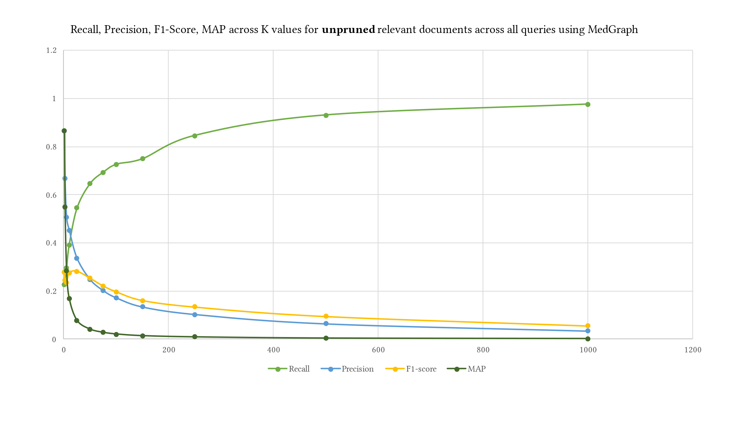
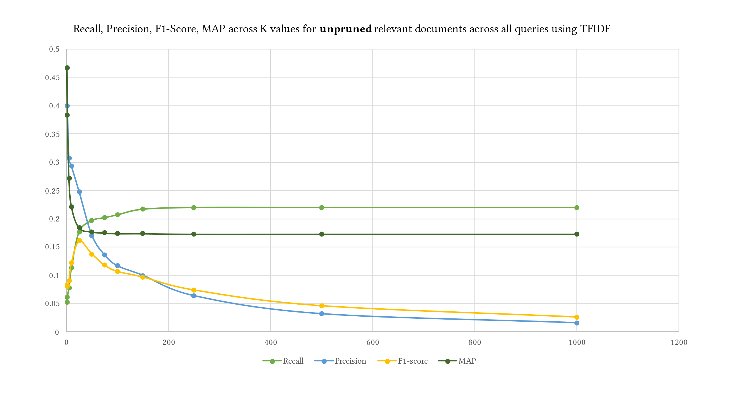
3. Evaluation: Results
Notes:
MedGraph had higher F1 Scores across all K levels due to its higher recall and precision. The highest difference between MedGraph and TF-IDF was at K=1, indicating that the first document in the retrieved documents almost always existed in the ground truth dataset. However, recall was the lowest because most of the relevant documents did not exist in the first position in the retrieved documents. Of course, as we increase K, the recall increases, indicating that most of the relevant documents in the ground truth appeared in the retrieved documents. At K = 10, MedGraph started underperforming on MAP while TF-IDF stayed consistent at higher K levels. That is because MedGraph ranks a small number of the relevant documents highly, while a large number of the documents do not appear in MedGraph. The documents that appear in the retrieved documents are ranked closely and higher due to the semantic nature of the algorithm, while the documents that are not closely ranked and in the top are usually ranked lower and tend to be spread out.
Alternatively, in other words, MedGraph produces relevant articles that are closely ranked together due to the semantic nature of the algorithm, while TF-IDF produces almost the same number of relevant articles but are not ranked closer together.

Slide 35
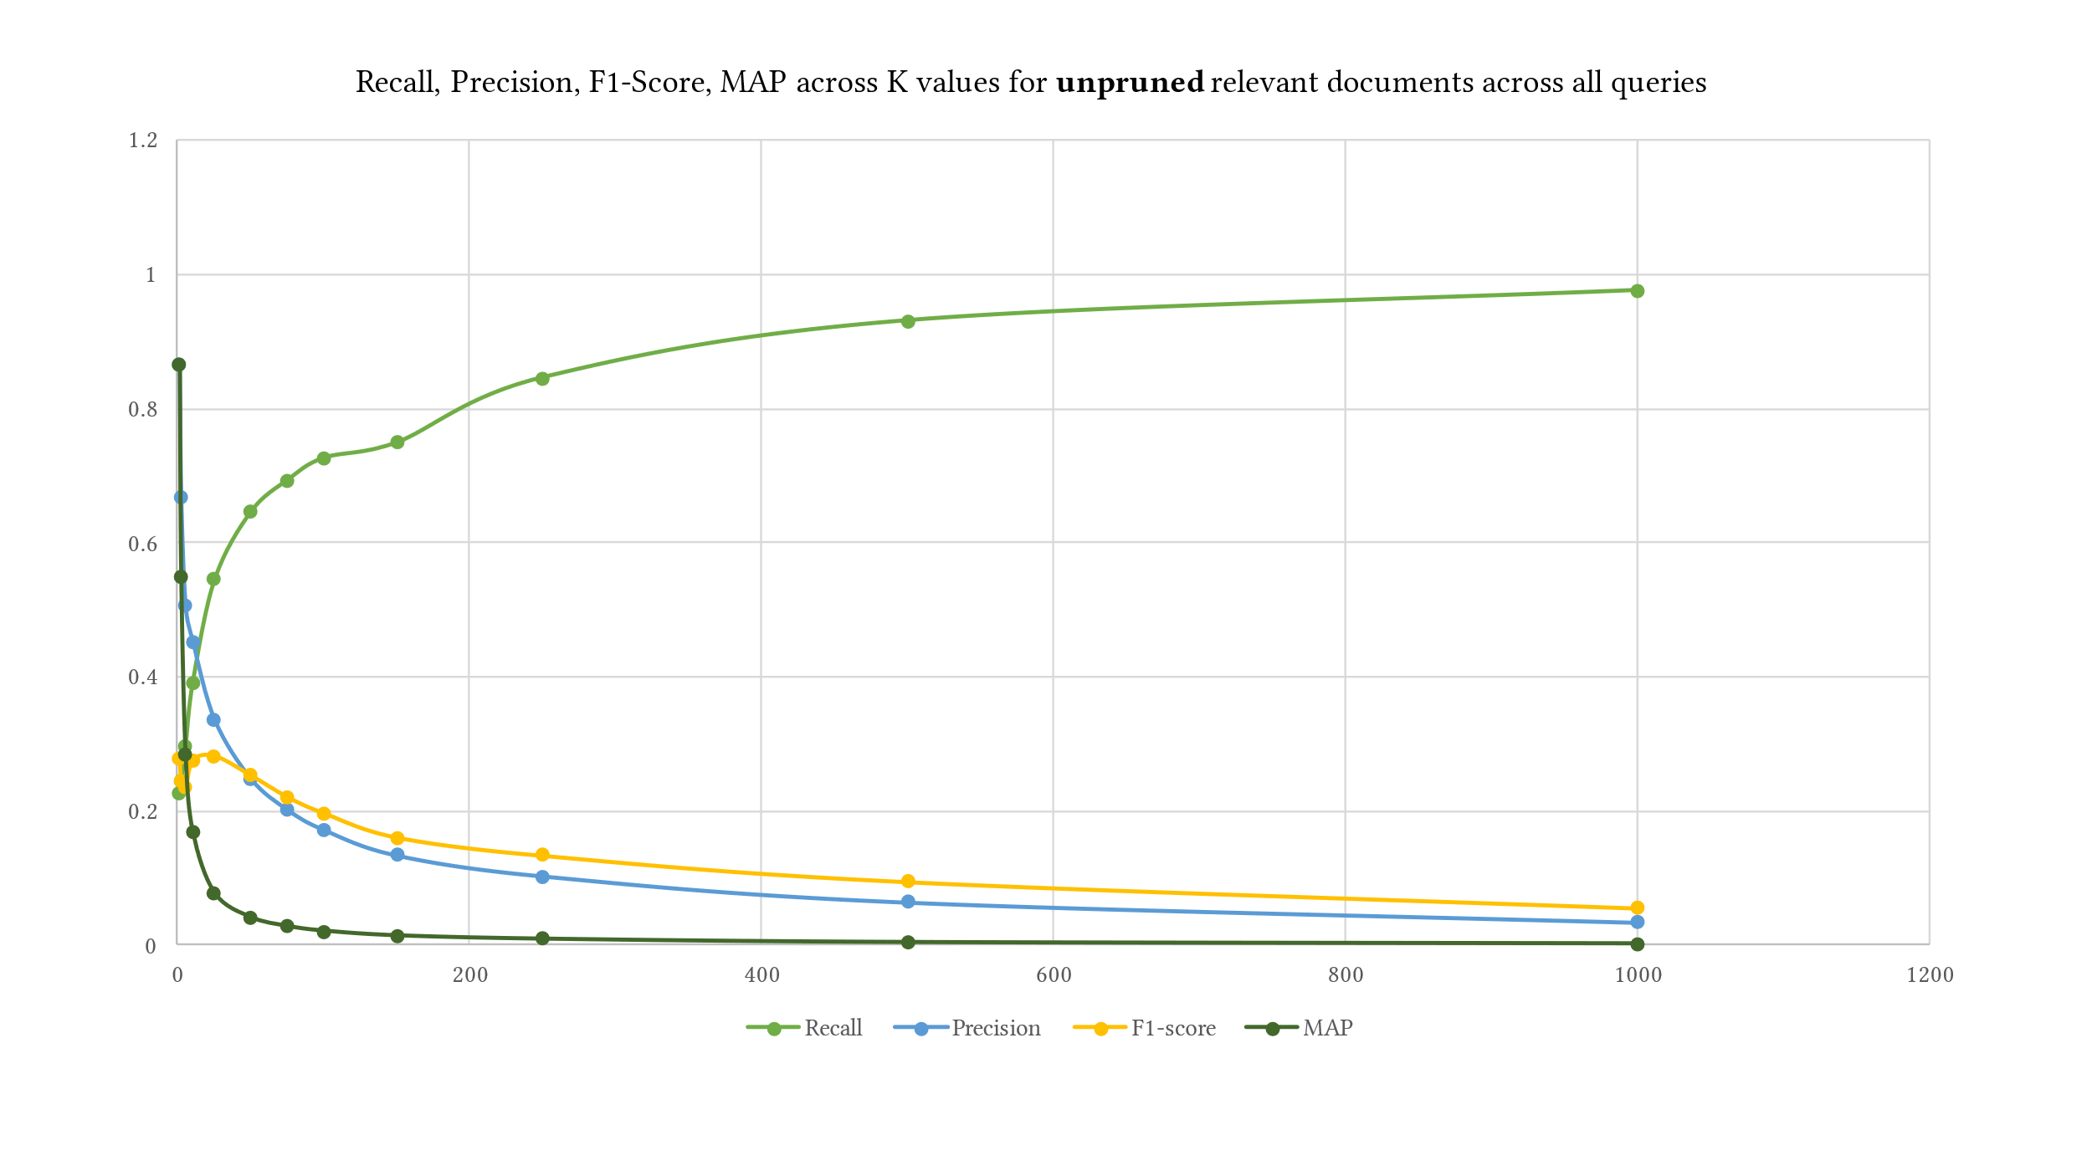
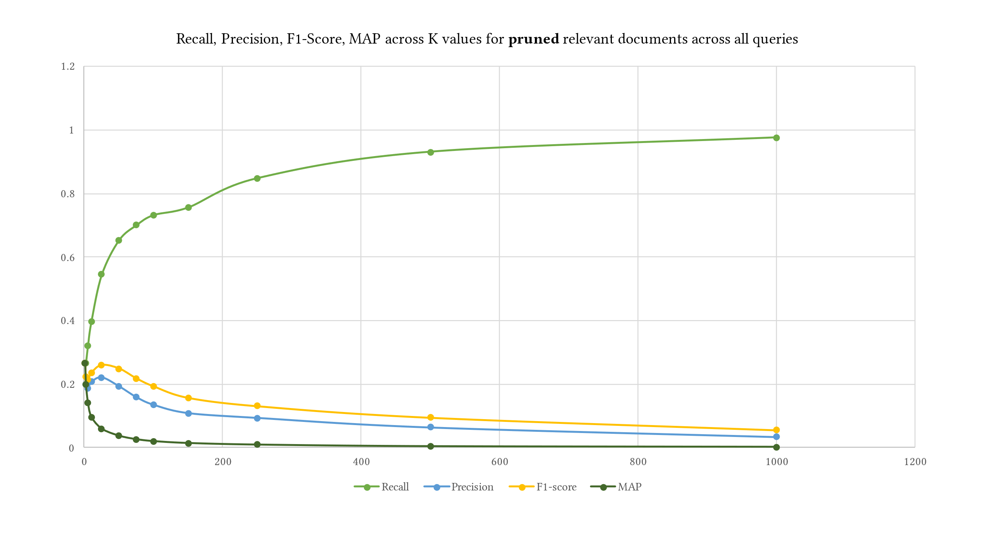
3. Evaluation: Results
Notes:
I also computed the four metrics by pruning the top K ground truth results relevant documents from BestMatch. I used the same K levels provided to prune the retrieved and relevant results. This figure shows the difference between pruning the relevant ground truth articles and not pruning them. The values of recall and F1-Score do not differ between both approaches, yet precision and MAP are higher when the relevant documents are not pruned using K. Pruning perhaps provides a mechanism to control the ground truth dataset. We do not know how exactly BestMatch ranked it. The returned BestMatch articles from PubMed have different retrieved articles without explanation. Hence pruning might make sense in some cases depending on the evaluation dataset.

Slide 36
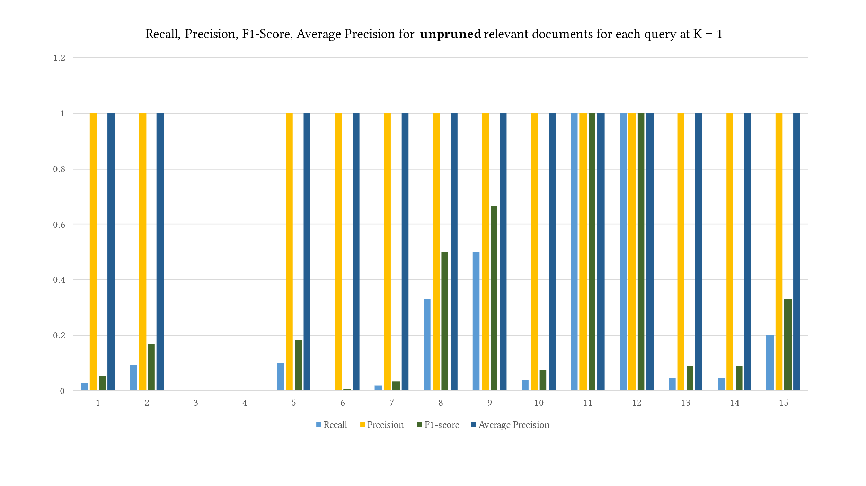
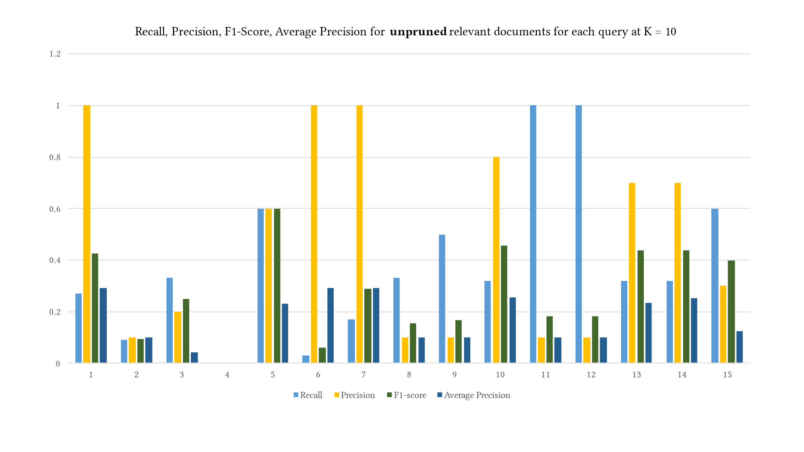
3. Evaluation: Results
Notes:
This diagram is a different way of observing the recall precision f1 scores and map values at different K levels for each query. At K=1 it seems like query 11 and 12 were perfect simply because both queries on PubMed returned only 1 document and the document was successfully retrieved by MedGraph. At K=100 precision decreases across all queries which also makes sense yet it stays consistent on queries with a small of number of relevant documents, again an evidence of MedGraphs success in retrieving articles that are semantically connected even though the model was trained on a small subset of articles compared on BestMatch that was trained on the whole corpus of PubMed.

Slide 37
3. Discussion & Future Work
Conlcusion
Future
Knowledge Graph methods are very useful and efficient
BestMatch and TFIDF do not understand semantics
MAP alone is not enough
A/B testing is needed
Precision alone is very informative, and Recall can be decieving
Conduct user studies
Train on the full dataset
Enrich the knowledge graph with semantic datasets
User knowledge graph embedding models that understand heterogeneity
Testing with more complex queries
Finding a ground truth dataset
Notes:
So this work provided evidence of the utility and efficiency of knowledge graph-based methods in information retrieval, especially in the biomedical field. We highlighted the need for more techniques that rely on semantic understanding of queries and datasets to aid in automated knowledge discovery and information organization. Knowledge graphs have been around for a while, yet they have not been fully utilized in search engines. Approaches such as BestMatch for PubMed are very efficient but do not understand semantics and are trained on user query logs that might change over time, requiring retraining. Traditional TF-IDF approaches do not rely on semantics and are almost outperformed by newly developed methods like mine. The results also indicated that MAP alone is not enough as an evaluation metric. The ranking is usually evaluated using A/B testing approaches involving user studies and metrics that would include users ranking relevance by hand then computing metrics such as Normalized Discounted Cumulative Gain (Busa-Fekete et al., 2012). Precision as a metric is very informative as evaluating how many relevant articles were retrieved. Nevertheless, metrics such as recall can be misleading. For example, if the system only retrieved one document, but that document is in the relevant documents no matter the rank, then recall shall be 100%. Precision acts as a self-assessment on the retrieved articles by MedGraph because it compares the numbers of retrieved relevant articles to the number of retrieved articles regardless of the number of relevant articles.
In future work, I plan to conduct a user study where each user, typically a biomedical researcher or a medical student, will be invited and asked to rank documents based on specific queries. We will create our ground-truth dataset instead of relying on BestMatch as our ground truth. We also plan to expand the scope to extract a knowledge graph from the entire dataset of 30 million articles described in (Xu et al., 2020) and compare our model with BestMatch and TFIDF using our ground truth. In addition, we plan to experiment with various other knowledge graph embedding models (Q. Wang et al., 2017). For example, Node2vec represents a basic model incapable of encoding heterogeneity in knowledge graphs. Heterogeneity refers to a knowledge graph having more than one type of node and more than one type of edge or relationship. Hence, we will experiment with models capable of capturing more semantics in the training of node embeddings, expanding our query matching capabilities to include more than four tokens, and handling out-of-context queries. In addition, we plan to have even more metadata nodes in our knowledge graph with the potential of enriching the knowledge graph with other semantic datasets such as Chem2Bio2RDF (Chen et al., 2010).

Slide 38
8. Bibliography
References and full bibliography is available in the report in section 7
Notes:
And lastly the used bibliography. It is worth mentioning that it took me a while to collect the literature filter it and analyze due to the sparsity graph methods in entity resolution. I expanded the search and Dr. Talburt also was very helpful that he had some literature on the topic. All of that has been reflected in the proposal.

Slide 39
Thank you for attending and listening.
iaebeid@ualr.edu

