Slide 1



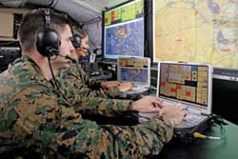
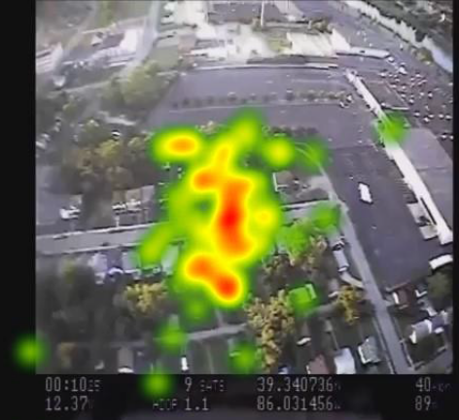
Eye Tracking for Adaptive User Interfaces
Dr. Paul Kogut – LM RMS C6ISR
Dr. Kevin Oden – LM RMS Training and Logistics Solutions
Dr. Jacek Gwizdka - School of Information, University of Texas Austin

Slide 2

Project Overview
Augmentations:
proactive assistance
adaptive displays
alerts…
Users:
ISR analyst
tactical commander
student pilot
OSINT/HUMINT analyst
cybersecurity analyst
homeland security…
Sensors:
eye-tracking
facial expression
EEG
heart rate
skin conductance
body position
Functional Near-Infrared…
Human Machine Teaming

Slide 3



Eye-Tracking
  Eye tracking sensors can accurately identify what the user is looking at (e.g., a word, an object on the screen or in a video…)
    Eye movement patterns and pupil dilation provide a window into the user’s thought processes
    Low cost eye tracking equipment is being developed for gaming, mobile phones, education, medical and neuro-marketing applications
    “with the advent of affordable eye trackers, there is a growing interest in pervasive attention-aware systems and interfaces that have the potential to revolutionize mainstream human technology interaction”
      Majaranta, P., & Bulling, A. (2014). Eye tracking and eye-based human–computer interaction. In Advances in physiological computing (pp. 39-65). Springer London.
    Apple acquired SensorMotoric Instruments (SMI is a leading eye-tracking company)
    Oculus/Facebook acquired EyeTribe (makers of a $99 eye-tracking device)
    Google acquired Eyefluence (eye-tracking user interface)

Slide 4
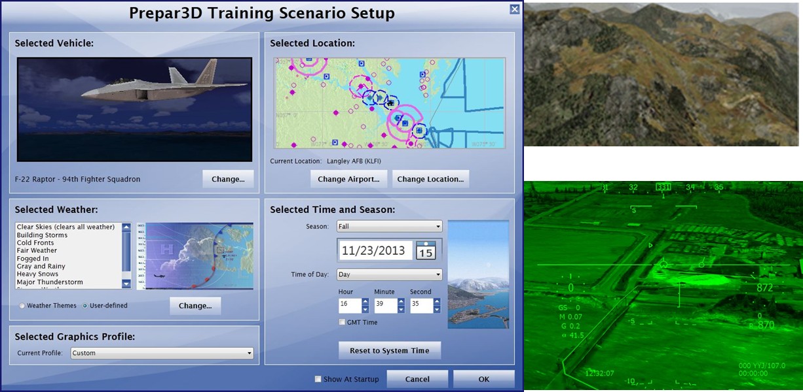
Eye-Tracking for Adaptive UI
Conduct experiments with human subjects to identify eye tracking measures that can guide UI adaptation
  e.g. eye movement patterns and dynamics of pupil dilation
Design adaptive user interfaces for ISR, C2 and pilot training scenarios. Examples:
  if an operator is looking at a specific geospatial location then the system could proactively retrieve relevant activity reports or dispatch a small UAV to collect video.
  a training system would determine if the gaze patterns are consistent with the training context.
Develop algorithms to interpret eye tracking data and correlate it with user information needs
Eye-tracker
and camera
raw data
Data collection
and analysis
Prepare3D
UI adaptation
control
scenarios
Lockheed Martin Proprietary Information

Slide 5
Example UI Adaptations
Data | Capabilities
Text e.g., news, social media, intelligence reports, HUMINT… | Proactively perform additional searches with words that are identified as relevant based on sensing the user’s mental reaction Refine the filtering of data based on documents that were identified as relevant or irrelevant by sensing the user’s reaction Dynamically build a profile of the user’s information needs based on the current session and not on historical queries and preferences.
Video and imagery e.g., from UAVs, satellites, ground based surveillance cameras, robots… | Sense what objects, segments or activities in the video or image is relevant and then: • Proactively search for additional data (e.g., IMINT, MASINT, HUMINT, OSINT) that is relevant to what the analyst is focusing on • Perform change detection and object recognition • Automatically zoom in on relevant detailed video • Automatically identify additional objects, areas and activities that are similar to what the analyst is currently focusing on • Automatically query the origin of a track, draw watch boxes, create new target folders…
Complex situation awareness displays e.g., multi-INT ISR, UAV C2, training system (e.g. pilot), air traffic control… | Sense what objects, windows, geospatial areas, data visualizations in the complex display are relevant and then proactively adjust the display or search for additional data that is relevant to what the operator/commander is focusing on

Slide 6
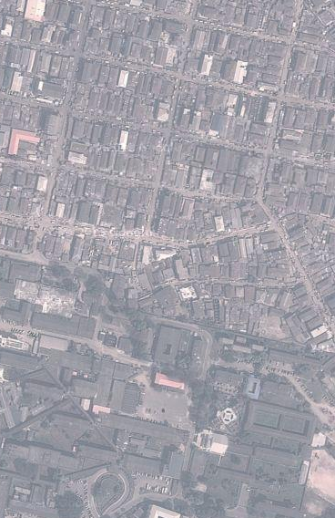

C4ISR Example
Retrieve relevant OSINT alert
Send UAV to collect video feed
gaze
gaze
gaze
Retrieve relevant HUMINT report

Slide 7
Key Accomplishments
  Project began July 2017
  PhD student on board
  Extensive literature review
  Presented to LM Joint TFG workshop Sept. 26
  Prepar3D installed at UTA
  Draft experiment design
  Draft research protocol for Institutional Review Board (IRB)
  Design ISR scenarios and implement in Prepar3D
    Improvised explosive device (IED) roadside deployment in war zone
    Weapons smuggling
    Terrorist attack on a US ship in a harbor by small vessels
  Revise ISR scenarios for experimental use
  Creating/modifying algorithms for real-time eye-tracking data processing

Slide 8
2018 Plans
  Conduct ISR experiment
  Analyze results

Slide 9
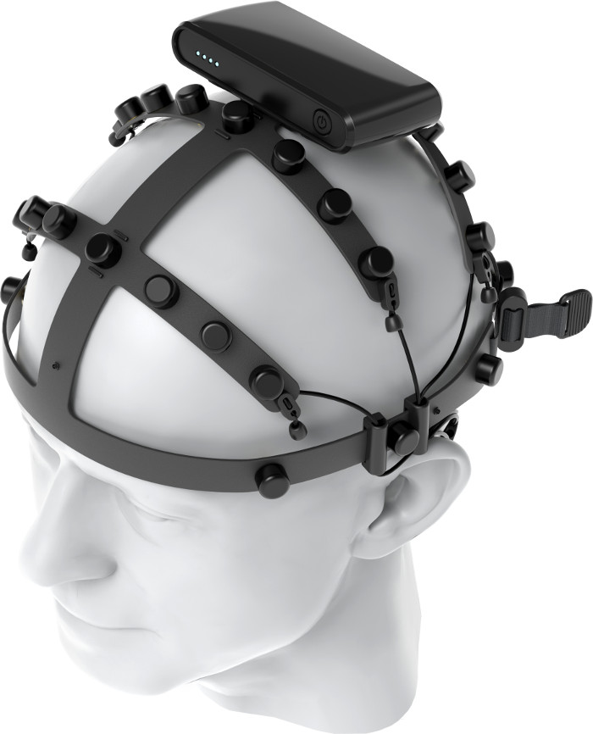
Future: Electroencephalography (EEG)
  EEG sensors can measure the user’s mental reaction to what the user is seeing
    Low cost EEG headsets are being developed for gaming, education, medical and neuro-marketing applications
    Comfort and accuracy are improving
      E.g. Nielsen F1 wireless headset has up to 40 channels with dry electrodes
Gwizdka, J., Hosseini, R., Cole, M., & Wang, S. (2017) Temporal dynamics of eye‐tracking and EEG during reading and relevance decisions. Journal of the Association for Information Science and Technology.

Slide 10


Initial EEG Results
What is the Bollywood equivalent of Beverly Hills?
Theta indicates possible answer
(working memory activity)
P300 happens when participant makes a decision that an answer has been found
Results from 2014 experiment sponsored by LM IS&GS
Dr. Joseph Dien - Maryland Neuroimaging Center, University of Maryland
Dr. Jacek Gwizdka - School of Information, University of Texas Austin
Dr. Bradley Hatfield - Department of Kinesiology (Chair), University of Maryland

Slide 11
Conclusions
Eye-tracking and EEG are basis for new forms of human machine teaming
$50K RMS funding for 2018
Seek additional funding from CETO and contract R&D
Explore integration with virtual/augmented reality
Transition path to customers:
  UAV C2
  Multi-domain C2
  ISR PED (DCGS AF Army, Navy)
  training systems
  MDA C2BMC
  NAVAIR Battle Management BAA
Paper:
  Dien, J., Kogut, P., Gwizdka, J., Hatfield, B., Gentili, R., Oh, H., Lo, L., Jaquess, K., Cognitive Augmentation for Coping with Open-Source Intelligence Overload, Decadal Survey of Social and Behavioral Sciences and Applications to National Security, National Academies of Sciences and Engineering, 2017

