Slide 1
XLPM Map Viewer
A protein-protein interaction map viewer

Slide 2
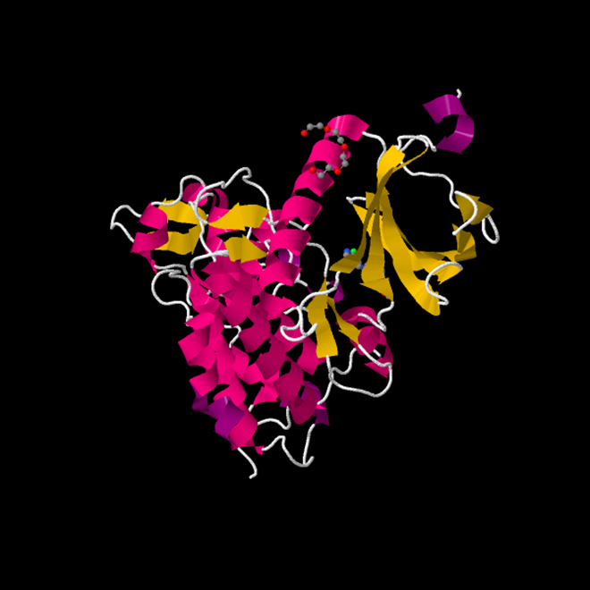
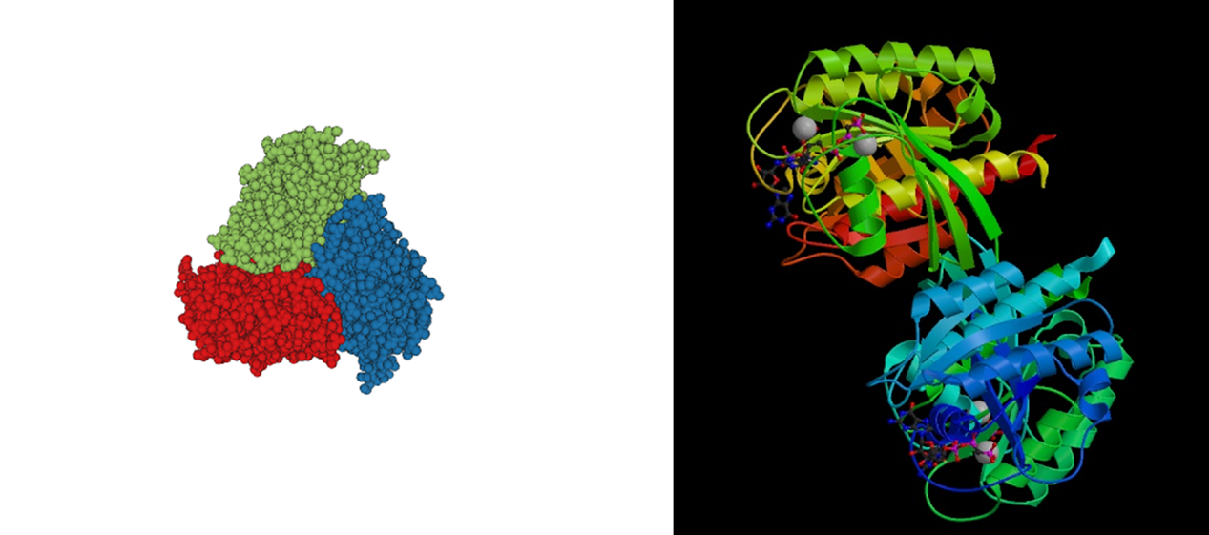
Proteins

Slide 3
Protein Data Bank
- Protein data bank is a database for all known existing proteins
- PDB is a source of information for protein sequencing, modeling and mapping
- You can download data files for any protein: PDB files, FASTA Files, Mapping files
- http://www.rcsb.org/pdb/home/home.do
- These provided materials are used to develop software tools to help biologists and other users understanding proteins

Slide 4
XLPM Algorithm
- Cross Link protein-protein mapping is an algorithm developed by students at the Bioinformatics lab
- It analysis the data coming out of what is called cross link analysis of two proteins
- Proteins → Peptides → Amino Acids → Residues → Molecules → Atoms
- It assigns a score two every two interacting peptides and based on this score the user can infer some conclusions
- The algorithm produces a text file with all the analysis data having a specific format

Slide 5
Data Flow
Input Files
Analyze FASTA
Generate First Level Grey Rectangle with Sequences Across the Axis in a Matrix form
Analyze Data File
Generate Blue Squares on top of the Grey Rectangle

Slide 6
Data Flow
Click on one data element representing two peptides interacting across the file
Generate a tree map describing the scores of the pair of peptides across the files
Click on one of the pairs to see interaction on the residue level

Slide 7
Visualization Details
- Inputs to this system are FASTA files and XLPM Data files
- The visualization is a representation of the data file on three levels including the molecular level
- The first level is a heat map for showing the overall interactions between the parts of the two protein sequences
- In the first level only the highest scored interaction is shown on the heat map for each pair of peptides

Slide 8
Visualization Details
- Clicking on any of the point on the heat map opens a level 2 visualization for that particular peptide pair
- Level 2 is a tree map showing all the analyzed spectra that found the interaction between the peptide pair chosen in the first level
- Selecting any of the spectra in the tree map opens a third level of visualization
- The third level of visualization is a heat map showing the cross-linking between pairs of residues

Slide 9
3D Models
- Understanding PDB files and FASTA files is so important to be able to parse it
- Using three.js WebGL based library to generate the molecules
- User enters either the Pdb Id or uploads a pdb file
- The system queries the PDB webservice for the PDB files
- Start parsing the PDB files and extracting coordinates, colors and sizes of Atoms

Slide 10
Data Types
- Ordered Data
- Flat Files
- After parsing the data I structure them in tables to be able to query easily
Sequence Table
Id
uniqueNumber
Block Table
Id
Fragment_1
Precursor Info Table
Block Id
Data Points Table
Id
Sequence
Type
Fragment_2
Score
Fragment_1
Fragment_2
Score
BlockId
Sequence_1
Sequence_2
Value

Slide 11
Applied Tufte
- Scaling is applied on the first and the third levels on color opacity
- Size Scaling is applied on the treemap third level
- Clear labeling is applied through mouse overs to avoid any ambiguity
- Data variation is clear on the three levels
- Also data ink ratio is maximized
- Avoided junk as much as possible

Slide 12
Demo
www.i3akef.net/xlpm
https://iaebeid@bitbucket.org/iaebeid/xlpmviewer.git

Slide 13
References
Mihir Jaiswal et. al. (2014) BMC Bioinfo 15(suppl 11):S16.
Michael Bostock et. al. (2011) IEEE Trans. Visualization & Comp. Graphics (Proc. InfoVis)
"GLmol - Molecular Viewer on WebGL/Javascript." GLmol - Molecular Viewer on WebGL/Javascript. Web. 31 Mar. 2015. <http://webglmol.sourceforge.jp/index-en.html>.
https://github.com/typicaljoe/taffydb
https://github.com/jakiestfu/Snap.js/

