Slide 1
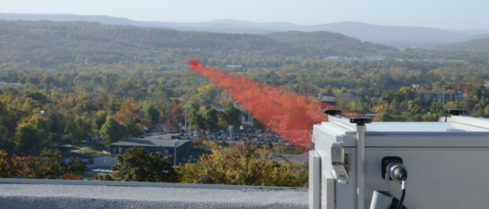
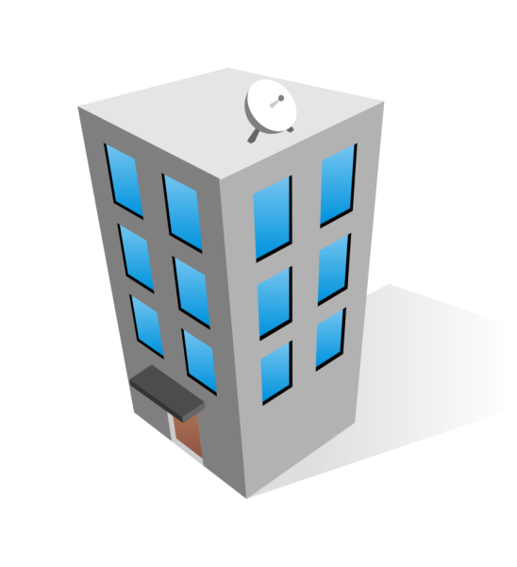





自由空間光通信&中継技術
Free-Space Optical Communications & Relaying Techniques
自由空間光通信
Free-Space Optical
Using light waves to transmit information through free-space medium (air, vacuum…)
応用
LAN-to-LAN connection
Inter-satellite communication
Last mile access
Receiver
Information carrying
Laser Beam
Transmitter
問題
障害物
超遠い
Too far
Weaken transmitted signal!
Direct transmission is unavailable!
中継技術
Relaying Techniques
中継ノード
中継ノード
Divide communication path
into several shorter hops
Avoid the obstacle
中継戦略: 中継ノードで光信号のプロセス方法です。
The signal is decoded before retransmitted to next node: Decode-and-forward (DF)
The signal is just amplified before retransmitted to next node: Amplify-and-Forward (AF)
中継配置
Serial relaying
Parallel relaying
S
1
…
N
D
1
S
2
D
…
N
Pham Van Thanh – コンピュータ通信学講座

