Slide 1
Supervised learning & KNN
Machine Learning Workshop
IEEE Ryerson Student Chapter

Slide 2
Agenda
An introduction to Big Data and Data Analytics
Supervised learning: KNN
Datameer Certification access code distribution

Slide 3
Recap on Unsupervised Learning
3
1
2

Slide 4
Supervised Learning
Use labeled dataset for training and testing to build an analytical model
The model will be used to classify new data
?

Slide 5
Training & Testing Data
Randomly assign the data into training and testing
K-fold widely used validation process
  K-1: 1 as Training:Testing ratio
Multiple execution to get the statistical results
4-fold cross validation
Training
Testing

Slide 6
K Nearest Neighbors (KNN)

Slide 7
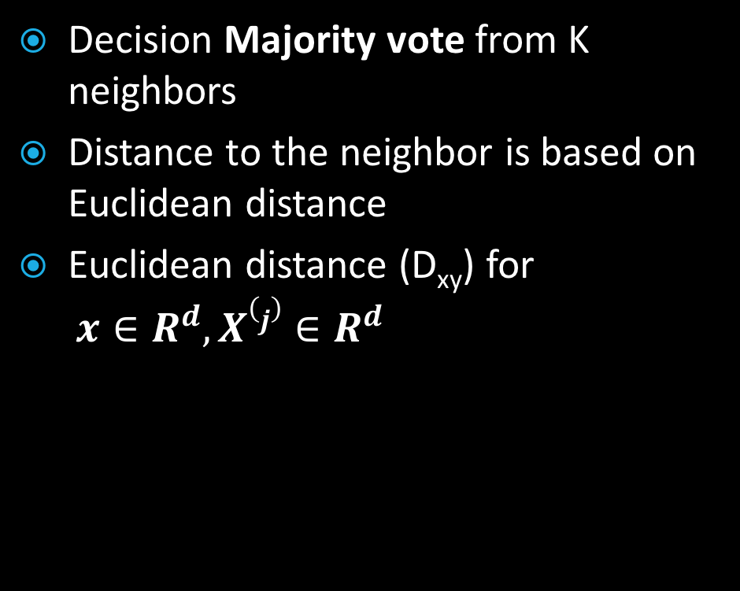
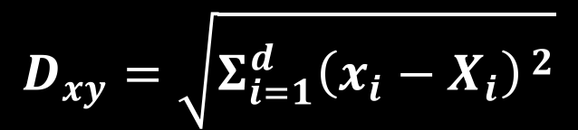

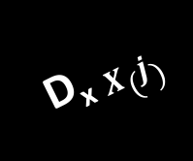


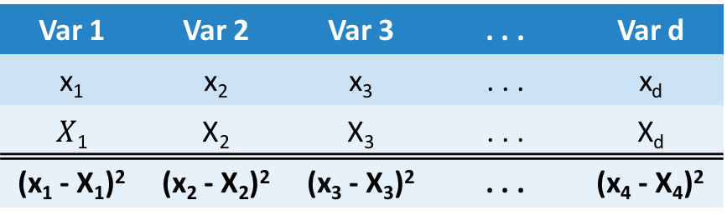
KNN Classification
Decision Majority vote from K neighbors
Distance to the neighbor is based on Euclidean distance
Euclidean distance (D_{xy}) for
$x∈R^{d}, X(j)∈R^{d}$
Var 1 | Var 2 | Var 3 | . . . | Var d
x₁ | x₂ | x₃ | . . . | x_{d}
$X$₁ | X₂ | X₃ | . . . | X_{d}
(x₁ - X₁)² | (x₂ - X₂)² | (x₃ - X₃)² | . . . | (x₄ - X₄)²
$$D_{xy}=\sqrt{Σ_{i=1}^{d}{\left(x_{i}−X_{i}\right)}^{ 2}}$$
D_{x} $X(j)$
$$X(1)$$
x
$$X(3)$$
$$X(2)$$

Slide 8
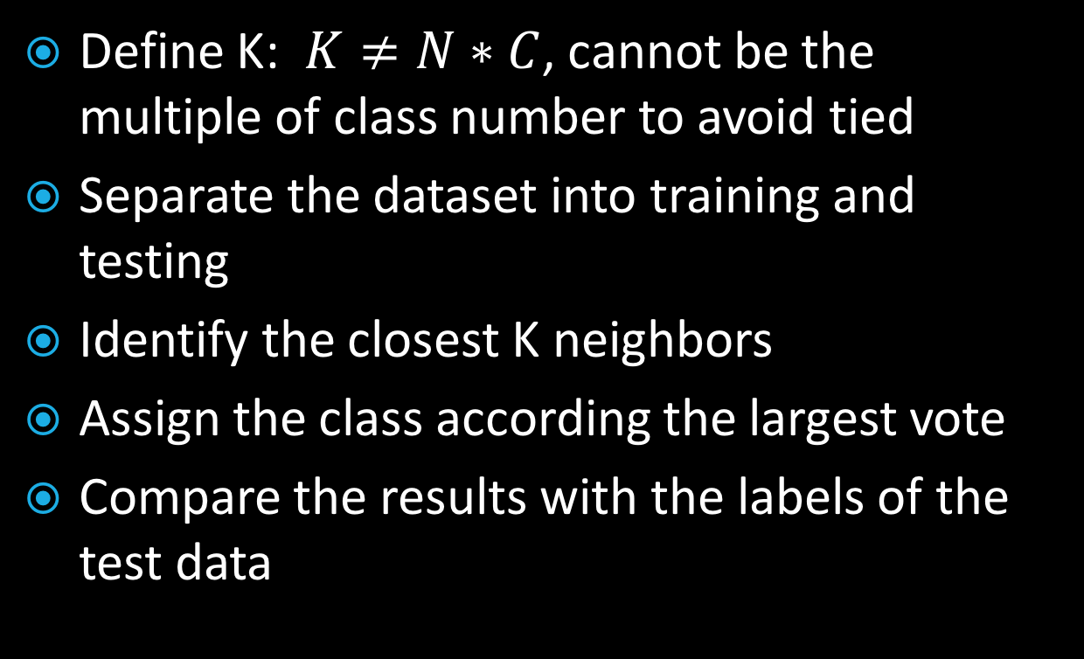
KNN Algorithm
Define K: $K≠N∗C$, cannot be the multiple of class number to avoid tied
Separate the dataset into training and testing
Identify the closest K neighbors
Assign the class according the largest vote
Compare the results with the labels of the test data
?

Slide 9
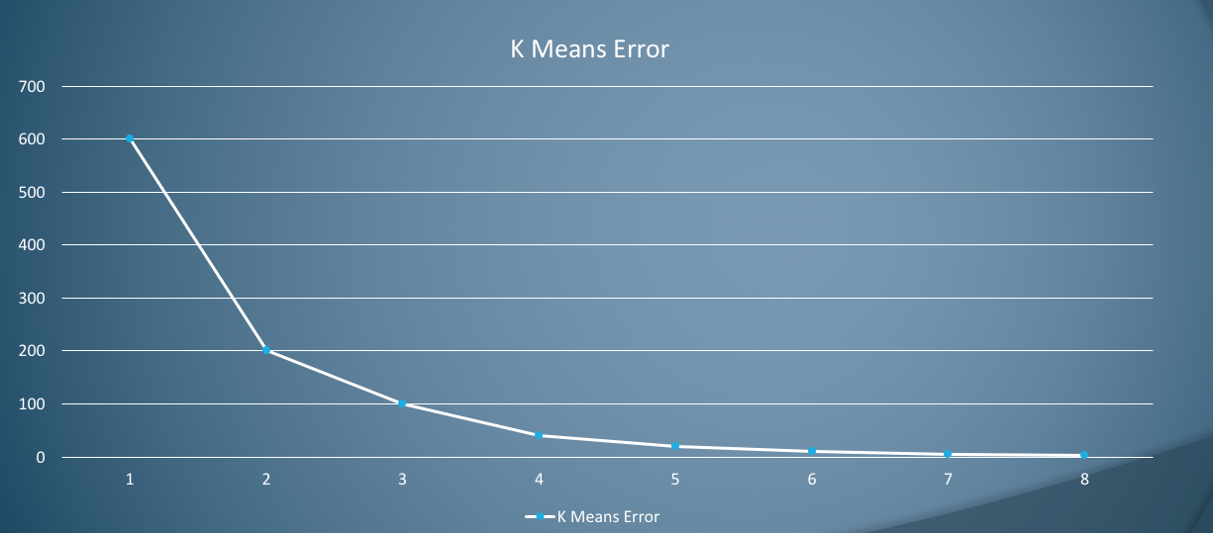
K-Means Elbow

Slide 10
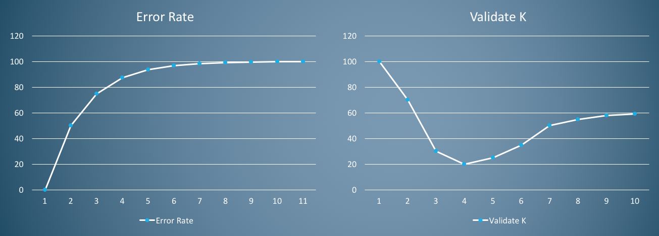
KNN K-value
Error Rate
Optimal K value

Slide 11
Pro and Cons
Simple and well perform
Provides consistent results
Limited error
  For an extremely large dataset, the nearest neighbor classifier (K=1) provides an guaranteed result of 2*min_error
  Upper bounded for Multi-class
Easy to apply weighted voting
Affected by skewed class distribution (one class has more data points in the training set)
Sensitive to ill-presented features:
  Feature selection and scaling are very important
Notes:
https://en.wikipedia.org/wiki/K-nearest_neighbors_algorithm
- KNN error converges to Bayes error with optimat rate of O(n^-(-4/(d+4))) with K as lowerbound(B*n^(-4/(d+4)))

Slide 12
Additional Information
KNN is also used in regression
You can always change the distance matrix to a different measurement for comparison, such as correlations

Slide 13
Sklearn code
Please download the python notebook code from https://tinyurl.com/yd83y3kn
The code added test data points to the example provided by sklearn website

Slide 14
Datameer University
Courtesy of Datameer
Website: academic.datameer.com
Extended period Access Code: Good until Oct 31, 2018
Unlimited access to all basic certification courses!!!!
Ryerson Email address only

