Slide 1

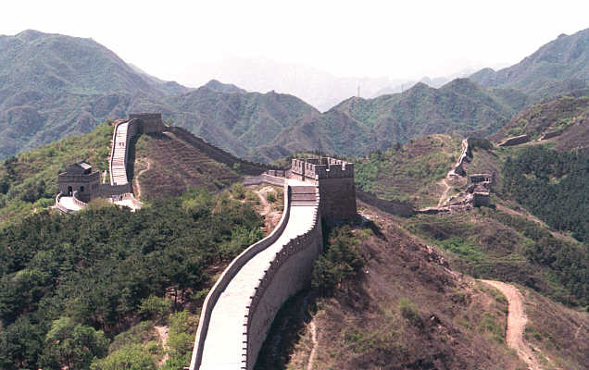



ICME 2007
2007 International Conference on Multimedia
July 2-5, 2007, Crown Plaza Hotel, Beijing, China
Sponsored by: Circuits and Systems Society, Communications Society, Computer Society, and Signal Processing Society

