Slide 1
Social Network and
Social Computing
Panel at ICME
Barcelona, 13th July 2011

Slide 2
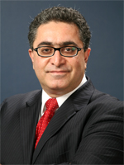
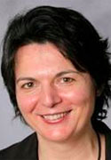
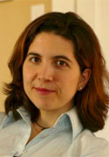
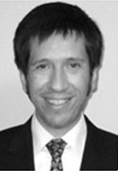
Panelists
Natasa Milic-Frayling, Principal Researcher at Microsoft Research Cambridge (MSRC), UK
Nuria Oliver, Scientific Director, Telefonica Research, Barcelona, Spain
Alejandro (Alex) Jaimes, Yahoo! Research, Barcelona, Spain
Touradj Ebrahimi, EPFL, Lausanne, Switzerland (moderator)

Slide 3
How to proceed
Short introduction from each panelist
Questions and answers from audience
Interactions
One-minute statement from each panelist to draw some conclusions and to close

Slide 4
Some questions in social media and social computing
What are the challenges?
Which trends in future social media technologies?
Which copyright issues in social media?
Which privacy issues in social media?
Is there going to be a single actor taking all, would social networks co-exist, or will there be aggregators of social networks?
Do social media need standards?
What are efficient business models in social media?
What are illustrative and interesting examples of social networks/media (including success stories, and failures)?

Slide 5
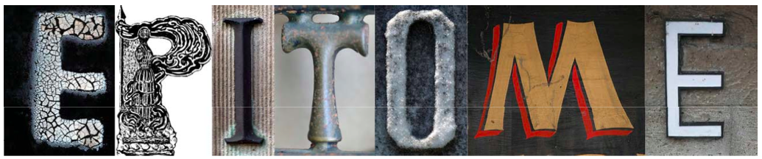
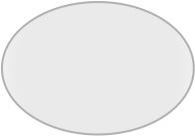
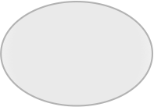
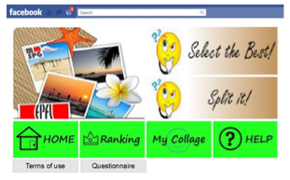




In the unlikely event of getting bored …
Play EPITOME…
http://apps.facebook.com/epitome/
Enjoyable and pleasant game
Summarize one’s album
EPITOME
Collect research data
Social application
SOCIAL GAME EPITOME VERSUS AUTOMATIC VISUAL ANALYSIS
Peter Vajda, Ivan Ivanov, Lutz Goldmann, Touradj Ebrahimi
PW1. Room: JHM; Date: July 13, 2011; Time: 13:30 - 15:30
LET EPITOME SUMMARIZE YOUR PHOTO COLLECTION!
Peter Vajda, Ivan Ivanov, Lutz Goldmann, Touradj Ebrahimi
Room: JHC.01; Date: July 13, 2011; Time: 10:10 - 18:00

