Slide 1
P1906.1 Molecular Motor Extension
Stephen F Bush
Thursday, January 29, 2015

Slide 2
IEEE 1906 NS-3 REFERENCE MODEL
Exercises definitions, framework, metrics, and use-cases
Provides base for higher-level nanoscale communication protocols, applications, and standards
Entertain motion to adopt molecular motor extension into standards repository

Slide 3
NS-3: THE BIG PICTURE
ns-3
Nanoscale Network Systems Scalability and Performance Tests
Nanoscale Network Applications
Nanoscale Network Protocol Layers
EM model
Diffusion model
Motor
model
1906 Framework
1906 Message
1906 Medium
1906 Motion
1906 Field
1906 Perturbation
1906 Specificity
1906 Message Carrier

Slide 4
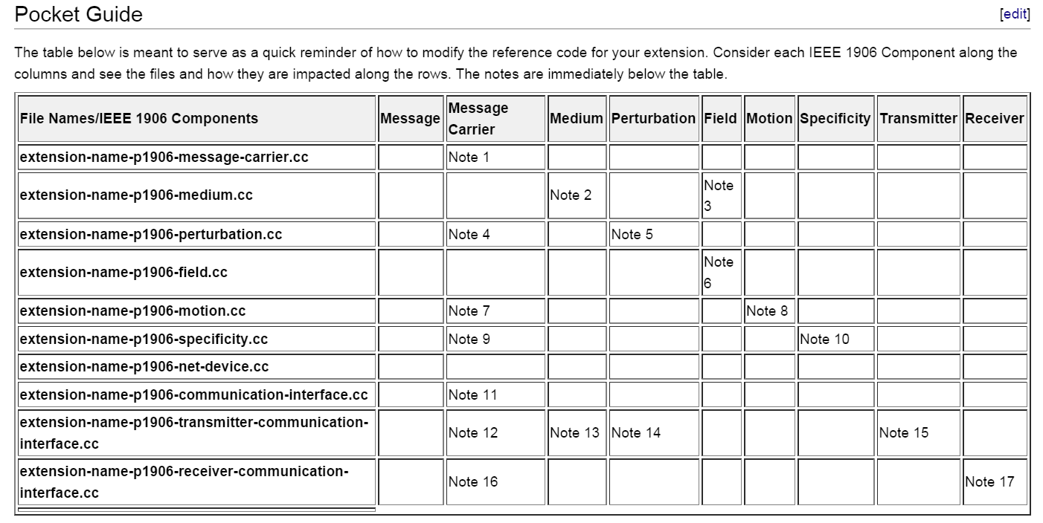
Reference Code Cheat Sheet
Notes on next page

Slide 5
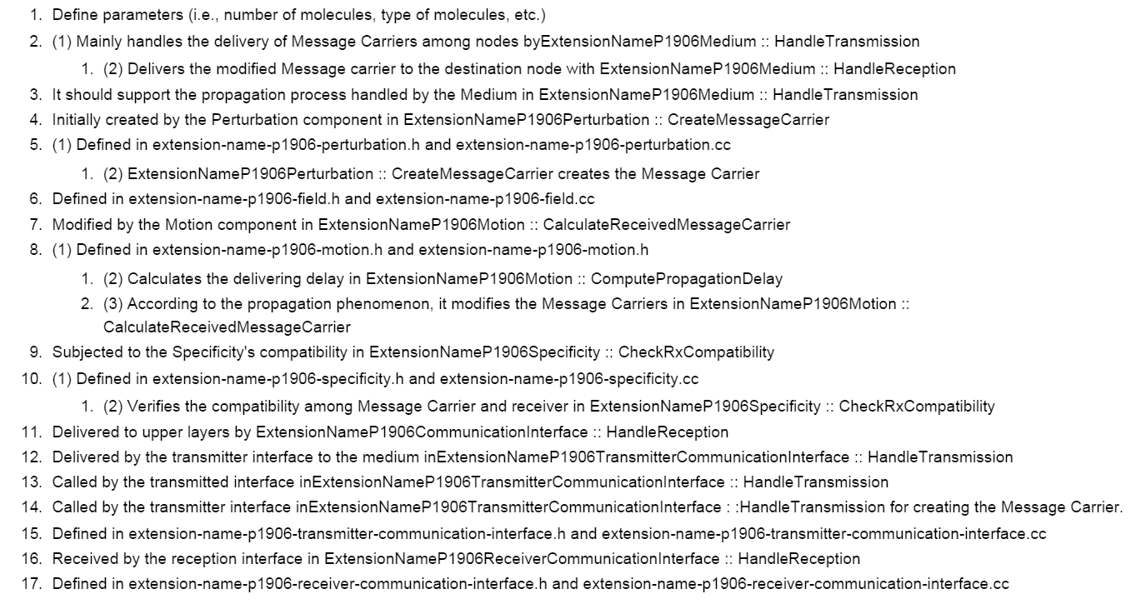
Reference Code Cheat Sheet

Slide 6
MOLECULAR MOTOR EXTENSION
Implements another use-case for the reference model
Briefly summarize the component class enhancements
See ../html/classns3_1_1_p1906_m_o_l___microtubules_field.html

Slide 7
MOLECULAR MOTOR TO 1906 MAP
P1906.1 Component | Molecular Motor
Message Carrier | Molecular Motor + cargo
Motion/Flow/Thrust Potential | Walking + directed diffusion
Field | Microtubule polarity and connectivity
Perturbation | Change in number and types of molecules inside the cargo
Specificity | Receptor sensitivity to cargo
Message Carrier | Molecular Motor + cargo
Motion/Flow/Thrust Potential | Walking + directed diffusion
Field | Microtubule polarity and connectivity
Perturbation | Change in number and types of molecules inside the cargo
Specificity | Receptor sensitivity to cargo
Message Carrier | Molecular Motor + cargo
Stephen F Bush (bushsf@research.ge.com)

Slide 8
GOALS
Extend IEEE 1906 Field component to enable nanoscale structural modeling
Simple cytoskeletal modeling as an infrastructure for nanoscale communication
Explore entropy of microtubule structure
Explore motor propagation delay to infer information about the structure
Stephen F Bush (bushsf@research.ge.com)

Slide 9
EXPLORING STRUCTURAL ENTROPY AND MOTOR LATENCY
Can structural entropy be used to characterize channel?
Use graph spectra to estimate propagation delay (Field)
Persistence length as mathematical field
Persistence length is precisely the expected change in the tangent field lines with distance from one another.
Tangent lines are the direction of the motor(s) [field lines]
Orientation is critical for high persistence length
Stephen F Bush (bushsf@research.ge.com)

Slide 10
RANDOM WALK WITHIN A MATHEMATICAL FIELD
Unbound time: random walk (implemented)
Bound time: follows tangents defined by microtubules (field lines) (almost completed)
How long if no field (pure random walk)? (implemented)
How long if field added (correlated tangents)? (almost completed)
Stephen F Bush (bushsf@research.ge.com)

Slide 11
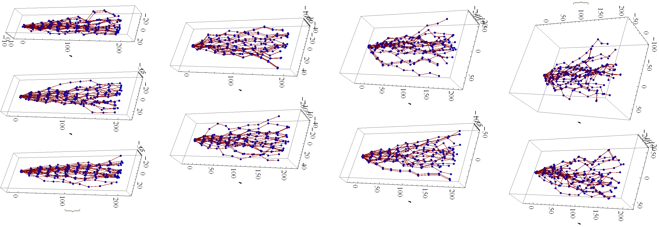
3D TUBE STRUCTURES VS PERSISTENCE LENGTH (1906 FIELD)
void ns3::P1906MOL_MicrotubulesField::genTubes
Microtubules (tpfig.png)
HIGH -> LOW
Stephen F Bush (bushsf@research.ge.com)

Slide 12
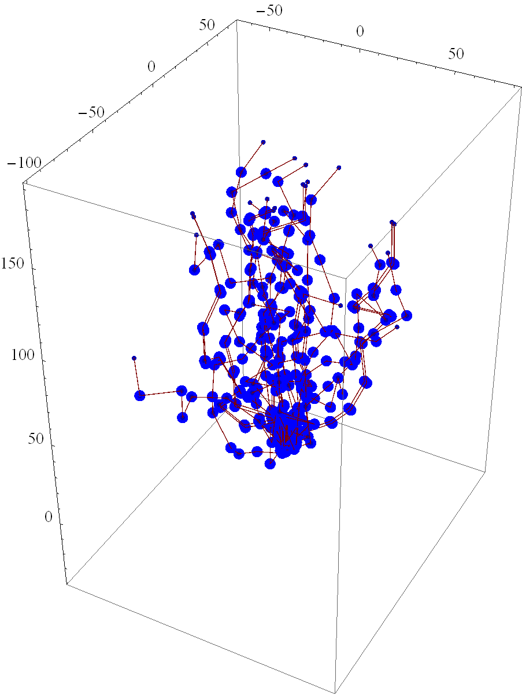
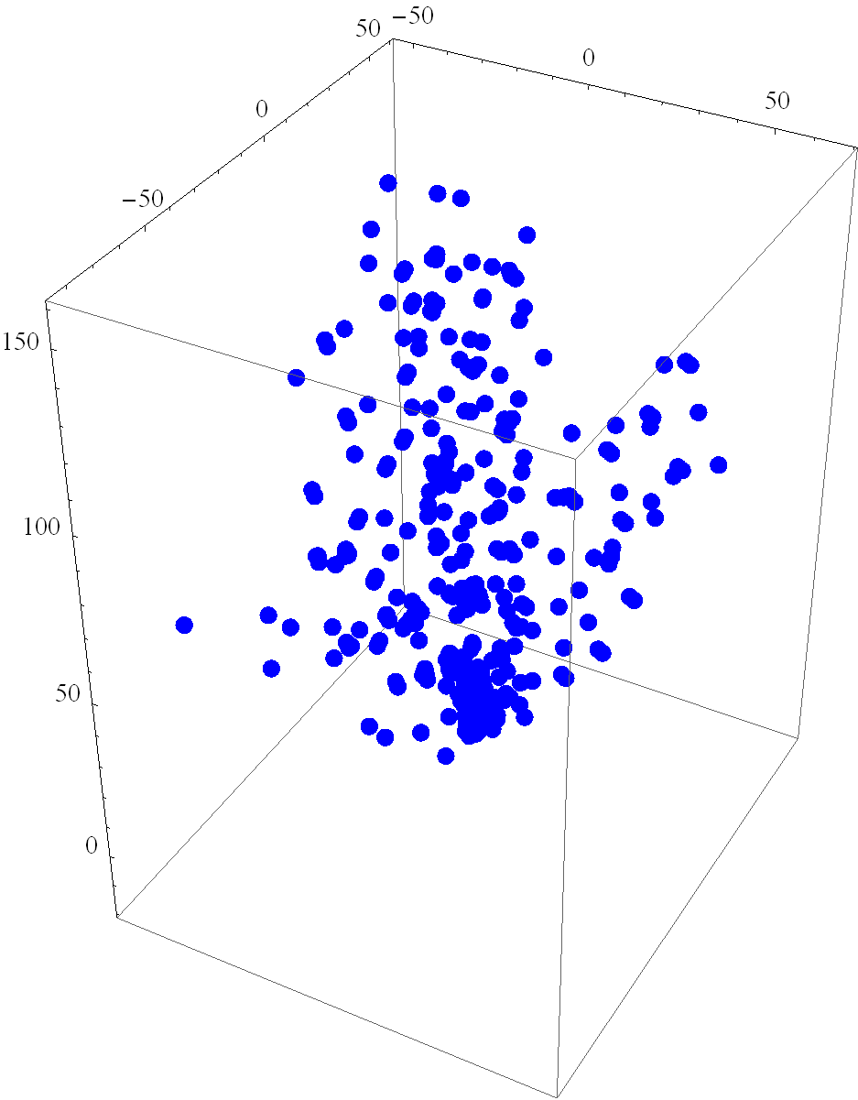
3D TUBES & INTERSECTION POINTS (1906 FIELD)
ns3::P1906MOL_ExtendedField::getOverlap3D
Tubes with intersection points laid on top (tubeIntersectionfig.png)
Points where tubes overlap (pointfig.png)
Stephen F Bush (bushsf@research.ge.com)

Slide 13
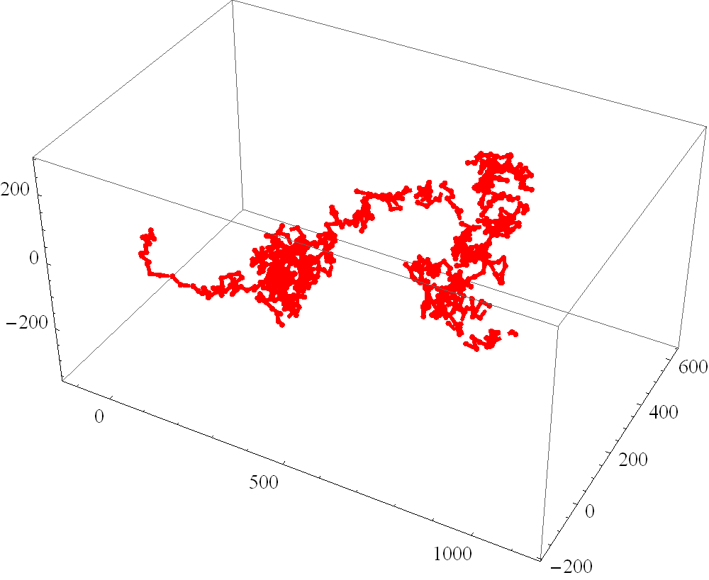
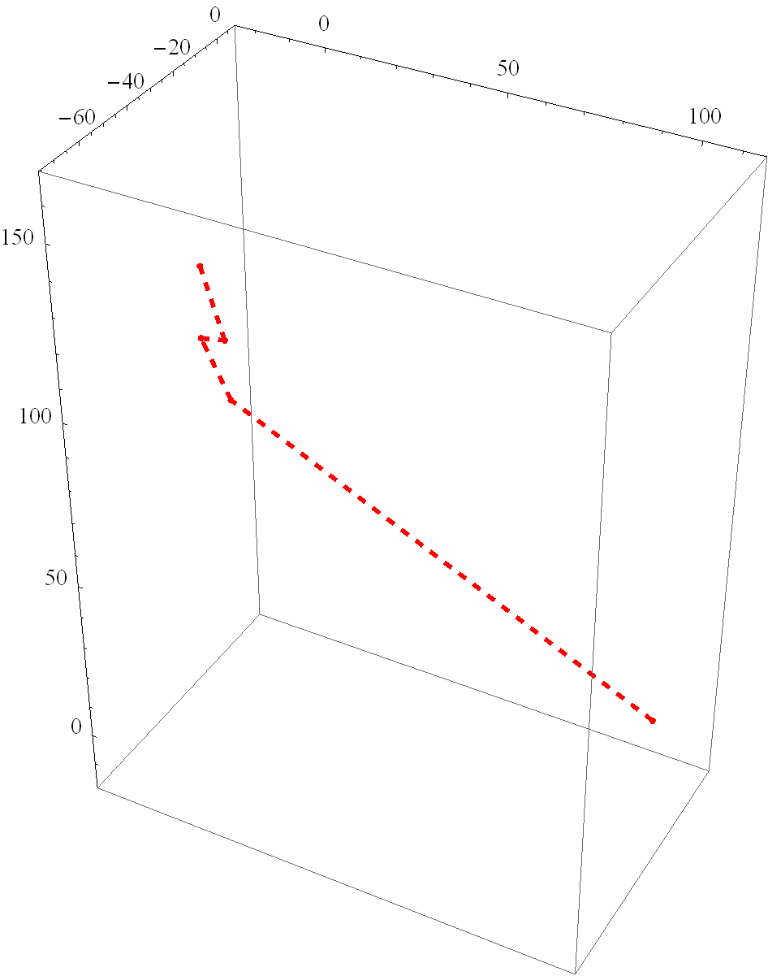
3D BROWNIAN MOTION AND TUBE WALK (1906 MOTION)
ns3::P1906MOL_ExtendedMotion::brownianMotion
ns3::P1906MOL_ExtendedMotion::motorWalk
Brownian motion (motionfig.png)
Bound to Tube (tubeMotionfig.png)
Stephen F Bush (bushsf@research.ge.com)

Slide 14
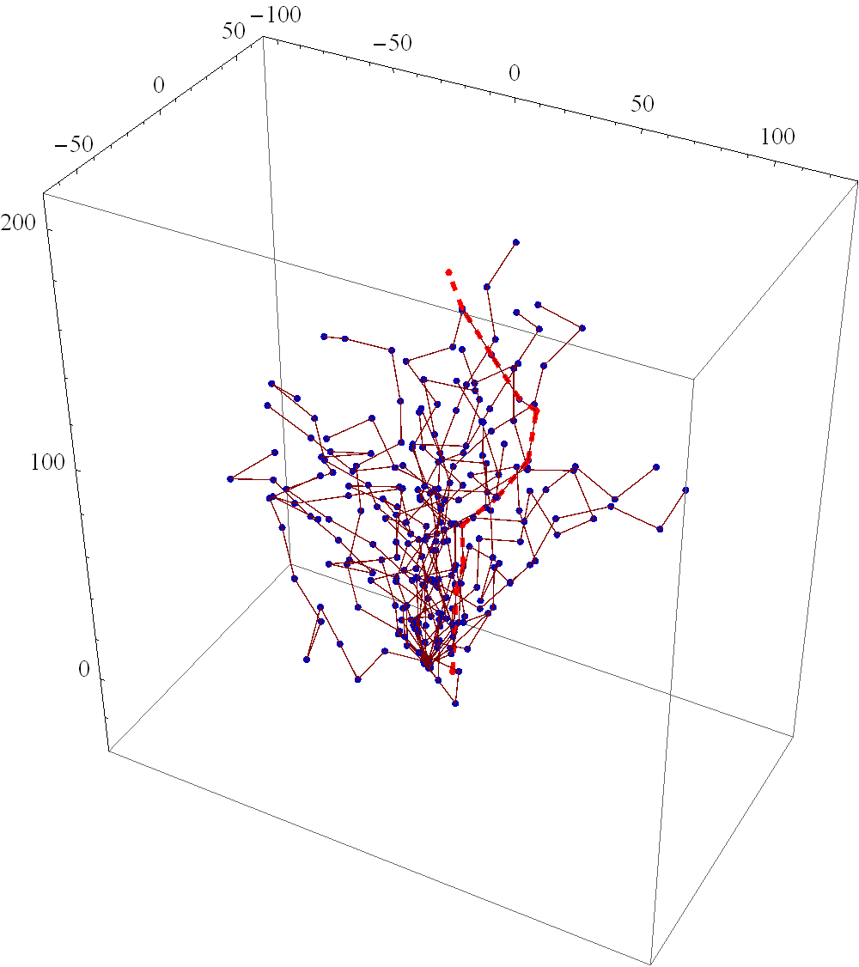
3D MOTION ALONG TUBE (1906 MOTION)
ns3::P1906MOL_ExtendedMotion::motorWalk
Motor motion (red dashed line)
Stephen F Bush (bushsf@research.ge.com)

Slide 15
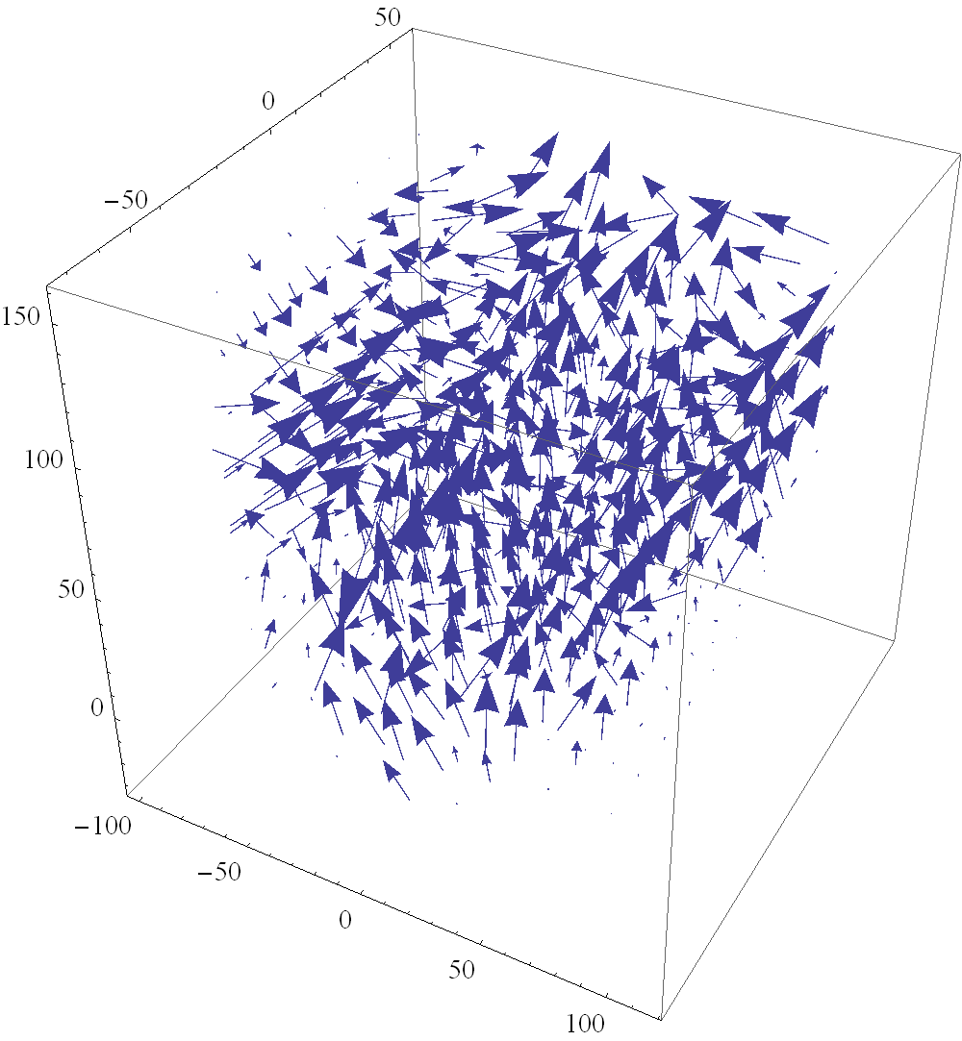
VECTOR FIELD RECONSTRUCTION (1906 FIELD)
ns3::P1906MOL_ExtendedField::tubes2VectorField
Tangent points along the microtubule structure (vectorField.dat)
Stephen F Bush (bushsf@research.ge.com)

Slide 16
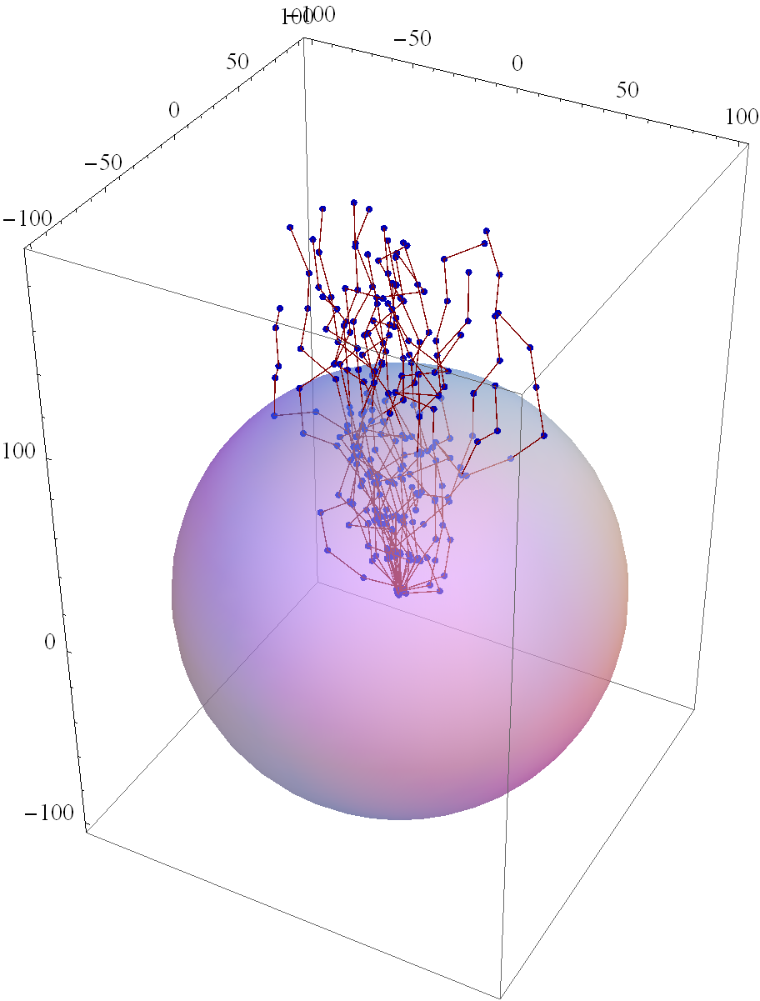
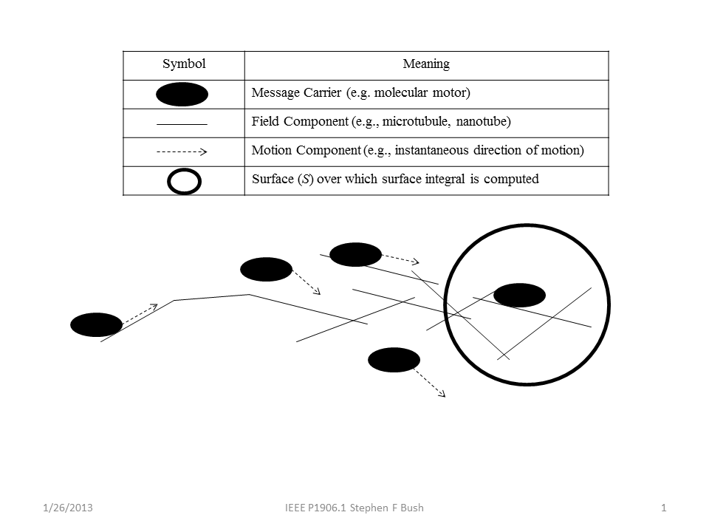
Message Carrier Flux Meter (P1906MOL_VolSurface)
Metric: Active Network Programmability
Surface object measures flow through its surface

Slide 17
INTEGRATION WITH NS-3
Implement microtubules are ns-3 Nodes
Nodes move as the microtubule network dynamically changes
Ns-3 node mobility
http://www.nsnam.org/docs/models/html/mobility.html
Matrix math using GNU Scientific Library w/ns-3
http://www.gnu.org/software/gsl/manual/html_node/Eigenvalue-and-Eigenvector-Examples.html#Eigenvalue-and-Eigenvector-Examples
Stephen F Bush (bushsf@research.ge.com)

Slide 18
NEXT STEPS (COMMENTS WELCOME)
See
mol-example.cc
_RUN_MOL_CHANNEL_CAPACITY_.sh
Notice that nodeDistance can be passed
./waf --run "scratch/mol-example --nodeDistance=${nodeDistance}“
Perhaps nodePosition could be passed
For Mobility, see
mobility.SetMobilityModel("ns3::ConstantPositionMobilityModel");
The question is how best to integrate and leverage ns-3 capabilities
Stephen F Bush (bushsf@research.ge.com)

Slide 19
SVN UPDATE INFORMATION
Motor / Microtubule Extensions:
https://code.google.com/p/ieee-p1906-1-reference-code/source/browse/#svn%2Ftrunk%2Fp1906%2Fextensions
Example:
https://code.google.com/p/ieee-p1906-1-reference-code/source/browse/trunk/p1906/examples/microtubules-example.cc
Stephen F Bush (bushsf@research.ge.com)

Slide 20
INSTALLATION
Make sure GSL is installed
Make sure GSL is enabled in ns-3 using configure
Issue: waf
Move microtubules-example.cc to scratch
Issue: ./waf --run microtubules-example.cc
Tests will be run and the results output to standard out
*.mma and *.dat files will be created to imported into Mathematica and MATLAB
Stephen F Bush (bushsf@research.ge.com)

Slide 21
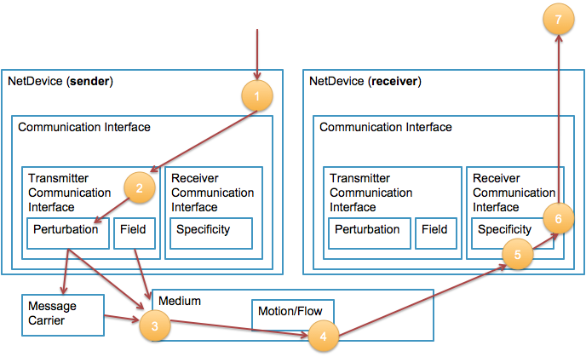
COMPONENTS/ENTITIES INTERACTION
Stephen F Bush
Stephen F Bush (bushsf@research.ge.com)

Slide 22
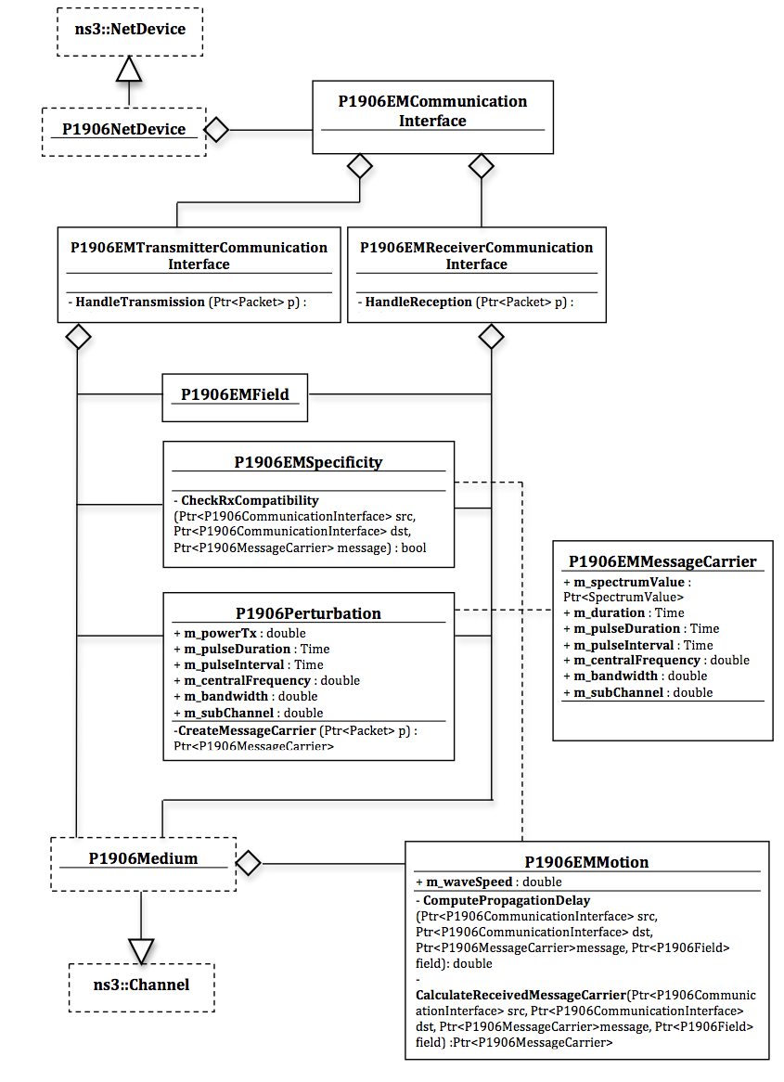
1906.1 REFERENCE CODE DIAGRAM
Stephen F Bush (bushsf@research.ge.com)

Slide 23
ns-3
Nanoscale Network Systems Scalability and Performance Tests
Nanoscale Network Applications
Nanoscale Network Protocol Layers
EM model
Diffusion model
Motor
model
1906 Framework
1906 Message
1906 Medium
1906 Motion
1906 Field
1906 Perturbation
1906 Specificity
1906 Message Carrier

Slide 24
Step 1: Basic Model
Transmitter
Receiver
Message
Signal
Received
Signal
Message
Noise

Slide 25
Step 2: Small-scale Signal (Perturbation)
1906 Perturbation
Transmitter
1906 Motion
Receiver
Noise
Perturbation of the Medium is much broader than electromagnetic waves

Slide 26
Step 3: Transporting the Message (Message Carrier)
1906 Perturbation
Transmitter
Receiver
1906 Message
1906 Message
1906 Message Carrier
Noise
1906 Message Carrier
Message Carrier…

Slide 27
Step 4: Reception (Specificity)
1906 Perturbation
Transmitter
Receiver
1906 Specificity
1906 Message
1906 Message
1906 Message Carrier
Noise
1906 Message Carrier
Specificity…

Slide 28
Step 5: Motility (Motion)
1906 Perturbation
Transmitter
1906 Motion
Receiver
1906 Specificity
1906 Message
1906 Message
1906 Message Carrier
Noise
1906 Message Carrier
Motion…

Slide 29
Step 6: Organized Flow (Field)
1906 Field
1906 Perturbation
Transmitter
1906 Motion
Receiver
1906 Specificity
1906 Message
1906 Message
1906 Message Carrier
Noise
1906 Message Carrier
Field…

