Slide 1
Implementation and Verification of Implicit Invocation Systems
Using Source Transformation
Hongyu Zhang, Jeremy S. Bradbury, James R. Cordy, Juergen Dingel Software Technology Laboratory School of Computing, Queen’s University Kingston, Ontario, Canada SCAM 2005
SUPPORTED BY

Slide 2
Verification and Validation
Testing and model checking
Certification gap:
  Testing uses execution artifacts (code) directly
  Model checking uses separate, hand-constructed models and properties
Bridged by hand:
  Either code-to-model or model-to-code
  Disjoint, error prone
Notes:
With the growing size and complexity of software systems, software verification and validation (V&V) is becoming increasingly important.
Testing and model checking
belong to the two categories of software V&V: testing/
inspection and formal methods. While testing focuses
on the actual behavior of the program, model checking focuses
on the mathematical model.
In fact, there is often a large semantic gap between the software developer artifacts that are tested and the artifacts that are

Slide 3
Implicit Invocation
Implicit invocation (II) systems
  Concurrent, loosely coupled components
  Communicate using events (external / internal)
  Increasingly popular for service integration (web)
Particularly difficult to certify
  Prone to deadlock, race conditions, etc.
  Good candidate for comparing, contrasting and unifying testing and model checking
Notes:
With the growing size and complexity of software systems, software verification and validation (V&V) is becoming increasingly important.
Testing and model checking
belong to the two categories of software V&V: testing/
inspection and formal methods. While testing focuses
on the actual behavior of the program, model checking focuses
on the mathematical model.
In fact, there is often a large semantic gap between the software developer artifacts that are tested and the artifacts that are

Slide 4
Our Approach: IIL
Custom language and system for uniform testing and model checking of II systems
  Custom implicit invocation language - IIL
  Clear, transparent expression of paradigm including verification constraints
  Executable for testing, automatic modelling for verification of constraints
Implementation of both execution and modelling using formal source transformations
Notes:
To alleviate the semantic artifact gap,
II systems feature a lot of non-determinism due to concurrent execution of components.
This high degree of non-determinism makes II systems challenging to test and model check.
Additionally, II has become increasingly popular as an integration mechanism for loosely coupled components.
II systems feature a lot of non-determinism due to concurrent execution of components.
This high degree of non-determinism makes II systems challenging to test and model check.
Additionally, II has become increasingly popular as an integration mechanism for loosely coupled components.

Slide 5
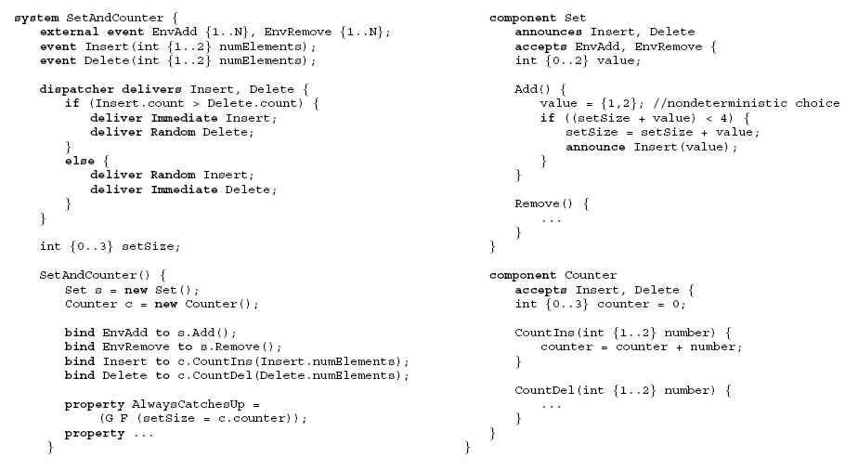
II Language (IIL)
Notes:
Special features in II language: Event declarations. Component declarations. Announce statements. Dispatcher declaration. Event-method bindings. Property declarations.

Slide 6
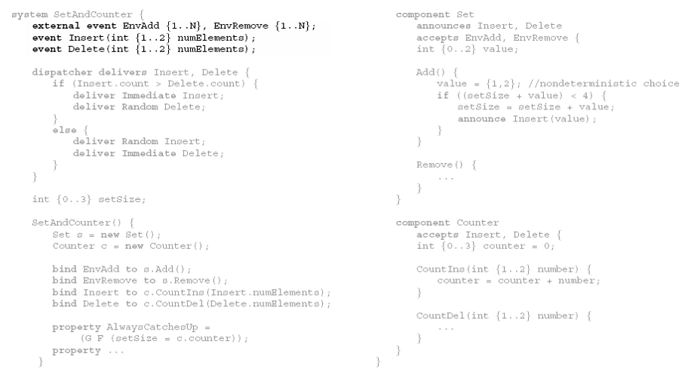
II Language (IIL)
Event Declarations
Notes:
Special features in II language: Event declarations. Component declarations. Announce statements. Dispatcher declaration. Event-method bindings. Property declarations.

Slide 7
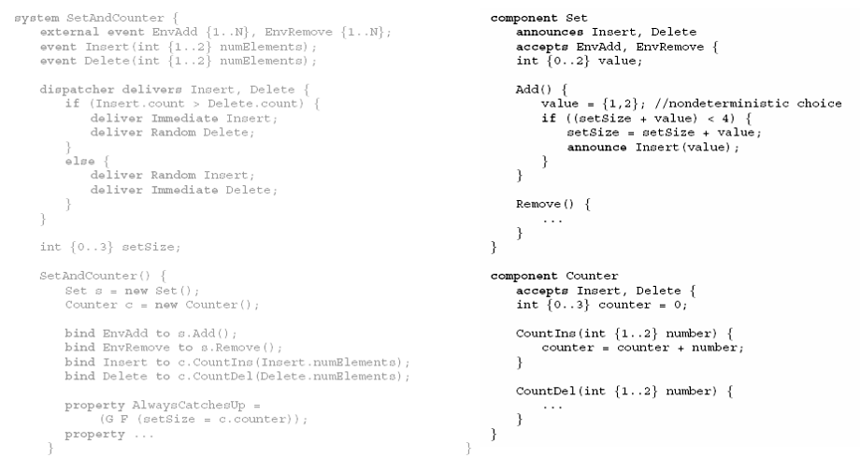
II Language (IIL)
Component Declarations
Notes:
Special features in II language: Event declarations. Component declarations. Announce statements. Dispatcher declaration. Event-method bindings. Property declarations.

Slide 8
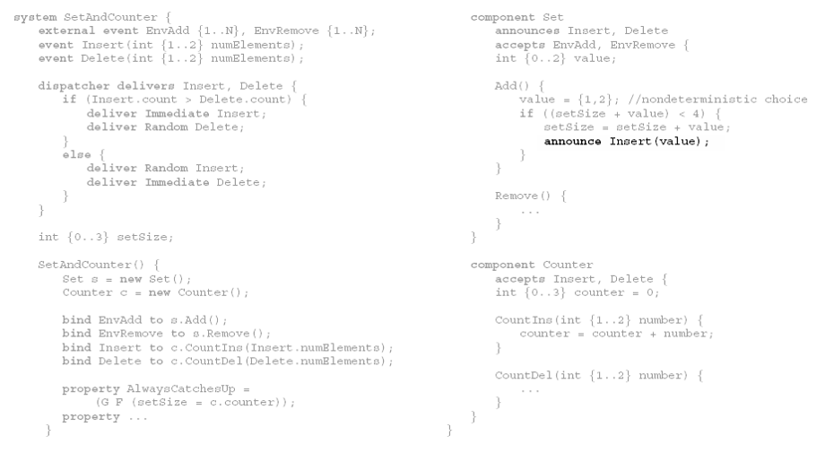
II Language (IIL)
Announce Statements
Notes:
Special features in II language: Event declarations. Component declarations. Announce statements. Dispatcher declaration. Event-method bindings. Property declarations.

Slide 9
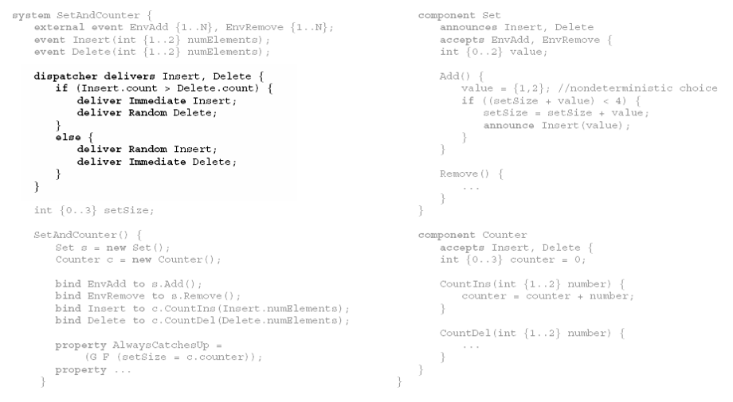
II Language (IIL)
Dispatcher Declaration
Notes:
Special features in II language: Event declarations. Component declarations. Announce statements. Dispatcher declaration. Event-method bindings. Property declarations.

Slide 10
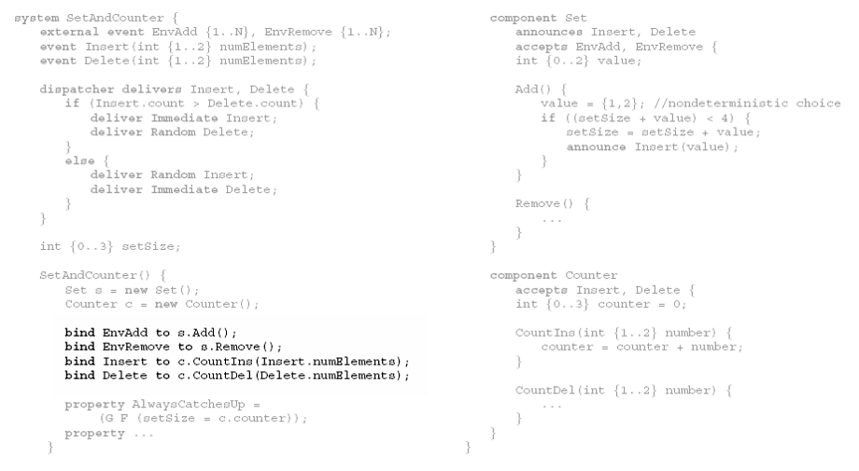
II Language (IIL)
Event-method Declarations
Notes:
Special features in II language: Event declarations. Component declarations. Announce statements. Dispatcher declaration. Event-method bindings. Property declarations.

Slide 11
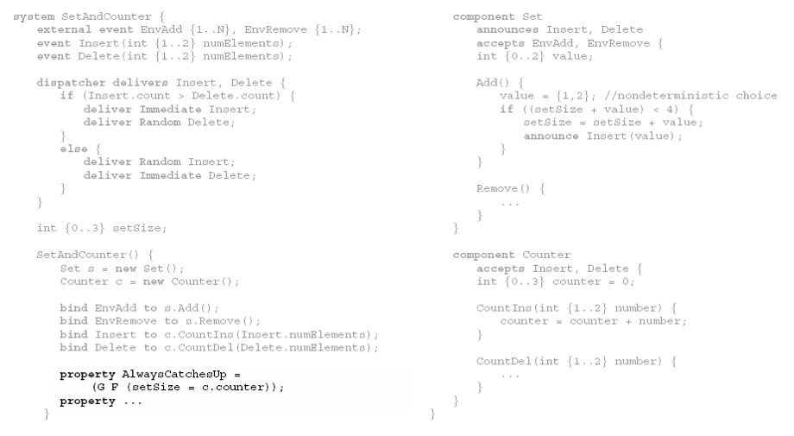
II Language (IIL)
Property Declarations
Notes:
Special features in II language: Event declarations. Component declarations. Announce statements. Dispatcher declaration. Event-method bindings. Property declarations.

Slide 12
Implementation of IIL
Source transformation framework using TXL
Experiment in both V&V and source transformation
Formal, verifiable

Slide 13
Execution & Testing IIL Programs
Notes:
Turing Plus
Efficiently executable concurrent programming language with random scheduling

Slide 14
Execution & Testing IIL Programs
Turing Plus concurrent language with random scheduling concurrency simulation
Need execution model of IIL (distributed, implicit) in Turing Plus (monolithic, explicit)
Notes:
In our Turing Plus model, we take this approach and use three steps of explicit invocation to implement II (see Figure 4). That is, an explicit method call is used in event announcement, event delivery and bound method invocation. The three main elements of our implementation of II in Turing Plus are:
1. A system event warehouse, a set of queues, is built to receive all the announced events. When components announce an event or an environment event is generated, it will be sent to the system event warehouse.
2. The dispatcher removes the events in the system event warehouse and delivers them. Environment events will be delivered immediately. Local events will be delivered according to the delivery policy. The dispatcher delivers the events in the system event warehouse by calling the bound component to receive the event.
3. Each component has a component event warehouse to receive the events delivered by the dispatcher. The component will invoke the bound method after it receives the delivered events.

Slide 15
Transforming IIL to Turing Plus
Nontrivial local/global, global/local, coupled transformation
Notes:
II to Turing Plus Transformation
The transformation is divided into four steps:
Component transformation.
Dispatcher transformation.
System and environment setup.
Re-ordering of the system body.

Slide 16
Transforming IIL to Turing Plus
Component Transformation
Notes:
II to Turing Plus Transformation
The transformation is divided into four steps:
Component transformation.
Dispatcher transformation.
System and environment setup.
Re-ordering of the system body.

Slide 17
Transforming IIL to Turing Plus
Dispatcher Transformation

Slide 18
Transforming IIL to Turing Plus
System and Environment Setup

Slide 19
Transforming IIL to Model
Notes:
We currently check properties written in LTL.

Slide 20
Transforming IIL to XML IL
Two step TXL transformation from IIL to
XML intermediate modelling language of Garlan & Khershonsky
  Step 1: Normalization of IIL to reorder, simplify and reduce semantics to meet constraints of XML intermediate language (in IIL syntax)
  Step 2: Syntactic translation of normalized simplified IIL to XML intermediate language
Notes:
To model check systems written in IIL we use the existing
approach we previously presented in [2]. This approach
is an extension of an II model checking system originally
developed by Garlan and Khersonsky in [6, 7]. This approach
focuses on the automatic analysis of II by representing
an II system in an XML parameterized representation.
Once the XML input has been created, a Java transformation
tool converts the information into a set of finite state
machines. This set of state machines can then be checked
using the Cadence SMV model checker [14]. We currently
check properties written in LTL.
A major drawback to our model checking work presented
in [2] was that it was not completely automatic since
user interaction was required in developing the XML representation.
The approach presented in this paper overcomes
this deficiency and completely bridges the gap between artifacts
by automating the process of generating finite state
models for software systems written in IIL.
5.1. Transformation of IIL to XML
Originally, due to the verbose nature of XML, IIL started
out as a replacement to the XML intermediate language that
would be easier to read and write. In addition to improving
the syntax, IIL evolved into a special-purpose language that
includes notational conveniences such as variable declarations
in methods, the use of for loops and the use of switch
statements.
As with the transformation to Turing Plus, our transformation
from IIL to XML is done using an automatic transformation
tool written in TXL. The transformation from IIL
to XML involves two steps. In the first step the notational
conveniences of IIL are removed. For example, for loops
are unrolled. The program is also reorganized to follow the
program order required by the XML representation. After
the first step the IIL program is a statement-by-statement
match to the XML representation. The second step of the
transformation involves the syntax translation from IIL to
XML.

Slide 21
Transforming XML IL to Model

Slide 22
Transforming XML IL to Model
Use existing Java automatic transformation tool from XML IL to finite state machine model modified from Garlan & Khershonsky
Resulting model then checked using Cadence SMV model checker to verify properties specified in original IIL program
Notes:
To model check systems written in IIL we use the existing
approach we previously presented in [2]. This approach
is an extension of an II model checking system originally
developed by Garlan and Khersonsky in [6, 7]. This approach
focuses on the automatic analysis of II by representing
an II system in an XML parameterized representation.
Once the XML input has been created, a Java transformation
tool converts the information into a set of finite state
machines. This set of state machines can then be checked
using the Cadence SMV model checker [14]. We currently
check properties written in LTL.
A major drawback to our model checking work presented
in [2] was that it was not completely automatic since
user interaction was required in developing the XML representation.
The approach presented in this paper overcomes
this deficiency and completely bridges the gap between artifacts
by automating the process of generating finite state
models for software systems written in IIL.
5.1. Transformation of IIL to XML
Originally, due to the verbose nature of XML, IIL started
out as a replacement to the XML intermediate language that
would be easier to read and write. In addition to improving
the syntax, IIL evolved into a special-purpose language that
includes notational conveniences such as variable declarations
in methods, the use of for loops and the use of switch
statements.
As with the transformation to Turing Plus, our transformation
from IIL to XML is done using an automatic transformation
tool written in TXL. The transformation from IIL
to XML involves two steps. In the first step the notational
conveniences of IIL are removed. For example, for loops
are unrolled. The program is also reorganized to follow the
program order required by the XML representation. After
the first step the IIL program is a statement-by-statement
match to the XML representation. The second step of the
transformation involves the syntax translation from IIL to
XML.

Slide 23
Experiments
Three “guinea pigs”
  Set-Counter, a standard toy example II system with sychronization constraints
  Active Badge Location System (ABLS), an II system for a realistic application with liveness constraints
  Unmanned Vehicle Control System (UVCS), a realistic simulated II system with safety constraints
Notes:
Turing Plus 3-5 times as big and
Our evaluation of each example involved modeling the example in the IIL language and verifying that our transformation tools from IIL to Turing Plus and from IIL to XML worked correctly.
Our evaluation of our automatic transformation tools also demonstrated that the semantics was well preserved during all of the transformations.

Slide 24
Results
Systems executed and traced over hundreds of random test runs
System properties verified as specified using Cadence SMV
Demonstrated errors discovered independently using both testing and model checking
Notes:
Turing Plus 3-5 times as big and
Our evaluation of each example involved modeling the example in the IIL language and verifying that our transformation tools from IIL to Turing Plus and from IIL to XML worked correctly.
Our evaluation of our automatic transformation tools also demonstrated that the semantics was well preserved during all of the transformations.

Slide 25
Experiences with
Source Transformation
Verifiable - formal independent rewrite rules,
pure first order functional application
Efficient - max 3 seconds per program
Effort - where did project time go?
  Not into source transformation:
  actual implementation of transformations
  smaller part of effort
Notes:
Turing Plus 3-5 times as big and
Our evaluation of each example involved modeling the example in the IIL language and verifying that our transformation tools from IIL to Turing Plus and from IIL to XML worked correctly.
Our evaluation of our automatic transformation tools also demonstrated that the semantics was well preserved during all of the transformations.

Slide 26
Experiences with
Source Transformation
Saved:
  Design and implementation of IIL
  compiler / interpreter
  Design and implementation of IIL
  concurrency kernel and simulation library
  Design and implementation of IIL modeller
Did not save:
  Design and understanding time for language framework and concurrency model
Notes:
Turing Plus 3-5 times as big and
Our evaluation of each example involved modeling the example in the IIL language and verifying that our transformation tools from IIL to Turing Plus and from IIL to XML worked correctly.
Our evaluation of our automatic transformation tools also demonstrated that the semantics was well preserved during all of the transformations.

Slide 27
Conclusion
Transformational framework for specifying, testing, and model checking II systems
  IIL language
  Automatic implementation and modelling by source transformation
    IIL to Turing Plus for execution and testing
    IIL to SMV model for model checking
Test bed for studying relationship and synergies between testing and model checking
Notes:
Turing Plus 3-5 times as big and
Our evaluation of each example involved modeling the example in the IIL language and verifying that our transformation tools from IIL to Turing Plus and from IIL to XML worked correctly.
Our evaluation of our automatic transformation tools also demonstrated that the semantics was well preserved during all of the transformations.

Slide 28
Implementation and Verification of Implicit Invocation Systems
Using Source Transformation
Hongyu Zhang, Jeremy S. Bradbury, James R. Cordy, Juergen Dingel Software Technology Laboratory School of Computing, Queen’s University Kingston, Ontario, Canada SCAM 2005
SUPPORTED BY

Slide 29
Future Work:
Testing vs Model Checking
To what extent can parallel testing be used
to increase confidence in model checking results and correctness of the model checker?
How can testing be used to simplify or optimize model checking and vice-versa?
Can we use similar transformation techniques to automatically derive run-time monitors for temporal safety properties?
Notes:
Can model checking be used to evaluate the coverage offered by the test suite?

Slide 30
Future Work:
Generalization of IIL
IIL currently restricted to a subset of II systems
  Centralized event dispatcher with static bindings
We would like to expand our framework to more general forms of II systems
  Dynamic bindings, multiple dispatchers, and additional concurrency models
What other generalizations are interesting?

