Slide 1
Evaluating C++ Design Pattern Miner Tools
Lajos Jenő Fülöp¹, Tamás Gyovai² and Rudolf Ferenc¹
¹ Department of Software Engineering
University of Szeged, Hungary
² evosoft Hungary Ltd.

Slide 2
Motivation
There are many design pattern miner tools
They differ in several aspects
  Pattern descriptions
  Target software representation
  Matching algorithm
They should be evaluated and compared
  We performed experiments on 4 real life open-source systems

Slide 3
Evaluated tools
Maisa
  Measures software quality at design level
  University of Helsinki
CrocoPat
  Relational computation
  Ecole Polytechnique Fédérale de Lausanne (EPFL), Switzerland
  University of California at Berkeley, USA
  Brandenburg University of Technology at Cottbus, Germany
Columbus
  Framework for source code analysis and quality assurance
  FrontEndART Ltd.
  University of Szeged
  Nokia Research Center

Slide 4
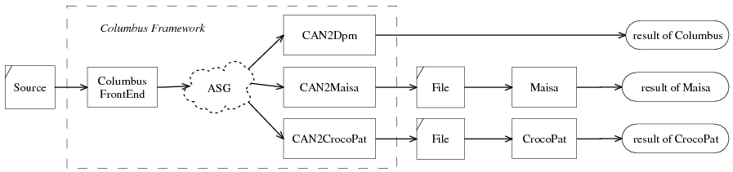
Evaluation framework
We search for pattern instances in the source code
Each tool has its own
  pattern description language and
  representation of the facts extracted from the source code
Columbus provides the same data for the tools

Slide 5
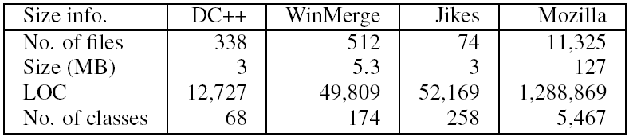
Analyzed projects
Four open source systems from different domains

Slide 6
Experiments
Three main aspects
  Number of design pattern instances found
  Pattern mining speed
  Memory requirements

Slide 7
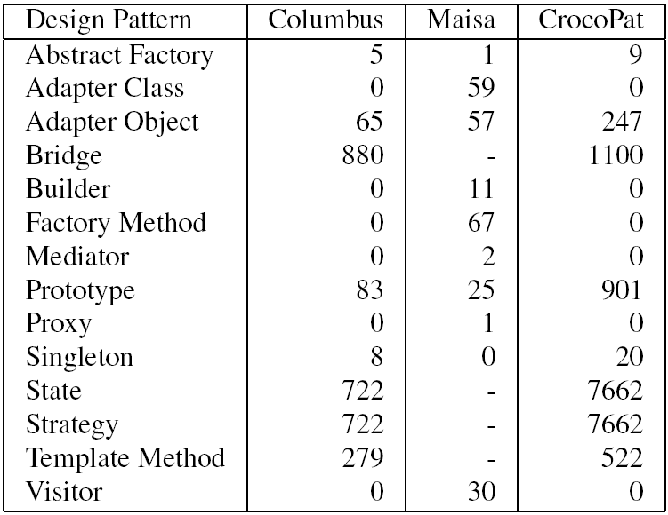
Number of pattern instances found
(Mozilla)

Slide 8
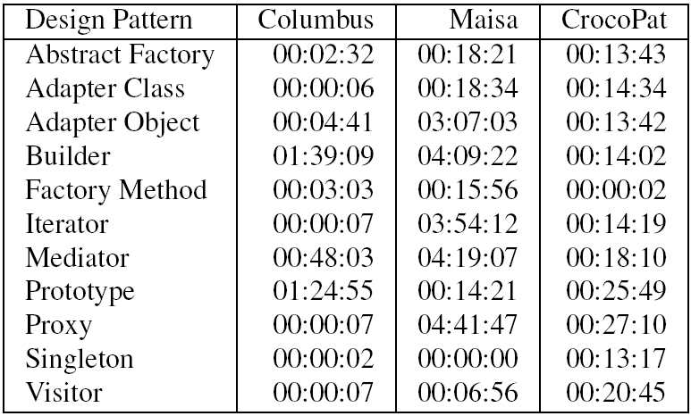
Speed
(Mozilla)

Slide 9
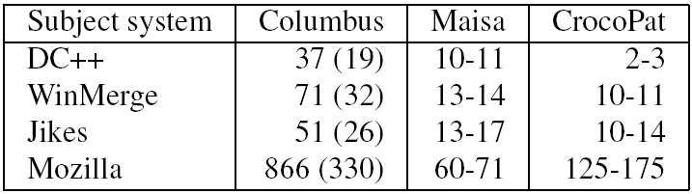
Memory requirements
(in megabytes)

Slide 10
Summary
Differences were caused by
  Different descriptions of design patterns
  Precision of pattern descriptions
  Differences in algorithms
To do …
  „Strict” design pattern catalog
  Evaluation benchmark
    More test systems
  Involving further tools

