Slide 1
Linking Analysis and Transformation Tools using Source-based Mappings
SCAM
28-9-2006
Magiel Bruntink

Slide 2
Linking tools
Can we exploit the source code itself?
What are traditional means?
How do source-based mappings work?
How do they compare?

Slide 3
Context
Source-to-source code manipulations
Use of analysis results to guide transformations
Analysis tools:
  CodeSurfer, LClint, PREfix, Coverity, …
Transformation tools:
  ASF+SDF, Stratego, TXL, …
Notes:
Why link tools?
Give example of use case, such as code elimination.

Slide 4
Schema-based mappings
Schema - “A diagrammatic representation; an outline or a model.” - Dictionary.com
Grammar, model, abstract representation
GXL, DMM, ANSI C grammar
Use target schema directly in mapping

Slide 5
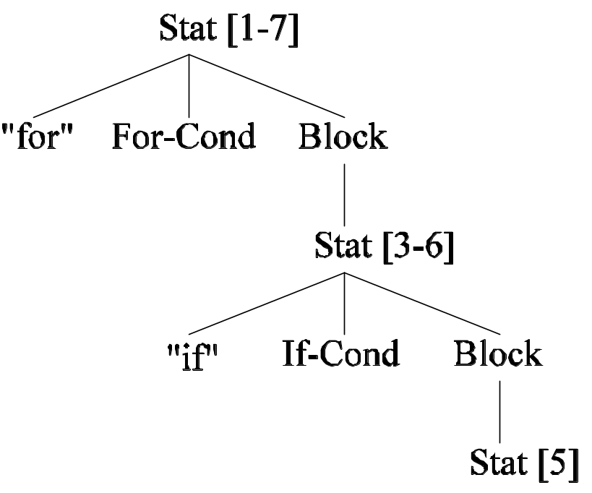
Code example
Analysis
Transformation
1 for (i = 0; i < length; i++)
2 {
3 if (array[i] > max)
4 {
5 max = array[i];
6 }
7 }

Slide 6
Example schema-based mapping
Analysis
Transformation
1 for (i = 0; i < length; i++)
2 {
3 if (array[i] > max)
4 {
5 max = array[i];
6 }
7 }
Stat -> Block -> Stat{1} -> Block -> Stat{1}

Slide 7
Can’t that be done simpler?
Analysis
Transformation
1 for (i = 0; i < length; i++)
2 {
3 if (array[i] > max)
4 {
5 max = array[i];
6 }
7 }
Stat node at line 5

Slide 8
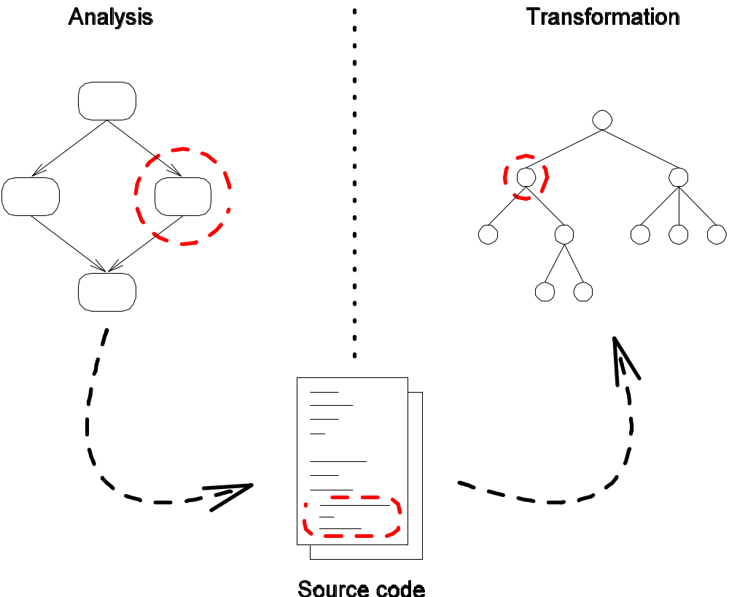
Source-based mappings

Slide 9
Which node exactly?
Analysis
Transformation
1 for (i = 0; i < length; i++)
2 {
3 if (array[i] > max)
4 {
5 max = array[i];
6 }
7 }
Stat node at line 5
Notes:
Mention causes for problems.
Mention safeness / strictness.

Slide 10
Comparison
Schema-based:
  Need to know target schema top-down
  Path expressions can be fragile
Source-based:
  Need to know source correspondence
  Source positions very fragile, unless…
Notes:
In source-based you need to know the source correspondence of the target abstraction (e.g., statements).

Slide 11
SCATR
Framework for source-based mappings to ASF+SDF
Analysis tool unrestricted
Based on Scaffolding (Sellink & Verhoef)

Slide 12
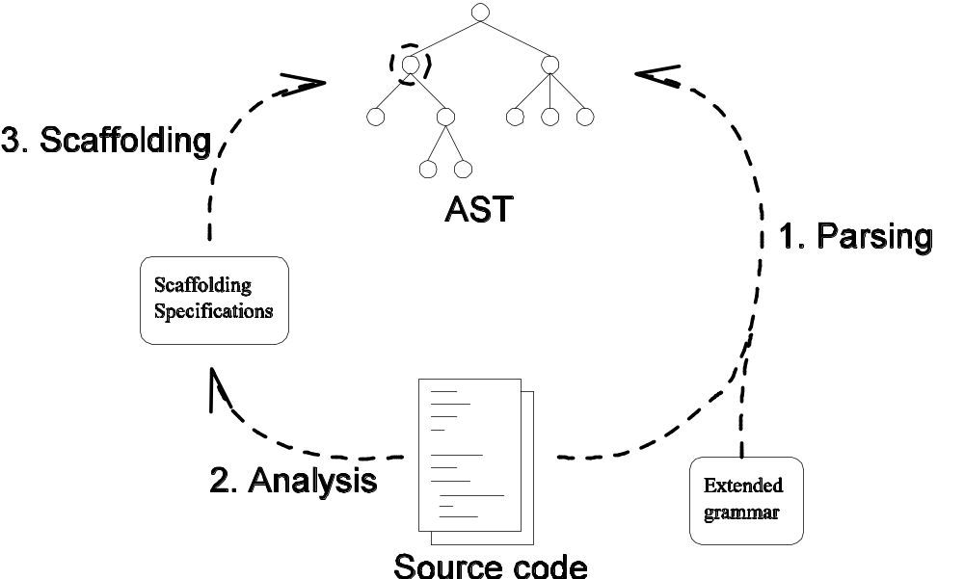
SCATR architecture
Notes:
Read paper for applications.

Slide 13
Finally
Questions?
Email:
Magiel.Bruntink@cwi.nl
Web:
http://www.cwi.nl/~bruntink

