Slide 1
Estimating the Run-Time Progress of a Call Graph Construction Algorithm
Jason Sawin, Atanas Rountev
Ohio State University

Slide 2
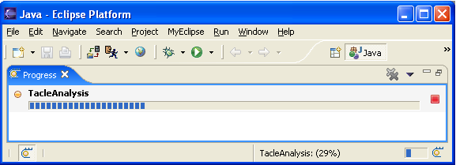
Progress Indicators
Important UI components
Performs several valuable tasks
  Immediate user feedback
  Indication of progress made
  Estimate of amount of time need to complete the task
Often it is difficult to create an accurate and meaningful progress indicator
Notes:
This slide needs to introduce and express the importance of GUI progress indicators. Research indicates that timely feed back to the client can be as important as over all speed of the application. There are two types of progress monitors, measured and non measured. Measured provides an estimate the total amount of running time of the application. This information is invaluable to clients as it assures them that the application is running and provides a time estimate for completion.
Include a graphic of the TACLE progress bar

Slide 3
TACLE and Rapid Type Analysis
TACLE is an Eclipse plug-in which implements a version of RTA
RTA produces type information and a call graph for a whole program
Uses a worklist algorithm
  Initial the only element in the worklist is the main method
  Methods are removed from the worklist and processed.
  During processing new methods discovered at invocation sites are added to the worklist

Slide 4
Why is it hard?
Accurate progress monitors rely on a priori knowledge of the total amount of work the application must perform
No such information for RTA
  There is no way to determine the exact number of reachable methods RTA will discover without first running it
Must rely on heuristics

Slide 5
Two Type of Heuristics
Initial Analysis
  The first time the analysis is ran on an application
Repeated Analysis
  Repeated executions of the analysis on slightly different version of the application
  Can utilize information stored from the initial analysis
Change impact analysis

Slide 6
Heuristics: Initial Analysis
Naïve
  Hardcoded estimate of 8101 reachable methods
  Indicates progress for every method processed
Number of user defined methods
  Only indicates progress when user defined methods are processed
Number of user defined methods and library entry methods

Slide 7
Heuristics: Repeated Analysis
Total number of reachable methods
  Indicate progress for every method processed
  Use the total number of reachable methods from an earlier version
Methods weighted by relative time
  Stores a table of methods and the amount of time it took to processes them
  Indicate progress for old methods only
Elapsed time
  Monitor runs in a separate thread and indicates progress in measured increments
  Uses total running time of previous version

Slide 8
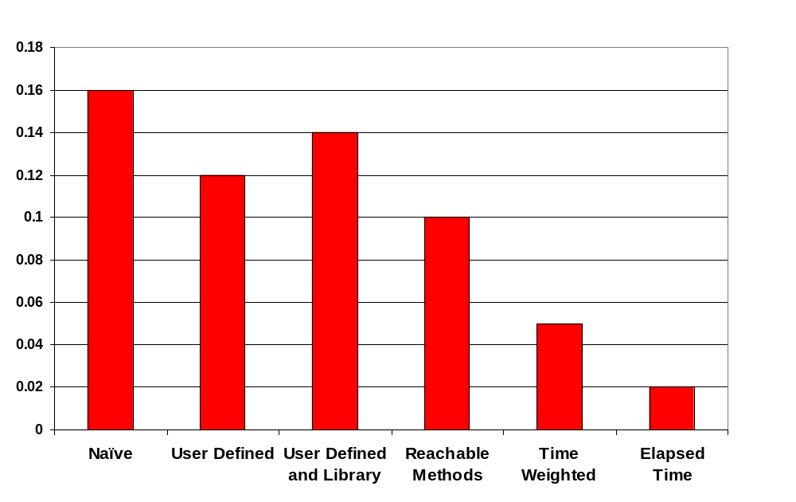
Accuracy Results

Slide 9
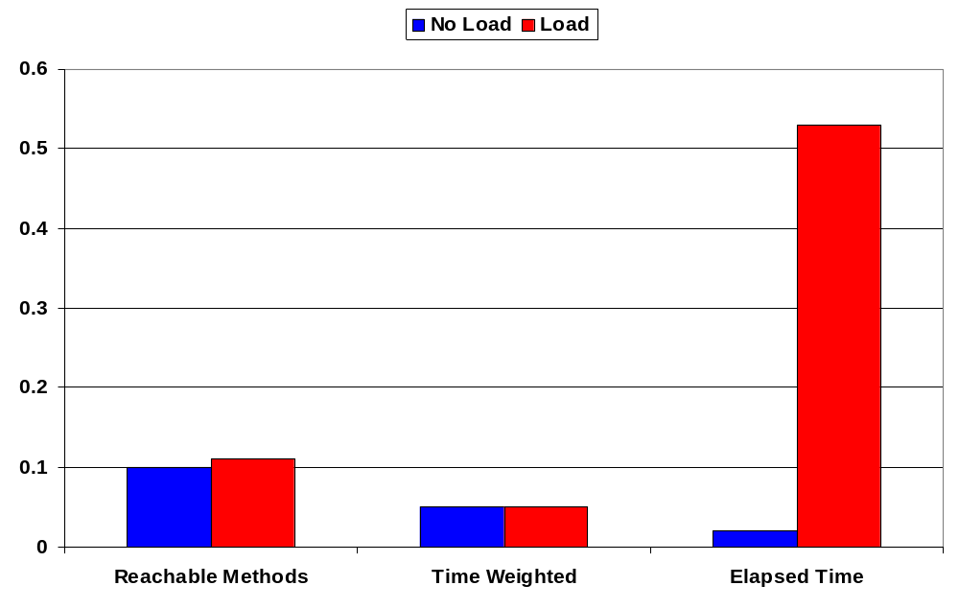
Accuracy Results Under Load

Slide 10
Conclusions and Future Work
Building progress indicators that are both meaningful and accurate can be a challenging task
  Many static analysis designers will face this challenge
  Two classifications of monitors
  Metrics to evaluate heuristics
Future Goals
  Extend our work to other static analyses such as points-to analysis
  Create more sophisticated heuristics for initial analysis

Slide 11
QUESTIONS

