Slide 1
A Comparative Study of Refactoring Haskell and Erlang Programs
Huiqing Li
Simon Thompson
Computing Lab, University of Kent

Slide 2
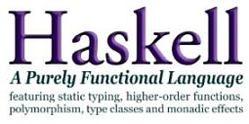

Background
Haskell: a lazy, statically typed, purely functional programming language featuring
higher-order functions, polymorphism, type classes and monadic effects.
Erlang: a strict, dynamically typed functional programming language with support for concurrency, communication, distribution and fault-tolerance.

Slide 3
Background
The ‘Refactoring Functional Programs’ project (2002-2005).
  HaRe: the Haskell Refactorer.
The ‘Formally-Based Tool Support for Erlang Development’ project (2005- 2008).
  Wrangler: the Erlang refactorer.
  Model checking of Erlang programs.
  Testing of Erlang programs.

Slide 4
A Refactoring Example
Generalise a function definition.
-module (test).
-export([f/1]).
add_one ([H|T]) ->
[H+1 | add_one(T)];
add_one ([]) -> [].
f(X) -> add_one(X).
-module (test).
-export([f/1]).
add_one (N, [H|T]) ->
[H+N | add_one(N,T)];
add_one (N,[]) -> [].
f(X) -> add_one(1, X).

Slide 5
Haskell Vs. Erlang
-- refactoring opportunities
Haskell Refactorings
Erlang Refactorings
Introducing/removing concurrency,
Asynchronous/synchronous
communication,
Refactoring to design patterns,
. . . . . .
Type/type class-related
refactorings.
Monad-related refactorings
. . . . . .
Renaming,
Removing unused definitions/parameters,
Swapping arguments,
Introducing a new definition,
. . . . . .

Slide 6
Tool Support for Refactorings
Behaviour-preservation. Given the same input value(s), the program should produce the same output value(s) before and after the refactoring.
Program appearance preservation. A real-world refactoring tool should preserve the original program layout and comments as much as possible.

Slide 7
Refactoring = Condition + Transformation
Our experience: for most refactorings, the side-condition analysis is more complex than the program transformation part.
Some typical static semantic analysis used during side-condition analysis and program transformation:
  Binding structure of variables,
  Function call graph,
  Module graph,
  Type information,
  Side Effect (only for Erlang programs).

Slide 8
Refactoring = Condition + Transformation
Our observation: analysing Erlang programs is in general more complex than analysing Haskell programs because of Erlang’s flexibility and some dynamic aspects. e.g. weak type information, dynamic function calls, etc.
Example 1:
start( ) -> spawn (ch1, ch1, []).
Example 2:
foo ( ) -> M = blah, F = list_to_atom(“fun1”),
M:F().

Slide 9
Program Layout Preservation
Haskell people tend to stick to their own layout, therefore standard pretty-printer does not help too much.
Erlang people tend to accept the standard layout, partially because most Erlang people use Emacs as the editor, therefore standard pretty-printer is acceptable.

Slide 10
Implementation
The Haskell Refactorer, HaRe, is implemented in Haskell,
The Erlang Refactorer, Wrangler, is implemented in Erlang.
In the implementation of HaRe, lots of effort has been put to comment and layout preservation, whereas much more effort has been put to the program analysis part for the implementation of Wrangler.

Slide 11
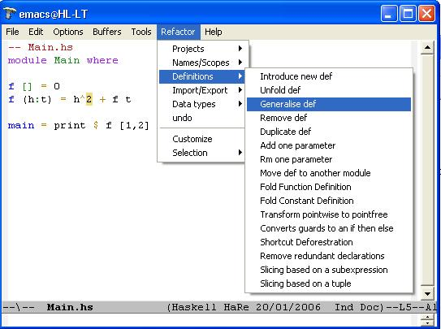
Snapshot of HaRe

Slide 12
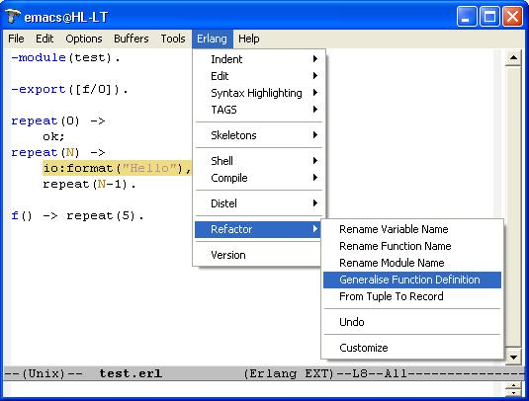
Snapshot of Wrangler

Slide 13
Conclusion and Future Work
Both Haskell and Erlang benefit from the referential transparency property of functional programming languages.
Different language characteristics and programming idioms affect the catalogue of useful refactorings.
Refactoring Erlang programs involves more complex static semantics analysis.
Building a language-generic refactorer can be very challenging in practice.
Future work: examine more Erlang refactorings in novel areas (e.g. concurrency).

Slide 14
Questions?

