Slide 1
Improved Static Resolution of Dynamic Class Loading in Java
Jason Sawin, Atanas Rountev
Ohio State University
Work supported by NSF

Slide 2
Dynamic Class Loading
Dynamic Class Loading
  Ability to install classes at run time
String className = “foo.bar.clazz”;
.....
Class c = Class.forName(className);
Object h = c.newInstance();
.....

Slide 3
Class Loading and Static Analysis
In the general case it is impossible to statically determine the affects of dynamic class loading
Static Analysis Approaches
  Ignore it
  Overly conservative
  Query the user
  Utilize casting information
  String analysis

Slide 4
Problems with Modern Approaches
Problem: string analysis only considers purely static string values
  Many uses of dynamic class loading will rely on string values which are not hard coded into applications
Insight: hybrid (static/dynamic) analysis can increase information being considered
  Increases precision
  Loss of global soundness
Problem: state-of-the-art string analysis is not powerful enough to precisely model all language features
Insight: generalization can be made to improve the precision of string analysis

Slide 5
Hybrid Generalization
Extended Java String Analyzer (JSA)
During the static string analysis, dynamically gather information about the values of system environment variables
Inject this information at environment variable entry points
  System.getProperty(String propName)
  Utilize JSA to resolve propName

Slide 6
Increasing the Precision of JSA
Field Generalization: JSA provides no treatment for fields
  We provide a context-insensitive treatment for certain fields
Type Generalization: String is a subclass of Object
  Use type inferencing analysis to determine objects of static type Object which are actually objects of type String
  Needed for the up and down casting of objects between String and Object

Slide 7
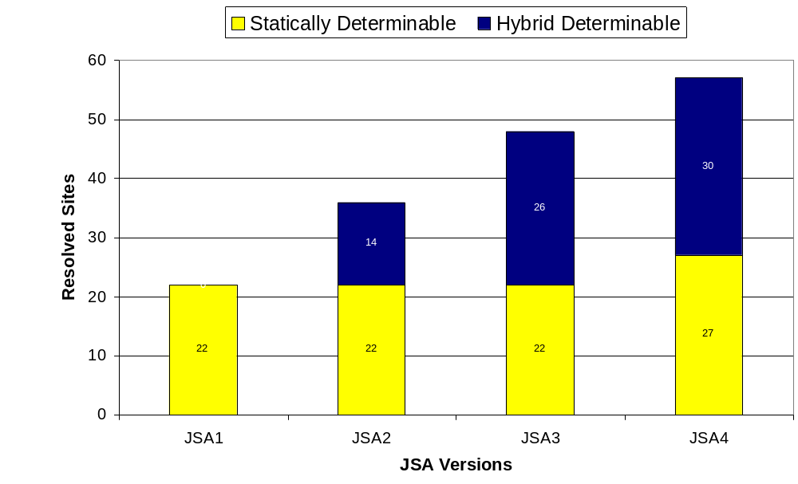
Study of Java 1.4 Libraries

Slide 8
Summary of Initial Study
Our approach increases by a factor of 2.6 the ability of a state-of-the-art string analysis to resolve instances of dynamic class loading
Results are sound for the values of environment variables observed at analysis time
Gathering environment information maybe a useful technique for a wide range of static analyses

