Slide 1
Bienvenue à SCAM 2007
Bogdan Korel and Mike Godfrey
Program co-chairs
Leon Moonen
General Chair

Slide 2
Welcome to SCAM 2007
As of 2007, we are now the
  IEEE Working Conference on Source Code Analysis and Manipulation
In practice, we’ve always been a kind of working conference:
  Presentations are kept short and directed …
  … and are followed by lively discussions of issues raised

Slide 3
Welcome to SCAM 2007
SCAM exists because source code is king!
  It’s the only reliable truth we have
We bring together researchers + practitioners
We focus on the algorithms + tools themselves — what they can achieve, and how they can be improved, refined, and combined.
  Other venues address applications of source code analysis and manipulation

Slide 4
PariSCAM mottos
Plus ça change, plus c'est la même scam.
  [Harman/Cordy]
L'état logiciel, c'est moi,
  [Louis XIV, le roi Solaris]
Que je scam avant quoi je scam.
[Sartre]

Slide 5
PariSCAM mottos
Les chemins logiciels de la liberté.
[Sartre]
On scam parce qu'il est absurde.
[Camus]
Cogito ergo scam
  [Descartes]
Vive les variables libres!
[de Gaulle, à Québec]

Slide 6
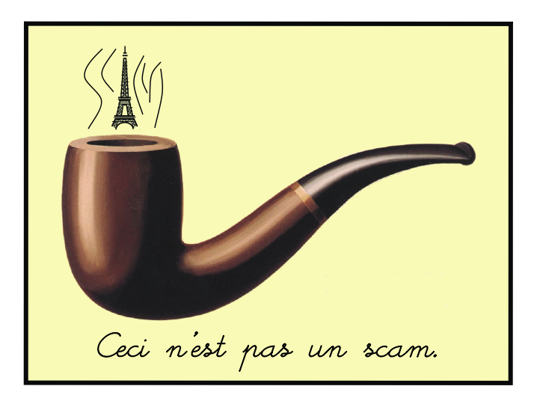
[Alors! Magritte était belge!!]

Slide 7
The SCAM 2007 review process
All papers were fully reviewed by three or four program committee members for relevance, soundness, and originality.
2007 acceptance rate was 26% — the lowest ever for SCAM — indicates a very strong technical program.

Slide 8
SCAM statistics
Year | # submitted | # accepted | Acceptance rate
2007 | 74 | 19 | 26%
2006 | 49 | 19 | 39%

Slide 9
Accepted papers by country
Germany 4
USA 4
Netherlands 3
Italy 2
Sweden 2
Switzerland 2
UK 2
Canada 1
Japan 1
Norway 1
Romania 1

Slide 10
Accepted papers by country

Slide 11
Submissions by country
USA | 15
Germany | 11
Canada | 5
Romania | 5
UK | 5
China | 3
Hungary | 3
Netherlands | 3
France | 3
Portugal | 3
New Zealand | 2
Norway | 2
Australia | 2
Sweden | 2
Japan | 2
Russia | 2
Austria | 2
Italy | 2
Switzerland | 2
India | 1
Greece | 1
Finland | 1
Czech Republic | 1
Spain | 1
Korea | 1
Saudi Arabia | 1
Israel | 1
Singapore | 1
Taiwan | 1
Unknown | 1

Slide 12
Submissions by country

Slide 13
SCAM paper sessions
Please see your sessions chairs ahead of time
  Session #6 chair is Paolo Tonella
  Today’s last session finishes at 5:50
Each authors is allowed 10 minutes to present their paper
  Then there’s 5 minutes for questions
  Then the speaker will write on the board a thought-provoking statement or a discussion question about the work or the area

Slide 14
SCAM paper sessions
After all speakers have presented, there will be a 45 minute discussion session on the session topic
SCAM attendees are encouraged to write down ideas / provocative statements on overhead transparencies
  Transparencies serve as our memory!
    Did you see the film Memento?

Slide 15
Bienvenue à SCAM 2007
Bogdan Korel and Mike Godfrey
Program co-chairs
Leon Moonen
General Chair

