Slide 1

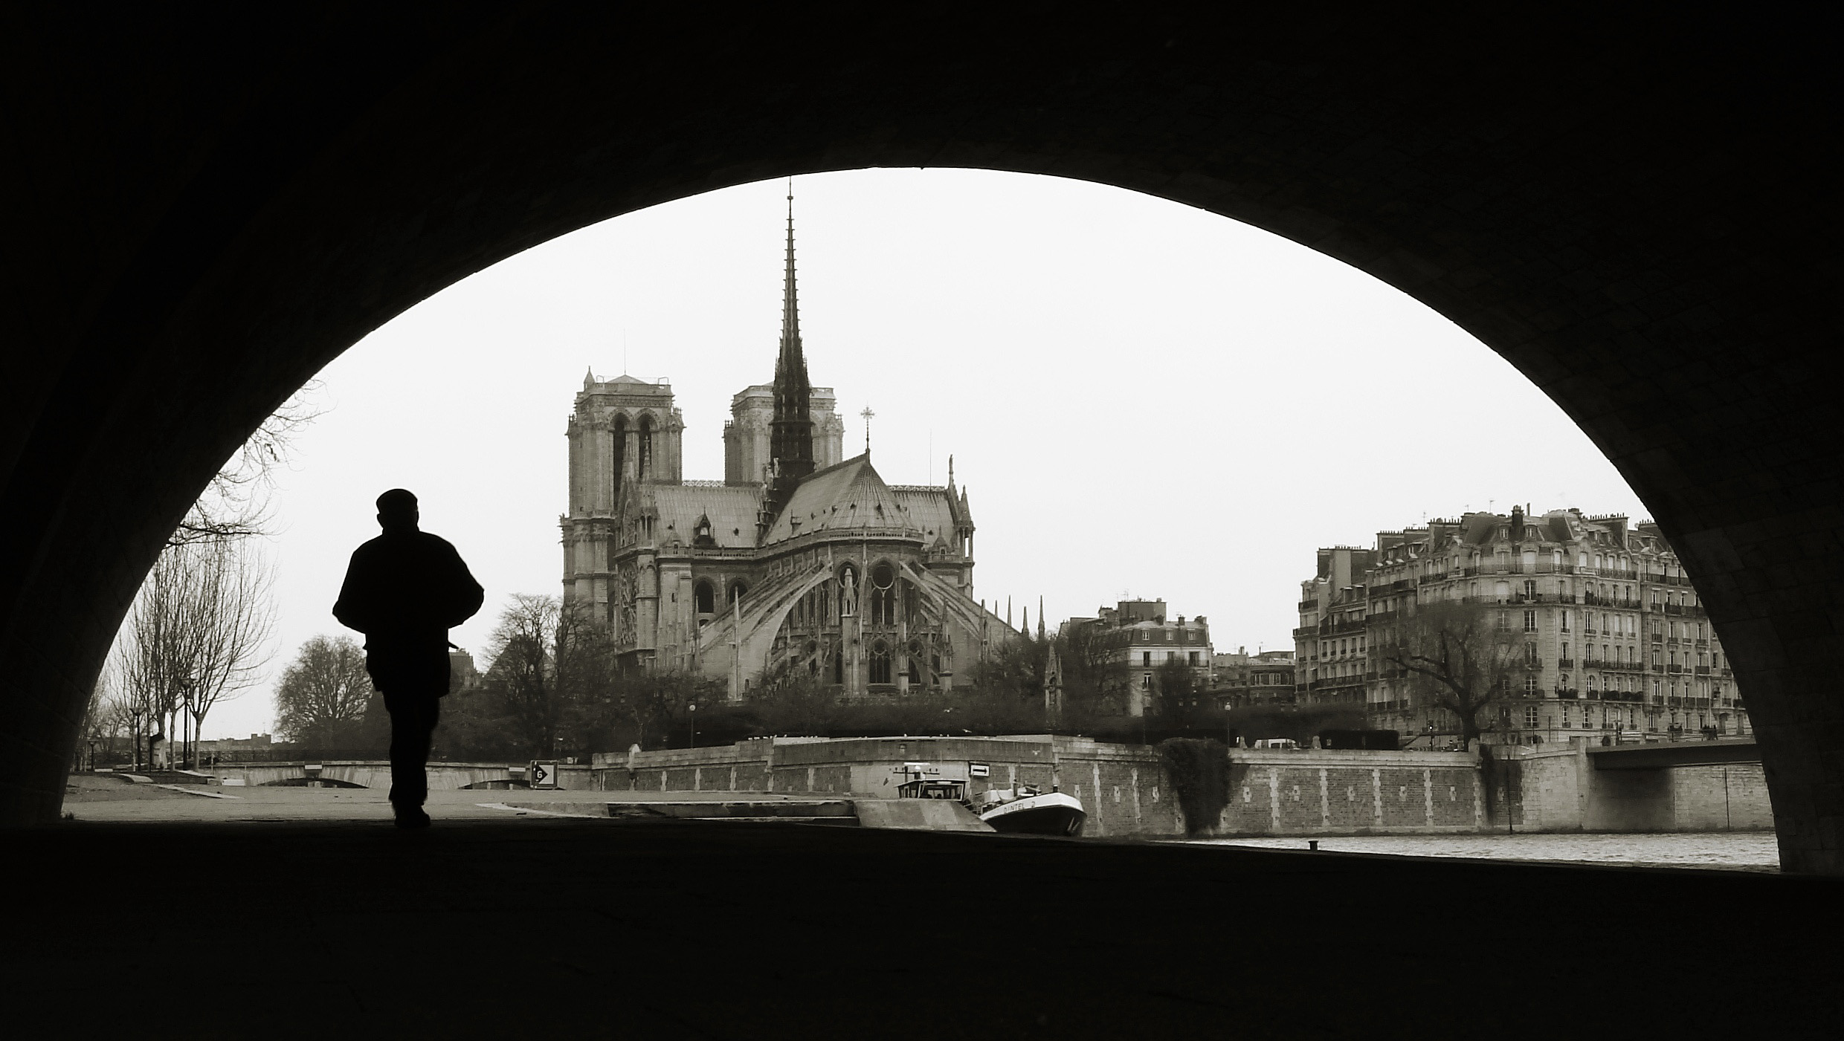
Seventh IEEE International Working Conference on
Source Code
Analysis And Manipulation
Closing remarks

Slide 2

Rene Magritte
(translates to: this is not a pipe)

Slide 3

On your mug
(the scam being that Magritte is Belgian, not French)

Slide 4





SCAM 2007 has been a success thanks to
Our program committee and all additional reviewers
who selected great papers
Authors who gave interesting presentations
Organizing committee for keeping me sane
  Program Chairs: Mike Godfrey & Bogdan Korel
  Finances & long term memory: Dave Binkley
  Local Arrangements: Matthieu Martel
  Tool Demonstrations: Keith Gallagher
  CyberChair: Massimiliano Di Penta
  Publicity & website: Zheng Li
Session chairs who ensured lively discussions
Our sponsors who made things affordable
Participants (i.e. you) who stayed around!
Centre for Research in Evolution, Search & Testing
King’s College, London

Slide 5
Special SCAM thanks award
The International Working Conference on
Source Code Analysis and Manipulation
SCAM
***
presented to
Professor Mark Harman
***
In recognition of vision, leadership
and commitment to the SCAM community
2001 -- 2007
Paris, France
September 2007

Slide 6




SCAM2008 in Beijing

Slide 7
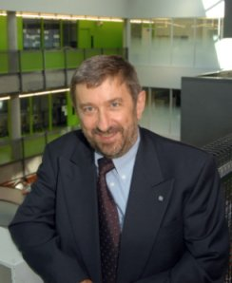
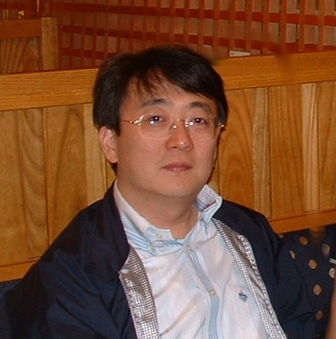
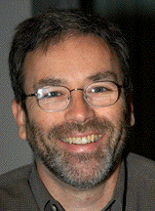
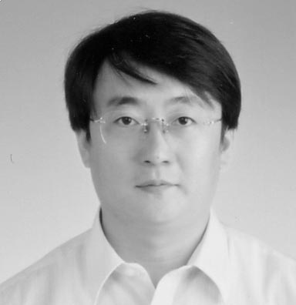
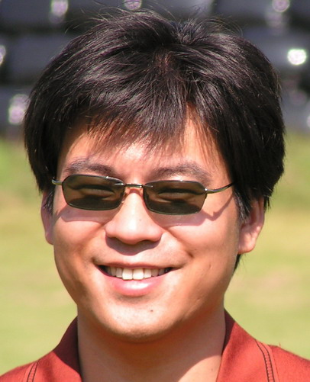
Organization
General Co-Chairs:
  Giulio Antoniol and Jianjun Zhao
Program Co-Chairs:
  Jim Cordy and Lu Zhang
WEB Master
  Zheng Lin
Tentative Date:
  September 28 and 29, 2008
Co-located with ICSM 2008

Slide 8

Access to Beijing
From North American, Europe, and Oceania: almost all the big cities have direct flights to Beijing
From Asia: principal Asian cities with direct flights to Beijing from many cities from Japan, Korea, Taipei, Hong Kong, Singapore, Sydney, and Bangkok, etc.

Slide 9
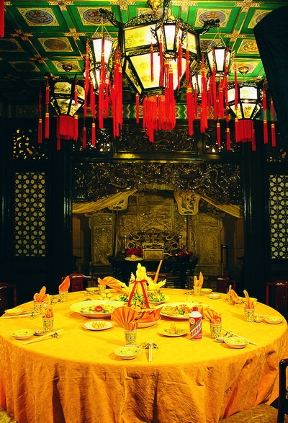

Enjoying Chinese Food in Beijing
Thousands of restaurants, each with their own special atmosphere, which offer:
    Popular dishes in China
    Local dishes in Beijing such as Beijing Duck

Slide 10

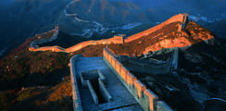

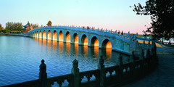
Enjoying Culture within Beijing

Slide 11
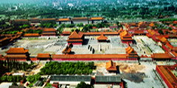
Forbidden City – Palace Museum

Slide 12

Beijing Forbidden City

Slide 13



And … finally …
See you in Beijing 2008!

Slide 14
Open Steering Committee meeting
Current Steering Committee
Jens Krinke (Chair)
Dave Binkley
Keith Gallagher
Leon Moonen
Tom Dean*
Mark Harman*
Term is 3 years, marked with * means end of term

Slide 15
Open Steering Committee meeting
1st open floor to nominations
Every nomination needs a second
Nominees accept or decline
After nominations close nominees make a short statement
Participants vote for two people
  Not twice on same person
  May vote for yourself (if nominated & accepted)
Then we count

Slide 16
Nominees & Votes
Mike Godfrey :111111111111111111111111111111111
Jim Cordy :1111111111111111111111111111111
Dawn Lawrie :1111111111111111111111111
New steering committee members: Mike and Jim

