Slide 1

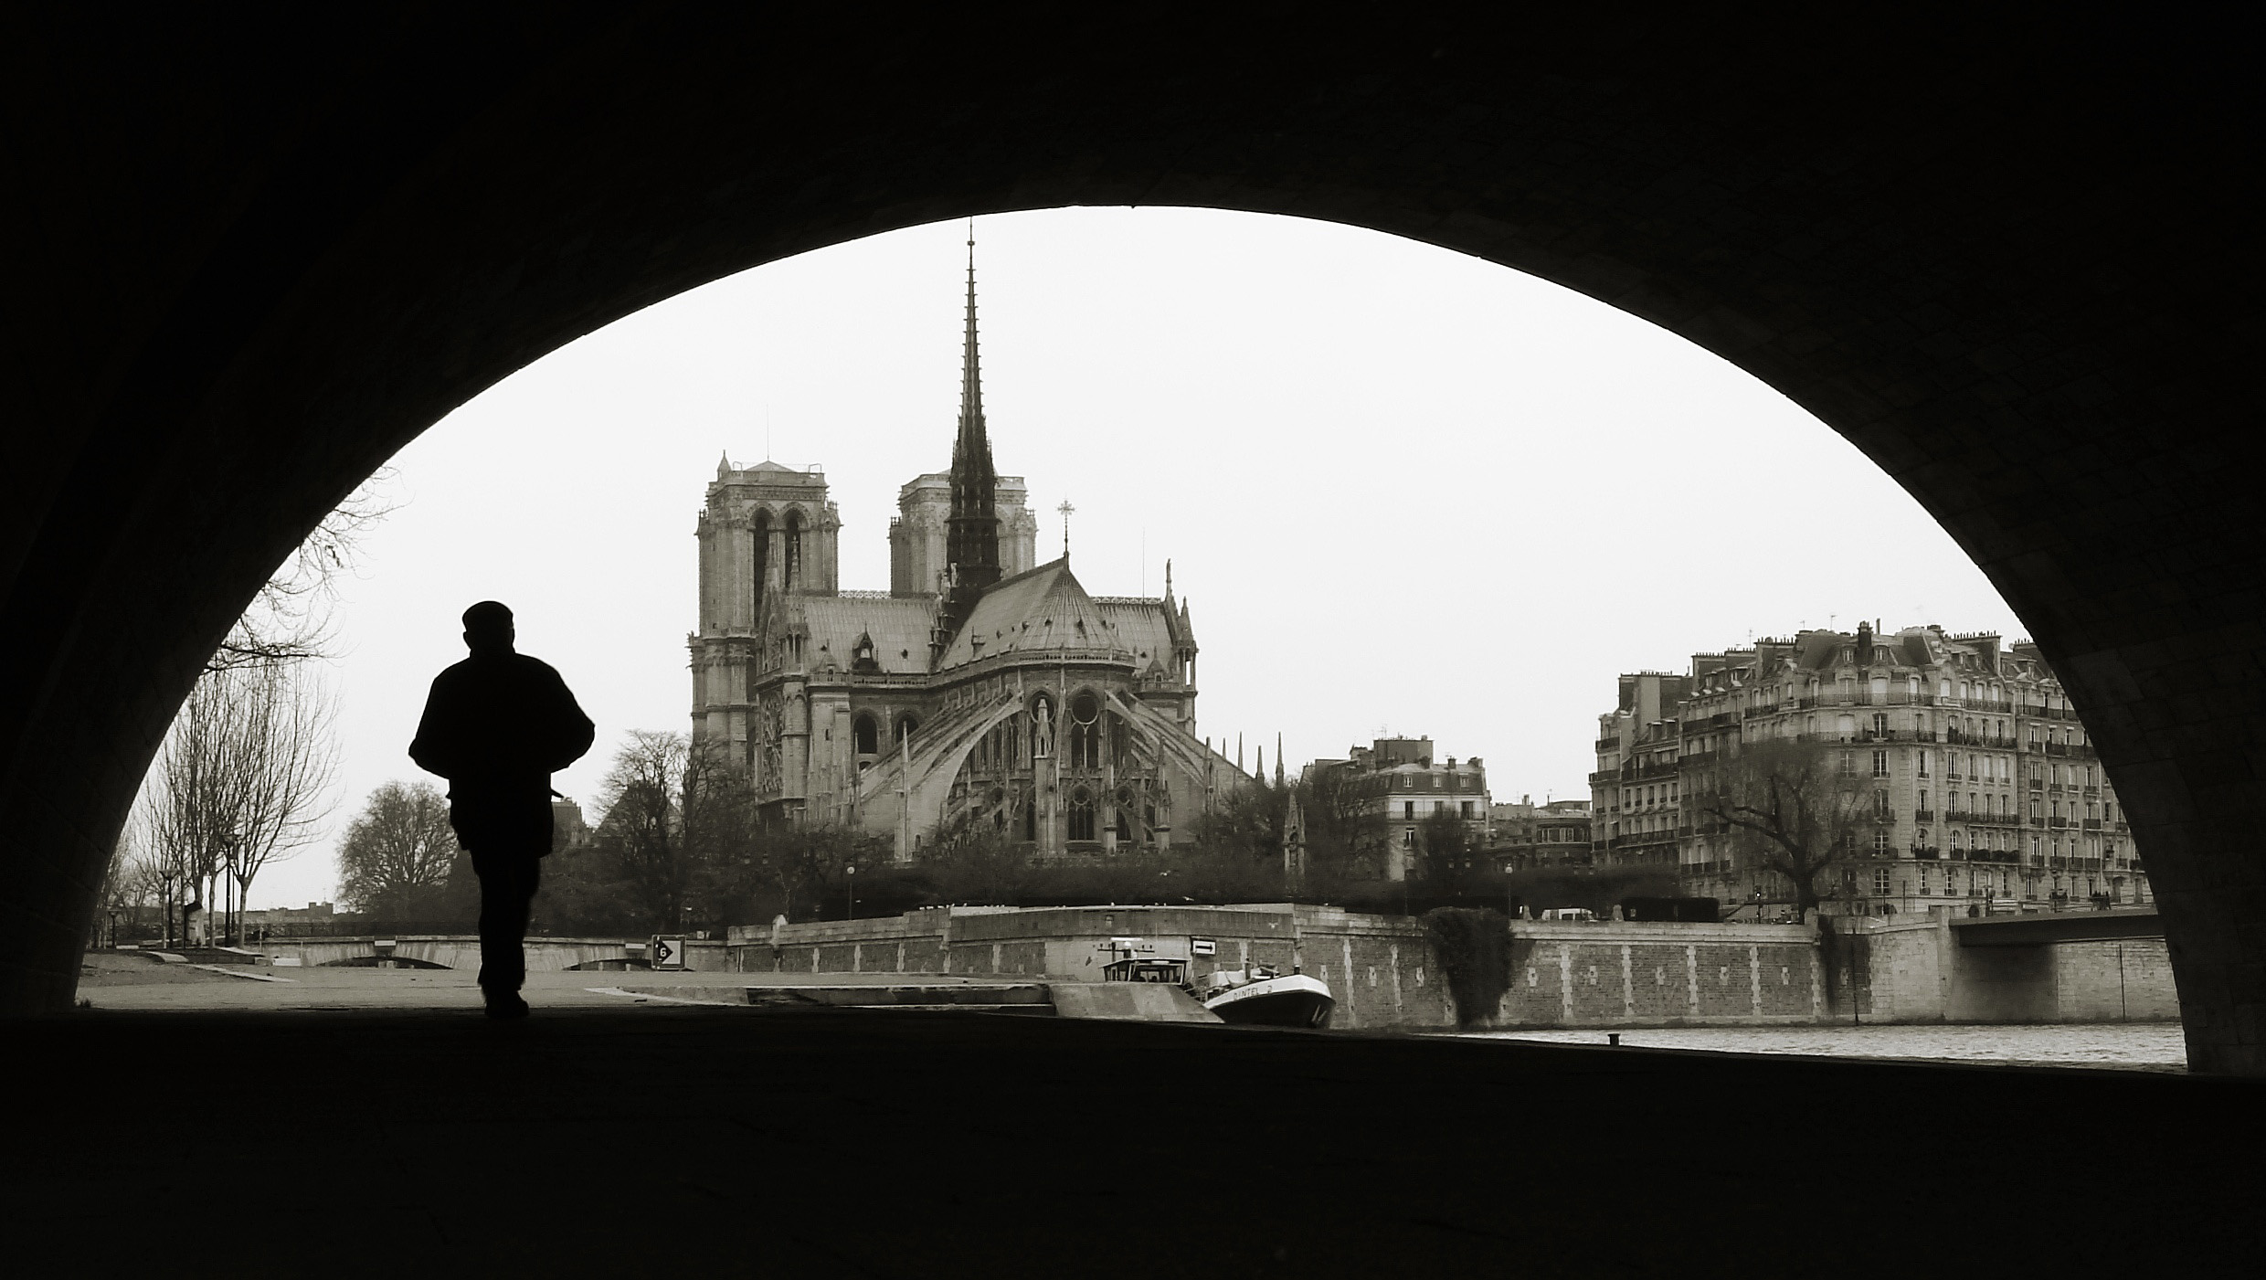
Seventh IEEE International Working Conference on
Source Code
Analysis And Manipulation

Slide 2
Welcome!
7th edition of SCAM
We have become a working conference
  keep “look & feel”: interesting, interactive, informal and fun
Two full days; program at a glance:
  exciting keynote by Oege de Moor
  19 full papers in 6 sessions
  3 tool demos in special session (tomorrow)
  social event with best paper award (tonight)
78 registered participants

Slide 3
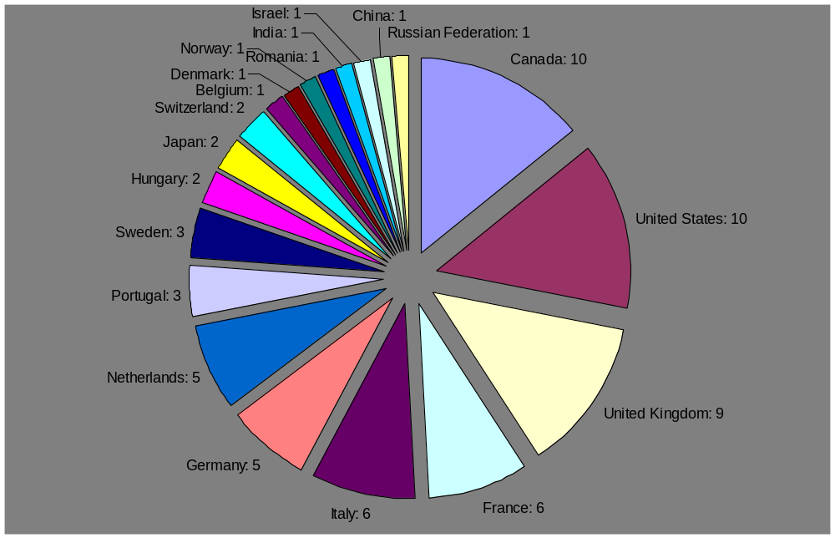
Participant Distribution
6% “other”
28% North America
66% Europe

Slide 4
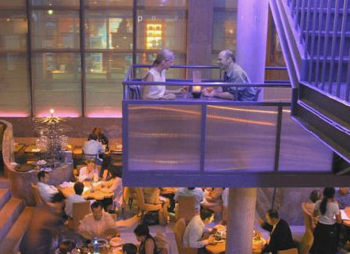
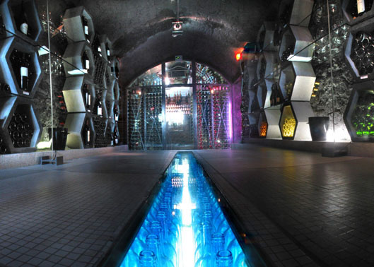
Social Event: Chai 33
tonight 7:30pm
3 converted chais (wine warehouses) in Bercy, used to be largest wine-trading centre in Europe (19th century)
tour wine cellar & tasting
dinner
go there by yourself
  metro
  stop “Cour Saint Emilion”
  most of you along RER
  transfer at “Chatelet-Les Halles”
14
B

Slide 5





SCAM will be a success thanks to
Our program committee and all additional reviewers
who did a great job at reviewing in time
Authors for submitting interesting work
Organizing committee for keeping me sane
  Program Chairs: Mike Godfrey & Bogdan Korel
  Finances & long term memory: Dave Binkley
  Local Arrangements: Matthieu Martel
  Tool Demonstrations: Keith Gallagher
  CyberChair: Massimiliano Di Penta
  Publicity & website: Zheng Li
Session chairs who will lead good discussions
ICSM & Francoise Balmas for co-location
Our sponsors for making things affordable
Centre for Research in Evolution, Search & Testing
King’s College, London

Slide 6
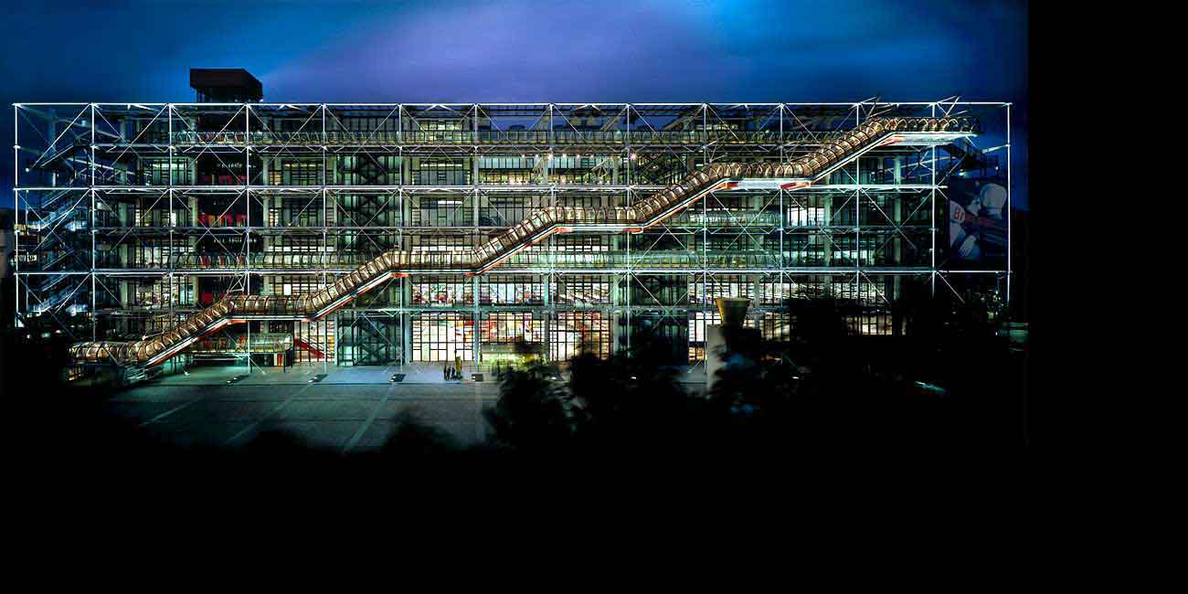
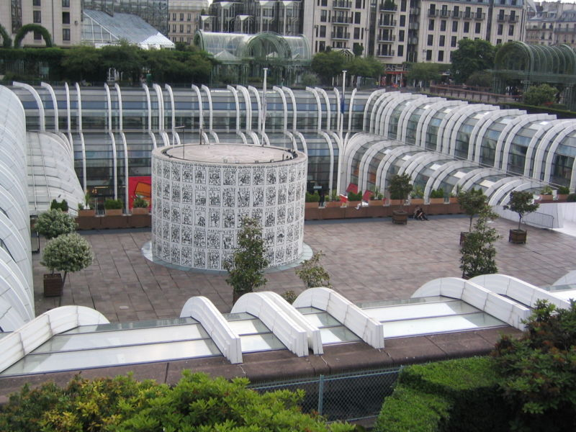
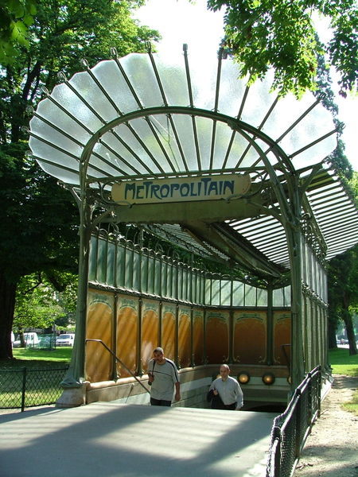
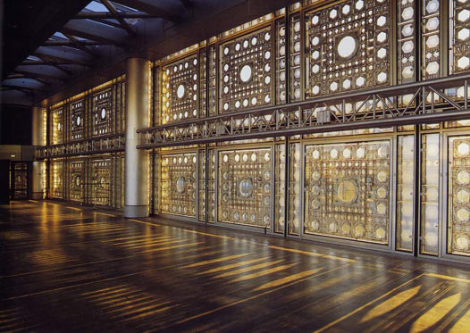
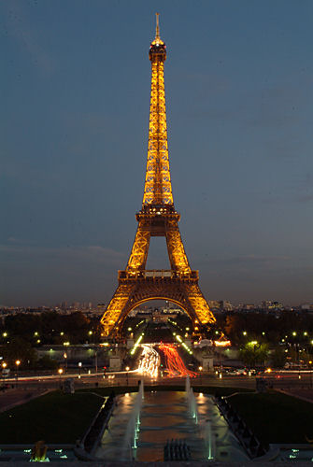
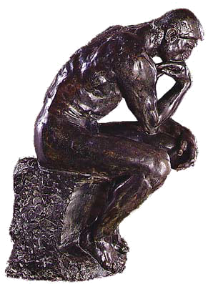
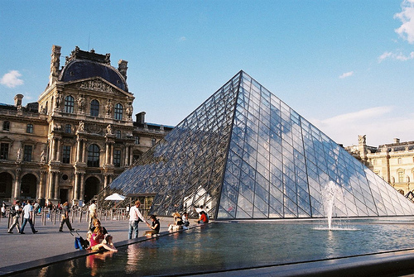
must go to SCAM, must go
to SCAM, must go to SCAM, must go to SCAM, must go to SCAM…

