Slide 1
The Evolution and Decay of Statically Detected
Source Code Vulnerabilities
Massimiliano Di Penta
Luigi Cerulo
Lerina Aversano
RCOST – Dept. Of Engineering
University of Sannio, Benevento (Italy)
dipenta@unisannio.it

Slide 2

Motivations
Vulnerable instructions in the source code are crucial problem for maintainers
  Buffer overflows, SQL injections, cross-site scripting (XSS)
  CERT reported buffer overflows as the major cause of software attacks
  XSS attacks are now increasing and becoming predominant
Existing approaches aim at testing them
[Del Grosso et al., GECCO’05, COR’08] or protecting them [Wang et al., WCRE’05]
Properly monitoring (and removal when needed) highly desirable to ensure security and reliability
Static vulnerability detection tools exist
Vulnerability maintenance not yet investigated
  A related study was done for compiler warnings
  [Kim and Ernst, ESEC-FSE’07]

Slide 3
Vulnerabilities we study
Inspired from Krsul PhD Thesis
INPUT VALIDATION: concerns the incorrect validation of input data
  XSS (XSS), SQL Injection (SQL), Command Injection (CI), File System Vulnerabilities (FS), Network Vulnerabilities (Net)
MEMORY SAFETY: concerns vulnerabilities dealing with memory access and allocation.
  Buffer Overflow (BO), Input Allocation Problem (I), Type Mismatch (TM), Memory Access Problem (M)
RACE/CONTROL FLOW CONDITIONS: arise when separate processes or threads of execution depend on some shared state.
  Race Check (RC), Control Flow Problem (CF)
OTHERS:
  Dead Code (DC), Random Number Generators (RND)
Important Note: we study vulnerabilities as detected by static analysis tools (Splint, Rats, Pixy)
  Same assumptions of Kim and Ernst
  Further validation might be necessary

Slide 4
Evolution Study
Goal: study the evolution of statically detected vulnerabilities with the purpose of determining their density trend and their permanence in the system. Quality focus: security and reliability.
Context: three network applications:
  Squid: Web caching proxy (C)
  Samba: file sharing and print service (C)
  Horde: Web application framework including a Web mail (PHP)
Research Questions:
  RQ1: How does the vulnerability density vary over the time?
  RQ2: Are there vulnerability categories that tend to disappear quicker?
    They can disappear because of (co-changes, changes, code removal)
  RQ3: How can we model the vulnerability decay process?
Vulnerabilities detected using three different static analysis tools
  Splint (flow analysis - C)
  RATS (pattern-matching detector – C, PHP, other languages)
  Pixy (XSS detector - PHP)

Slide 5
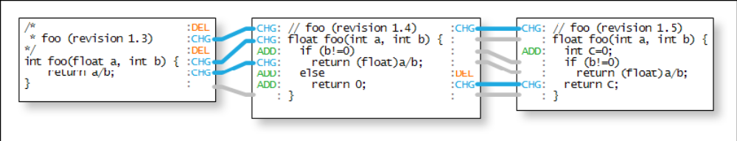
Analysis process
Step 1: CVS/SVN Snapshots extraction and change set (snapshot) identification
  Sequences of commits (same note and author) having a distance < 200 s
Step 2: Tracing source code line changes
  Using the ldiff algorithm and tool [Canfora et al. MSR 2007]
  Overcomes limitations of Unix diff to distinguish changes from add and del
Step 3: Identifying vulnerabilities in each snapshots
Step 4: Analyzing vulnerability lifetime (using Step 2 info)
  When it is introduced
  When it disappears (not detected anymore)
  Change to vulnerable code and co-change

Slide 6
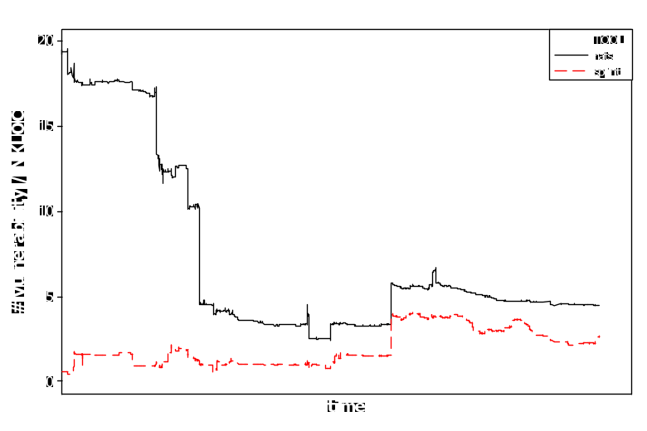
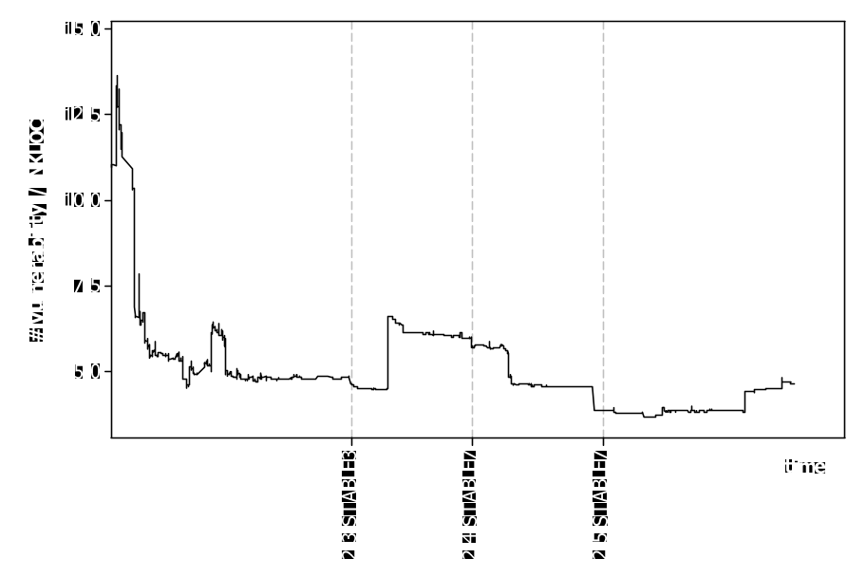
RQ1: Evolution of vulnerability density
Samba - Overall
Squid – Buffer Overflows
Splint vulnerabilities tend to have a lower density (thorough analysis)
Initially, a high number vulnerabilities detected by RATS
  Pre-release, then vulnerabilities removed by security patches
No trend detected (ADF test)
Buffer Overflows introduced at release 2.3 STABLE3
Then removed in the subsequent releases 2.4STABLE7 and 2.5STABLE7 with proper security patches
  As documented in the system history

Slide 7
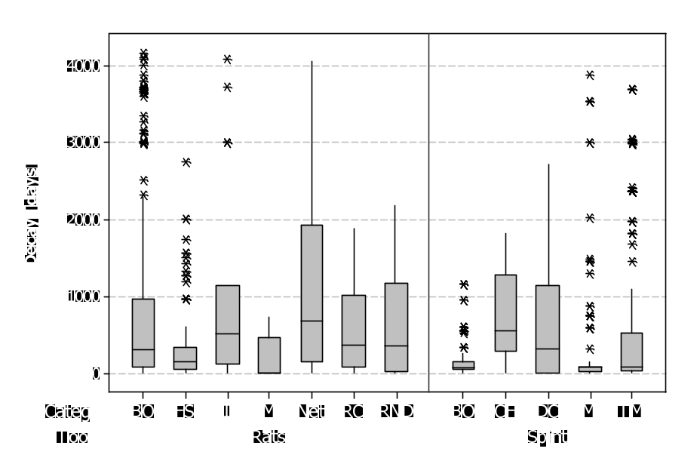
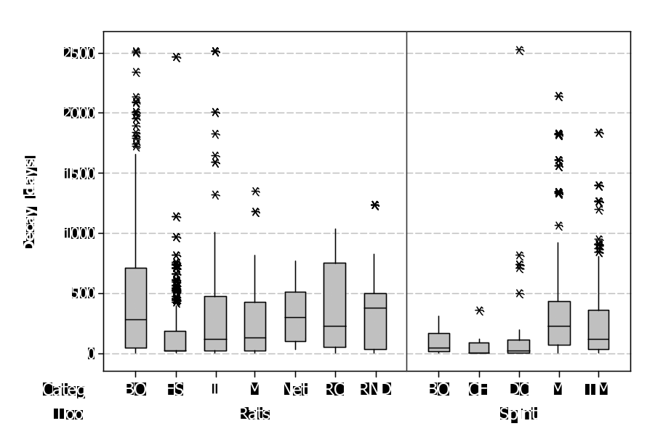
RQ2: Vulnerability Decay
Vulnerability Decay in Squid
Vulnerability Decay in Samba
Buffer Overflows tend to disappear significantly quicker than most of other vulnerabilities (M-W test)
File System vulnerabilities the quickest to be fixed
  Samba domain: sharing files and printers

Slide 8
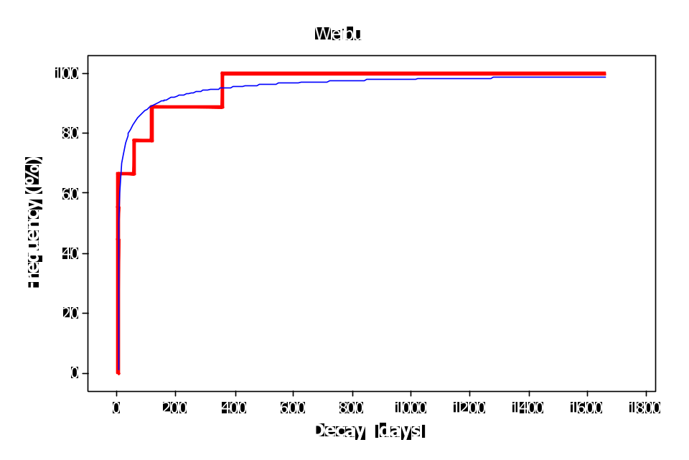
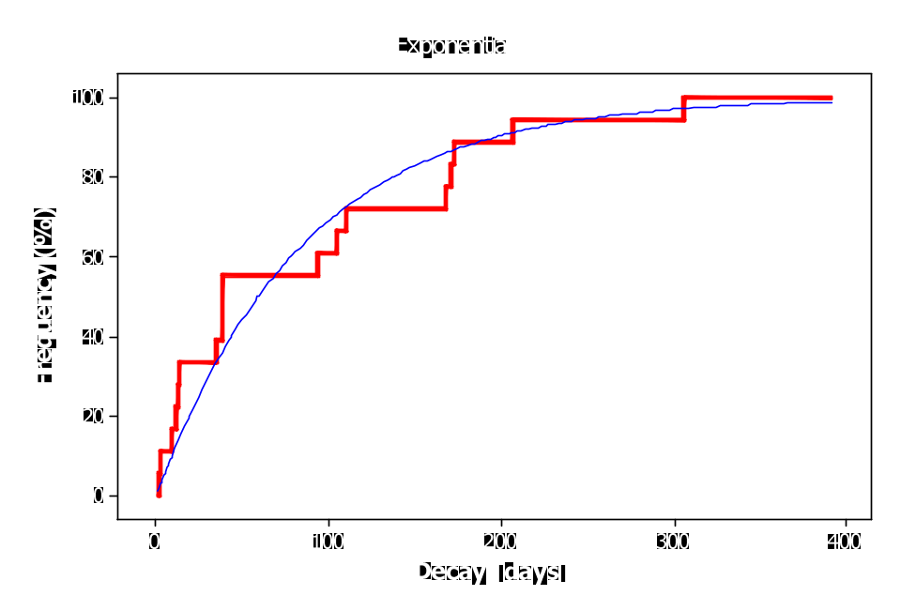
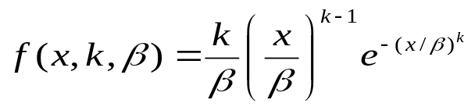
RQ3: Decay CDF
Samba – Control Flow Problem CDF
Samba – Buffer Overflow CDF
Vulnerability decay distributed fitted Exponential or Weibull distributions in many cases
  Distribution built using a Maximum Likelihood Estimator
  Fitting tested using the Kolmogorov-Smirnov test
Weibull (exp for k=1)
The likelihood a vulnerability has to disappear from the system exponentially decreases with the time.

Slide 9
Threats to validity
Construct validity (relationship between theory and observation)
  Tools can exhibit false positives or false negatives
  As said for now we focused on vulnerabilities “as detected”
  Vulnerabilities can be removed “accidentally”
Reliability validity (can I replicate your study?)
  Tools available (including ldiff)
  Data extraction and analysis method fully detailed
  Systems available
External validity (generalization of findings)
  We analyzed 3 different systems
  Further studies necessary
  Also with more focus on XSS and SQL-injection

Slide 10
Conclusions
We performed a fine-grained analysis on the evolution of statically detected source code vulnerabilities
Main insights:
  Vulnerability density is often stationary
  Often vulnerabilities introduced in pre-releases, then fixed with security patches
  Vulnerability removal priority might depend on the particular harmfulness of the vulnerability
    Different from system to system
  Vulnerability decay can be modeled with Weibull/exponential distributions
  A potential vulnerability surviving for a long time is unlikely to be removed
    Perhaps because it is not dangerous
Work in progress:
  Better validation (these are vulnerabilities as detected)
  Further analyses on the cause of vulnerability removal

Slide 11

A (potential) vulnerability remains in the system for a long time.
Does this mean it is not dangerous?
Thank you!

