Slide 1

DTS（Defect Testing System）
Yang Zhao Hong, Gong Yun Zhan,Xiao Qing, Wang Ya Wen
Beijing University of Posts and Telecommunications
2008.09

Slide 2
Outline
How does DTS work?
Defects patterns
Defects Testing Framework
Testing an example-Tomcat

Slide 3
DTS
Supports Java/C/C++ source code static analysis
Tool is written by Java

Slide 4

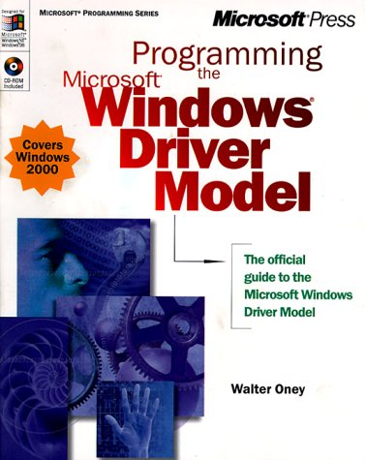

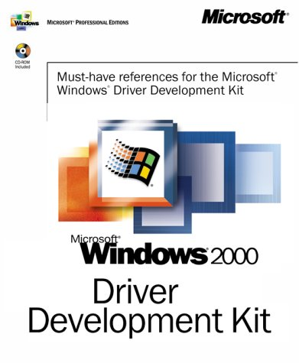



How does DTS work?
Rules
Testing
Static Testing Tool
Source Code
Precise
Rules
Program Analysis Engine
Defects
Notes:
页眉
elapsed time: 2

Slide 5
Outline
How does DTS work?
Defects patterns
Defects Testing Framework
Testing an example

Slide 6
Various defect patterns
Memory Leak Fault
Out of Bounds Array Access Fault
Illegal Computing Fault
Uninitialized Variable Fault
buffer overflow vulnerability
Tainted Data vulnerability
Race Condition
…
Over 300 patterns

Slide 7

How to define defect patterns?

Slide 8
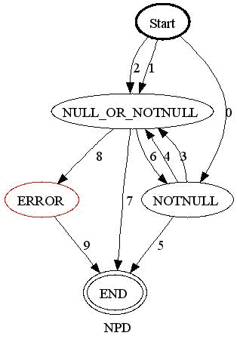
Defect defined by extended state machine -NULL Pointer Dereference

Slide 9
Defect Patterns
-NULL Pointer Dereference Fault
 | State Transition | The State transition conditions
0 | Start→NOTNULL | Variable’s value is NOTNULL
1 | Start→NULL_OR_NOTNULL | Variable’s value is NULL
2 | Start→NULL_OR_NOTNULL | Variable’s value is NULL_OR_NOTNULL
3 | NOTNULL → NULL_OR_NOTNULL | Variable’s value is NULL
4 | NOTNULL → NULL_OR_NOTNULL | Variable’s value is NULL_OR_NOTNULL
5 | NOTNULL → END | Out of variable’s scope
6 | NULL_OR_NOTNULL → NOTNULL | Variable’s value is NOTNULL
7 | NULL_OR_NOTNULL → END | Out of variable’s scope
8 | NULL_OR_NOTNULL → ERROR | The variable is dereferenced
9 | ERROR→ END | No conditions

Slide 10
Common elements for description
Syntax elements（Xpath)
Variable’s scope
Variable’s value range
Control flow information
Dataflow information

Slide 11
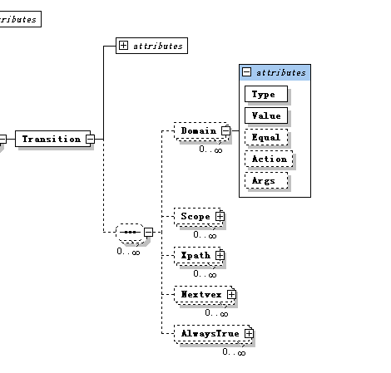
Schema of description methods

Slide 12
Outline
How does DTS work?
Defects patterns
Defects Testing Framework
Testing an example

Slide 13
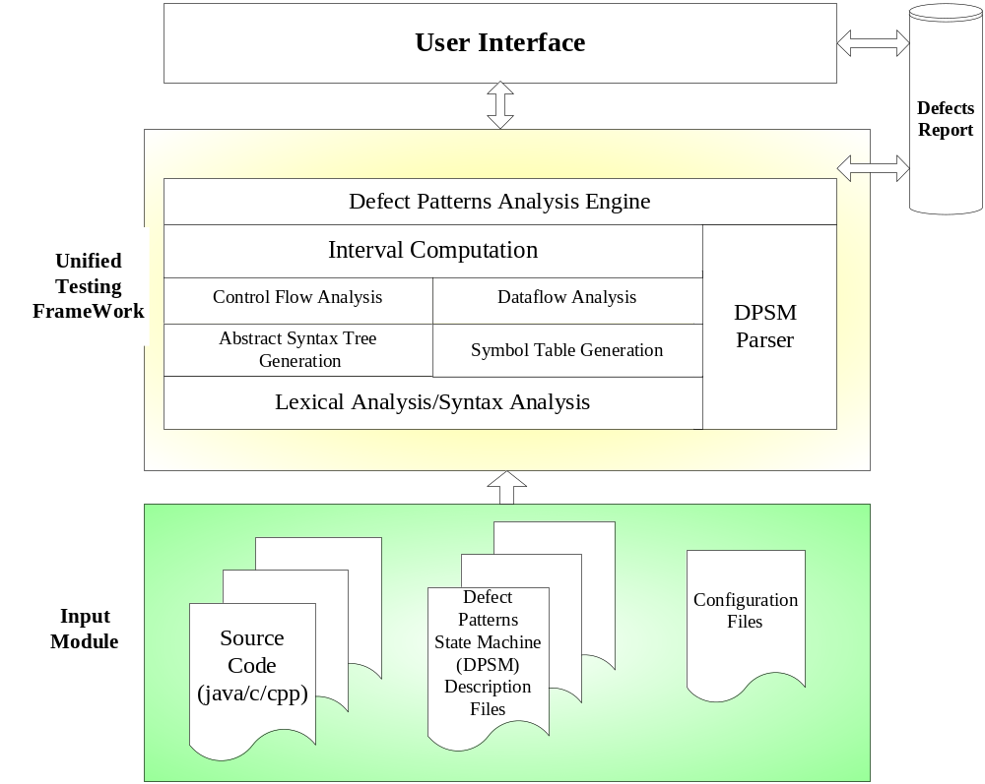

Slide 14
Outline
How does DTS work?
Defects patterns
Defects Testing Framework
Testing an example-Tomcat

Slide 15
Thanks

