Slide 1

Automated Detection of Vulnerabilities
Based on Program Analysis and Model Checking
Wang L., Zhang Q., Zhao P.
SYSTEM SOFTWARE RESEARCH GROUP
SOFTWARE ENGINEERING INSTITUTE

Slide 2
Outline
Why choose model checking
How we do it
Static analysis
Prototype - CodeAuditor
Demo example
Experiment result
Related work
Conclusion & future work

Slide 3
Why choose model checking
Dynamic
  Be efficient
  Depend on special input data
Static
  General static method
    Program analysis
    Efficient, but imprecise
  Formal verification method
    Model checking (abstract-verify-refine paradigm)
    Emphasizing precision
Notes:
explore an abstract tree which stores all reachability paths information.

Slide 4
How we do it
Model Checking
  Model checker - BLAST
  Can NOT automatically build the vulnerability model
  State space explosion
Program analysis
  Constraint-based analysis
    Model the buffers in source code
  Pointer alias analysis - to improve precision
  Slicing - to improve efficiency
……
char name[5];
if(true)
name[9] = 'c';
……

Slide 5
Static analysis
Constraint-based analysis
  Model string buffers as pairs of integer
    {max_length ,used_length}
  Model the statement and function as attributes transfer and constraints.
  Be described in an XML configuration file
Code instrumentation
  Traverse the AST of GCC, parse configuration file
  and execute instrumentation
  Convert the instrumented AST to original code

Slide 6
Static analysis (cont.)
Alias analysis
  Compute pointer alias at every program location
  Update attributes of aliased pointers

Slide 7
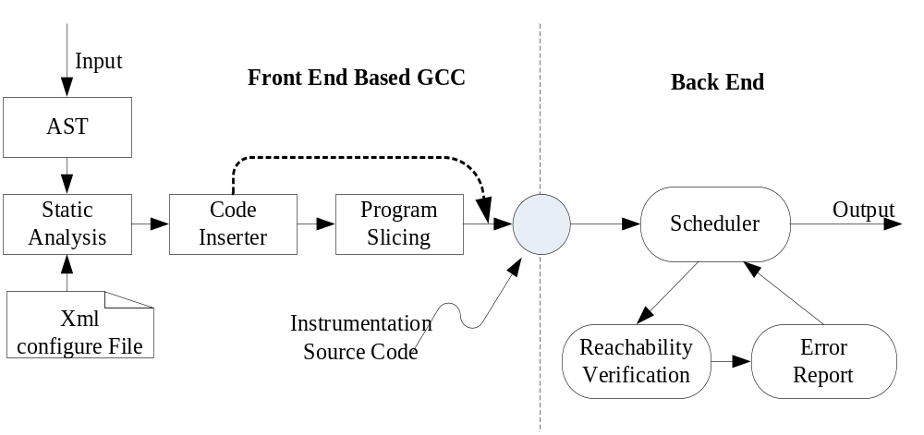
Prototype - CodeAuditor

Slide 8
More details
Several buffer operations and their constraints/assertions
Dangerous function call
  strcpy(dst, src)
Interprocedual analysis
  char * foo (char *s);
C Code | constraints and assertions
char *p | 0 ⊆ p.max ; 0 ⊆ p.used
char a[n] | n ⊆ a.max; 0 ⊆ a.used
p = malloc(n) | n ⊆p.max; 0 ⊆ p.used
strcpy(dst, src) | assert(dst.max >= src.used); src.used ⊆ dst.used
strcat(s,t) | assert(s.max >= s.used + t.used); t.used + s.used ⊆ s.used
strncat(s,t, n) | assert(s.max >= s.used + n); s.used + n ⊆ s.used
scanf(“%ns”,str) | assert(str.max >= n); n ⊆ str.used
sprintf(dst, “%s”, str) | assert(dst.max >= str.used);str.used ⊆ dst.used
sprintf(dst, “%d”, n) | assert(dst.max >= 20); 20 ⊆ dst.used
assert(dst_length_max >= src_length_used);
dst_length_used = src_length_used;
assert(dst_length_max >= src_length_used);
dst_length_used = src_length_used;
assert(dst_length_max >= src_length_used);
dst_length_used = src_length_used;
int foo_ret_length_max = 0;
int foo_ret_length_used = 0;
int foo_s_length_max = 0;
int foo_s_length_used = 0;

Slide 9
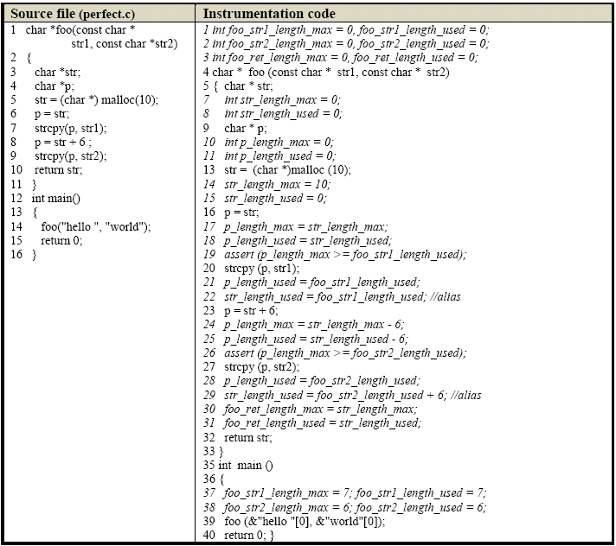
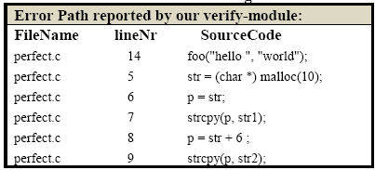
Demo example

Slide 10
Experiment results
Vulnerability detection
  1 Minicom: http://alioth.debian.org/projects/minicom/
  2 Corehttp: http://corehttp.sourceforge.net/
  3 Monkey: http://sourceforge.net/projects/monkeyd/
Software | LOC |  | Total Alarms | True Alarms | False Alarms | New Bugs
 | Before | After
minicom-1.80 | 6000 | 18080 | 3 | 2 | 1 | 1
corehttp-alpha | 5008 | 13020 | 9 | 8 | 1 | 7
monkey0.11 | 443 | 1200 | 5 | 2 | 3 | 2

Slide 11
Program slicing
Program slicing – to reduce state space
  Slicing criterion : SC(L)=(L,V)
    L: Location of buffer relate statements
    V: variables of buffer related
# | No. of predicates | Trace length | Time (ms) | Perf. Improve % | result
Assert_1 | 4126 | 165 | time out | ---- | No result
Assert_1_slice | 43 | 44 | 2530 |  | safe
Assert_2 | 4140 | 305 | time out | ---- | No result
Assert_2_slice | 33 | 36 | 2530 |  | safe
Assert_3 | 507 | 47 | 3409 | 19.5 % | unsafe
Assert_3_slice | 36 | 11 | 2743 |  | unsafe
Assert_4 | 915 | 126 | 2315 | 15.7 % | safe
Assert_4_slice | 15 | 6 | 1950 |  | safe
Assert_5 | 715 | 76 | 12765 | 33.1 % | unsafe
Assert_5_slice | 15 | 23 | 8550 |  | unsafe

Slide 12
Related work
Static
  ATOM
  Pin
  Cascade
  CCured
  …
Dynamic
  Cred
  …

Slide 13
Conclusion & future work
Conclusion
  The tool is precise and effective
Future work
  The efficiency remains to improve
  Apply it to other new vulnerabilities
  replace model checking with other tech.

Slide 14
Q&A

