Slide 1
Succinct Analysis Specification with Automatic May/Must Determination
The DFAGEN Tool
Andrew Stone,
Michelle Strout,
Shweta Behere (Avaya)
Colorado State University
SCAM 2008 Conference
September 29th
Slide <number>

Slide 2
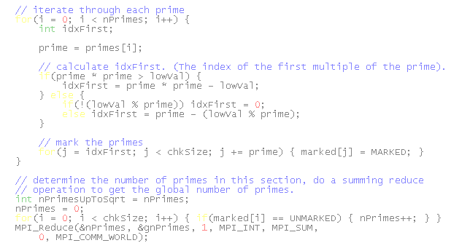
Why Data-Flow Analysis?
F
For the M in SCAM:
Optimization
For the A in SCAM:
Program Understanding
Debugging
DF-Analysis is a common way or formulating flow- sensitive analyses
Slide <number>

Slide 3

Why DF Analysis is Hard To Implement:
It’s simple for a scalar only language
But these issues complicate things:
Aliases?!
May or Must?!
Aggregates?!
Side Effects?!
Slide <number>

Slide 4
DFAGen: The DataFlow Analysis Generator
Solves issues on prior slide
Approach:
Automatic determination of may/must set usage
Requires:
A Control flow graph
Alias analysis results (with may/must information)
Side-effect analysis results
Slide <number>

Slide 5
May or Must
int x, y, z;
int *p, *q;
x = rand() % 1000;
y = rand() % 1000;
z = rand() % 1000;
p = &x;
q = &y;
if(*p < *q) {
q = &z;
}
*q = 500;
Must use: {x, y}
May use: {x, y}
Must def: {}
May def: {y, z}
Slide <number>

Slide 6


Reaching Definitions Again
{}
{S1}
Meet: union
Direction: forward
Flowtype: statements
Style: may
GEN[s] =
KILL[s] =
S1: a = 3
{S1}
{S1, S2}
S2: b = c*d
{S1, S2}
{S1, S2}
S3: if(cond)
reachingdefs.spec
{S1, S2}
{S1, S2, S4}
{S1, S2}
{S2, S5}
analysis: ReachingDefs
meet: union
direction: forward
flowtype: stmt
style: may
gen[s]: { s | defs[s] !=empty }
kill[s]: { t | defs[t] <= defs[s] }
S4: c = 5
S5: a = 6
S5: a = 6
{S1, S2, S4, S5}
{S1, S2, S4, S5}
S6: print a
Slide <number>

Slide 7
So is it May or Must?
reachingdefs.spec
May
analysis: ReachingDefs
meet: union
direction: forward
flowtype: stmt
style: may
gen[s]: { s | defs[s] !=empty }
kill[s]: { t | defs[t] <= defs[s] }
Must
Slide <number>

Slide 8
How DFAGen Determines May/Must
Meet | Type | Gen | Kill
union | may | Upper | Lower
intersect | must | Lower | Upper
Parse GEN and KILL expressions into an AST.
Analyze in a top down fashion, determine whether we want an “upper bound” or “lower bound” value at each node.
Use tables to left to determine these values.
Operator | UB | UB | LB | LB
 | lhs | rhs | lhs | rhs
<= | lower | upper | upper | lower
>= | upper | lower | lower | upper
< | lower | upper | upper | lower
> | upper | lower | lower | upper
union | upper | upper | lower | lower
intersect | upper | upper | lower | lower
!=empty | upper | - | lower | -
Slide <number>

Slide 9
More Detail
gen[s]: { s | defs[s] !=empty }
kill[s]: { t | defs[t] <= defs[s] }
Meet | Type | Gen | Kill
union | may | Upper | Lower
intersect | must | Lower | Upper
Meet | Type | Gen | Kill
union | may | Upper | Lower
intersect | must | Lower | Upper
GEN
UB
KILL
LB
reachingdefs.spec
May
analysis: ReachingDefs
meet: union
direction: forward
flowtype: stmt
style: may
gen[s]: { s | defs[s] !=empty }
kill[s]: { t | defs[t] <= defs[s] }
Build Set
UB
Build Set
LB
Operator | UB | UB | LB | LB
 | lhs | rhs | lhs | rhs
<= | lower | upper | upper | lower
!=empty | upper | - | lower | -
Operator | UB | UB | LB | LB
 | lhs | rhs | lhs | rhs
<= | lower | upper | upper | lower
!=empty | upper | - | lower | -
Must
!=empty
UB
<=
LB
Defs[s]
UB
defs[t]
UB
defs[s]
LB
(may)
(may)
(must)
Slide <number>

Slide 10


DFAGen Versus Hand-Written
Writes
OA DF Analysis Framework
.SPEC File
Writes
Passed to
Links To
DFAGen
C++ Source Code
Links To
Generates
C++ Source Code
You write:
8 line SPEC file
DFAGen Writes:
398 lines of C++ code
You write:
376 lines
Slide <number>

Slide 11
Conclusions
DFAGen makes writing analyses easier.
  It generates the analysis from succinct specifications.
  DFAGen deals with the may/must issue of aliasing automatically.
We hope to prove that DFAGEN generated analyses are as fast a hand-written equivalents.
Slide <number>

