Slide 1


Evaluating Key Statements Analysis
David Binkley - Loyola College, USA
Nicolas Gold, Mark Harman,
Zheng Li, Kiarash Mahdavi
CREST, King’s College London, UK

Slide 2
Overview
KSA
Two metrics
  Impact
  Cohesion
Research Questions
Empirical study
Results

Slide 3
Key Statement Analysis (KSA)
Identify key statements
The statements that capture most impact with highest cohesion

Slide 4
Why KSA
Many analyses produce far too much e.g. slicing, chopping

Slide 5
Framework
Modules
Functions Classes Concept bindings
Principal Variables
Key Statements

Slide 6
Principal Variables (PV)
Bieman and Ott’s Principal Variables
PV_{G} – a global variable assigned in F
PV_{O} – a variable used in an output statement in F
PV_{G} U PV_{O}

Slide 7
r
void cylinder(int r, h)
{
D=2*r;
perimeter=PI*D;
undersurface=PI*r*r;
sidesurface=perimeter*h;
area=2*undersurface+sidesurface;
volume=undersurface*h;
printf(“\nThe Area is %d\n", );
printf(“\nThe Volume is %d\n", );
}
h
area
volume

Slide 8
Metrics for KSA
Impact: outward influence of the key statements
Cohesion: inward connectedness of the key statements

Slide 9
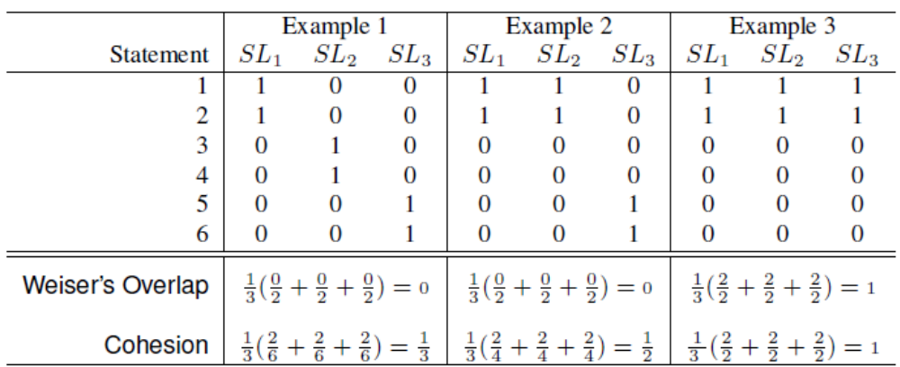
Cohesion

Slide 10
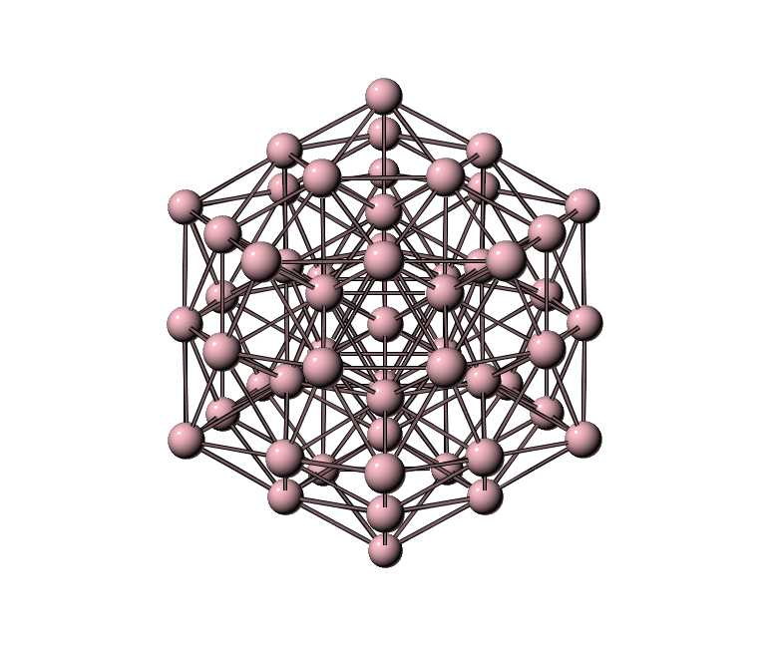
Dependence Cluster

Slide 11

The worst case for KSA
If all statements in a module are in a dependence cluster…

Slide 12
Research Questions
Size
Impact
Cohesion
Large dependence cluster

Slide 13
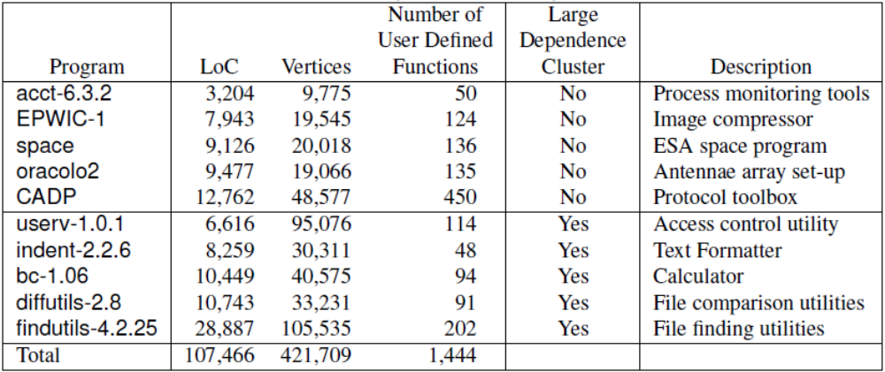
Analysis Subjects

Slide 14


Tools
CodeSurfer
SPSS

Slide 15
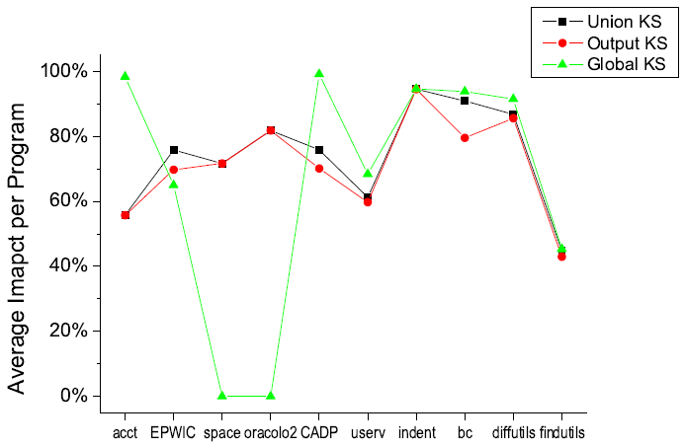
Impact

Slide 16
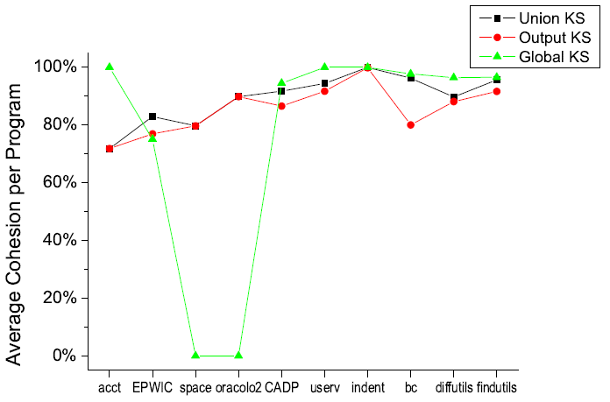
Cohesion

Slide 17
Results
Size
  25% of the function size
Impact
  70% of impact of the function.
Cohesion
  More than 80% of cohesion
Large Dependence Cluster
  a clear and largely negative impact

Slide 18
less is more

