Slide 1
Lightweight techniques for tracking unique program statements
Jaime Spacco, Colgate University
jspacco@colgate.edu
Chadd Williams, Pacific University
chadd@pacificu.edu

Slide 2
The problem
Given two versions of a file...
  track the ancestry of a line as accurately as possible
Possible uses:
  Identifying exactly where bugs are introduced
  Studying software evolution
  Code clone detection

Slide 3
Best available solutions
Canfora et al.
  LDiff (line difference)
  MSR 2007, ICSE 2009
Reiss
  large suite of techniques
  ICSE 2008
Our work
  SDiff (statement difference)

Slide 4
LDiff

Slide 5
Reiss
Huge suite of techniques
  Combination of simple techniques worked best on his test suite
Essentially, a weighted combination of:
  line similarity metric (Levenshtein)
  context similarity metric for surrounding lines
More complex techniques available
  Reiss's ICSE 2008 paper lists them all
  didn't perform as well as hybrids of simple techniques

Slide 6
Our contribution: SDiff
Statement Diff
Diff Java statements rather than lines of text

Slide 7
Finding statements
Parse Java code to an AST
  use parser from PMD (static style checker)
Break the AST into statements
Turn the statements into a canonical tokenized format
match the statements between the two versions

Slide 8
SDiff
public int f(int x) {
int z=g(x);
int w = getW();
int result=p(z, w, x);
return result; }
public int f(int x)
{
int z=g(x);
int w = getW();
// compute result
int result=p(z,
w,
x);
return result;
}

Slide 9
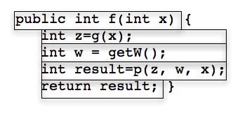
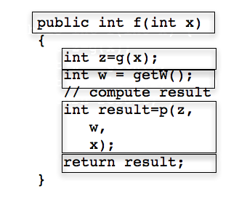
Matching statements

Slide 10
Advantages of SDiff
Automatically ignores whitespace, comments and brackets
Handles statements broken across multiple lines
Can diff by character or by token

Slide 11
Contributions:
SDiff algorithm
  http://code.google.com/p/sdiff/
Running best available algorithms:
  on Reiss's test suite
  on a new test suite

Slide 12
Reiss's test suite
Track 53 lines across 25 revisions of one source file
all changes are single lines
  includes adds, deletes and changes
Only two pairs of adjacent lines

Slide 13
Our test suite
20 files from the Eclipse version control repository
  before and after an edit
  each edit is 3-12 lines

Slide 14
Reiss's test suite
Algorithm | Recall %
Reiss w_besti_linei_method | 97.7
Reiss w_besti_besti | 97.0
LDiff tweaked | 85.0
LDiff default | 83.0
SDiff | 86.2
SDiff, ignore non-executable statements | 96.1

Slide 15
Eclipse test suite
Algorithm | Recall %
Reiss w_best_diff | 66
Reiss w_smart_best | 61
LDiff tweaked | 64
LDiff default | 45
SDiff tweaked | 70
SDiff default | 66

Slide 16
Controversial Statement
You can't match up individual lines between large diff chunks
  You can only match changes up to N lines
Some changes shouldn't even have an ancestry
  a 1-character edit distance to a for loop header is different if the 40 surrounding lines have also changed
Code available:
  http://code.google.com/p/sdiff/

Slide 17
Big questions
When is it useful to track lines backwards?
  do we care about the ancestry of a curly brace?
How large can diff chunks be before we lose track of them?

Slide 18
Strengths and weaknesses of each approach
Tasks | LDiff | Reiss | SDiff
Match comments | yes | yes | no
detect edited lines | yes | yes | yes
handle any arbitrary text file | yes | yes | no
Use context of surrounding lines to assist matching | yes | yes | yes
supported unordered similarity metrics | yes | no | no
detect renamed methods | no | no | yes
detect statements broken across several lines | no | no | yes
easy to download and run | yes | no | yes

Slide 19
Strengths and weaknesses of each approach
Tasks | LDiff | Reiss | SDiff
Match comments | yes | yes | no
detect edited lines | yes | yes | yes
handle any arbitrary text file | yes | yes | no
Use context of surrounding lines to assist matching | yes | yes | yes
supported unordered similarity metrics | yes | no | no
detect renamed methods | no | no | yes
detect statements broken across several lines | no | no | yes
easy to download and run | yes | no | yes
http://code.google.com/p/sdiff/

