Slide 1


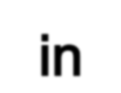

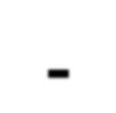
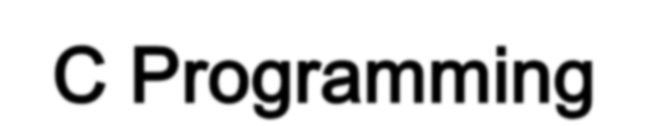
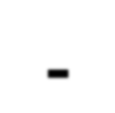



Slide 2
Function is a subpart of program used to perform
specific task and it is executed individually.
Basically a job of function is to do something
Every C program contain at least one function called main().

Slide 3
Why Do We Need Function

Slide 4
Functions make the program more readable and understandable.
Using functions the program implementation become easy.
Once a function is created it can be used many times(code re-usability).
Using functions large program can be divided into smaller modules

Slide 5

Classification of Function
User define
functions
Library
functions
-printf()
-scanf()
-gets()
-puts()
- main()

Slide 6
Library Function
Library functions are inbuilt functions which are grouped
together and placed in a common place called library.
Library:
stdio.h conio.h string.h
printf(); clrscr(); strlen();
scanf(); getch(); strrev();
gets();
puts();
math.h
pow();
sqrt();

Slide 7
1.Write a program to find a square root of the given
number.
2.Write a program to calculate the length of the given
string.

Slide 8
The function must contains
1.Function Declaration
2.Function Definition
3.Function Call

Slide 9
Function Declaration
Provides the compiler with the description of functions that will be used later in the program
Function declaration is also known as Function Prototype.
Function declaration need to be written at the beginning of the program.
The function declaration must have :
A return type indicating the variable that the function will be return

Slide 10
Syntax for Function Declaration
return-type function_name(parametersList);
Function Prototype Examples
double squared( double number );
void print_report( int report_number );
int get_menu_choice( void);

Slide 11

The actual task of the function is implemented in the Function
Definition.
The function definition is also known as body of the function.
Syntax for Function definition
return-type function_name(arg-type name-1,..,arg-type name-n)
---- Function
Header
{
declarations; statements; return(expression);
}
Function Body

Slide 12
Function call
The function call tells the compiler when to execute the
function definition.
When a function call is executed, the execution control jumps
to the function definition where the actual code gets
executed and returns to the same function call once the
execution completes.
The function call is performed inside main function or inside
any other function or inside the function itself.
Syntax for function call
Function_name(parameters lists);

Slide 13
Function can be return any of the C‟s data type:
char
int
float
long………
Examples:
int func1(...)
float func2(...)
void func3(...)
/* Returns int */
/* Returns float */
/* Returns Nothing */

Slide 14

Based on the data flow between the calling function and
called function, the functions are classified as follows
1.Function without parameters and without return value
2.Function with parameters and without return value
3.Function without parameters and with return value
4.Function with parameters and with return value

Slide 15
Syntax
Without parameter and without With parameter and without
return value return value
void fun_name() void fun_name(par_list)
{ {
statements; statements;
} }
Without parameter and with With parameter and with
return value return value
ren_type fun_name() ren_type fun_name(par_list)
{ {
statements; statements;
return(expression); return(expression);
} }

