Slide 1
Pointers

Slide 2
Computer Memory
Each variable is assigned a memory slot (the size depends on the data type) and the variable’s data is stored there
Memory address:
1020
1024
1032
…
…
100
…
1024
…
a
Variable a’s value, i.e., 100, is
stored at memory location 1024
int a = 100;

Slide 3
Pointers
A pointer is a variable used to store the address of a memory cell.
We can use the pointer to reference this memory cell
Memory address:
1020
1024
1032
…
…
100
…
1024
…
integer
pointer

Slide 4
Pointer Types
Pointer
  C has pointer types for each type of object
    Pointers to int objects
    Pointers to char objects
    Pointers to user-defined objects
    (e.g., RationalNumber)
  Even pointers to pointers
    Pointers to pointers to int objects

Slide 5
Pointer Variable
Declaration of Pointer variables
  type* pointer_name;
  //or
  type *pointer_name;
  where type is the type of data pointed to (e.g. int, char, double)
  Examples:
  int *n;
  RationalNumber *r;
  int **p; // pointer to pointer

Slide 6
Address Operator &
The "address of " operator (&) gives the memory address of the variable
  Usage: &variable_name
Memory address:
1020
1024
…
…
100
…
…
…
a

Slide 7
Address Operator &
Memory address:
1020
1024
1032
…
88
100
…
…
…
a
b

Slide 8
Pointer Variables
The value of pointer p is the address of variable a
A pointer is also a variable, so it has its own memory address
Memory address:
1020
1024
1032
…
88
100
…
1024
…
a
p
;

Slide 9

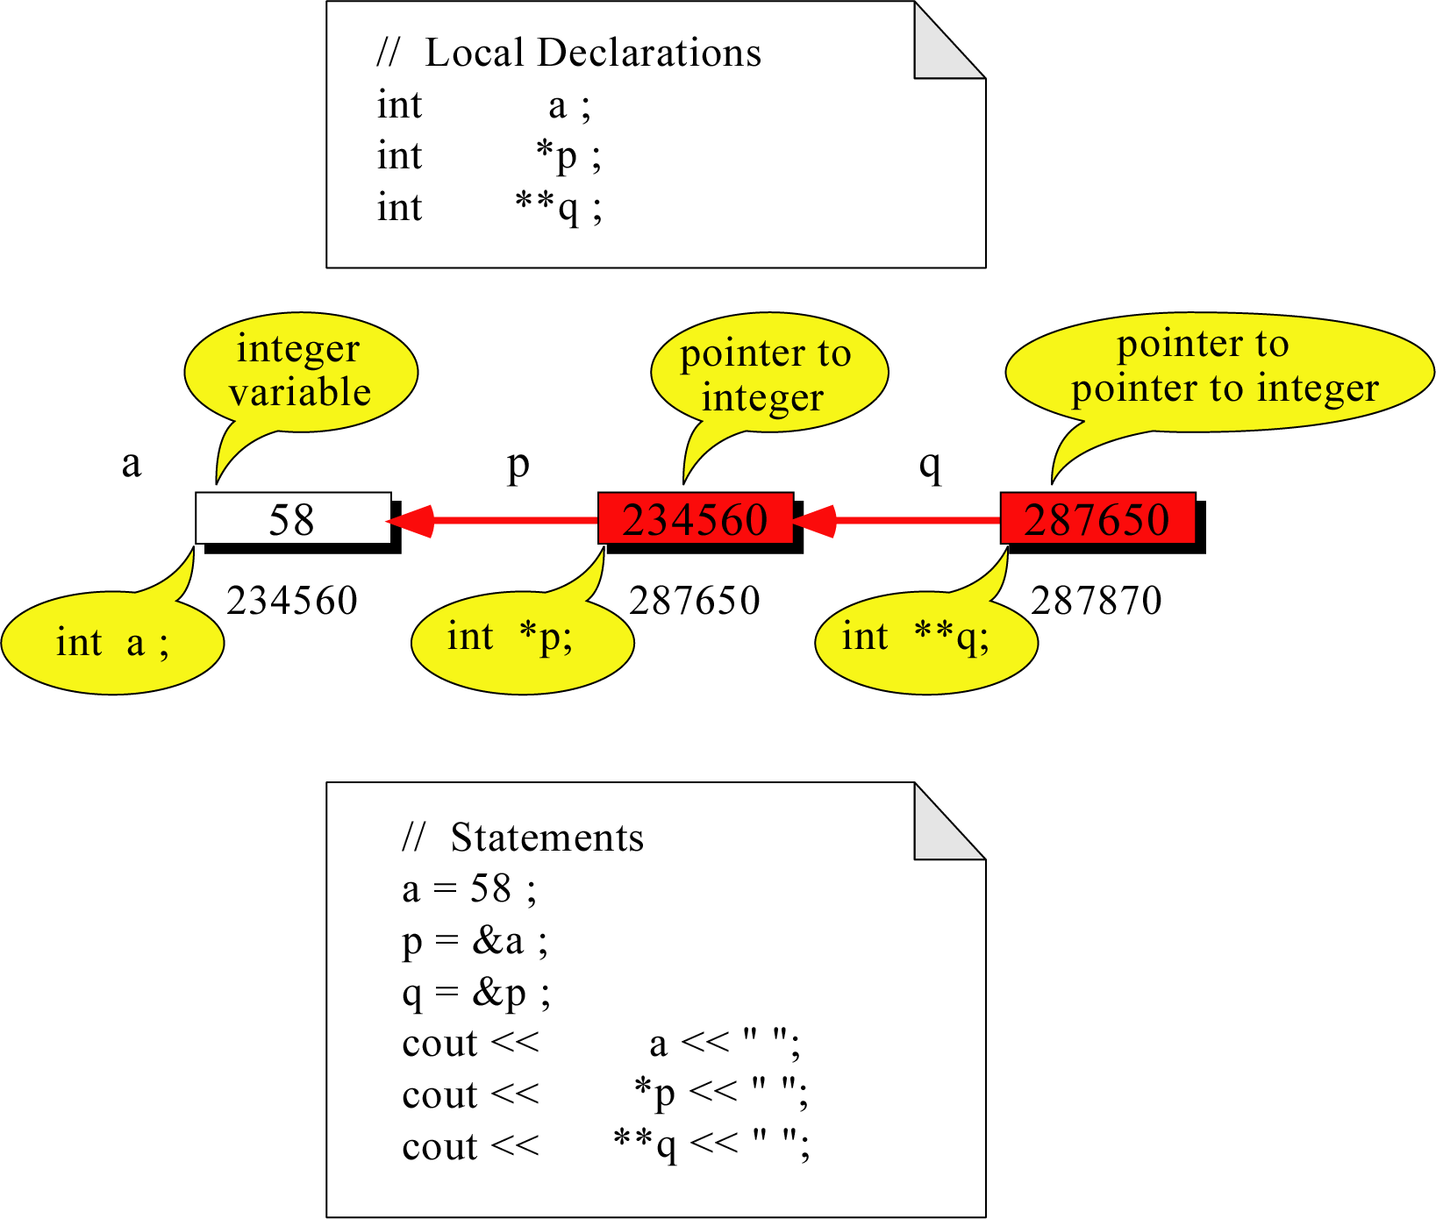
Pointer to Pointer
What is the output?
58 58 58

Slide 10
Dereferencing Operator *
We can access to the value stored in the variable pointed to by using the dereferencing operator (*),
Memory address:
1020
1024
1032
…
88
100
…
1024
…
a
p
Result is:
100
1024
1024 100
1032

Slide 11
Don’t get confused
Declaring a pointer means only that it is a pointer: int *p;
Don’t be confused with the dereferencing operator, which is also written with an asterisk (*). They are simply two different tasks represented with the same sign

Slide 12
A Pointer Example
Memory Layout
The code
void doubleIt(int x,
int * p)
{
*p = 2 * x;
}
int main()
{
int a = 16;
doubleIt(9, &a);
printf(“%d”,a);
return 0;
}
Box diagram
main
16
p
(8200)
8192
a
doubleIt
x
(8196)
9
a
(8192)
16
main
doubleIt
x
9
a gets 18
p
Notes:
Note the signature of main() – it’s an array parameter. And, like other examples we’ve given, it takes the number of elements as a parameter. Why?

Slide 13
Pass By Reference

Slide 14
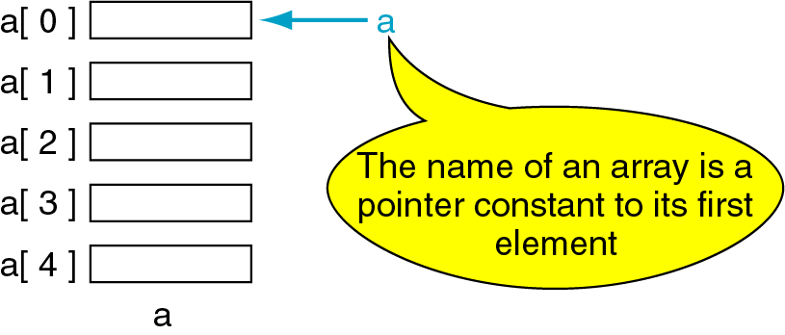
Pointers and Arrays
The name of an array points only to the first element not the whole array.
1000
1004
1008
1012
1016

Slide 15
Dereferencing An Array Name
This element is called a[0] or *a
a[0]
2
a[1]
4
a[2]
6
a[3]
8
a[4]
22
a

Slide 16

Array Names as Pointers
To access an array, any pointer to the first element can be used instead of the name of the array.
We could replace *p by *a
a
p
a[0]
2
2 2
a[1]
4
a[2]
6
a[3]
8
a[4]
22
a

Slide 17
Multiple Array Pointers
Both a and p are pointers to the same array.
a[0]
a[0]
2
p
a[1]
4
a[2]
6
p[0]
a[3]
8
a[4]
22

Slide 18
Pointer Arithmetic
Given a pointer p, p+n refers to the element that is offset from p by n positions.
a
2
p - 1
4
p
a + 1
a + 2
6
p + 1
a + 3
8
p + 2
a + 4
22
p + 3

Slide 19
Dereferencing Array Pointers
a[0] or *(a + 0)
2
a
a[1] or *(a + 1)
4
a + 1
a[2] or *(a + 2)
6
a + 2
a[3] or *(a + 3)
8
a + 3
a[4] or *(a + 4)
22
a + 4
*(a+n) is identical to a[n]
Note: flexible pointer syntax

Slide 20
Array of Pointers & Pointers to Array
a
p
b
c
An array of Pointers
A pointer to an array
int a = 1, b = 2, c = 3;
int *p[5];
p[0] = &a;
p[1] = &b;
p[2] = &c;
int list[5] = {9, 8, 7, 6, 5};
int *p;
P = list;//points to 1st entry
P = &list[0];//points to 1st entry
P = &list[1];//points to 2nd entry
P = list + 1; //points to 2nd entry

Slide 21
NULL pointer
NULL is a special value that indicates an empty pointer
If you try to access a NULL pointer, you will get an error
int *p;
p = 0;
p //prints 0
&p //prints address of p
*p //Error!

Slide 22
Pointer to 2-Dimensional Arrays
table
table[i] = &table[i][0] refers to the address of the ith row
table + 1
table[ 0] or *( table + 0 )
table + 2
table[ 1] or *( table + 1 )
table[ 2] or *( table + 2 )
int table[3][4] = {{1,2,3,4},
{5,6,7,8},{9,10,11,12}};
*(table[i]+j)
= table[i][j]
What is
**table ?

