Slide 1
C Programming

Slide 2
Three levels of programming language
High level language
Assembly level language
Machine language

Slide 3
Machine language
Machine language is the collection of binary langauge or bits .
The computer reads and interprets it.
This is the only language the computer can understand

Slide 4
Assembly language
An assembly language is the low level programming language
It is used in microprocessors and other programable device .
It is also known as assembly code .this translation is done by the assembler.

Slide 5
High level language
High level language like c ,c ++ ,java, etc….
High level languages are designed to be used by human operator/programmer
High level languages require translation to machine languages before execution.

Slide 6
What converts high level language to machine language??

Slide 7
what is a compiler??
The main task of the compiler is to convert the source code written using high level programming language into machine language .
It translates the code written in one programming language to some other language without changing the meaning of the code.
The compiling process includes basic translation mechanisms and error detection.

Slide 8
Structure of a c program
Documentation section
Pre-processor statements (link section)
Global declaration
The main() function
Local declarations
Program statements and expressions
User defined functions

Slide 9
Program structure
//this is simple c program
#include<stdio.h> int main()
{
Printf(“ hello world “);
}

Slide 10
Documentation section COMMENTS : it is the explanation or the description to the source code of the program. At run-time , a comment is ignored by the compiler ignored by the compiler
It contains a set of comments including the name of the program and other necessary details
Comments are ignored by the compiler and is used to provide documentation to the people who reads the code .
Comments are of two types
Single line comments
Multiline comments

Slide 11
Single line comment
// (double slash)
Termination of comment is by pressing enter key
Multi line comment
/*….
…….*/
This can span over to multiple lines

Slide 12
Preprocessor Directives
•
•
•
The first statement to be checked by the compiler
Preprocessor Directives always preceded with ‘#’ sign
They contain information to the compiler which are required by the compiler during compilation.
HEADER FILE
– #include <stdio.h>
•
•
•
Tells the compiler to include the file stdio.h during compilation
Anything in the header file will be included a part of the program

Slide 13
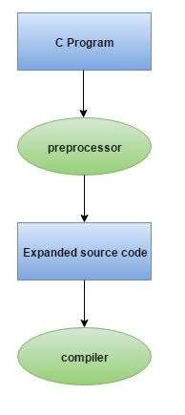
Preprocessor directives are executed before compilation.

Slide 14
main() function
This is the entry point of a program
When a file is executed, the start point is the main function
From main function the flow goes as per the programmers choice.
Main function is compulsory for any c program

Slide 15
printf()
Used to send data to the standard output (usually the monitor) to be printed according to specific format.
General format:
printf(“ text ”);
printf(“ text and format specifier ”, variable);
Example:
printf(“Thank you”);
•
•
•
•

Slide 16
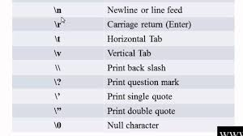
ESCAPE SEQENCES :when a character is preceded by a backslash , it is an escape sequence and it has special meaning to the compiler.

Slide 17
Errors
LOGICAL ERRORS : these errors are occurred in the logic of the program and results in unexpected output . Compiler does not report logical errors
SYNTACTICAL ERRORS : this error occurs when syntax is not followed. These errors are listed by the compiler.
DEBUGGING- process of removing errors in a program

Slide 18
Basic Structure Of “C” Programs
#include<stdio.h> #include<conio.h>
Header Files
Entry Point Of Program
void main()
{
Indicates Starting of Program
printf(“hello world”);
}

Slide 19
DATATYPES : they represent the type of data that a variable can hold
Two types of data types
PRIMITIVE DATATYPE – these are the default datatypes that are supported by the compiler
DERIVED DATA TYPE –data types which are derived using basic datatypes

Slide 20
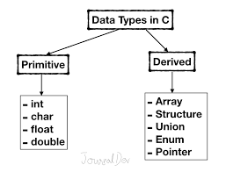

Slide 21
PRIMIVITVE DATA TYPES
INT
used to store integer values only .it occupies 4 bytes of memory location
Example :int a=20;
int b=40;
int c=30; etc
It occupies 4 bytes of memory
CHAR
Datatype used to store a single character. Each character is associated with the integer value known as ASCII( ameriacn standard code for information interchange) number.
Example : char ch= ‘A ’ ;
It occupies 1 byte of memory
FLOAT
Used to store decimal values . occupies 4 bytes of memeory
Example : float b=10.99 ;
It occupies 4 bytes of memory
DOUBLE : it is the extended version of float
Occupies 8 bytes of memeory

Slide 22
Keywords
keyword is word that is reserved by a program because the word has special meaning . Keywords can be commands or parameters . Every programming language has a set of keywords that can used as variable name.
All keywords have fixed meanings and you can not change its meanings.
Ex: int, float, double, extern, static, auto, continue, if, goto short, long etc. are the keywords

Slide 23

Variables
Glass = Variable
Water = Value
Example:
Variable

Slide 24
Variables in C
Variables are names used to refer to some memory locations of computer.
The piece of information stored at this location is referred as value of a variable.
The variables are not fixed values and might change during the execution of a program.
www.programming9.com

Slide 25
RULES TO DECLARE VARIABLES :
Only alpha numeric values can be used
No special characters can be used except the underscore
Also no two successive underscores can be used
Keywords cant be used as variable name.
The first character of identifier cant be a number however last character can be a numerical character
Variable name should begin with small letter
SYNATX TO DECLARE VARIABLE
datatype variable_name ;

Slide 26
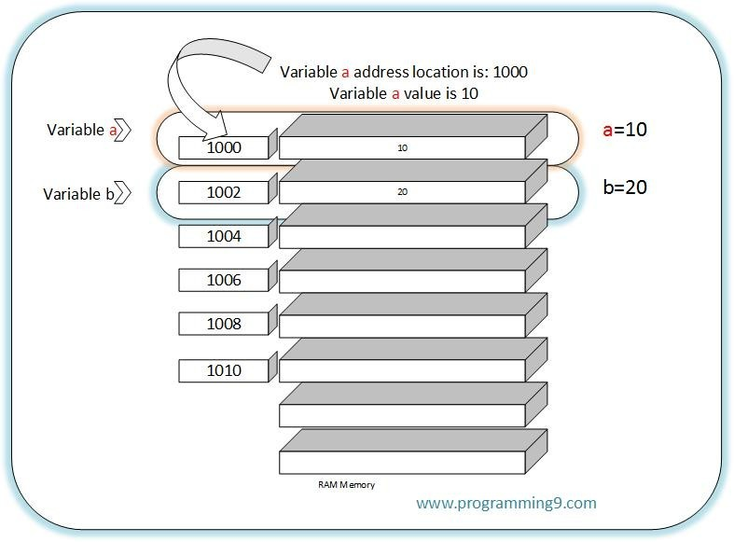
Memory allocation to variables
www.programming9.com

Slide 27
scanf()
•
Reads data from the standard input device (usually keyboard) and store it in a variable. The General format is:
– scanf(“Control string”, &variable);
The general format is pretty much the same as printf() except that it passes the address of the variable (notice the & sign) instead of the variable itself to the second function argument.
Example:
int age;
printf(“Enter your age: “); scanf(“%d”, &age);
•
•

Slide 28
Operators

Slide 29
What is an operator?
An operator is a symbol that tells the computer to perform certain mathematical or logical manipulations.
These operators are used in programs to manipulate data and variables.
A valid sequence of operators and operants is called an expression
2
www.programming9.com

Slide 30
operators
Arithmetic operator
Relational operator
Logical operator
Assignment operator
Conditional operator
Bitwise operator

Slide 31
ARITHMETIC OPERATOR : further divided in two 3 types
UNARY OPERATOR – acts on only one operand
Example : post and pre increment (++)
BINARY OPERATOR – acts on two operand
Example + , -, / , * ,%
TERNARY OPERATOR – acts on 3 operands
?:

Slide 32
RELETIONAL OPERATOR: < , >, <= ,>= ,==, != it is a binary operator which tells us the relation between two variables.
LOGICAL OPERATOR : && , || , !
Used to check for some condition.
BITWISE OPERATOR : & , | , ^
ASSIGNMENT OPERATOR : =
Used to assign the the value to the variable.

Slide 33
Special Operators Contd…
Sizeof Operator:
Sizeof is an operator used to return the number of bytes the operand occupies.
Syntax:
m=sizeof(sum); k=sizeof(2351);
www.programming9.com

