Slide 1
Web Application Security
BY:
Lavanya Grover
Prerak Mittal

Slide 2
SQL Injection

Slide 3

What is it???
A SQL injection attack consists of insertion or "injection" of a SQL query via the input data from the client to the application.
Some common SQL injection examples include:
Retrieving hidden data: where you can modify an SQL query to return additional results.
Subverting application logic: where you can change a query to interfere
with the application's logic.
UNION attacks: where you can retrieve data from different database tables.
Examining the database: where you can extract information about the version and structure of the database.
Blind SQL injection: where the results of a query you control are not returned in the application's responses.

Slide 4

Impact
A successful SQL injection exploit can
Gain unauthorized access to sensitive data from the database( Passwords, Credit card information, Health Information)
Modify database data (Insert/Update/Delete) and may even change the backend architecture
Execute administration operations on the database (such as shutdown the DBMS)
Recover the content of a given file present on the DBMS file system and in some cases issue commands to the operating system.
An attacker may even obtain a persistent backdoor into an organization's systems, leading to a long-term compromise that can go unnoticed for an extended period.

Slide 5

Some Interesting SQL Injection Examples:

Slide 6
Retrieving hidden data
Consider a shopping application that displays products in different categories. When the user clicks on the Gifts category, their browser requests the URL:
https://insecure-website.com/products?category=Gifts
This causes the application to make an SQL query to retrieve details of the relevant products from the database:
SELECT * FROM products WHERE category = 'Gifts' AND released = 1
This SQL query asks the database to return:
all details (*)
from the products table
where the category is Gifts
and released is 1.

Slide 7
The restriction released = 1 is being used to hide products that are not released. For unreleased products, presumably released = 0.
The application doesn't implement any defenses against SQL injection attacks, so an attacker can construct an attack like:
https://insecure-website.com/products?category=Gifts'--
This results in the SQL query:
SELECT * FROM products WHERE category = 'Gifts'--' AND released = 1
Going further, an attacker can cause the application to display all the products in any category, including categories that they don't know about:
https://insecure-website.com/products?category=Gifts'+OR+1=1--
This results in the SQL query:
SELECT * FROM products WHERE category = 'Gifts' OR 1=1--' AND released = 1
The modified query will return all items where either the category is Gifts, or 1 is equal to 1. Since 1=1 is always true, the query will return all items.

Slide 8
Demo:
https://portswigger.net/web-security/sql-injection/lab-retrieve-hidden-data

Slide 9

Subverting application logic
Consider an application containing a LOGIN Page.
If a user submits the username Harry and the password Hogwarts, the application checks the credentials by performing the following SQL query:
SELECT * FROM users WHERE username = ‘Harry' AND password = ‘Hogwarts’
Similarly, for admin access we may send the following query:
SELECT * FROM users WHERE username = ‘administrator’ AND password = ‘pass’
Now, the attacker can manipulate the query in such a way that he gains the admin access without actually knowing the password.
SELECT * FROM users WHERE username = 'administrator'--' AND password = ‘’
Here, an attacker can log in as any user without a password simply by using the SQL comment sequence -- to remove the password check from the WHERE clause of the query.

Slide 10
Demo:
https://portswigger.net/web-security/sql-injection/lab-login-bypass

Slide 11
Determining the number of columns required in an SQL injection UNION attack
When performing an SQL injection UNION attack, there are two effective methods to determine how many columns are being returned from the original query.
The first method involves injecting a series of ORDER BY clauses and incrementing the specified column index until an error occurs. For example, assuming the injection point is a quoted string within the WHERE clause of the original query, you would submit:
' ORDER BY 1-- ' ORDER BY 2--

Slide 12
The second method involves submitting a series of UNION SELECT payloads specifying a different number of null values:
' UNION SELECT NULL-- ' UNION SELECT NULL,NULL-- Since NULL is convertible to every commonly used data type, using NULL maximizes the chance that the payload will succeed when the column count is correct.
If the number of nulls does not match the number of columns, the database returns an error, such as:
All queries combined using a UNION, INTERSECT or EXCEPT operator must have an equal number of expressions in their target lists.
The interesting data that you want to retrieve will be in string form, so you need to find one or more columns in the original query results whose data type is, or is compatible with, string data which can be found out by:
' UNION SELECT 'a',NULL,NULL,NULL-- ' UNION SELECT NULL,'a',NULL,NULL-- ' UNION SELECT NULL,NULL,'a',NULL-- ' UNION SELECT NULL,NULL,NULL,’a’–-
If the data type of a column is not compatible with string data, the injected query will cause a database error

Slide 13
Demo:
https://portswigger.net/web-security/sql-injection/union-attacks/lab-determine-number-of-columns
https://portswigger.net/web-security/sql-injection/union-attacks/lab-find-column-containing-text

Slide 14
Using an SQL injection UNION attack to retrieve sensitive data
When you have determined the number of columns returned by the original query and found which columns can hold string data, you are in a position to retrieve interesting data.
Suppose that:
The original query returns two columns, both of which can hold string data.
The injection point is a quoted string within the WHERE clause.
The database contains a table called users with the columns username and password.
In this situation, you can retrieve the contents of the users table by submitting the input:
' UNION SELECT username, password FROM users–

Slide 15
Demo:
https://portswigger.net/web-security/sql-injection/union-attacks/lab-retrieve-data-from-other-tables

Slide 16
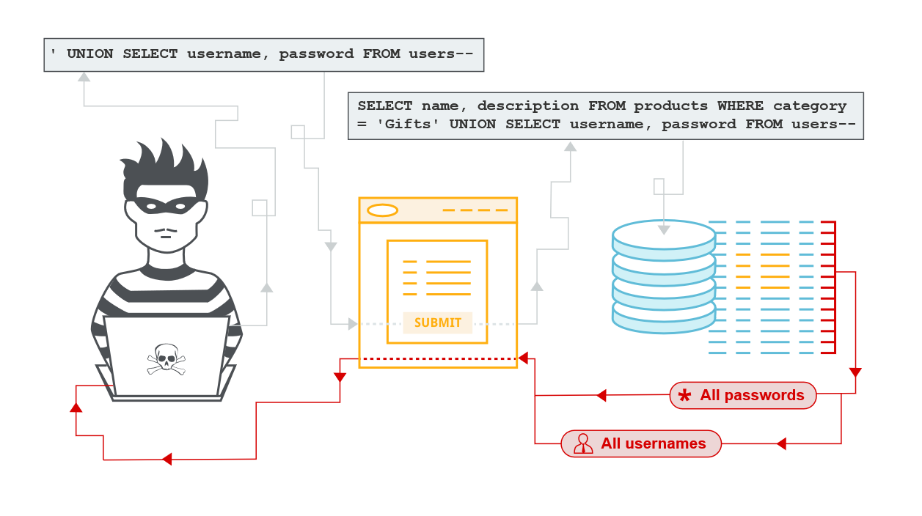

Slide 17
Examining the Database
Following initial identification of an SQL injection vulnerability, it is generally useful to obtain some information about the database itself. This information can often pave the way for further exploitation.
You can query the version details for the database. The way that this is done depends on the database type, so you can infer the database type from whichever technique works. For example:
SELECT * FROM v$version (oracle)
SELECT @@VERSION (My SQL and Microsoft)
You can also determine what database tables exist, and which columns they contain. For example, on most databases you can execute the following query to list the tables:
SELECT * FROM information_schema.tables

Slide 18
Cheat Sheets
Portswigger:
https://portswigger.net/web-security/sql-injection/cheat-sheet
Pentest Monkey: (MySQL)
http://pentestmonkey.net/cheat-sheet/sql-injection/mysql-sql-injection-cheat-sheet

Slide 19
Prevention
1. Using parameterized queries (also known as prepared statements) instead of string concatenation within the query.
The following code is vulnerable to SQL injection because the user input is concatenated directly into the query:
String query = "SELECT * FROM products WHERE category = '"+ input + "'";
Statement statement = connection.createStatement();
ResultSet resultSet = statement.executeQuery(query);
This code can be easily rewritten in a way that prevents the user input from interfering with the query structure:
PreparedStatement statement = connection.prepareStatement("SELECT * FROM products WHERE category = ?");
statement.setString(1, input);
ResultSet resultSet = statement.executeQuery();

Slide 20
2. Use positive or “whitelist” server-side input validation. This is not a complete defense as many applications require special characters, such as text areas or APIs for mobile applications.
3. Use LIMIT and other SQL controls within queries to prevent mass disclosure of records in case of SQL injection.
4. Escape special characters using the specific escape syntax for that interpreter such as ‘,”,)

Slide 21
OS Command Injection

Slide 22

What is it?
OS command injection (also known as shell injection) is a web security vulnerability that allows an attacker to execute arbitrary operating system (OS) commands on the server that is running an application, and typically fully compromise the application and all its data.

Slide 23
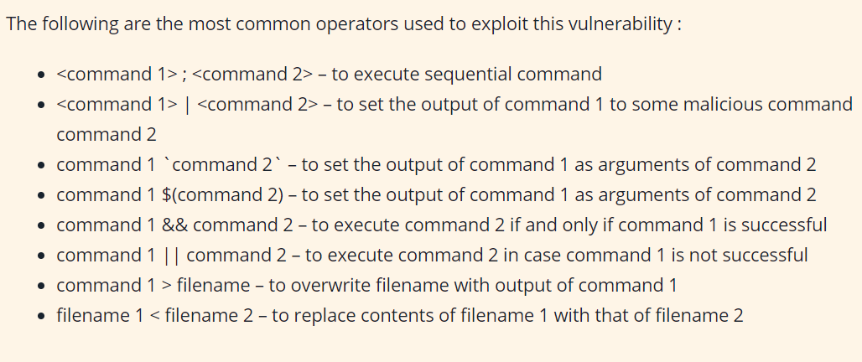
Ways of injecting OS commands

Slide 24

Some useful OS Commands
Purpose of command | Linux | Windows
Name of current user | whoami | whoami
Operating system | uname -a | ver
Network configuration | ifconfig | ipconfig /all
Network connections | netstat -an | netstat -an
Running processes | ps -ef | tasklist

Slide 25
Executing arbitrary commands
Consider a shopping application that lets the user view whether an item is in stock in a particular store. This information is accessed via a URL like:
https://insecure-website.com/stockStatus?productID=381&storeID=29
The functionality is implemented by calling out to a shell command with the product and store IDs as arguments:
stockreport.pl 381 29
This command outputs the stock status for the specified item, which is returned to the user.
Since the application implements no defenses against OS command injection, an attacker can submit the following input to execute an arbitrary command:
& echo Hello &

Slide 26
If this input is submitted in the productID parameter, then the command executed by the application is:
stockreport.pl & echo Hello & 29
The echo command simply causes the supplied string to be echoed in the output, and is a useful way to test for some types of OS command injection. The & character is a shell command separator, and so what gets executed is actually three separate commands one after another. As a result, the output returned to the user is:
Error - productID was not provided Hello 29: command not found
The three lines of output demonstrate that:
The original stockreport.pl command was executed without its expected arguments, and so returned an error message.
The injected echo command was executed, and the supplied string was echoed in the output.
The original argument 29 was executed as a command, which caused an error.

Slide 27
Demo:
https://portswigger.net/web-security/os-command-injection/lab-simple

Slide 28
Blind OS command injection vulnerabilities
It occurs when the application does not return the output from the command within its HTTP response. Blind vulnerabilities can still be exploited, but different techniques are required.
Example:
Consider a web site that lets users submit feedback about the site. The user enters their email address and feedback message. The server-side application then generates an email to a site administrator containing the feedback. To do this, it calls out to the mail program with the submitted details. For example:
mail -s "This site is great" -aFrom:peter@normal-user.net feedback@vulnerable-website.com
The output from the mail command (if any) is not returned in the application's responses, and so using the echo payload would not be effective. In this situation, you can use a variety of other techniques to detect and exploit a vulnerability.

Slide 29
You can use an injected command that will trigger a time delay, allowing you to confirm that the command was executed based on the time that the application takes to respond. The ping command is an effective way to do this, as it lets you specify the number of ICMP packets to send, and therefore the time taken for the command to run:
& ping -c 10 127.0.0.1 &
This command will cause the application to ping its loopback network adapter for 10 seconds.

Slide 30
Demo:
https://portswigger.net/web-security/os-command-injection/lab-blind-time-delays

Slide 31

Prevention
Never call out to OS commands from the application.
If unavoidable, then strong input validation must be performed, like:
Validating against a whitelist of permitted values.
Validating that the input is a number.
Validating that the input contains only alphanumeric characters, no other syntax or whitespace.
Never attempt to sanitize input by escaping shell metacharacters. In practice, this is just too error-prone and vulnerable to being bypassed by a skilled attacker.

Slide 32
Server Side Request Forgery (SSRF)

Slide 33
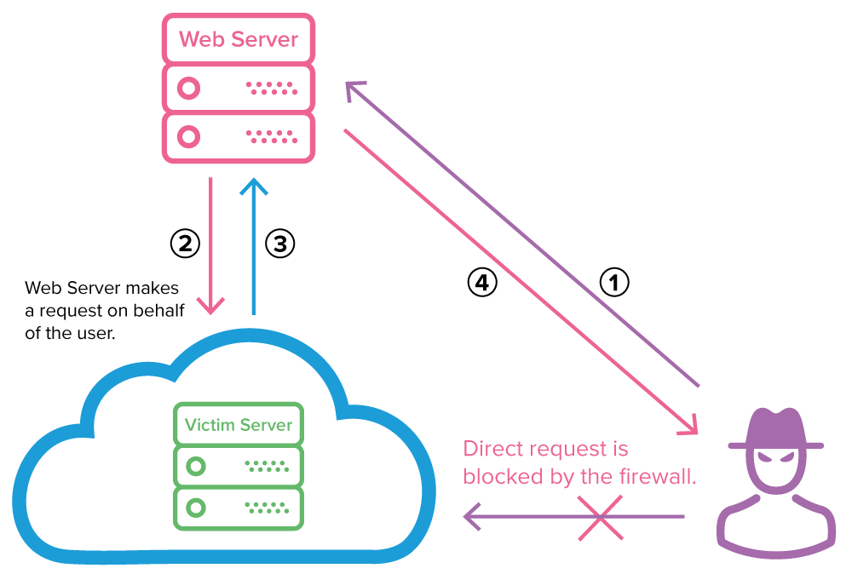
What is it?
Server Side Request Forgery (SSRF) is a web security vulnerability that allows an attacker to induce server-side application to make arbitrary HTTP requests of his liking.

Slide 34
Impact
A Successful SSRF attack allows:
Unauthorised access to internal servers
Unauthorised data access
Malicious third-party system access through the vulnerable application
Arbitrary Command Execution (sometimes ☺)

Slide 35
Demo
Basic SSRF against local server
https://portswigger.net/web-security/ssrf/lab-basic-ssrf-against-localhost
SSRF with blacklist-based input filters
https://portswigger.net/web-security/ssrf/lab-ssrf-with-blacklist-filter

Slide 36

Mitigation
Simple blacklisting is a bad security measure. Rather we should focus on whitelisting the DNS and IP addresses.
Ensure that received response is as expected.
Disable unused URL schemes to prevent attackers making potentially dangerous requests using file:///, ftp://, etc.
Implement authentication even on internal services.

Slide 37
HTTP Request Smuggling

Slide 38
What is it?
HTTP Request Smuggling is a technique for interfering with the way a web site processes sequences of HTTP requests.
These are often critical in nature, allowing an attacker to:
Bypass security controls
Gain unauthorized access to sensitive data
Directly compromise other application users.

Slide 39
Demo
Basic CL.TE vulnerability
https://portswigger.net/web-security/request-smuggling/lab-basic-cl-te
Request Rewriting
https://portswigger.net/web-security/request-smuggling/exploiting/lab-reveal-front-end-request-rewriting

Slide 40
Mitigation
Disable reuse of back-end connections, so that each back-end request is sent over a separate network connection.
Use HTTP/2 for back-end connections, as this protocol prevents ambiguity about the boundaries between requests.
Use exactly the same web server software for the front-end and back-end servers, so that they agree about the boundaries between requests.

Slide 41
Thank You !!! ☺

