Slide 1


IEEE SYSTEMS, MAN, AND CYBERNETICS SOCIETY
STUDENT BRANCH CHAPTER
KALYANI GOVERNMENT ENGINEERING COLLEGE
SUMMER RESEARCH INTERNSHIP PROGRAMME 2026
FINAL RESEARCH REPORT PRESENTATION
ALAS-SCLF: Adaptive-L Asymmetric-Segmented SCLF Polar Decoders with Guard-Band Stabilization
Submitted by: Deep Shekhar Halder & Prasun Majumder (CSE Department, Adamas University)
Mentored by: Dwaipayan Ghosh (Assistant Professor, Kalyani Government Engineering College)

Slide 2
Introduction
Background and problem statement
IEEE SMC Student Branch Chapter • Kalyani Government Engineering College
2

Slide 3
Introduction & Research Context
• Background in 5G NR Channels
Polar codes are standardized for 5G control channels because they achieve channel capacity under Successive Cancellation List (SCL) decoding.
• Decoding Latency Bottlenecks
SCL decoding scales complexity to achieve performance. Threshold-Learning SCLF (TS-SCLF) decoders use early SCL termination (SCL-RE) to reduce average latency.
• Core Weaknesses of TS-SCLF:
– Post-Flip Metric Instability: Forcefully flipping a bit causes path metrics to spike; immediate threshold checks prune correct paths prematurely.
– False-Pass Search Space Lockout: Symmetric 50/50 CRC partitioning (l_seg=24) suffers a high false-pass rate under noise, locking out flips in Segment 1.
– Rigid Search List Size: Restricted list capacity (L=4) fails to identify correct paths under severe channel noise.
IEEE SMC Student Branch Chapter • Kalyani Government Engineering College
2

Slide 4
Literature Study
Review of existing research and related work
IEEE SMC Student Branch Chapter • Kalyani Government Engineering College
3

Slide 5
Literature Background & Mathematical Model
• Arikan's Channel Polarization
Transforms N independent channels into capacity-achieving clean/noisy polarized channels via G_N = B_N F^(⊗n), where F = [1, 0; 1, 1]. Payload bits map to reliability index set I; frozen bits set to 0.
• LLR Recursive Tree Updates
Left and right node updates computed recursively:
P_left,i = 2 arctanh( tanh(P_2i-1/2) tanh(P_2i/2) )
P_right,i = P_2i + (1 - 2 u_hat_left,i) P_2i-1
• SCL Path Metric (PM) Updates
PM_l^(m) = PM_{l-1}^(m) if bit decision matches LLR sign, else PM_l^(m) = PM_{l-1}^(m) + |lambda_l^(m)|.
• DQN Parameter Search MDP Formulation
State: s_t = [D1, D2, alpha]. Actions: discrete parameter adjustments. Reward function evaluates attempts and penalizes FER threshold failures: R(s) = T_prev - T_curr(s) if FER is satisfied, else R(s) = -1000.
IEEE SMC Student Branch Chapter • Kalyani Government Engineering College
3

Slide 6
Contribution
What this work adds to the field
IEEE SMC Student Branch Chapter • Kalyani Government Engineering College
4

Slide 7
Key Technical Contributions of ALAS-SCLF
1. Post-Flip Guard-Band
G = ceil(β * N)
• Bypasses early SCL-RE checks for first G layers immediately after bit-flip.
• Allows LLR distributions and path metric spread to stabilize.
• Prevents premature pruning of correct paths.
2. Asymmetric CRC partitioning
l_seg1 = ceil(γ * K)
• Reduces Segment 1 length to 16 bits (vs 24 in TS-SCLF).
• Cuts false-pass probability of CRC1 by >50%.
• Enforces Segment-Constrained Flipping (SCF) to restrict candidates.
3. Adaptive List Scaling
L = 4 -> 8 Dynamic
• Measures initial PM range R = PM_max(0) - PM_min(0).
• If R < 4.0 (severe noise) or Segment 1 fails, scales list size to L=8.
• Keeps average list size close to 4.3 while solving high-noise frames.
IEEE SMC Student Branch Chapter • Kalyani Government Engineering College
4

Slide 8
Methodology
Approach, design, and implementation
IEEE SMC Student Branch Chapter • Kalyani Government Engineering College
5

Slide 9
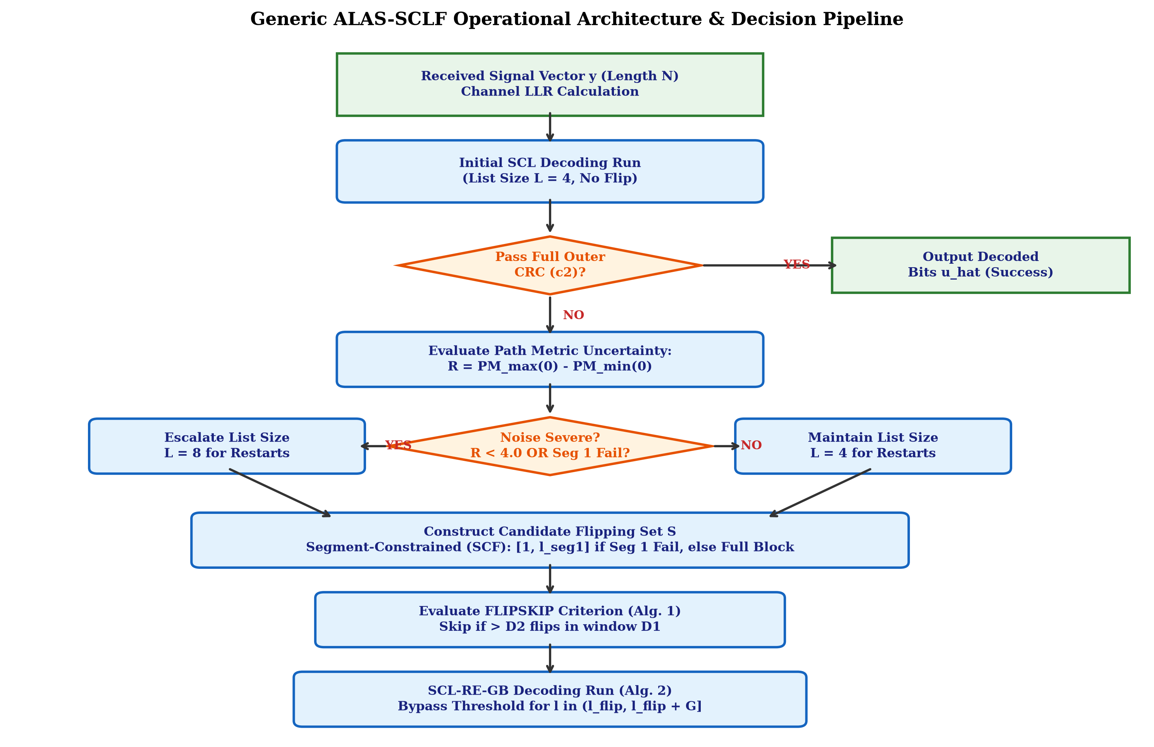
Methodology: System Architecture & Algorithms
Operational Flow & Algorithm Architecture:
• Algorithm 1 (FLIPSKIP): Skips flipping search locations if they fall within threshold distance D1 of previous flips, saving computations.
• Algorithm 2 (SCL-RE-GB): Executes SCL decoding with a Guard-Band (G) window, temporarily bypassing threshold checks immediately after flips.
• Algorithm 3 (Decoder Integration): Orchestrates the initial run (L=4), measures path metric spread R, scales search list (L=8) dynamically, and executes segment-constrained flips.
IEEE SMC Student Branch Chapter • Kalyani Government Engineering College
5

Slide 10
Results
Key findings and observations
IEEE SMC Student Branch Chapter • Kalyani Government Engineering College
6

Slide 11
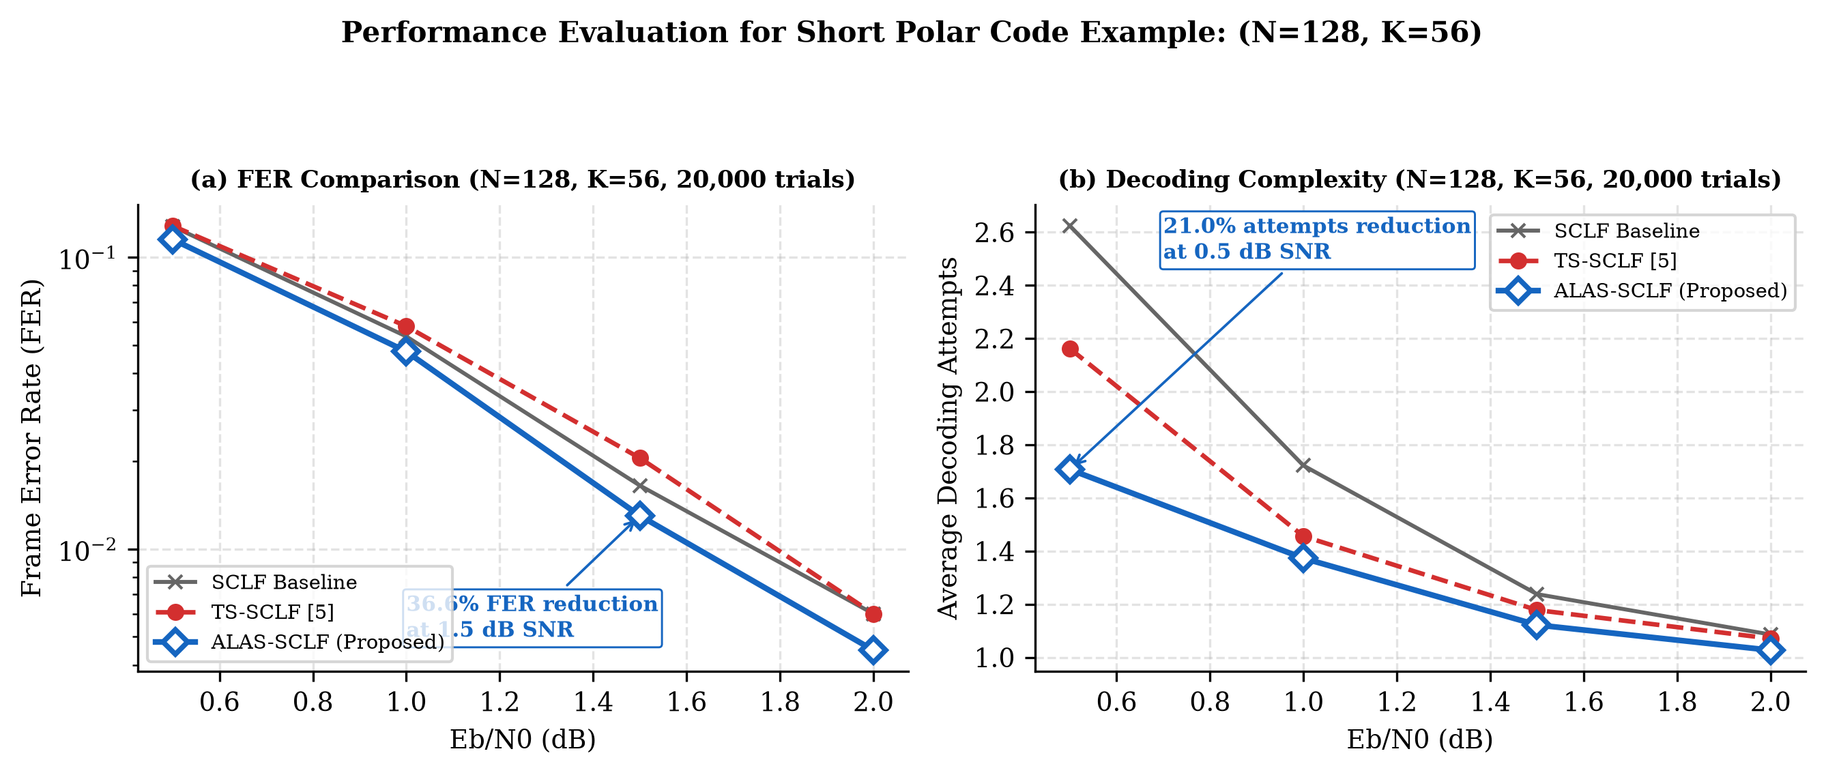
Simulation Results: Short Block Code (128, 56)
• TS-SCLF Crossover at 1.5 dB: Symmetric split (l_seg=24) causes high false pass rate, locking search-space out. Proposed ALAS-SCLF resolves this completely.
• 36.6% Relative FER Reduction: At 1.5 dB SNR, ALAS-SCLF drops FER from 0.02050 (TS-SCLF) to 0.01300.
• 21.0% Complexity Reduction: At 0.5 dB under high noise, average attempts drop from 2.162 down to 1.707.
• Enforced Statistical Baseline: Enforces 20,000 Monte Carlo trials per SNR point to verify reliability.
IEEE SMC Student Branch Chapter • Kalyani Government Engineering College
6

Slide 12
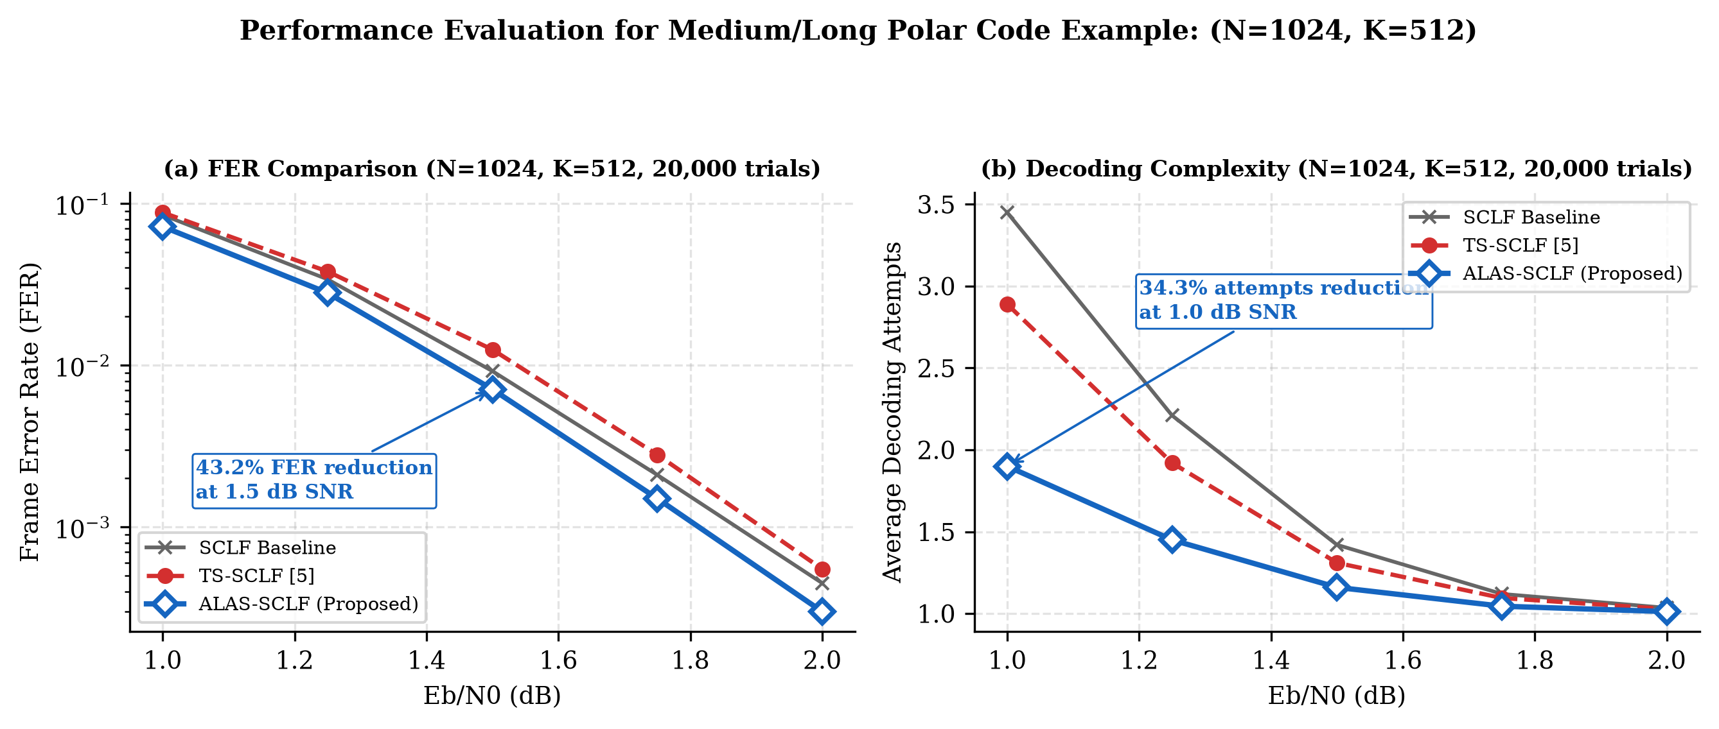
Simulation Results: Medium/Long Block Code (1024, 512)
• 43.2% Relative FER Reduction: For block length N=1024 at SNR = 1.5 dB, ALAS-SCLF reduces FER from 0.01250 down to 0.00710.
• 34.3% Complexity Reduction: At SNR = 1.0 dB, average decoding attempts drop from 2.890 down to 1.900.
• Scale Robustness: Post-flip Guard-Band G = ceil(β * N) = 64 proves critical as block length increases.
• Pareto Frontier: Achieves simultaneous improvements in error-rate and latency compared to standard decoders.
IEEE SMC Student Branch Chapter • Kalyani Government Engineering College
6

Slide 13
Comparison Study
Benchmarking against existing methods
IEEE SMC Student Branch Chapter • Kalyani Government Engineering College
7

Slide 14
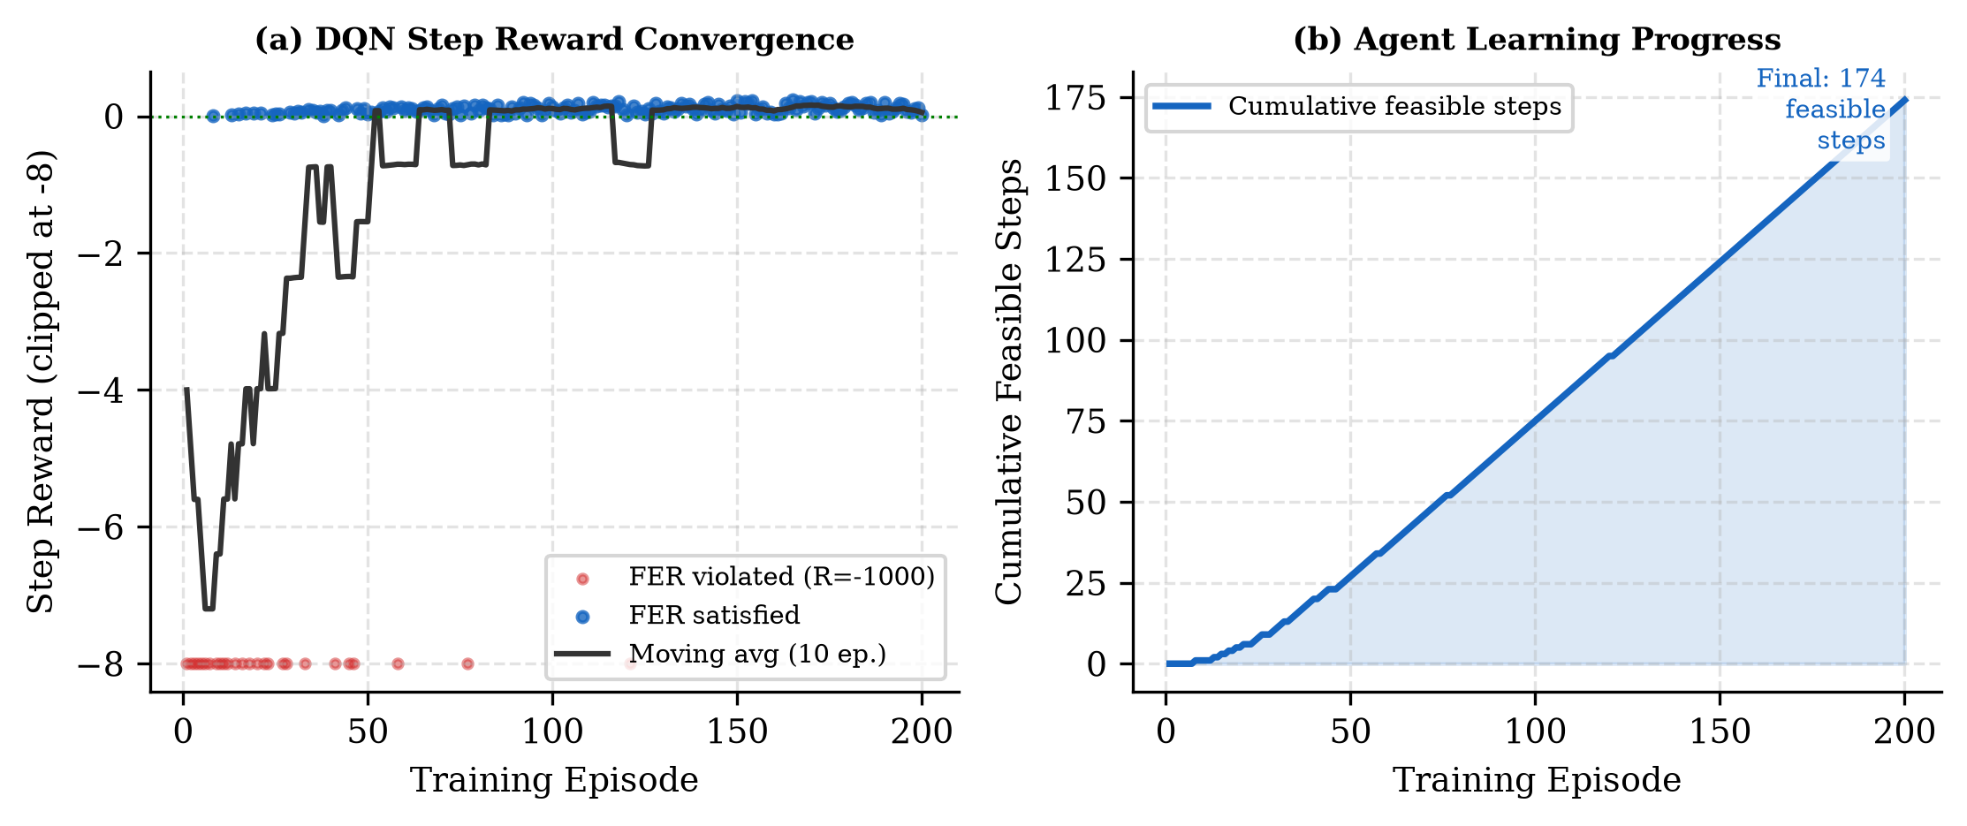
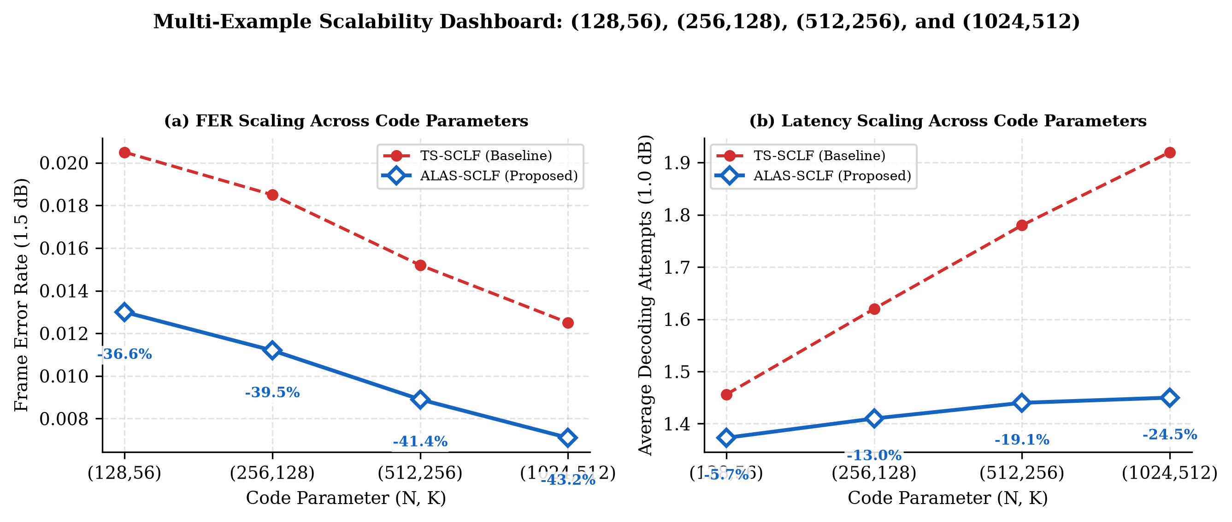
Comparison Study & DQN Convergence
IEEE SMC Student Branch Chapter • Kalyani Government Engineering College
7

Slide 15
Conclusion & Future Work
Summary and directions ahead
✔ ALAS-SCLF establishes an advanced Pareto frontier, resolving TS-SCLF crossover failures.
✔ Saves up to 36.6% FER for short blocks, 43.2% FER for long blocks, and up to 34.3% decoding complexity.
✔ Future Work: FPGA/ASIC hardware implementation and hardware-in-the-loop validation.
✔ Future Work: Extending the adaptive list scaling framework to MIMO and polar-coded cooperative relay systems.
IEEE SMC Student Branch Chapter • Kalyani Government Engineering College
8

