Slide 1

NashDQNSleep+: Research gap Analysis and Proposed Extensions
Swastik Basu
Department of Computer Science
Ramakrishna Mission Vivekananda Centenary College, Rahara
IEEE SMC Student Branch Chapter • Kalyani Government Engineering College
2

Slide 2
Introduction
Industrial IoT and Sleep Scheduling Challenge
Continuous Monitoring
↓
High Energy Consumption
Sleep Scheduling
↓
Lower Energy — Higher AoI
NashDQNSleep
Nash Equilibrium + DQN
Goal:
Energy Efficiency ↔ Data Freshness
IEEE SMC Student Branch Chapter • Kalyani Government Engineering College
2

Slide 3

Literature Study
Review of existing research and related work
Deployment
Real-world DRL/ hardware validation
Relaying
Multi-hop and relay-aware AoI scheduling
AoI
Non Linear freshness
Energy
Energy Harvesting IIoT
Node Diversity
heterogeneous agent scheduling
Existing literature addresses these challenges individually, while NashDQNSleep does not fully incorporate them into its current formulation.
IEEE SMC Student Branch Chapter • Kalyani Government Engineering College
3

Slide 4

Contribution
Works done and gaps identified
Gaps in NashDQNSleep
Linear AoI model
No Energy Harvesting
Homogeneous Nodes
Simulation Only
Relay Aware Scheduling
Works Done in NashDQNSleep+
Non-Linear AoI
Energy Harvesting
Relay-aware Reward
IEEE SMC Student Branch Chapter • Kalyani Government Engineering College
4

Slide 5

Methodology
Research Gap Identification Methodology
Paper
Mathematical analysis
Assumption Analysis
Literature Review
NashDQNSleep+
Gap
Vallidation
Equations + Assumptions + Literature = Research Gaps
IEEE SMC Student Branch Chapter • Kalyani Government Engineering College
5

Slide 6

Results
Key findings and observations
 | Finding | Direction
AoI | Linear growth | Non-linear model
Energy | No Harvesting | Energy-aware state
Nodes | Homogeneous | Heterogeneous Extension
Validation | Simulation | Hardware validation
Relay | Limited awareness | Relay
IEEE SMC Student Branch Chapter • Kalyani Government Engineering College
6

Slide 7

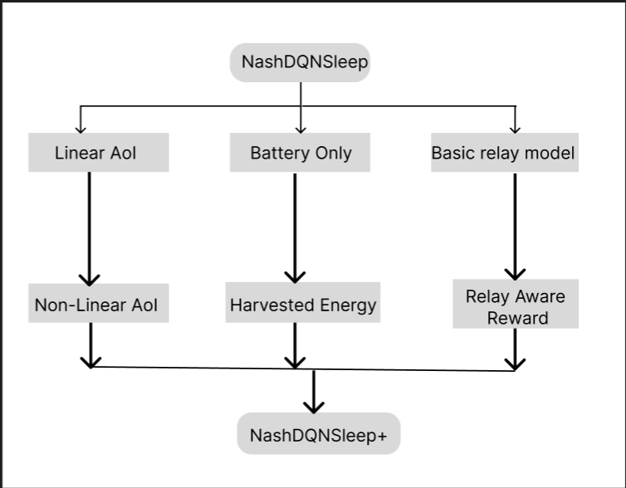
Comparison Study
Benchmarking against existing methods
IEEE SMC Student Branch Chapter • Kalyani Government Engineering College
7

Slide 8

Conclusion & Future Work
Summary and directions ahead
5 Research Gaps
3 Algorithmic Extensions
1 Proposed Framework
NashDQNSleep+
Future Work = Heterogeneous Nodes and Hardware Validation
IEEE SMC Student Branch Chapter • Kalyani Government Engineering College
8

Slide 9
THANK YOU
IEEE SMC Student Branch Chapter • Kalyani Government Engineering College

