Slide 1
Workshop of the IEEE Finland Jt. Chapter
Signal Processing (SP) and
Circuits and Systems (CAS)
(CH08056)
05-Oct-2022, Aalto University

Slide 2
Schedule of Today
09:00 - 10:00 Welcome, Overview of Chapter
10:00 - 10:30 Expert Talk: Dr. Jiawei Yang
10:30 - 11:10 Paper Award Candidate: Dr. Zitong Yu
11:16 - 12:00 Paper Award Candidate: Dr. Rui Gao
12:00 - 14:00 Lunch at Metso
14:00 - 16:00 Expert Talk: Dr. Jakob Hoydis (NVIDIA)
Recordings offline:
Paper Award Candidate: Dr. Robin Rajamäki
Paper Award Candidate: Dr. Andreas Hauptmann

Slide 3
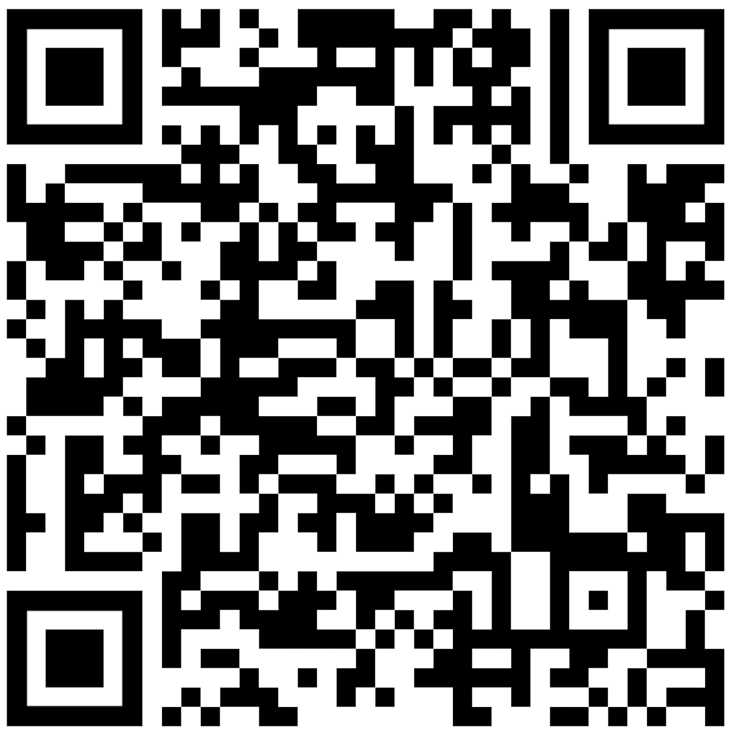
JOIN OUR SLACK !
https://join.slack.com/t/ieeespcas/shared_invite/zt-1fjem37fa-DcLuNHbj_KC1N8NDUblHHQ

Slide 4
Who are We ?
IEEE Finland Section Jt. Chapter, SP01/CAS04 (CH08056)
SP = Signal Processing
CAS = Circuits and Systems
part of IEEE Finland Section
associated with
IEEE Signal Processing Society (https://signalprocessingsociety.org/)
IEEE Circuits and Systems Society (https://ieee-cas.org/about)

Slide 5
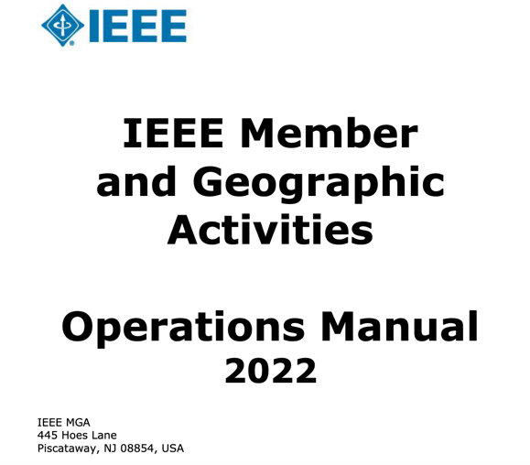
Our Constitution

Slide 6
What is a IEEE Chapter?
technical subunit of …one or more Sections…
may be single or joint Society Chapters…
minimum of twelve (12) IEEE voting member of Societies
see. Section 9.6 of https://mga.ieee.org/images/files/MGA_Operations_Manual_2022_February_Updated_.pdf

Slide 7
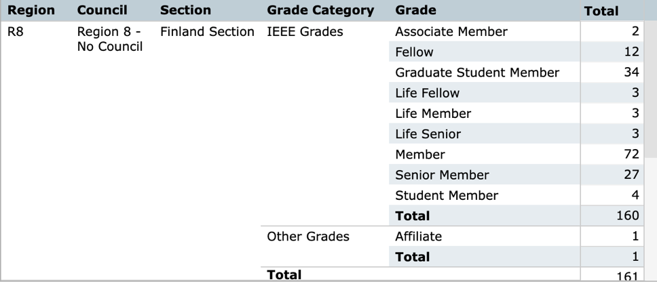
Chapter Members
“IEEE members of Graduate Student Member, Member, Senior Member, or Fellow grade who belong to an IEEE Society and a geographic unit which has formed a Technical Chapter of such Society are considered Chapter members…”

Slide 8
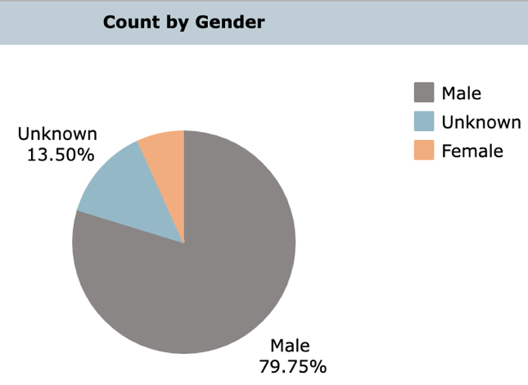
Gender Imbalance

Slide 9
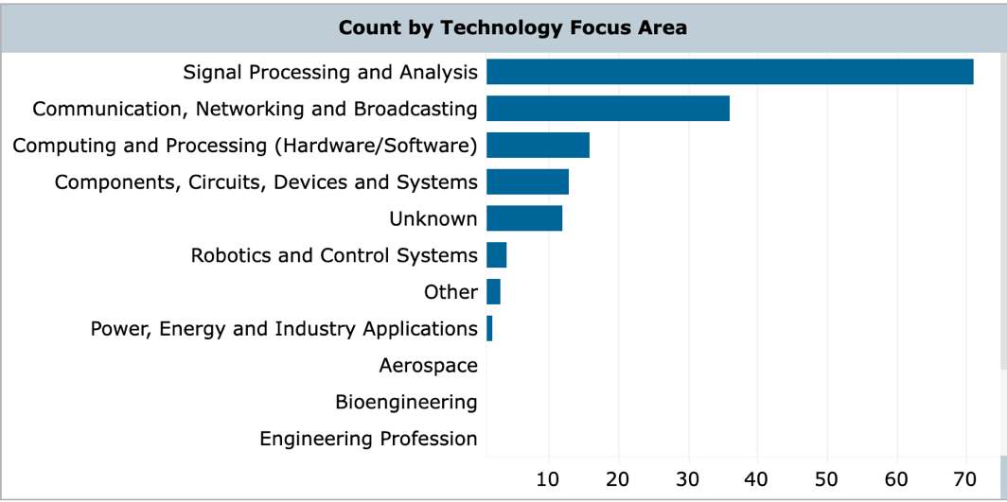

Slide 10
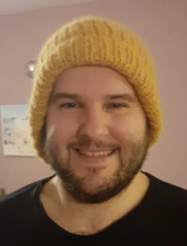
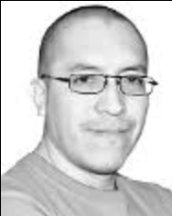
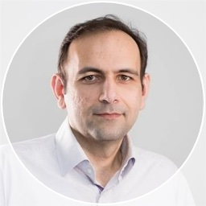
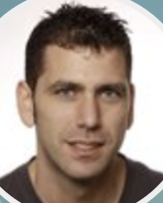
Chapter Board
Chair: Alex Jung (Aalto)
Treasurer: Dick C. Melgarejo (LUT)
Co-Chair: Hamed R. Tavakoli (Nokia)
Secretary: Jose Maria Perez-Macias(TAU)

Slide 11
What is a IEEE Chapter? (https://mga.ieee.org/resources-operations/geographic-unit/chapters#sec1)
technical sub-unit of one or more IEEE Sections (IEEE Finland)
Society/Technical Council Chapters consist of members from one or more IEEE Societies/Technical Councils (IEEE SPS, IEEE CASS)
activities include guest speakers, workshops, seminars and social functions
offer valuable opportunities to network at a local level,
serve IEEE members by holding meetings at the local level

Slide 12
What did we do ?

Slide 13
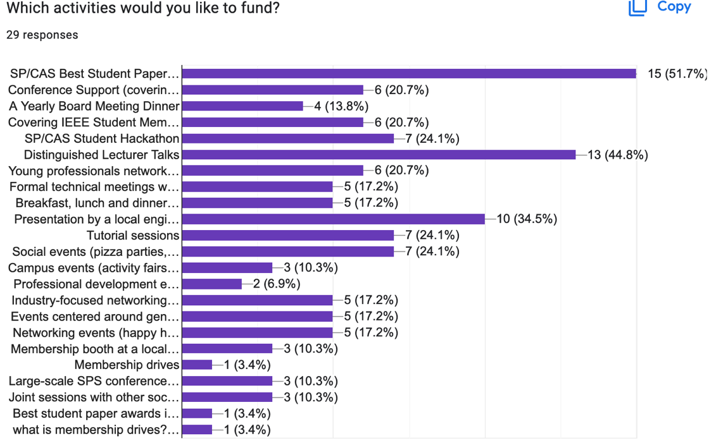

Slide 14
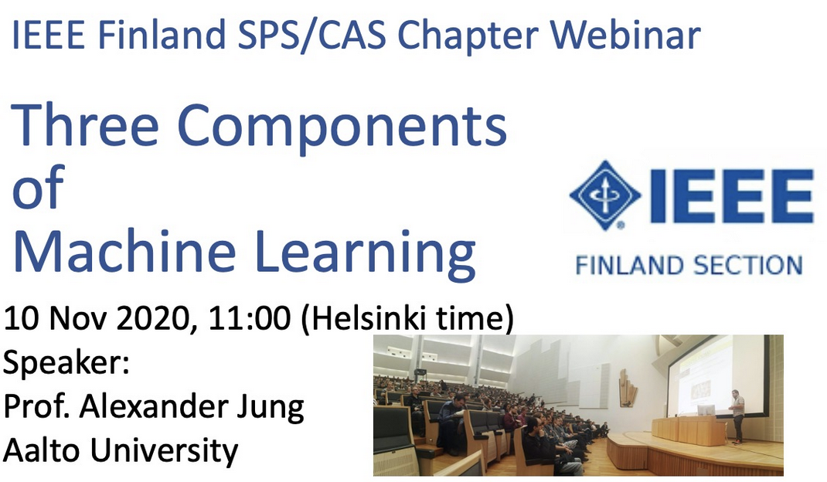
66 registrations according to vTools

Slide 15
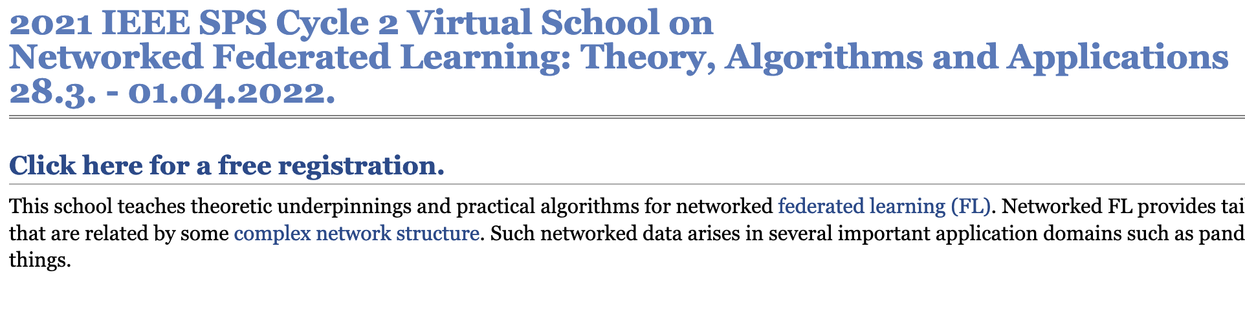
545 registrations according to vTools

Slide 16
Best Paper Award
honour an IEEE Finland Section member who has made contributions of exceptional distinction that are a model for other members to emulate.
journal publication during 01.01.2020 and 31.12.2021
journal must be listed
https://signalprocessingsociety.org/publications-resources
https://ieee-cas.org/publications
First prize: EUR 500,00. Second: EUR 200,00. Third: EUR 100,00.
Announcement of Awardees: December 2022.

Slide 17
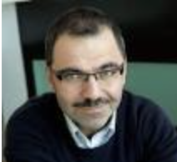
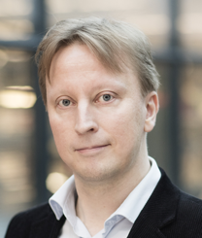
Award Committee
Prof. Karen Eguiazarian (TAU)
Prof. Simo Särkkä (Aalto)

Slide 18
at 10:00
Dr. Jiawei Yang
Neighborhood Representative for Improving Outlier Detectors
Jiawei Yang received the B.Eng. degree in Electronic Engineering from Beihang University, China in 2013, the M.Eng. and Ph.D. degrees in Computer Science from University of Eastern Finland, Finland, in 2019 and 2020, respectively. He currently works in Northwestern Polytechnical University.

Slide 19
Dr. Zitong Yu
AutoHR: A Strong End-to-end Baseline for Remote Heart Rate Measurement with Neural Searching
Zitong Yu is currently a postdoctoral researcher at ROSE Lab of Nanyang Technological University, Singapore. He also serves as an advisor on remote physiological measurement for BioTrillion, USA. He received the Ph.D. degree in Computer Science from University of Oulu, Finland, in 2022. He was previously a visiting scholar at Torr Vision Group of the University of Oxford, UK, in 2021.

Slide 20
Dr. Robin Rajamäki
Robin Rajamäki is a postdoctoral scholar at the University of California San Diego. He received his D.Sc. degree in electrical engineering in 2021 from Aalto University, Finland. His research interests lie in the intersection of theory and applications of statistical signal processing and optimization. In particular, his work focuses on sparse sensing using resource-efficient multisensor systems, which find applications in, e.g., radar and ultrasound imaging.

