Slide 1
Workshop of the IEEE Finland Jt. Chapter
Signal Processing (SP) and
Circuits and Systems (CAS)
(CH08056)

Slide 2
Schedule of Today
09:00 - 10:00 Welcome, Overview of Chapter
10:00 - 11:00 Expert Talk: Dr. Jiawei Yang
11:00 - 12:00 Paper Award Candidate: Dr. Zitong Yu
12:00 - 13:00 Lunch at Metso
13:00 - 14:00 Paper Award Candidate: Dr. Rui Gao
14:00 - 16:00 Expert Talk: Dr. Jakob Hoydis
16:00 - 17:00 Paper Award Candidate: Dr. Robin Rajamäki

Slide 3
Who are We ?
IEEE Finland Section Jt. Chapter, SP01/CAS04 (CH08056)
SP = Signal Processing
CAS = Circuits and Systems
part of IEEE Finland Section
associated with
IEEE Signal Processing Society (https://signalprocessingsociety.org/)
IEEE Circuits and Systems Society (https://ieee-cas.org/about)

Slide 4
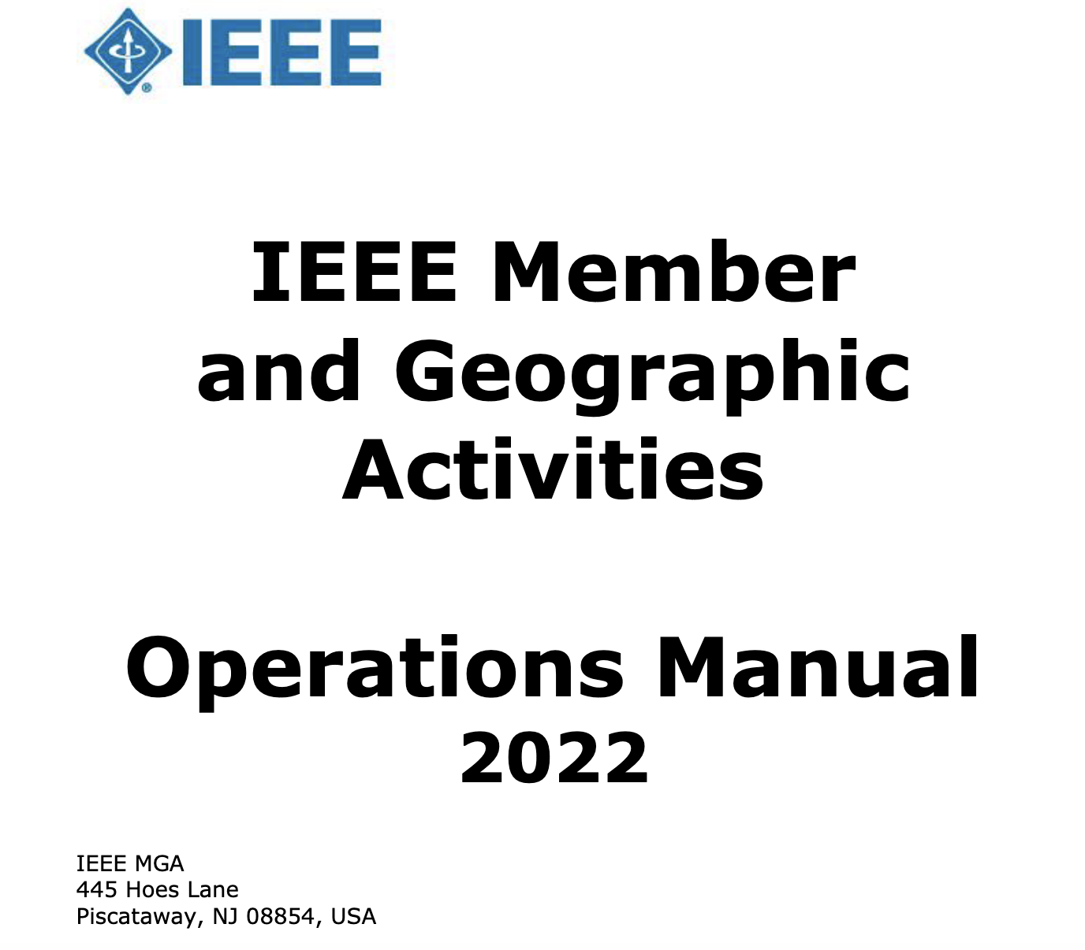
Our Constitution

Slide 5
What is a IEEE Chapter?
technical subunit of …one or more Sections…
may be single or joint Society Chapters…
minimum of twelve (12) IEEE voting member of Societies
see. Section 9.6 of https://mga.ieee.org/images/files/MGA_Operations_Manual_2022_February_Updated_.pdf

Slide 6
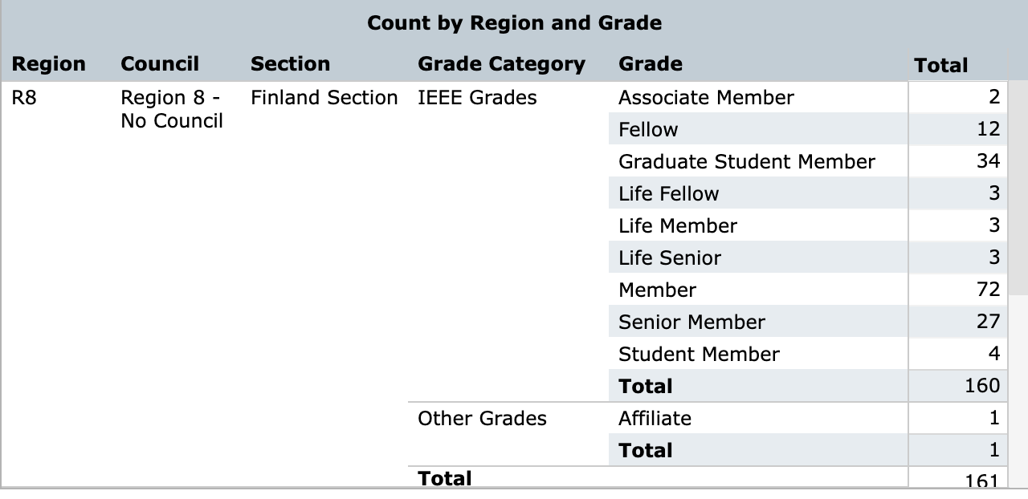
Chapter Members
“IEEE members of Graduate Student Member, Member, Senior Member, or Fellow grade who belong to an IEEE Society and a geographic unit which has formed a Technical Chapter of such Society are considered Chapter members…”

Slide 7
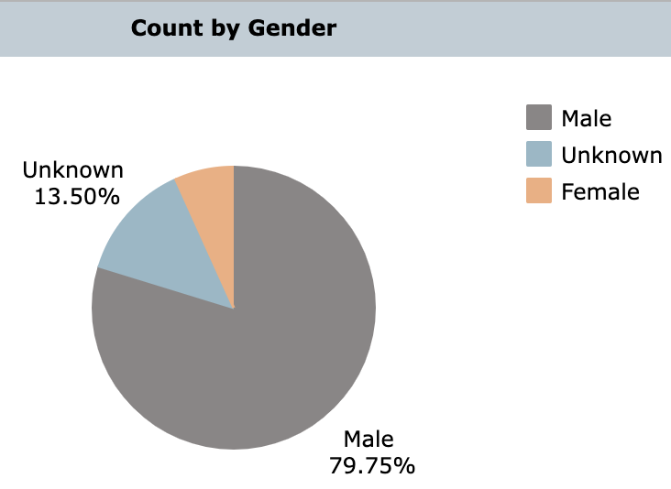
Gender Imbalance

Slide 8
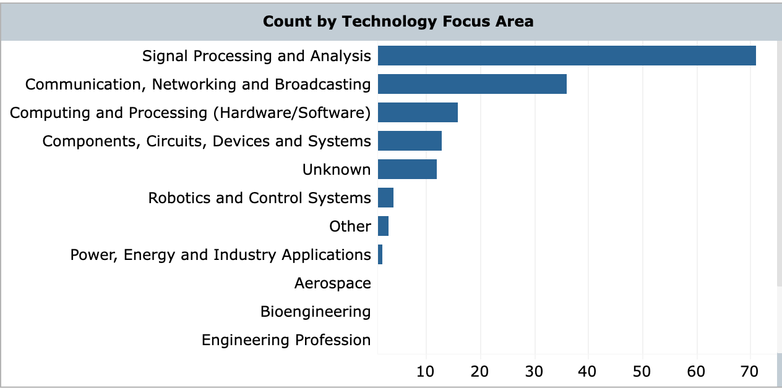

Slide 9
Chapter Board
Chair: Alex Jung (Aalto)
Treasurer: Dick Carrillo Melgarejo (LUT)
Co-Chair: Hamed Rezazadegan Tavakoli (Nokia)
Secretary: Jose Maria Perez-Macias(TAU)

Slide 10
What is a IEEE Chapter? (https://mga.ieee.org/resources-operations/geographic-unit/chapters#sec1)
technical sub-unit of one or more IEEE Sections (IEEE Finland)
Society/Technical Council Chapters consist of members from one or more IEEE Societies/Technical Councils (IEEE SPS, IEEE CASS)
activities include guest speakers, workshops, seminars and social functions
offer valuable opportunities to network at a local level,
serve IEEE members by holding meetings at the local level

Slide 11
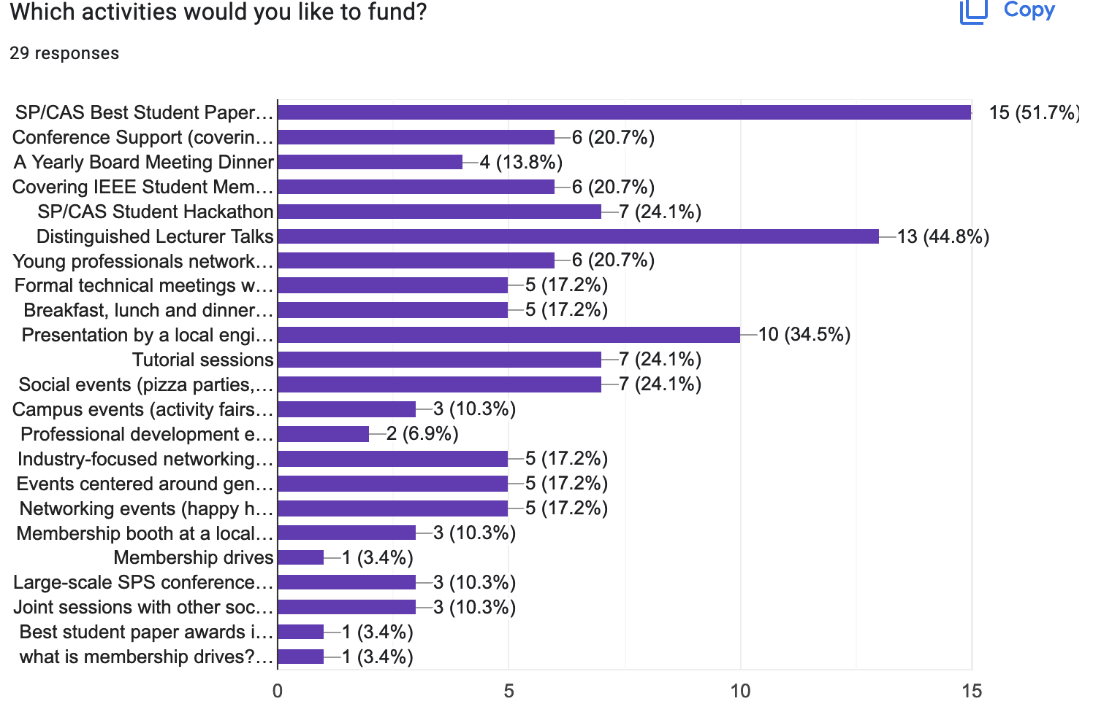

Slide 12
Best Paper Award
honor an IEEE Finland Section member who has made contributions of exceptional distinction that are a model for other members to emulate.
journal publication during 01.01.2020 and 31.12.2021
journal must be listed
https://signalprocessingsociety.org/publications-resources
https://ieee-cas.org/publications
First prize: EUR 500,00. Second: EUR 200,00. Third: EUR 100,00.
Announcement of Awardees: December 2022.

Slide 13
Award Committee
Prof. Karen Eguiazarian (TAU)
Prof. Simo Särkkä (Aalto)

