Slide 1


IEEE Signal Processing Society Seasonal School 28.03.2022 – 01.04.2022 Networked Federated Learning Theory, Algorithms and Applications Alex Jung (Aalto University)

Slide 2
About Me.
MSc (2008) and Ph.D. (2012) in EE, TU Vienna
since 2015 Ass. Prof. for Machine Learning at Aalto/CS
leading group “Machine Learning for Big Data”
2020- Associate Editor for IEEE Signal Processing Letters
2019-2022: Chair of IEEE Finland Jt. Chapter SP/CAS
Notes:
Let me give a quick overview of my academic journey so far. I have received a MSc and Phd in Electrical Engineering in 2008 and 2012, respectively, both from TU Vienna. Since 2015 I am an assistant professor at the Department of Computer Science at Aalto University. Here I am leading the group Machine Learning for Big Data which is researching and teaching the mathmatical foundations of machine learning.

Slide 3
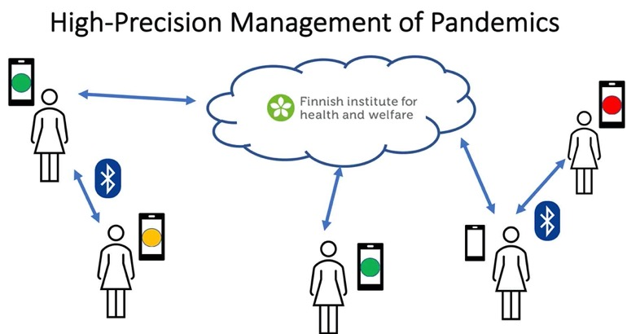
RA1: Networked Federated Learning.
Y. Sarcheshmehpour, M Leinonen and AJ, “Federated Learning From Big Data Over Networks”, IEEE ICASSP, 2021.
AJ, “Networked Exponential Families for Big Data Over Networks,” in IEEE Access, 2020, doi: 10.1109/ACCESS.2020.3033817.
AJ, N. Tran, “Localized Linear Regression in Networked Data,” in IEEE SPL, 2019, doi: 10.1109/LSP.2019.2918933.
Notes:
Our current research focus is two areas. The first research area is federated mutl-task learning which is relevant e.g. for the high-precision management of pandemics. Indeed, the personalized predicition of infection risks results in a networked collection of individual learning tasks. Each single task corresponds to learning accurated infection risk predictors for a particular person. I will talk more about how the statistical and computational aspects of such federated multit-task earning problems udring the main part of my talk.

Slide 4
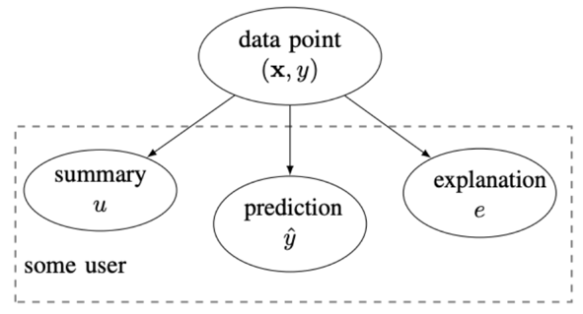
RA2: Explainable Machine Learning.
explanation can be:
relevant example of training set
subset of features
counterfactuals
a free text explanation
court sentence
L. Zhang, G. Karakasidis, A. Odnoblyudova, L. Dogruel and AJ., “Explainable Empirical Risk Minimization”, arXiv, 2022. weblink
AJ and P. H. J. Nardelli, “An Information-Theoretic Approach to Personalized Explainable Machine Learning,” in IEEE SPL, 2020, doi: 10.1109/LSP.2020.2993176.
Notes:
Our second current research area is explainable machine learning. Our take on this hot topic is to measure the usefulness of an explanation by the amount by which the entropy of the prediction is reduced. An explanation can be any artefact that is revealed together with the prediction. For example, an explanation could amount to selecting a particular training example. Another form of explanations is obtained by listing a set of most relevant features. Formally, we model the explanation and prediction as correlated random variables. This information-theoretic approach is appealing as it allows to take into account the user background knowledge. We characterize the user background by a user summary that is provided by a training set. We use the user summary to design explanations that maximally reduce the uncertainty about a prediction for a specific user.

Slide 5



School Format.
Exercises
(independent work)
Lectures
(via zoom, recorded)
Discussion Forum
click here to join
Notes:
Let me give a quick overview of the organization of our seasonal school. We will have lectures via zoom which will be recorded and made available to participants. Don’t worry if you cannot attend them live. Another main component of the school are exercises.

Slide 6
all times EET/local Helsinki time)
hall: https://aalto.zoom.us/j/64034033878?pwd=ayt4aDNyaEVSSGt1eHNNZFVFR2RoZz09
Tue, 11:00-13:00, Basics of spectral graph theory, Prof. Avratchenkov
We, 10:00-11:00, Parallel/distributed methods for state-space models, Prof. Särkkä
We, 12:30-13:30, Compact and Efficient Neural Networks, Steps Towards Communication Efficient Federated Learning, Dr. H. Tavakoli
Thu., 11:00-12:00, Machine Learning applications in meteorological forecasting, Dr. Schicker
Thu, 13:00-14:00, Towards Communication-Efficient and Personalized Federated Learning, Dr. Samek
Thu, 14:30-15:30, Communication-Computation Efficient Distributed Machine Learning , Prof. Fischione
Fr, 11:00-12:00, Tackling the problem of “bad” explanations with the Human-in-the-Loop principle, Dipl.-Ing. Saranti
Notes:
Let me give a quick overview of the organization of our seasonal school. We will have lectures via zoom which will be recorded and made available to participants. Don’t worry if you cannot attend them live. Another main component of the school are exercises.

Slide 7
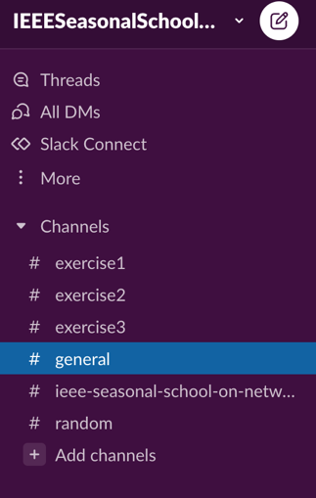
Discussion Forum („Slack“)
can be used via web-browser or with
an installed app;
link to join is on school site
https://ieeespcasfinland.github.io/
post your questions there in suitable
channel, e.g., “exercise1”
don’t hesitate to answer other’s questions
Notes:
Let me give a quick overview of the organization of our seasonal school. We will have lectures via zoom which will be recorded and made available to participants. Don’t worry if you cannot attend them live. Another main component of the school are exercises.

Slide 8


Teacher Support for Exercises
Dr. Yu Tian
Dr. Shamsiiat (Shamsi) Abdurakhmanova
Notes:
Let me give a quick overview of the organization of our seasonal school. We will have lectures via zoom which will be recorded and made available to participants. Don’t worry if you cannot attend them live. Another main component of the school are exercises.

Slide 9
Exercises.
three exercises: Exercise 1, 2 and 3
each exercise consists of a Python notebook
notebook contains starter code and explanations
tasks at the end of notebooks
Notes:
Let me give a quick overview of the organization of our seasonal school. We will have lectures via zoom which will be recorded and made available to participants. Don’t worry if you cannot attend them live. Another main component of the school are exercises.

Slide 10
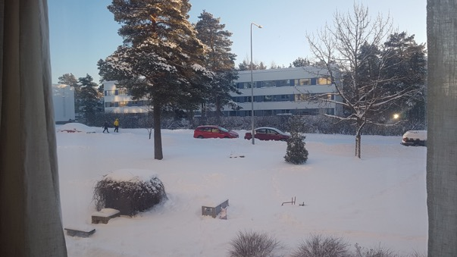



Running Toy Application
morning temperature = - 10 (minimum daytime temp.)
maximum daytime temperature ?
Notes:
We consider data as collections or lists of datapoints. A datapoint is any object that potentially carries relevant information for some ML task. Here, a data point represents a daily weather condition at some location in Finland. You can see some Python code that reads in datapoints form a csv file with the name FMIData.csv which has been downloaded from the Finnish Meterological institute. We then print out the first five datapoints from this file. Each data point is characterized by several properties. In machine learning we call properties that we can measure easily as features. Properties that represent a quantity of interest are referred to as labels. The label is only known for some carefully selected datapoints. In general we want to predict the label based on the feature.

Slide 11


Exercise 1.
basic components of ML: data, model and loss
principle of empirical risk minimization (ERM)
solve ERM using gradient descent
read in datapoints from a csv file
Notes:
Let me give a quick overview of the organization of our seasonal school. We will have lectures via zoom which will be recorded and made available to participants. Don’t worry if you cannot attend them live. Another main component of the school are exercises.

Slide 12
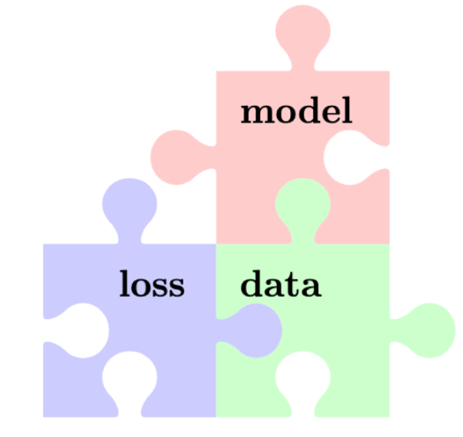
Three Components of ML
linear space
decision tree
neural nets
….
squared error
logistic loss
focal loss
….
numeric arrays
text
networks
…

Slide 13
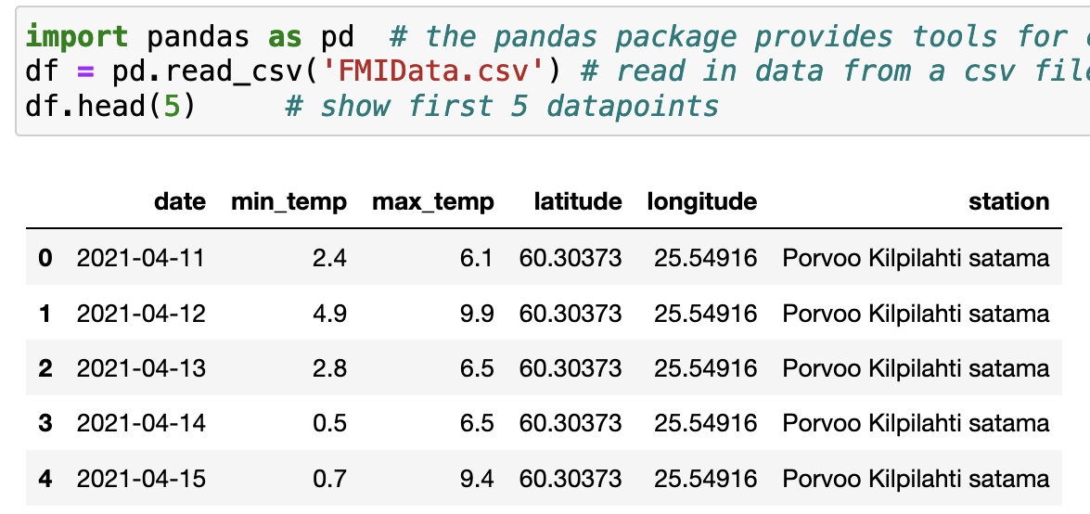

Data.
Notes:
We consider data as collections or lists of datapoints. A datapoint is any object that potentially carries relevant information for some ML task. Here, a data point represents a daily weather condition at some location in Finland. You can see some Python code that reads in datapoints form a csv file with the name FMIData.csv which has been downloaded from the Finnish Meterological institute. We then print out the first five datapoints from this file. Each data point is characterized by several properties. In machine learning we call properties that we can measure easily as features. Properties that represent a quantity of interest are referred to as labels. The label is only known for some carefully selected datapoints. In general we want to predict the label based on the feature.

Slide 14
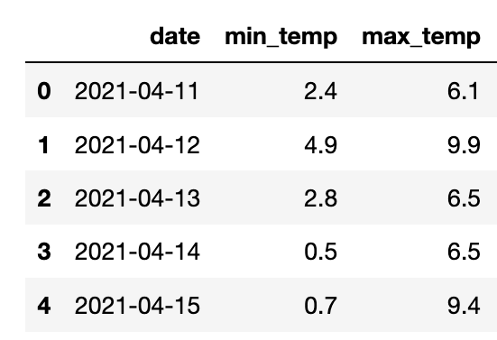
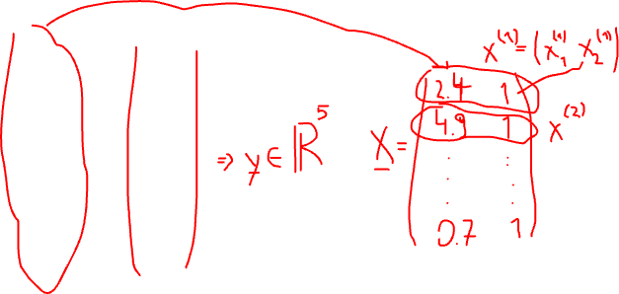
Feature Matrix and Label Vector.
Notes:
We consider data as collections or lists of datapoints. A datapoint is any object that potentially carries relevant information for some ML task. Here, a data point represents a daily weather condition at some location in Finland. You can see some Python code that reads in datapoints form a csv file with the name FMIData.csv which has been downloaded from the Finnish Meterological institute. We then print out the first five datapoints from this file. Each data point is characterized by several properties. In machine learning we call properties that we can measure easily as features. Properties that represent a quantity of interest are referred to as labels. The label is only known for some carefully selected datapoints. In general we want to predict the label based on the feature.

Slide 15
Linear Model
h’(x)=w1’*x1+w2’
label y (max.tmp.)
h(x)=w1*x1+w2
feature x1 (min.tmp.)

Slide 16
which hypothesis h(x), or model parameter w, is best?

Slide 17
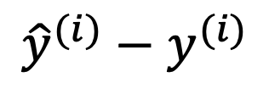

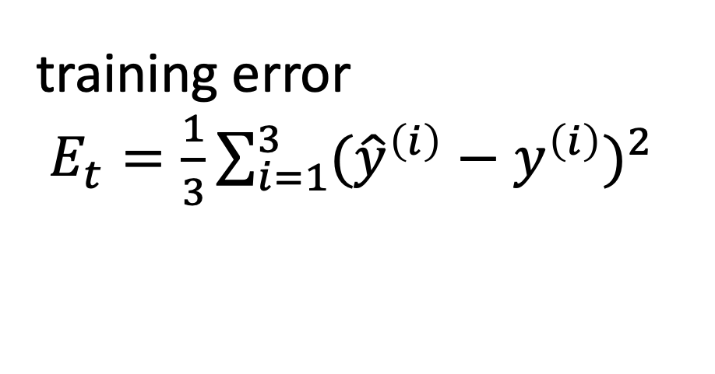
Mean Squared Error
$${\hat{y}}^{(i)}−y^{(i)}$$
$$x^{(i)},y^{(i)}$$
label y
training error
$E_{t}=\frac{1}{3}\sum_{i=1}^{3}{({\hat{y}}^{\left(i\right)}−y^{\left(i\right)})^{2}}$
feature x

Slide 18
Empirical Risk Minimization (informal)
learn hypothesis (model parameters) such that
the resulting average loss (“empirical risk”)
on a training set is minimal

Slide 19

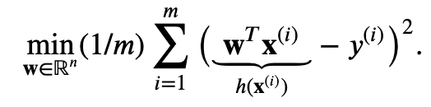
Empirical Risk Minimization
datapoints

Slide 20



Matrix/Vector Notation
feature matrix
label vector

Slide 21

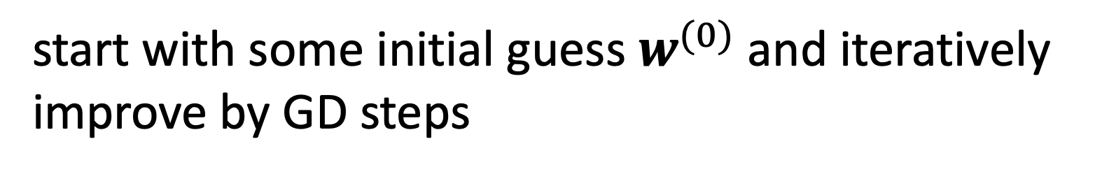
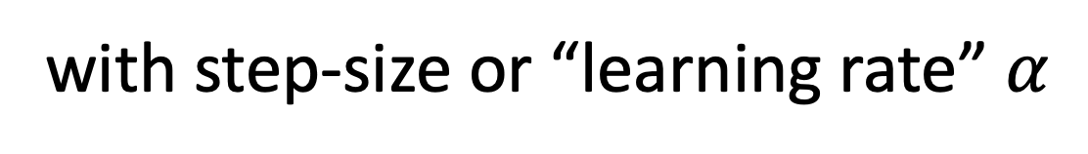
Gradient Descent
start with some initial guess $w^{(0)}$ and iteratively
improve by GD steps
with step-size or “learning rate” $α$

Slide 22
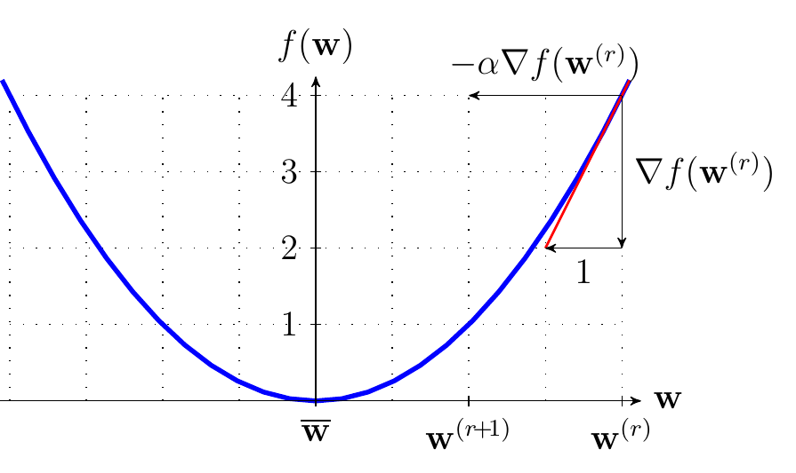
Gradient Descent Step

Slide 23
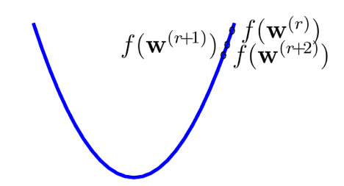
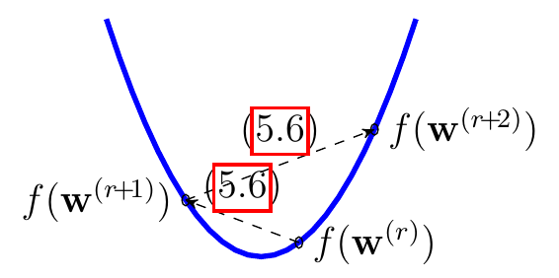
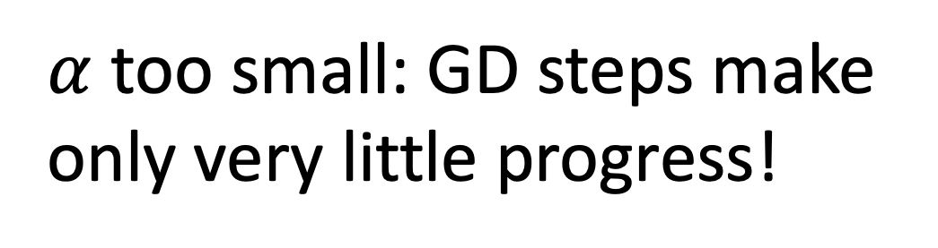
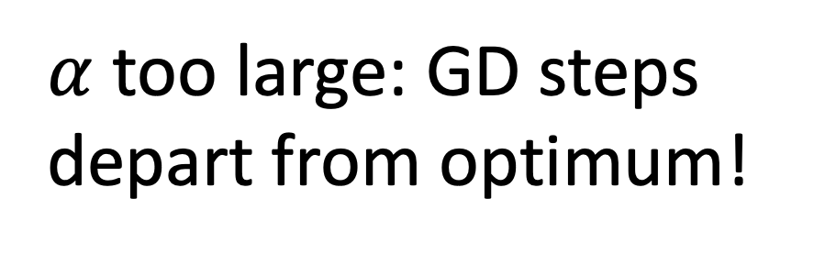
Effect of Learning-Rate.
$α$too small: GD steps make
only very little progress!
$α$too large: GD steps
depart from optimum!

Slide 24



A Sufficient Condition.
assume objective function is “$β$-smooth”
GD converges when using learning rate
proof: https://www.stat.cmu.edu/~ryantibs/convexopt-F13/scribes/lec6.pdf

Slide 25




Computing Gradient.
to implement GD step
we need to compute gradient
for
we obtain
see A.4 of S. Boyd and L. Vandenberghe, "Convex Optimization", CUP, 2004

Slide 26

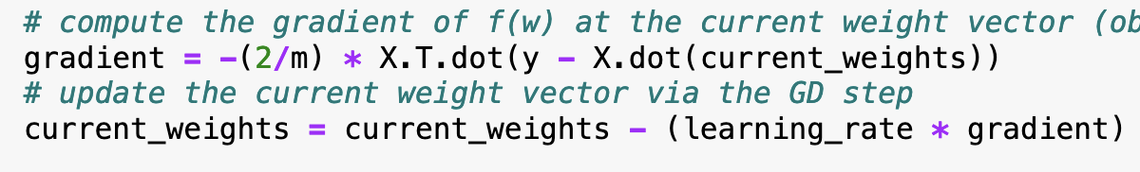
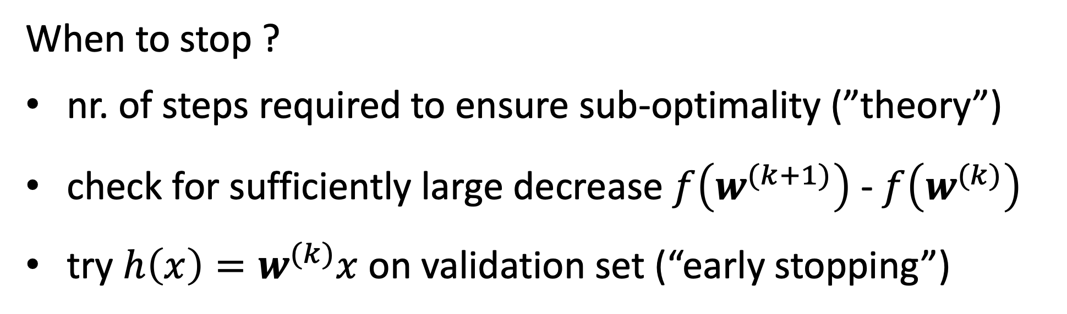
GD for Linear Regression.
When to stop ?
nr. of steps required to ensure sub-optimality (”theory”)
check for sufficiently large decrease $f\left(w^{(k+1)}\right)$ - $f\left(w^{(k)}\right)$
try $h\left(x\right)=w^{(k)}x$ on validation set (“early stopping”)

Slide 27
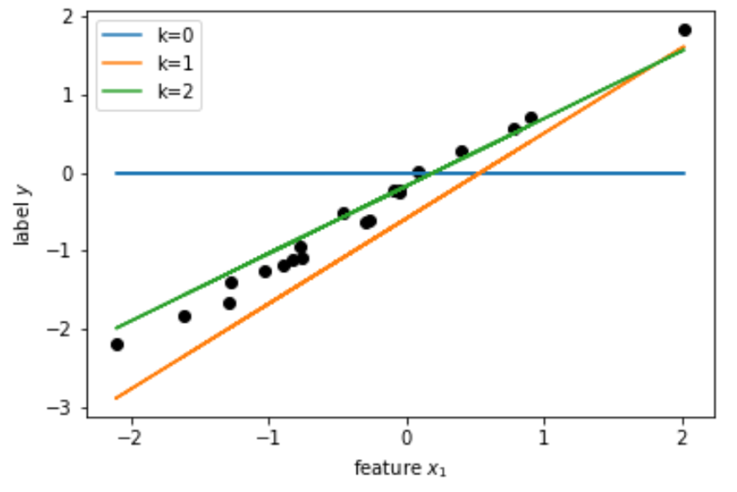
GD in Action.

Slide 28
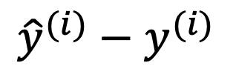
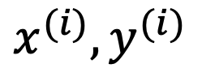

Train and Validate.
$${\hat{y}}^{(i)}−y^{(i)}$$
$$x^{(i)},y^{(i)}$$
label y
validation error
$E_{v}=({\hat{y}}^{\left(1\right)}−y^{\left(1\right)})^{2}$
feature x

Slide 29
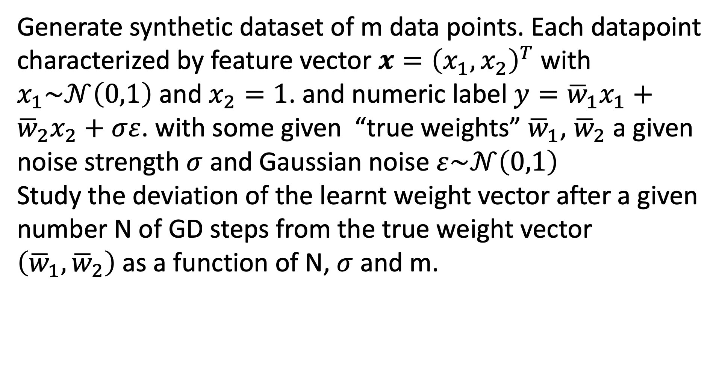
Exercise 1 – Task 1.1
Generate synthetic dataset of m data points. Each datapoint
characterized by feature vector $x={\left(x_{1},x_{2}\right)}^{T}$ with $x_{1}\sim 𝒩\left(0,1\right)$ and $x_{2}=1$. and numeric label $y={\overline{w}}_{1}x_{1}+{\overline{w}}_{2}x_{2}+σε$. with some given “true weights” ${\overline{w}}_{1}$, ${\overline{w}}_{2}$ a given noise strength $σ$ and Gaussian noise $ε\sim 𝒩\left(0,1\right)$
Study the deviation of the learnt weight vector after a given
number N of GD steps from the true weight vector $\left({\overline{w}}_{1},{\overline{w}}_{2}\right)$as a function of N, $σ$ and m.

Slide 30
Exercise 1 – Task 1.2
Learn the weights of a linear predictor for the maximum
daytime temperature (label) from the minimum daytime
temperature (feature) at some place in Finland. To achieve
this goal, use the datapoints in
https://raw.githubusercontent.com/ieeespcasfinland/ieeespcasfinland.github.io/main/FMIData.csv

Slide 31

Questions ? 5 Min Break

Slide 32

Exercise 2.
store networked data and models using networkx.Graph object
add local datasets and model parameters as node attributes
combine GD with a network averaging algorithm to collaboratively linear hypothesis from a network of local datasets

Slide 33
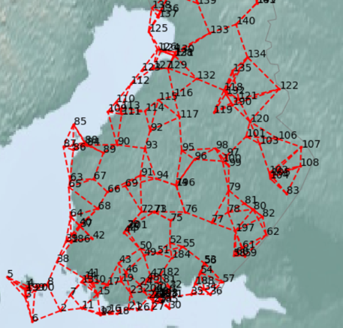
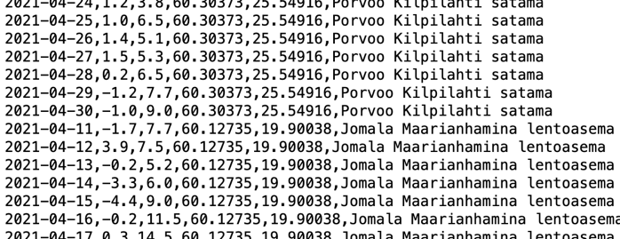
Network of Weather Data

Slide 34

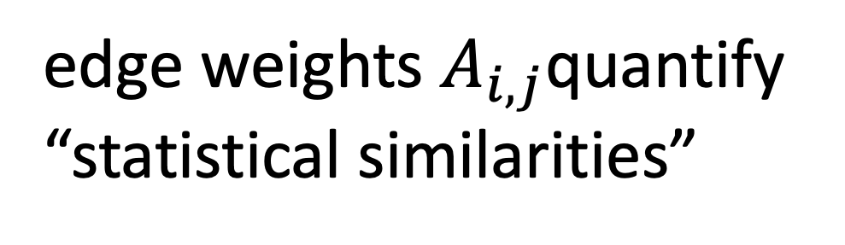
The Empirical Graph.
weather station i
“similar"
j
edge weights $A_{i,j}$quantify
“statistical similarities”
Notes:
We represent networked data using an undirected weighted graph which we refer to as the empirical graph. The nodes of the empirical graph represent individual local datasets, e.g., generated by a particular person or by a particular IoT sensing device. Two nodes are connected by an edge if they are similar in a domain-specific sense. This similarity notion might be be obtained from spatio-temporal proximity as in contact networks for disease spread or by presence/absence of direct communication links. Our research studies how to combine the geometry of the network or network topoloy with the geometry of local models that are used for each local dataset.

Slide 35
Attaching Local Datasets to Nodes
weather station i
Notes:
We represent networked data using an undirected weighted graph which we refer to as the empirical graph. The nodes of the empirical graph represent individual local datasets, e.g., generated by a particular person or by a particular IoT sensing device. Two nodes are connected by an edge if they are similar in a domain-specific sense. This similarity notion might be be obtained from spatio-temporal proximity as in contact networks for disease spread or by presence/absence of direct communication links. Our research studies how to combine the geometry of the network or network topoloy with the geometry of local models that are used for each local dataset.

Slide 36

Attaching Linear Model to Nodes
weather station i
Notes:
We represent networked data using an undirected weighted graph which we refer to as the empirical graph. The nodes of the empirical graph represent individual local datasets, e.g., generated by a particular person or by a particular IoT sensing device. Two nodes are connected by an edge if they are similar in a domain-specific sense. This similarity notion might be be obtained from spatio-temporal proximity as in contact networks for disease spread or by presence/absence of direct communication links. Our research studies how to combine the geometry of the network or network topoloy with the geometry of local models that are used for each local dataset.

Slide 37

Learning a Global Model
learn weight vector w via GD applied to linear regression with pooling all local datasets
Notes:
We represent networked data using an undirected weighted graph which we refer to as the empirical graph. The nodes of the empirical graph represent individual local datasets, e.g., generated by a particular person or by a particular IoT sensing device. Two nodes are connected by an edge if they are similar in a domain-specific sense. This similarity notion might be be obtained from spatio-temporal proximity as in contact networks for disease spread or by presence/absence of direct communication links. Our research studies how to combine the geometry of the network or network topoloy with the geometry of local models that are used for each local dataset.

Slide 38
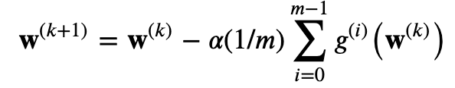





Centralized Federated Learning
GD step for linear regression on pooled local datasets:
local gradient
i
i
j
j
Notes:
We represent networked data using an undirected weighted graph which we refer to as the empirical graph. The nodes of the empirical graph represent individual local datasets, e.g., generated by a particular person or by a particular IoT sensing device. Two nodes are connected by an edge if they are similar in a domain-specific sense. This similarity notion might be be obtained from spatio-temporal proximity as in contact networks for disease spread or by presence/absence of direct communication links. Our research studies how to combine the geometry of the network or network topoloy with the geometry of local models that are used for each local dataset.

Slide 39
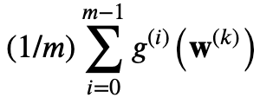
Distributed Federated Learning
GD step for linear regression on pooled local datasets:
local gradient
use network averaging to (approximately) compute
Notes:
We represent networked data using an undirected weighted graph which we refer to as the empirical graph. The nodes of the empirical graph represent individual local datasets, e.g., generated by a particular person or by a particular IoT sensing device. Two nodes are connected by an edge if they are similar in a domain-specific sense. This similarity notion might be be obtained from spatio-temporal proximity as in contact networks for disease spread or by presence/absence of direct communication links. Our research studies how to combine the geometry of the network or network topoloy with the geometry of local models that are used for each local dataset.

Slide 40
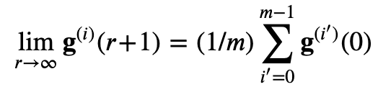
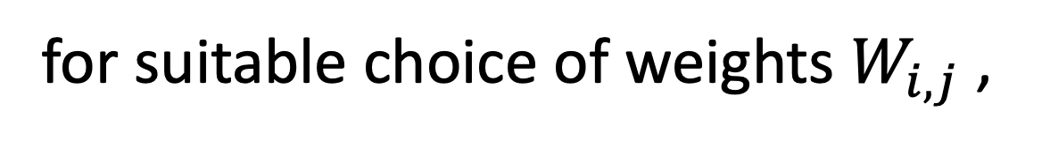
Network Averaging
j
k
i
for suitable choice of weights $W_{i,j}$ ,
Notes:
We represent networked data using an undirected weighted graph which we refer to as the empirical graph. The nodes of the empirical graph represent individual local datasets, e.g., generated by a particular person or by a particular IoT sensing device. Two nodes are connected by an edge if they are similar in a domain-specific sense. This similarity notion might be be obtained from spatio-temporal proximity as in contact networks for disease spread or by presence/absence of direct communication links. Our research studies how to combine the geometry of the network or network topoloy with the geometry of local models that are used for each local dataset.

Slide 41
Algorithm 1
init weights to zero at all nodes
2. repeat for N_GD times:
2.1 compute local gradients at all nodes
2.2 N_AV iterations of network averaging
2.3 do a GD step at each node
Notes:
We represent networked data using an undirected weighted graph which we refer to as the empirical graph. The nodes of the empirical graph represent individual local datasets, e.g., generated by a particular person or by a particular IoT sensing device. Two nodes are connected by an edge if they are similar in a domain-specific sense. This similarity notion might be be obtained from spatio-temporal proximity as in contact networks for disease spread or by presence/absence of direct communication links. Our research studies how to combine the geometry of the network or network topoloy with the geometry of local models that are used for each local dataset.

Slide 42
Exercise 2 – Task 2.1
Try out Algorithm 1 for a toy networked dataset
consisting of two clusters/blocks
study effect of having an edge between clusters,
varying number of GD steps, varying number of
network averaging iterations

Slide 43
Exercise 2 – Task 2.2
Try out Algorithm 1 for a networked data obtained
from Finnish meteorological institute (Demo code
shows to load this data)

Slide 44
Questions ? 5 Min Break

Slide 45
Exercise 3.
couple local models using total variation (TV)
gradient descent for TV regularized local linear regression

Slide 46
Networked Data and Models.
weather station i
Notes:
We represent networked data using an undirected weighted graph which we refer to as the empirical graph. The nodes of the empirical graph represent individual local datasets, e.g., generated by a particular person or by a particular IoT sensing device. Two nodes are connected by an edge if they are similar in a domain-specific sense. This similarity notion might be be obtained from spatio-temporal proximity as in contact networks for disease spread or by presence/absence of direct communication links. Our research studies how to combine the geometry of the network or network topoloy with the geometry of local models that are used for each local dataset.

Slide 47

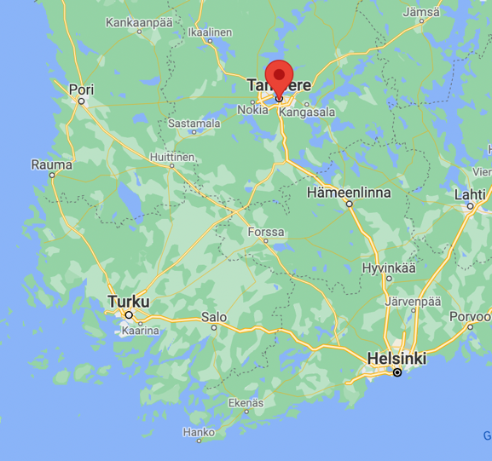


Learn Personalized Models

Slide 48

Local Linear Regression
we could learn local weight vector by solving
local linear regression for each node
not a good idea if local dataset is too small

Slide 49
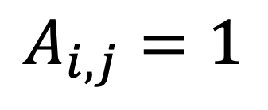
Clustering Assumption
$$A_{i,j}=1$$
force weight vectors of
well connected nodes to
be similar
2

Slide 50
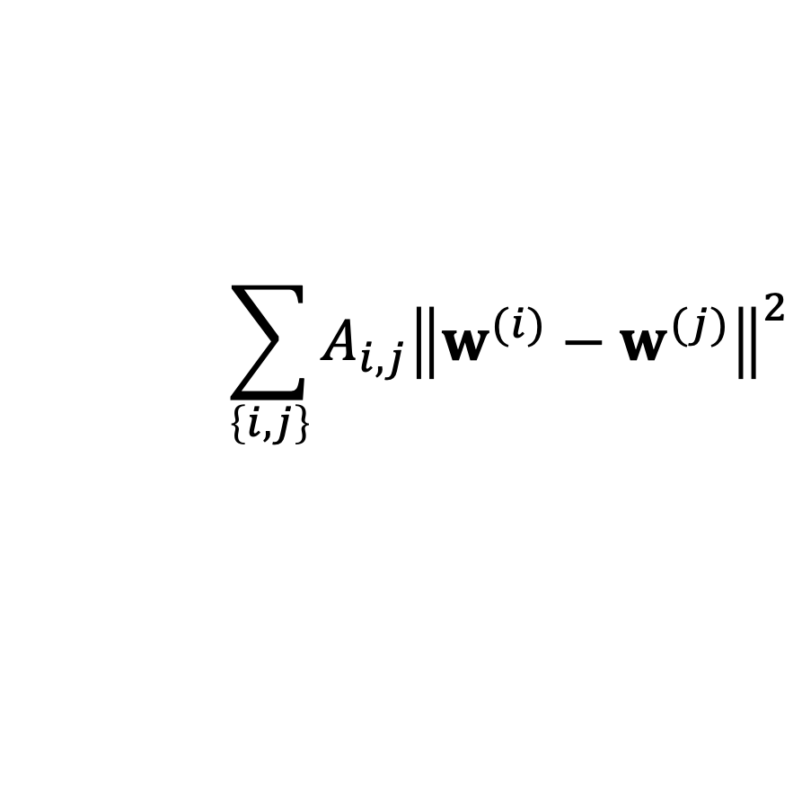
Total Variation (TV)
$$A_{i,j}=1$$
requiring small TV
$$\sum_{\left\{i,j\right\}}{A_{i,j}{\left\|w^{(i)}−w^{(j)}\right\|}^{2}}$$
2
enforces weights to be nearly
constant over clusters

Slide 51
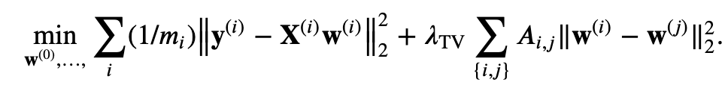

TV-Regularized Linear Regression
increasing
“clusteredness”
local training errors
Notes:
Starting with a given empirical graph we define a networked model. Each node is equipped with some parametric model with paramters of weights w. These local models could be linear regression models or deep neural nets. Our methods allow to abstract from the details of the local models and only need a loss function that provides a score for a given choice of weights.

Slide 52
Gradient Descent
objective function is smooth and convex;
-> can be solved iteratively using GD steps
Notes:
Starting with a given empirical graph we define a networked model. Each node is equipped with some parametric model with paramters of weights w. These local models could be linear regression models or deep neural nets. Our methods allow to abstract from the details of the local models and only need a loss function that provides a score for a given choice of weights.

Slide 53
GD Step as Message Passing
i’
i
Notes:
Starting with a given empirical graph we define a networked model. Each node is equipped with some parametric model with paramters of weights w. These local models could be linear regression models or deep neural nets. Our methods allow to abstract from the details of the local models and only need a loss function that provides a score for a given choice of weights.

Slide 54
Algorithm 2
init weights to zero all nodes
2. repeat for N_GD times:
update local weights at all nodes as
Notes:
Starting with a given empirical graph we define a networked model. Each node is equipped with some parametric model with paramters of weights w. These local models could be linear regression models or deep neural nets. Our methods allow to abstract from the details of the local models and only need a loss function that provides a score for a given choice of weights.

Slide 55

Exercise 3 – Task 3.1
Try out Algorithm 2 for a toy networked dataset
consisting of two clusters/blocks
study the effect of varying edge weight between
clusters, varying number of GD steps, varying
regularization parameter

Slide 56
Exercise 3 – Task 3.2
Try out Algorithm 2 for a networked data obtained
from Finnish meteorological institute (Demo code
shows to load this data)

Slide 57
Thank You! Enjoy the School Week!

