Slide 1


INNOVΛTECH
Welcome to the

Slide 2

About us
We are a technical chapter in VIT, which aims to understand how technology can impact society and advance it to help improve the world
With the growing technology in today's world, there comes a parallel need to introspect its uses and consequences. The IEEE Society on Social Implications of Technology (SSIT) is not only concerned about the magnitude of technology, but also how it's applications can change the world for the better. The VIT bureau of IEEE-SSIT aims to undertake quality projects on the various streams of engineering, to provide solutions for a better quality of living to the society.

Slide 3
Project 1
Accident detection and alerting system
Every day around the world, a large percentage of people die from traffic accident injuries. An influential indicator of survival rates after detecting the accident is the time between the occurrence of the accident and the arrival of emergency responders to the scene. Reductions in this time will surely affect the numbers of fatalities, and this can be achieved through using automatic traffic accident detection and notification systems which are either built-in the modern vehicles or available in the roads.
This model i.e. the project we will be making detects whether an accident occurs or not using a tap module. The message then will be sent to the mobile device using a Bluetooth module through an app. This app too will be created in this session using the MIT app inventor.

Slide 4
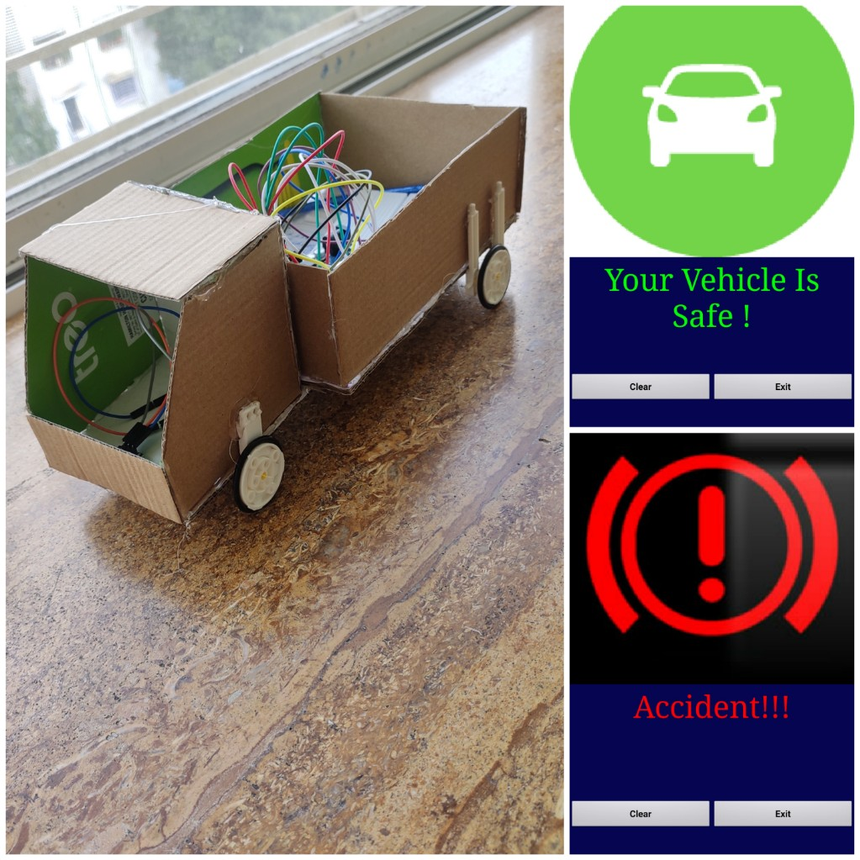
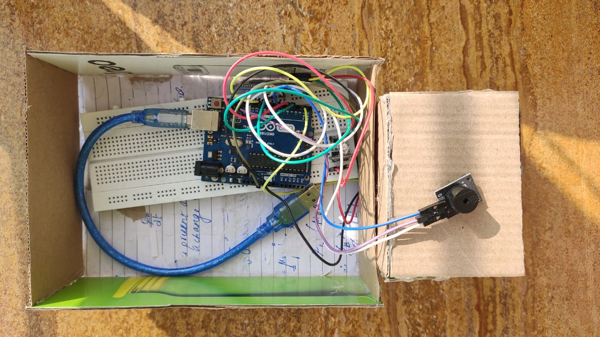
The model

Slide 5

Components/modules used
The components used in this project :-
Arduino UNO
Tap module- KY-013
RGB LED
Bluetooth module HC-05
Buzzer module
Jumper wires
Power Bank (power source)
Software used in this project :-
Arduino IDE
MIT app inventor

Slide 6
Arduino UNO
Arduino Uno is a microcontroller board developed by Arduino.cc which is an open-source electronics platform mainly based on AVR microcontroller Atmega328. It also includes another microcontroller- Atmega16U2.
The Atmega328 placed on the board provides serial communication using pins like Rx and Tx. The Atmega16U2 incorporated on the board provides a pathway for serial communication using USB com drivers.
Atmega328 microcontroller that is placed on the board comes with a number of features like timers, counters, interrupts, PWM, CPU, I/O pins and based on a 16MHz clock that helps in producing more frequency and number of instructions per cycle.
This board comes with all the features required to run the controller and can be directly connected to the computer through USB cable that is used to transfer the code to the controller using IDE (Integrated Development Environment) software, mainly developed to program Arduino.

Slide 7
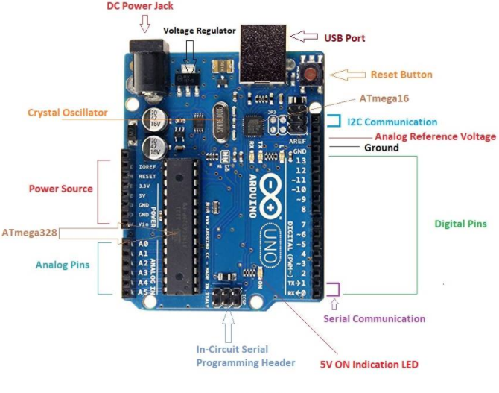
Arduino UNO

Slide 8
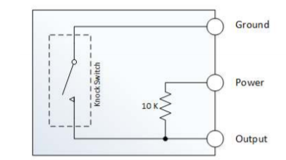
2. Tap Module
The knock sensor, detects the knocks and the taps. It can work like a switch. The sensor sends data momentarily to the board. To keep the LED on, the button state change codes should be used. So the sensor will work as a switch.
The switch primarily consists of a terminal that forms a center post and a second terminal that is a spring that surrounds the center post. When a sufficient force is transferred to the switch, the terminal consisting of the spring moves and shorts both terminals together.

Slide 9
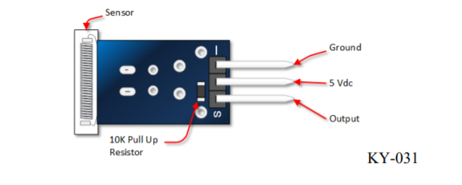
2. Tap Module
Knock sensor module and a digital 13 interface, built-in LED build a simple circuit to produce percussion flasher. Interface comes with digital LED, will knock sensor connected digital 3 interface, when percussion sensor senses measure to percussive signals, LED flashing light.
The pins on the knock sensor that you will connect to are shown in the picture below-

Slide 10
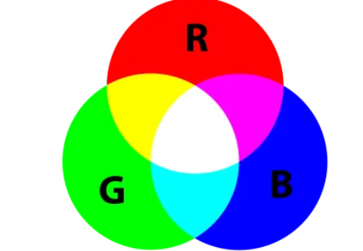
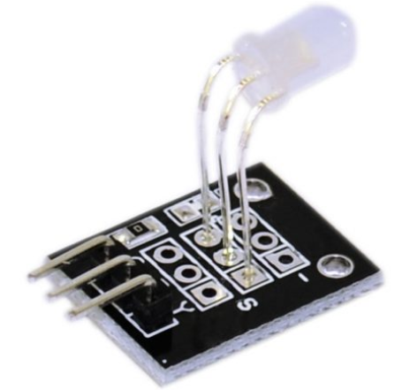
3. RGB LED
An RGB LED is a combination of 3 LEDs in just one package.
To produce other colors, you can combine the three colors in different intensities. To adjust the intensity of each LED you can use a PWM signal.
Since the LEDs are very close to each other, our eyes see the result of the combination of colors, rather than the three colors individually.

Slide 11
4. Bluetooth Module
The HC-05 is a very useful module which can add two-way wireless functionality to your projects. You can use this module to communicate between two microcontrollers like Arduino or communicate with any device with Bluetooth functionality like a Phone or Laptop.
Specifications:
Serial Bluetooth module for Arduino and other microcontrollers
Operating Voltage: 4V to 6V (Typically +5V)
Operating Current: 30mA
Range: <100m
Can operate in Master, Slave or Master/Slave mode
Can be easily interfaced with Laptop or Mobile phones with Bluetooth

Slide 12
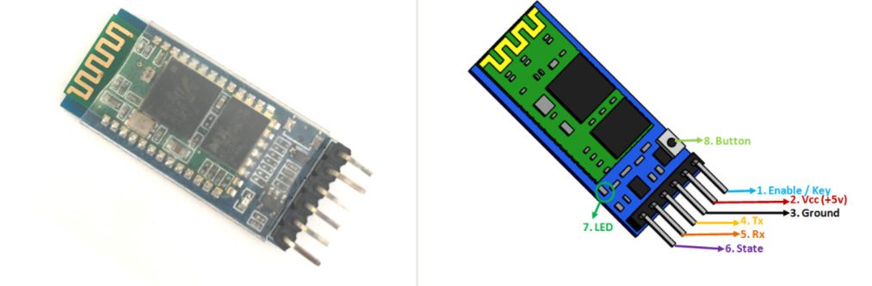
4. Bluetooth Module
The HC-05 can send and receive data from other Bluetooth devices and/or Arduino. It is very easy to pair the HC-05 module with microcontrollers because it operates using the Serial Port Protocol (SPP).

Slide 13
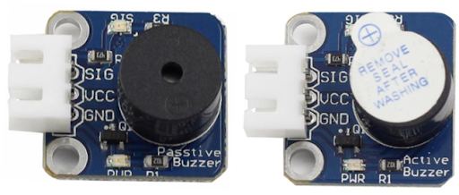
5. Buzzer Module
An Active Buzzer Alarm Module for Arduino is an audio signaling device, which may be mechanical, electromechanical, or piezoelectric. It is a 3.3V-5V DC Electronic Part Active Buzzer Module.
An active buzzer generates the sound itself. You basically just turn it on or off. A passive buzzer needs a signal source that provides the sound signal.
Typical uses of buzzers include alarm devices, timers, and confirmation of user input such as a mouse click or keystroke.

Slide 14
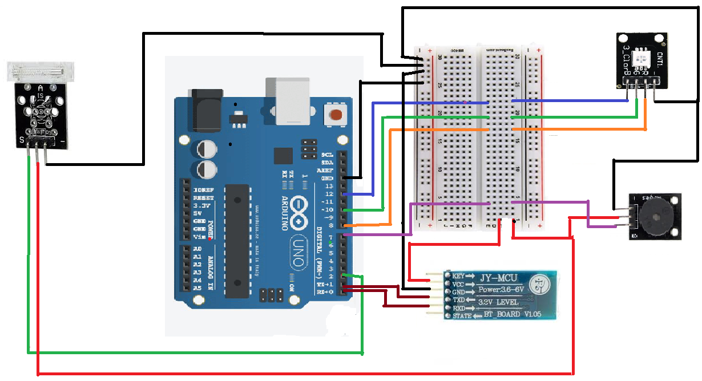


RGB LED
Buzzer module (passive)
Bluetooth module (HC-05)

