Slide 1

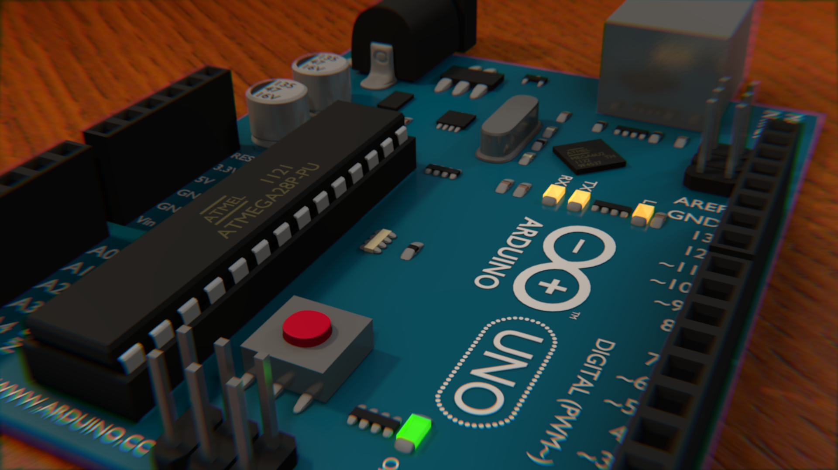
WORKSHOP ARDUINO
24, Abril 2017 Duração - 3h
nuieee@fe.up.pt
nuieee.fe.up.pt
facebook.com/nuieeefeup

Slide 2
WORKSHOP ARDUINO
Link GitHub: http://bit.ly/2pcB6lc
nuieee@fe.up.pt
nuieee.fe.up.pt
facebook.com/nuieeefeup

